Slide 1
My Experience in Game Development
Kevin Call

Slide 2
About Me
Took CSS 385 in spring 2013
Made “Music TD” along with Noel Diep, Michael Letter, and Matt Parker
Got an internship at Camouflaj in summer 2013 for CSS 497
Helped develop iOS version of “Republique”
Graduated UWB in fall 2013 with BS in CSSE
Began working fulltime at Camouflaj in Jan. 2014

Slide 3
About Camouflaj
Founded in 2011
Product: video games
Location: Bellevue
Size: 33
Relatively flat structure
Open space

Slide 4
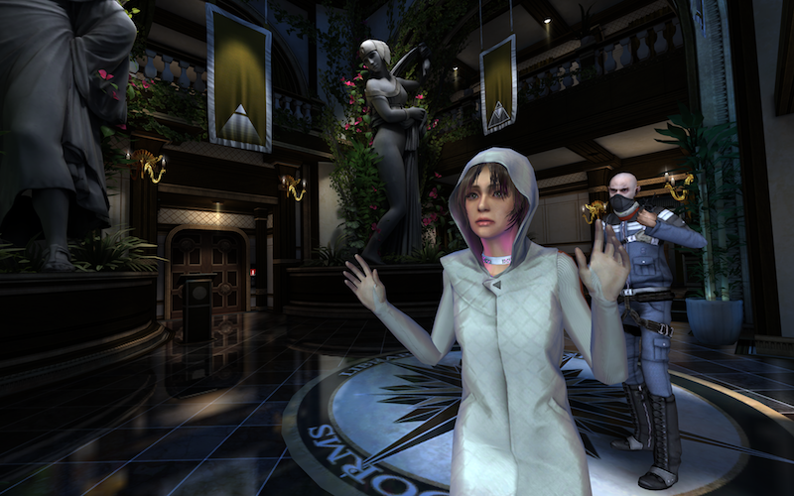
First Game: Republique
Genre: stealth-based adventure
Platform: iOS, Android, Windows, Mac, PS4
Episodic: all episodes (1-5) available now on all platforms!
Trailer

Slide 5
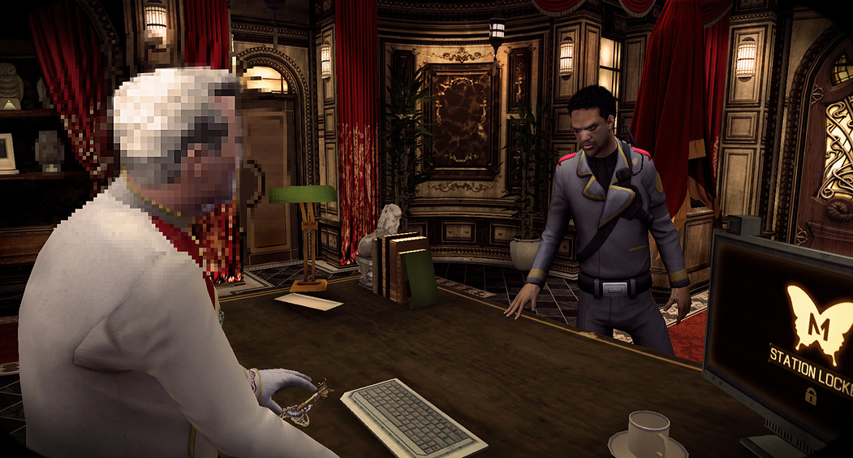
My Role on Republique:
Graphics
Shaders
Art pipeline support
Gameplay
Abilities
One-off “puzzles”
Tools
Cinematics
Batch processes
Miscellaneous
Input
Loading
Subtitles
Optimization

Slide 6
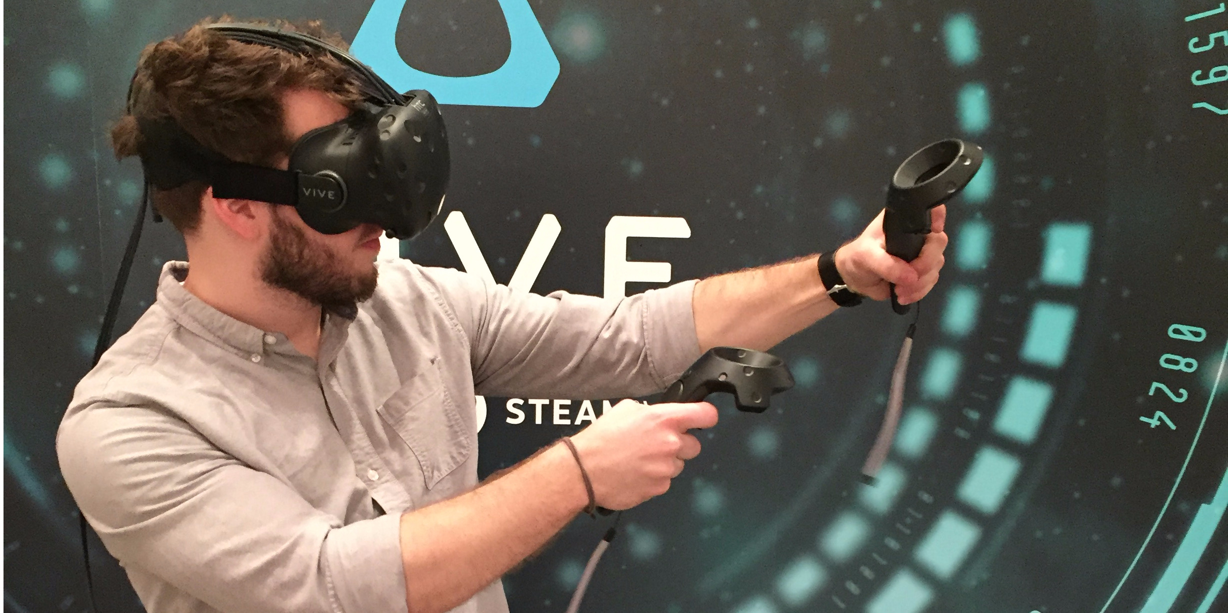
Next Game: Unannounced VR Project
Genre: shooter
Platform: Vive, Oculus

Slide 7
My Role on New VR Project:
Player movement systems (main responsibility)
Physics
Controls
Avoid motion sickness
Miscellaneous other things:
Shaders
Art support

Slide 8
Tools We Use
Unity (game engine)
Visual Studio (IDE)
Perforce (source control)
Beyond Compare (diff/merge tool)
Jira (bug database)
Slack (communication)

Slide 9
Development Process
Agile (daily standups, 2 week sprints, 2 month milestones)
Determine tasks
Usually driven by design & art
Engineering makes tasks based on these
Time estimates
Triage

Slide 10
Challenges
Supporting so many platforms
Performance
Content
Controls
Updating engine version
Need to update to fix bugs/get new features
Update introduces new bugs
Can break plugins
Scope

Slide 11
VR-Specific Challenges
Motion Sickness
Awareness
Player can put their head wherever they want
Screen space effects fall apart
Input
Performance (okay, not really specific to VR, but worth a special mention)

Slide 12
Getting in the Game Industry
Make connections
Show your passion by working on side game projects
Get real-world experience with internships

Slide 13
Interviews
What I look for:
General programming skills (data structures, algorithms)
Ability to write efficient code (understand big-O, cache, memory fragmentation)
Math skills (vectors, coordinate systems)
Thought process
Personality/team fit
Communication skills

Slide 14
On the Job Survival
Communicate with your teammates
Know how to research
Know how to debug
Manage your time well
Write maintainable code
But also recognize when it is appropriate to take shortcuts

Slide 15
Game Development FAQs
“You develop games, you must play games all day, right?”
NO!
“I hear you have to work crazy-long hours?”
Normal: 8-10 hour days, 5 days
Crunch: 9-12 hour days, 5-7 days
“How is the salary?”
On average, less than Google, Amazon, etc.
“Viable as long term career?”
If you are passionate, yes. Though it is possible to get burnt out.

Slide 16
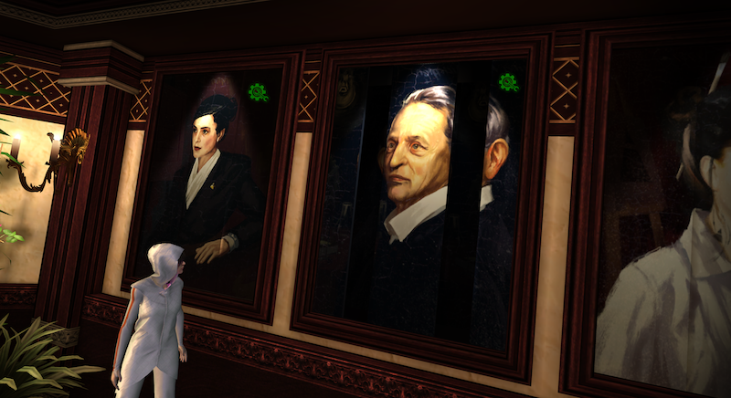
Questions?

