Slide 1
So You Want to Not Suck at Art Implementation
Nathan Evers
Art Lead
Digital Future Lab

Slide 2
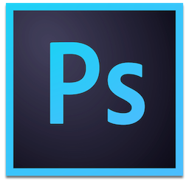
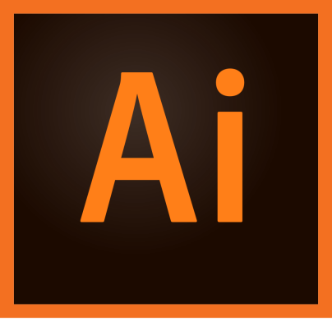
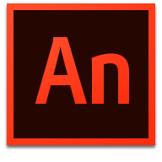
What to Use and Where to Begin?
Adobe Creative Suite:
Photoshop (bitmap)
Illustrator (vector)
Animate (vector)
Previously known as Flash
Get a 30-day free trial!
Photoshop $10/month
Single App $20/month
Full Subscription $50/month

Slide 3
But I’m A Student and Things Cost Money (Ugh!)
Free Alternatives:
Gimp (Photoshop)
Krita (Photoshop)
Pixelmator (Photoshop, Mac-only)
Pixlr.com (Photoshop, web client)
Inkscape (Illustrator)
Vectr (Illustrator, web client)
DrawPlus (Illustrator)
Synfig Studio (Animate)
Interested in 3D?
Autodesk is free for students!
Blender (3D modeling)
xNormal (normals, ambient occlusion, displacement maps)
UWB Open Learning Lab (UW2-140)
Open during UW2 building hours
M-TH 6:30AM - Midnight
Friday 6:30AM - 8:00PM
Saturday 8:00AM - 8:00PM
Sunday 12:00PM – 8:00PM
Pre-loaded with Creative Cloud apps for free student use
On-site tutoring!
Audacity, Photoshop, Premiere Pro
Tutorial Repository

Slide 4
Before Starting Your Art Journey Pt. 1
Establish target platform and stick to ONE.
Redoing UI assets for different resolutions or aspect ratios is a pain, especially if created in a bitmap editor.
Backgrounds and general layout/sizing is going to be quite different between aspect ratios, and requires intentional planning for everything to “work.”
iPad, iPhone and PC user interfaces are NOT interchangeable.
Backgrounds in 4:3 and 16:9 can be quite different, as well.
Phone and Tablet resolution chart
Figure out target resolution and create all art with that in mind.
1080p or 720p?
4:3 aspect ratio or 16:9 aspect ratio?
Mac support? Plan for 16:10!
Targeting multiple platforms:
Figure out the largest resolution you’re willing to support and build all assets with that in mind.
Easier to reduce than to blow up.

Slide 5
Before Starting Your Art Journey Pt. 2
Create an art reference folder for all aspects of your game:
User interfaces, buttons, menus
Art style references, color palates, genre examples
It helps to establish a stylistic goal beforehand as a benchmark.
It also helps to have something to look at when “artist’s block” occurs.
Where to gather resources:
Pinterest
Shutterstock
Take screencaps from games that inspire you or that you think represents “good” UI or art design choices.
Mobile apps are a good start!
Video game concept art galleries
Artstation
Behance
Tutorials:
Cubebrush
Gumroad (Tutorial List)
RND Fantasy

Slide 6
We Want to Animate Everything!
Texture Packer
Sprite sheet creation (from individual PNG files)
Compression and sheet packing control
Can target multiple platforms/engines
Multi-pack (atlasing), data file generated with pointers for each sprite and animation
Atlasing reduces draw calls, improving performance
Adobe Animate
Has built-in sprite sheet and atlas generation, but with less overall control.
Free Alternatives:
Monkey X
Zwoptex
Sprite sheet and animation tips:
Determine frame rate and stick with it (60 fps, 30 fps, 24 fps).
Use as a marker for quarter second, half-second, full-second animations.
Keep sheets squared and at a power of two (512x512, 1024x1024, 2048x2048)
Frames with PoT padding can make splicing and implementation much easier. Use Photoshop scripts/actions to increase canvas size of individual PNG frames before using a sprite sheet app.
Be efficient and mindful about what can be accomplished via code and what needs an animation.
Scaling, movement (translation), color correction, etc.
Check Unity Asset Store for easy solutions!

Slide 7
We Want to Animate Everything! (Mini Slide)
It’s probably best to try animating everything IN Unity using Spline Editor.
Check out Spine 2D as an alternate animation software.

Slide 8
Compress to Impress
Recommended free apps:
pngquant
ScriptPNG
PNGoo
Reduce the overall weight and size of your game by keeping art assets (.PNGs) at an 8-bit depth compression, improving load times.
Target these compressions:
PVRTC4
RGBA 8888 (for alpha)
RGB 8888 (no alpha)
Compression tips:
Avoid dithering
Avoid heavy use of gradients, limit them unless absolutely necessary, and play around with compression settings until artifacting disappears.
More info on compression:
Smaller PNG files
Going further with game art compression
Use packing tags in Unity!
Organize by scene or asset “type”
UI, sprite, background, menu

Slide 9
Tips and Best Practices Vol. 1
Naming conventions and organization are paramount to your success!
Saves time finding what you’re looking for.
Compartmentalizes the “parts” of your game:
UI and Menus
Player Characters
NPCs
Background Assets
Objects and Interactables
DON’T just throw every sprite and asset into ONE main library folder
Name all layers in working files (.PSD, .FLA, .AI, etc.) so other artists or team members can navigate them without wasting time.
No artists? No problem!
Textures.com
Turbosquid (3D models)
Unity Asset Store (UI, shaders, particles, models, plugins)

Slide 10
Tips and Best Practices Vol. II
Color saturation:
Devs: Tone down saturation of primary colors
Artists: Increase color saturation
Don’t be perfect! It’s far easier and faster to create, review, trash, and redraw than to obsessively tinker for an hour.
Know your limitations.
Can’t draw? Embrace that with an intentionally “non-artsy” style.
Or, make the best damn squares and circles and triangles you possibly can.
Throw some googly eyes and gradients on it!
Color must be intentional, particularly for user interaction and comprehension.
Be deliberate and consistent. Pick a style that works and stick with it.
No one cares if it looks weird as long as it’s supposed to look weird.
Use a color palette (Kuler) and stick with those complimentary and contrasting colors.
Review basic color theory.
FontSpace, Google Fonts, or DaFont for free fonts.
Pick thematically relevant fonts.
No more than two or three different fonts in the entire game.
When possible, use one font with regular, black, light, bold styles.

Slide 11
Tips and Best Practices Vol. III
Photoshop:
Use layer styles and avoid filters or image adjustments when possible.
Right-click a layer and turn it into a “Smart Object” to preserve the original asset when applying changes.
”Non-destructive” art practices are perfect for not having to redo or lose work after making an adjustment you can’t revert!
For assets with multiple variations:
Create assets in grayscale or completely desaturated so you can tint them in-engine.
Also useful for buttons and their hover, static, and pressed states.
Generate text in Unity when possible so you just have to create a single set of containers for buttons or menu items.
Make them look super fancy by applying: inner shadows, double-strokes, and subtle gradients.
Use Discord, Slack, or other project management software to stay in communication with your artist and team members!
Keep daily tabs on each other’s progress, especially if you’re outsourcing art support.
Store assets in a shared online space like Google Drive, OneDrive, or Dropbox!
When in doubt, Google it!
How do I _______?
What is _______ error?
Why did I think game dev was a good life choice?

Slide 12
Questions!?
Thanks for listening, and go forth and art your hearts away!
Any further inquiries: nevers@uw.edu
#ILearnedStuffToday

