Slide 1
Cel Shading, Bloom Effect, Lens Flare (with Post Rendering) & Mesh Rendering (with Axis-Aligned Bounding Box and KD-Tree)
CSS552 Final Project Demo
Peter Lam
Tim Chuang
Notes:
Thinking to break down the talk with me taking problem statement, post rendering, and cel shading. You will take bloom, multi threading, and risk.

Slide 2
Problem Statement
Our goal is to experiment with different post rendering effects (Cel Shading, Bloom Effect, and Lens Flare) to provide the rendered images with more dramatic and interesting appearances and enhanced realism.
In order to create exciting renders, we decided to add support for loading and rendering Mesh files to provide a high variety of shapes and objects.
Rendering Mesh image can be extremely resource intensive with the current framework. We try to add in the bounding box algorithm in correspondence with the KD-Tree acceleration structure to improve mesh rendering performance.
Finally, everything is implemented with multi-threaded support for extra performance enhancement.

Slide 3
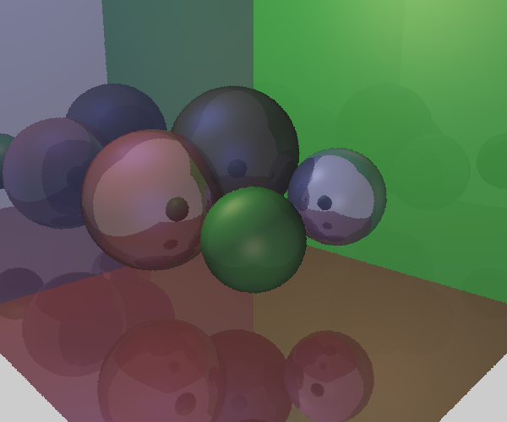
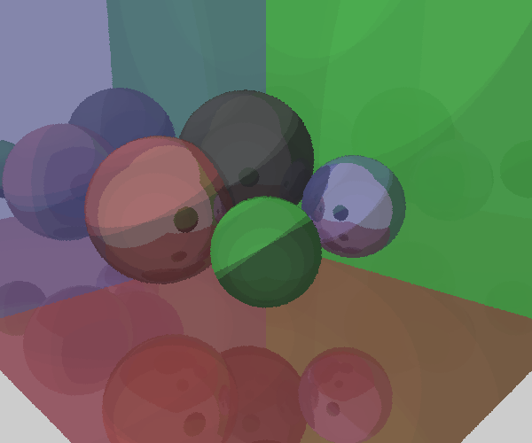
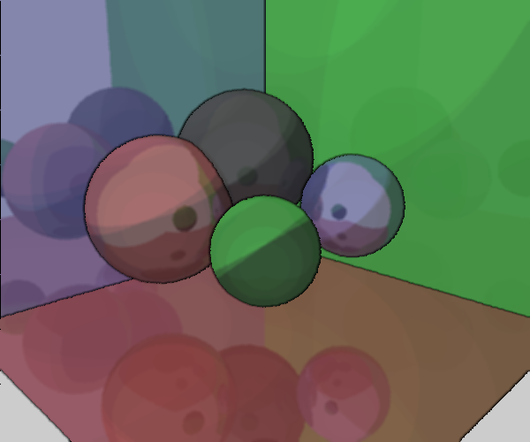
Cel Shading
Cel Shading color is being set to a simpler color range (both NdotL and VDotR), when computing the color of the rendered image with Phone’s illumination method. An object ID map is being created when rendering the original image. This object ID map will be used later in the post rendering stage to determine the outline. If there is a change of object ID around a particular pixel, that pixel will be set with the outline color.

Slide 4
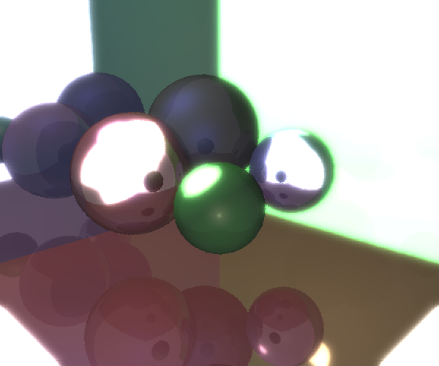
Bloom Effect
Run a bright-pass filter through the rendered image to create a black and white image highlighting where the bright areas are located. Apply Guassian blur with a 3x3 kernel to that black and white image. Down sample the result image of the Gaussian blur. Repeat the Guassian blur and down sampling process a few times. Finally, combine the output images of each iteration to the original rendered image.

Slide 5
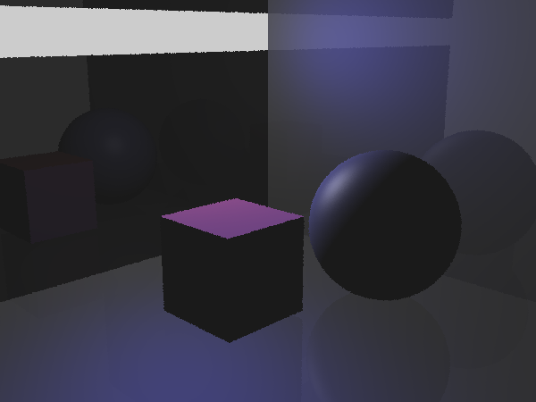
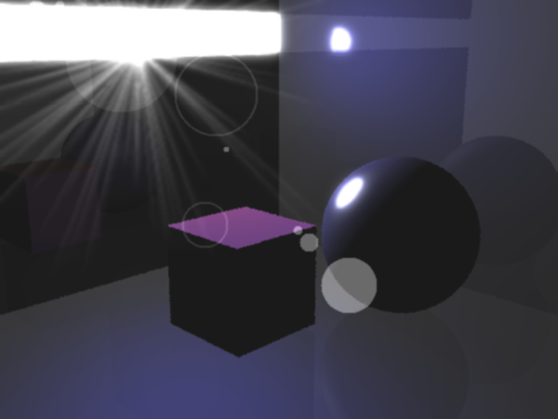
Lens Flare
Prompt user for the light location for creating lens flare. Use the graphic class to draw a star shape light area base on the position user provided, down sample the output a couple of times. Then, draw a number of circles and halos which line up along an imagine line that go from th light position to the center of the image. Finally, clamp the position of all lens flare elements to always show on the screen (even some appear to be outside the range of the image).

Slide 6
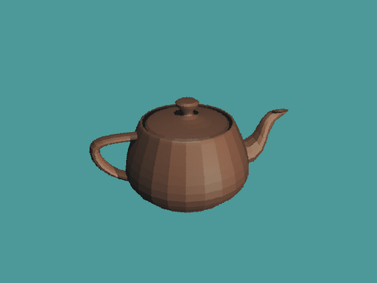
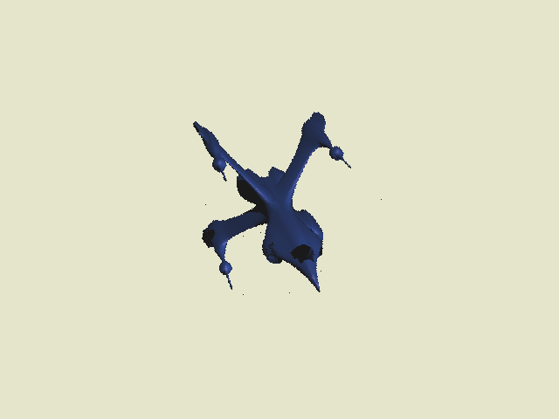
Mesh Loading/Rendering
The XNA graphics engine was utilized to add mesh support. There is a new hidden UI with an XNA content project that is used to help load mesh files. The content pipeline allows us to extract mesh information such as Index Buffer and Vertex Buffer and create RTTriangle objects. However, VertexBuffer data extraction can be tricky. We have to know what kind of information is stored in Vertex buffer to successfully extract vertices and/or normal values.

Slide 7
Enhance Mesh Rendering
Axis-Aligned Bounding Box (Voxel)
Bounding Box class was created to support KD-tree construction. All bounding boxes are axis-aligned. Each geometry in the scene is associated with its bounding box.
KD-Tree
To support proper rendering of meshes, an acceleration structure is required. A non-uniform KD-Tree was chosen to speed up rendering. The build time of KD-tree is quite slow because I chose to use surface area heuristic algorithm to find the best splitting plane, which requires stepping through all geometries in the node to find the surface area of left/right voxels and compute cost. However, the ray-tracing performance gain is substantial enough to warrant the long build time.
Creation of KD-tree: First the world boundary box is defined that encloses only objects within the world, and for each axis, the world box is divided based on a SAH cost calculation to find the best splitting position. The process is repeated until either the max number of depth is reached or the max number of primitives per node is assigned.
Tree Traversal: An iterative version of a recursive tree traversal algorithm is implemented to improve ray-tracing performance.
Notes:
Tim, this slide is all yours, see how you want to introduce your MT logic

Slide 8
Questions?

Slide 9
Sources
Cel Shading
http://rastergrid.com/blog/2010/09/efficient-gaussian-blur-with-linear-sampling/
http://digitseven.com/celshader.aspx
Bloom Effect
http://kalogirou.net/2006/05/20/how-to-do-good-bloom-for-hdr-rendering/
http://lemoi-www.dvgu.ru/download/HDR/hdr_hdrr.pdf
Gaussian Blur
http://www-personal.engin.umd.umich.edu/~jwvm/ece581/21_GBlur.pdf
http://nebelfront.org/articles/gaussianblur.html
http://rastergrid.com/blog/2010/09/efficient-gaussian-blur-with-linear-sampling/
http://avisynth.org/mediawiki/Resampling#Example:_the_bilinear_resampling_filter_-_downsampling
Lens Flare
http://www.ogre3d.org/tikiwiki/LensFlare.cpp&structure=Cookbook
http://www.gamedev.net/page/resources/_/reference/programming/special-effects/lens-flares/the-art-of-modeling-lens-flares-r874
ftp://ftp.sgi.com/opengl/contrib/mjk/tips/lensflare/index.html
http://www.cambridgeincolour.com/tutorials/lens-flare.htm
http://www.opengl.org/resources/features/KilgardTechniques/LensFlare/
Mesh loader
http://www.riemers.net/eng/Tutorials/XNA/Csharp/Series2/Loading_a_Model.php
http://www.fairyengine.com/articles/xnainform.htm
Acceleration structure (Kd-tree)
http://www.devmaster.net/articles/raytracing_series/part7.php
http://www.cgg.cvut.cz/members/havran/DISSVH/dissvh.pdf

