Slide 1
Post-rendering Cel Shading & Bloom Effect
Peter Lam
Tim Chuang

Slide 2
Problem Statement
Expand the existing framework to support post-rendering.
Render a scene by using Cel (Toon) Shading.
Enhance the scene quality by applying the Bloom effect. (And possibly many other 2D filters on top of the 3D rendered result)
Enable multi-threading for the post-rendering mechanism.

Slide 3
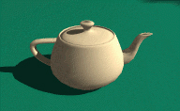
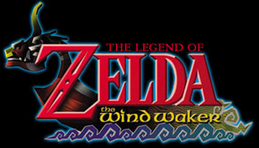
Cel Shading
Cel shading is a method of rendering a three dimensional model so that it looks like a hand-drawn image, rather than a photorealistic rendering.

Slide 4
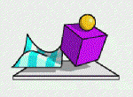
What are the steps?
Techniques can be summarized to two major steps:
Create the outline
Reduce the colors
Scene Description
Scene rendered with Cel Shading

Slide 5
Creating Outline
Silhouettes: an object or scene consisting of the outline and a featureless interior
Crease Edges: edges that are sharp

Slide 6
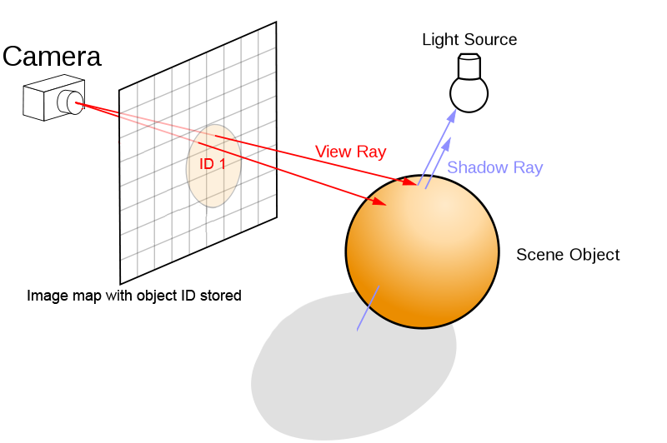
Our Plan to Creating Object Outline
Store a new ID specified depth map from the camera viewing direction.
In post rendering, scan the depth map (sample with 3x3 kernel) similar to what how we create soft shadow with shadow depth map. Whenever there is a change of Object ID, turn the pixel black to create a border.

Slide 7
Creating (simplified) Color

Slide 8
Our Plan to Create Color…
When N Dot L is positive, always set it to 1, in another word, just omit that. However, if it is negative, give it two sets of colors to give it some layer. Why? It looks better that way.
When doing the V Dot R for specular, always set it to 0.5 (or less), so the surface doesn’t shine to much.

Slide 9
Example (on a familiar image)

Slide 10
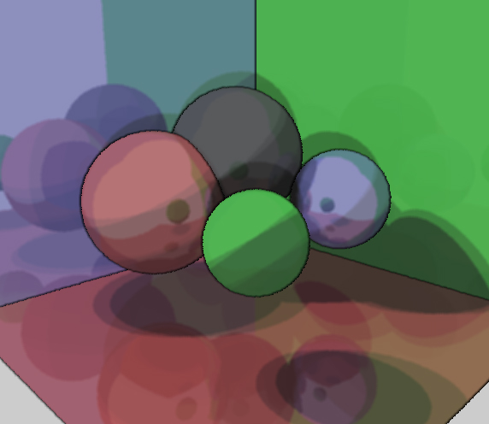
Example (on a familiar image)

Slide 11
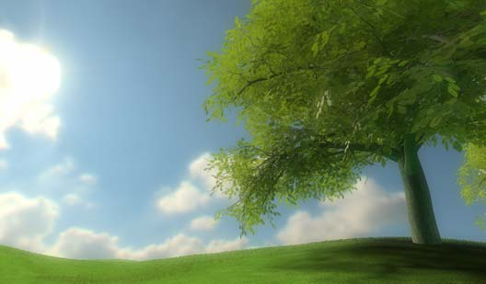
Bloom Effect
Bloom (sometimes referred to as light bloom or glow) is a computer graphics effect used in computer games, demos and high dynamic range rendering (HDR) to reproduce an imaging artifact of real-world cameras. The effect produces fringes of light around very bright objects in an image. Basically, if an object has a light behind it, the light will look more realistic and will somewhat overlap the front of the object from the 3rd person perspective.

Slide 12
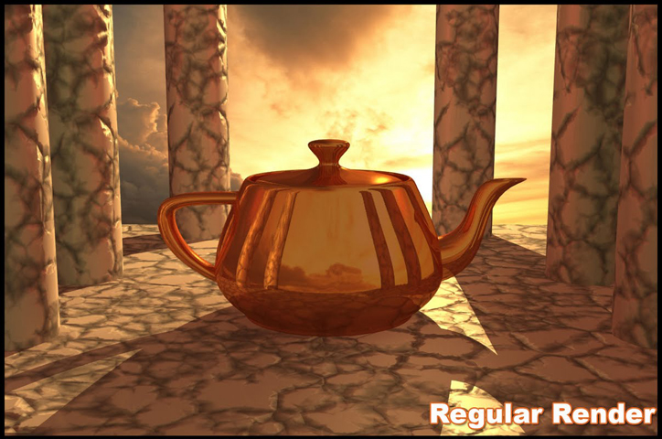
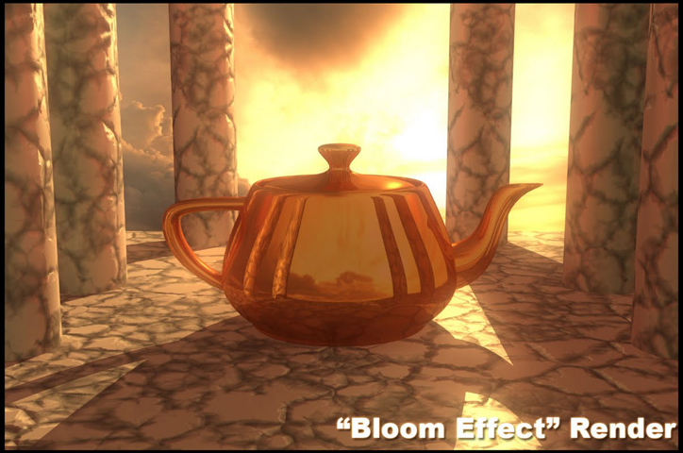
Bloom Effect (continues…)
A bloom effect makes the image look brighter and have a "hazy" look to it.

Slide 13
How to implement Bloom? Post-rendering!!
One algorithm for acheving bloom is:
Apply a bright-pass filter on the image to keep only high luminance values.
Apply a 3x3 Gaussian blur filter of small kernel size several times to blur the image.
Additively blend the resulting texture on the screen.

Slide 14
Brightpass Filter
A bright-pass filter is used to extract the bright pixels (including bright spots created from NDotL or specular).
The brightpass filter will separate the brightest parts from the rest and the final texture will contain only a black image with those bright parts. Then we scale down this texture to a reasonable size and do some blurring on it.
Do this on every pixel

Slide 15
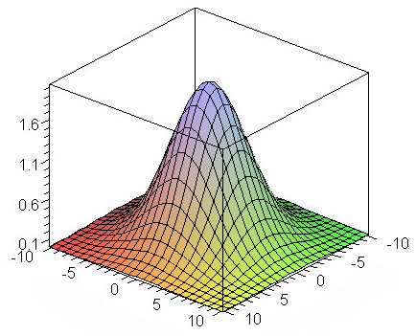
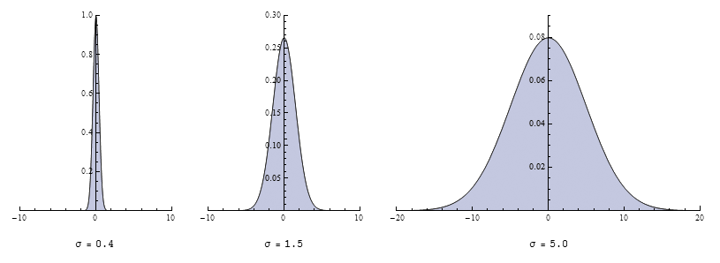
Gaussian Blur
It is also known as Gaussian smoothing, the result is an image with reduced detail and noise.
A 3D version of the curve
Following the the 2D equation of the bell curve:

Slide 16
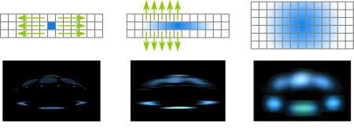
Gaussian Blur (continues…)
If the blurring is done in one pass the area that we have to blur is proportional to the blur diameter squared (d2). This is very expensive when the area becomes very large. It can instead be done in two separate passes (separable convolution) which will reduce the area that's needed to blur down to 2d instead, first blur along the x-axis (horizontally) and then blur the horizontal blur along the y-axis (vertically).

Slide 17
Gaussian Blur Examples

Slide 18
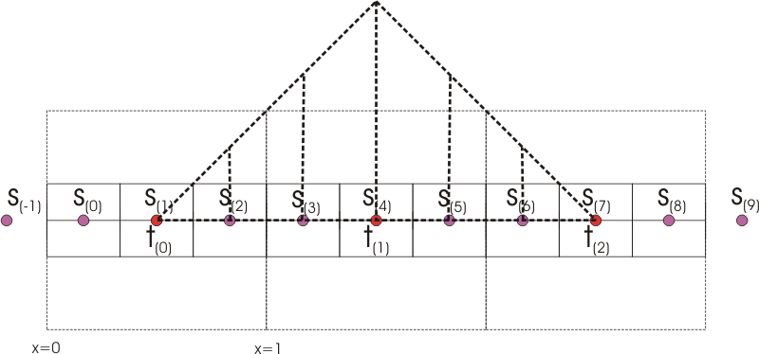
Down Sampling (Decimation)
Instead of increasing the Gaussian filter kernel size, we can downscale the image and apply the same Gaussian filter to create more blur.
Downscaling can be done with the a simple 3x3 kernel.
It can be done really fast.

Slide 19
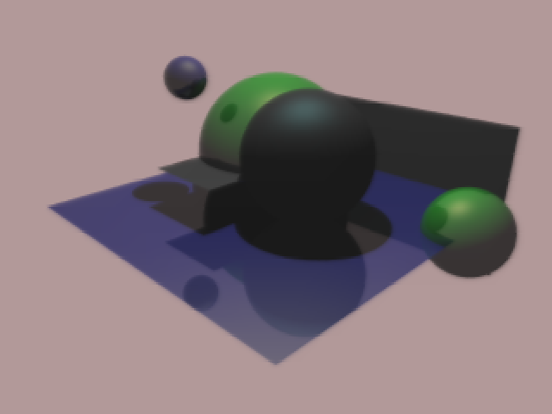
Down Sampling Examples

Slide 20
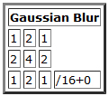
Our approach …
We begin with a simple 3x3 kernel that approximates the Gaussian bell curve (see below).
To add extra blur (like down sampling), we sample the 3x3 area and give each pixel the same color, instead of moving by one pixel at a time, we move by two pixels at a time so we jump from one 3x3 square to another. This effectively downscales the image while keeping the dimensions the same. When we repeat this process, we can increase the guasian blur coverage to more pixels
Color Factor :
The total weight you want to divide the summation by.
Offset:
When the factor is less than the total weight, it can be used to brighten or darken pixels.
Code -
new Vector3(Offset / 255f, Offset / 255f, Offset / 255f)

Slide 21
Other Filters at a Glance

Slide 22
Multi-Threading Support
Integrated into the existing Ray-tracing frame work
Increased the “Step” a thread takes when getting the next workload
Threads have to proceed at the same pace in order to render different stages of post-rendering

Slide 23
Risk!?
Proper scene that matches the implementation is required in order to observe good results.
Multi-threading support does not increase performance proportional to the number of threads. (Bitmap objects are the bottlenecks)
If the resolution of the rendering image is low, the output for toon will be poor, where as bloom will not be affected as much, since it is post-rendered.

Slide 24
Questions?

Slide 25
Sources
Cel Shading
http://rastergrid.com/blog/2010/09/efficient-gaussian-blur-with-linear-sampling/
http://digitseven.com/celshader.aspx
Bloom Effect
http://kalogirou.net/2006/05/20/how-to-do-good-bloom-for-hdr-rendering/
http://lemoi-www.dvgu.ru/download/HDR/hdr_hdrr.pdf
Gaussian Blur
http://www-personal.engin.umd.umich.edu/~jwvm/ece581/21_GBlur.pdf
http://nebelfront.org/articles/gaussianblur.html
http://rastergrid.com/blog/2010/09/efficient-gaussian-blur-with-linear-sampling/
http://avisynth.org/mediawiki/Resampling#Example:_the_bilinear_resampling_filter_-_downsampling

