Slide 1
Ray Tracing Height Fields
Aran Shirdavani
And
Frank ow

Slide 2
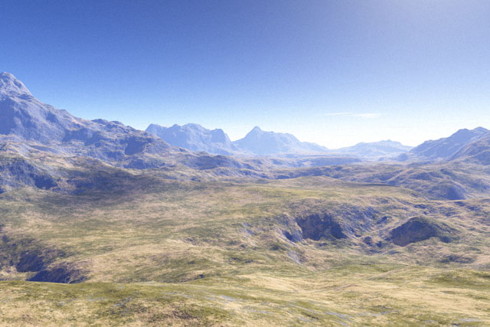
Computer Generated Terrain
This image was created using Terrain – a fractal terrain generator

Slide 3
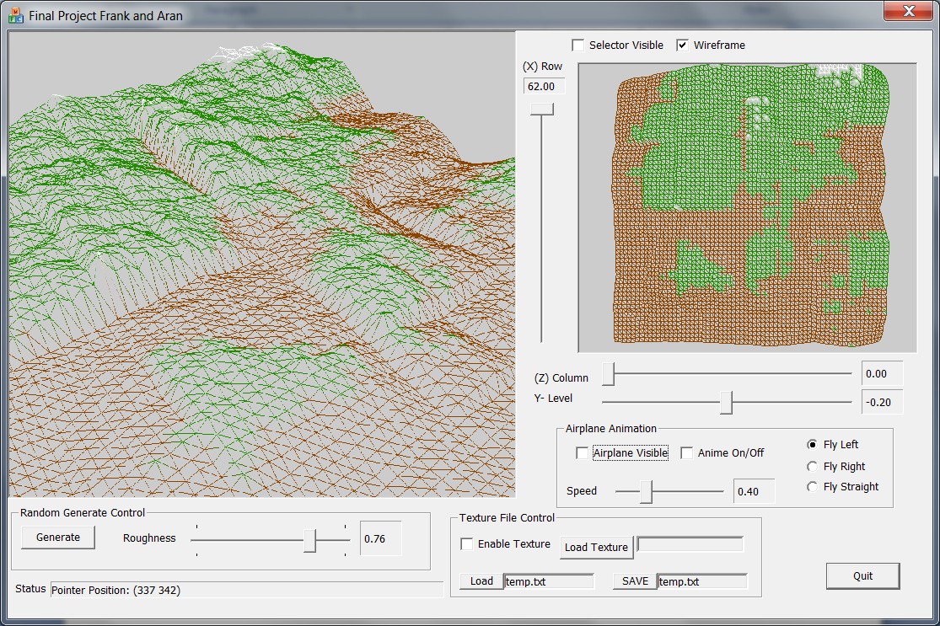
Create 3D Mesh
Generated Terrain by
* Create 3D Mesh
* Ray Tracing on 3D Mesh
* Compute each Pixel by intersect each Ray with each triangle on the 3D Mesh.

Slide 4
Height Map
6 | 1 | 85 | 4 | 6 | 1 | 8 | 4
63 | 7 | 3 | 41 | 8 | 5 | 9 | 0
3 | 218 | 0 | 416 | 4 | 81 | 85 | 165
189 | 165 | 1 | 8 | 4 | 97 | 6 | 26
748 | 4 | 512 | 84 | 85 | 695 | 5 | 2
41 | 8 | 96 | 23 | 2 | 8 | 8 | 56
0 | 3 | 54 | 4 | 56 | 7 | 8 | 78
5 | 4 | 8 | 2 | 6 | 74 | 8 | 4

Slide 5
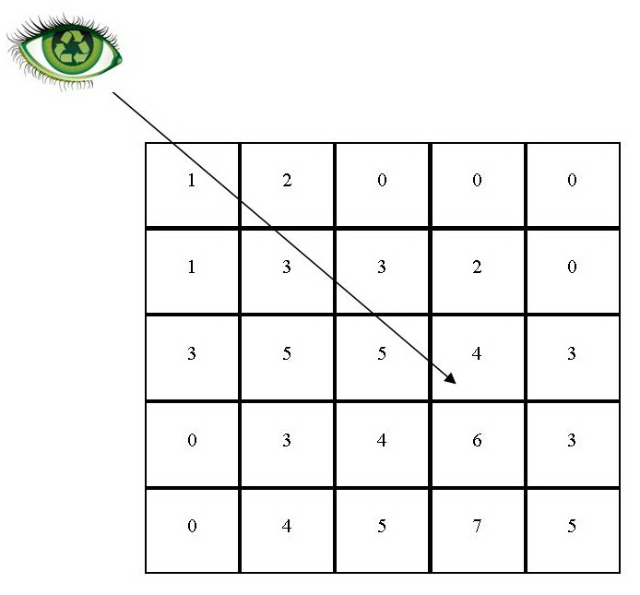

Slide 6
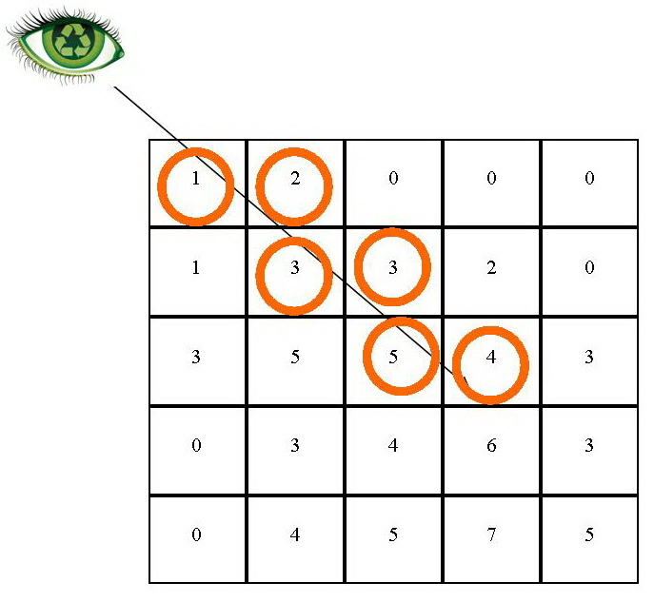

Slide 7
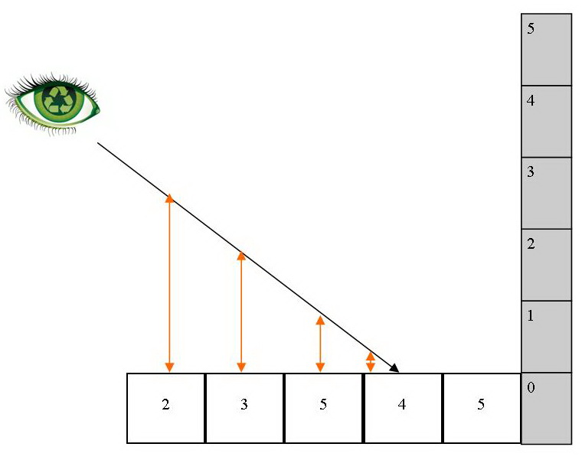

Slide 8
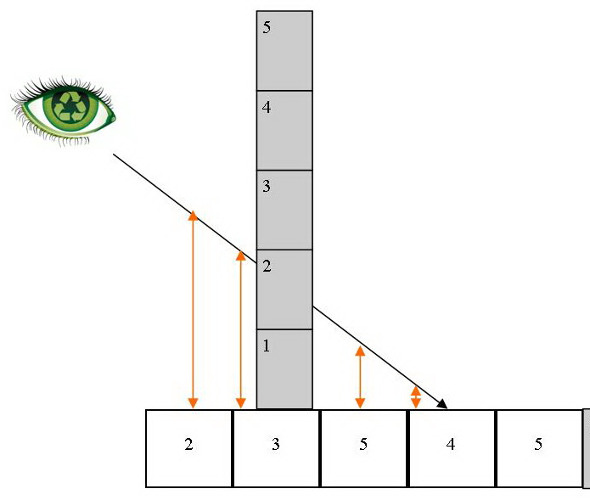

Slide 9
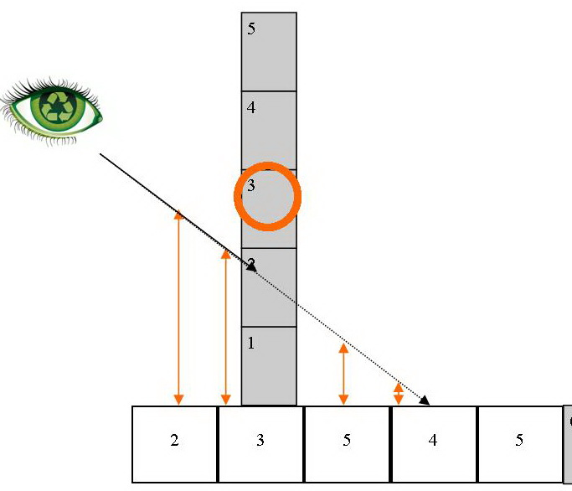

Slide 10


Tricky bits…imagine this is 3D

Slide 11
More tricky bits… traversing at an angle in 3 dimensions

Slide 12
Resolving Visibility
Height

Slide 13
Resolving Visibility in Section

Slide 14
Resolving Visibility in Section

Slide 15
Resolving Visibility in Section

Slide 16
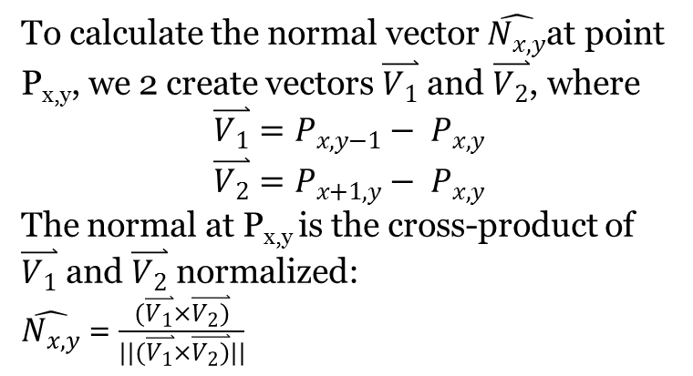
Calculating Surface Normals

Slide 17
Questions?

