Slide 1
Caustics Ray Tracing
CSS522
Steve Dame
Aysun Simitci
Sabitha Abraham

Slide 2
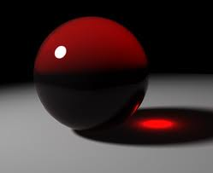
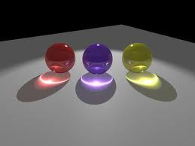
Caustics
Caustics are great light effects that you can observe in liquids, glass objects and gems.
In mathematics, caustic is a method of deriving a new curve based on a given curve and a point.
    http://www.eecis.udel.edu/~wei/Caustics/
    http://forum.daz3d.com/viewtopic.php?t=115030

Slide 3
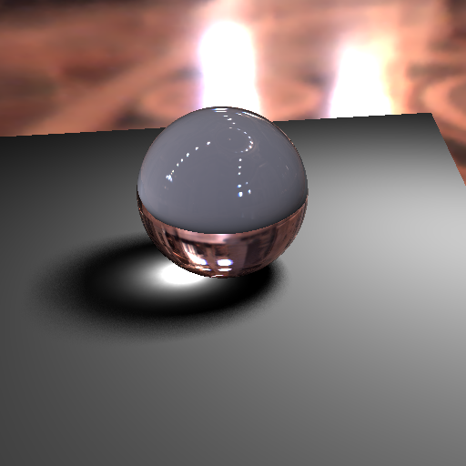
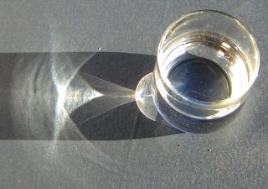
Examples of Caustics Rendering
can be seen on the surface of drinks in glass mugs
Light passing through cylindrical or spherical objects
http://graphics.ucsd.edu/courses/rendering/2010/rgross_wgeorge/pmapping.html

Slide 4
Solution research: some of the existing solutions
Caustics with Traditional Ray Tracing
Caustics with Radiosity
Caustics with Photon Mapping

Slide 5
Caustics with Traditional Ray Tracing
Most light paths traced backward from the eye never reach a light source, and most paths traced forward from the light sources never reach the eye.
Not able to correctly generate shadows and caustic of transparent objects
https://catalyst.uw.edu/gopost/attachment/ksung/20093/92322a64fc7b2d4b68da53e66723ad79
Notes:
problem is that

Slide 6
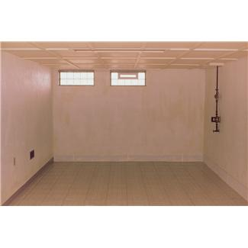

Slide 7
Caustics with Radiosity
Radiosity method divides a scene into polygons and computes the illumination of each polygon without considering any viewpoints
It provides soft shadows, color bleeding and indirect illumination;
Problems:
  It does not handle specular reflection,
  Has difficulty in processing transparency (i.e., reflection and refraction),
  Requires the scene to be subdivided into polygons
  Time consuming. A second pass (e.g., ray tracing) is needed to produce reflection and refraction.
Notes:
It should be noted the basic radiosity method is viewpoint independent: the solution will be the same regardless of the viewpoint of the image.

Slide 8
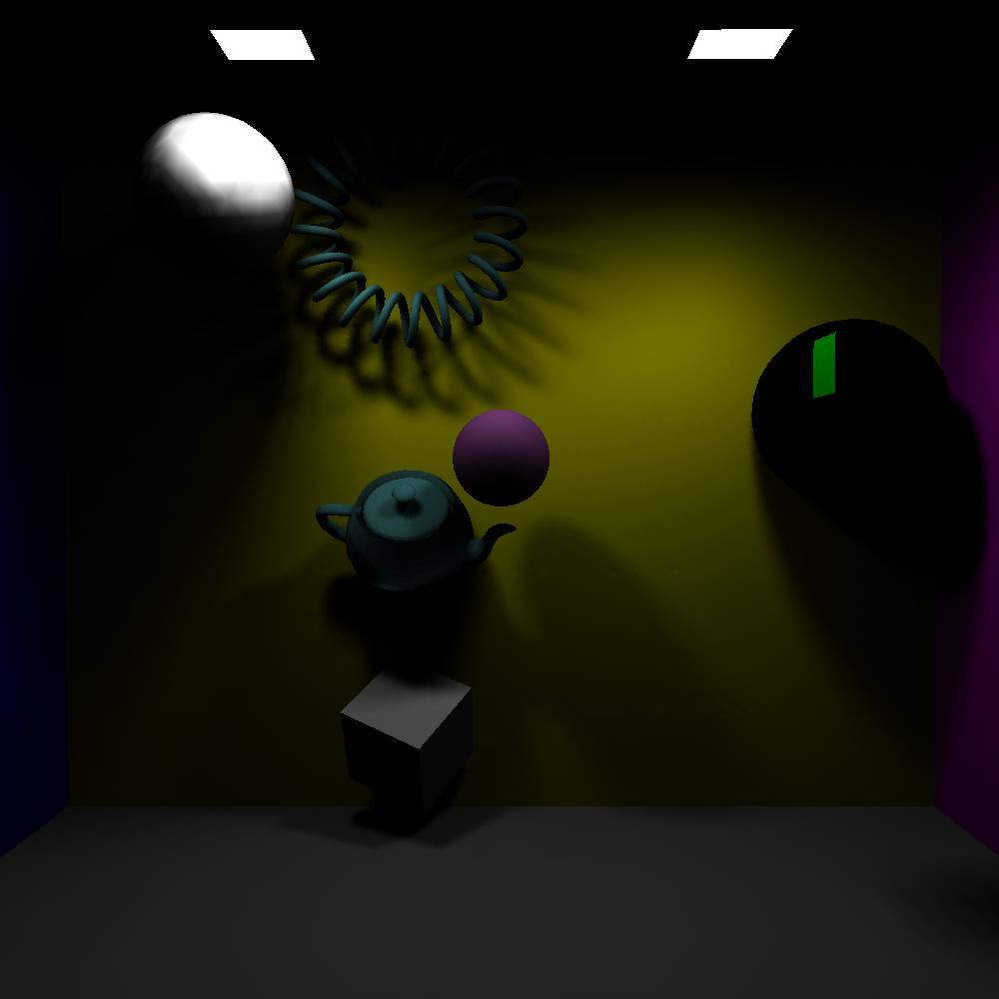
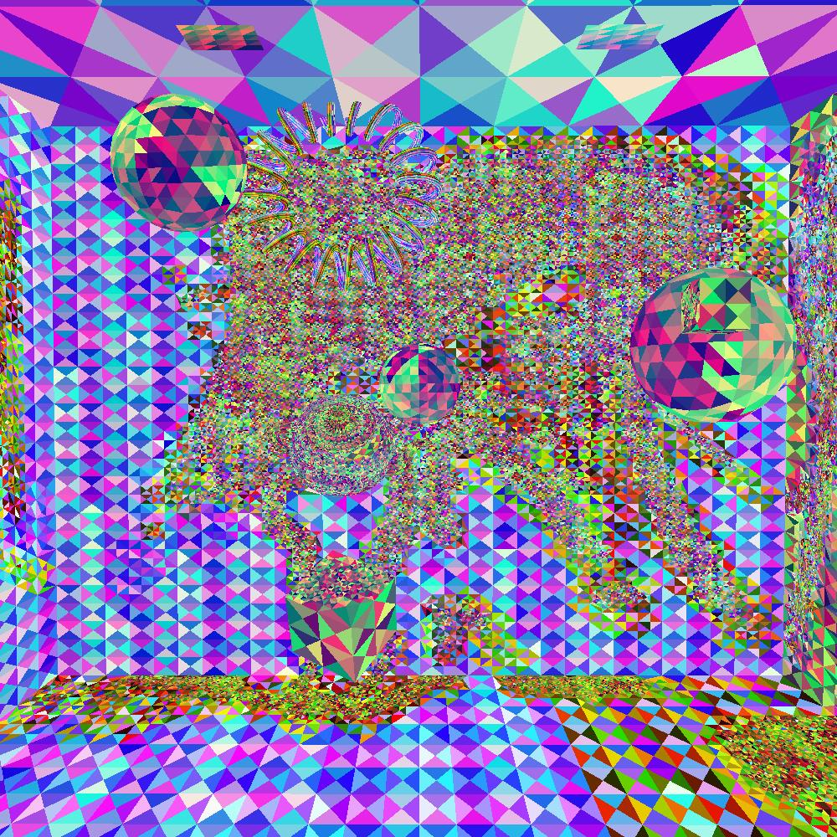
Radiosity Example

Slide 9
Caustics with Photon Mapping
was introduced by Jensen and Christensen [1995]
is a popular global illumination algorithm with attractive mathematical properties, especially for simulating caustics.
http://www.cs.mtu.edu/~shene/PUBLICATIONS/2005/photon.pdf

Slide 10
Why Photon Mapping
is simple
  tries to decouple the representation of a scene from its geometry and stores illumination information in a global data structure, the photon map
is a two-pass method
  The first pass builds the photon map by tracing photons from each light source, and the second pass renders the scene using the information stored in the photon map.
  http://www.cs.mtu.edu/~shene/PUBLICATIONS/2005/photon.pdf

Slide 11
Caustic Ray Tracing
PL
7
Compute Phong Illumination where L_{c} is the photon map light cell intensity.
^
1
Compute Caustic Ray Point Map
-L
3
Shoot Caustic Rays
^
(ray = P_{S} – P_{L})
Pe
UP
Image Plane
6
Accumulate Photon “hits”
^
N
θ₀
^
^
w
u
4
Intersect & Compute
First Refraction
FOV
Φ₀
Ps
^
V
^
Φ₁
N
θ₁
5
Intersect & Compute Second Refraction
Photon Map
2
Create Photon Density Array

Slide 12
Refraction (in 3D)
Caustic Ray Tracing
[1] Jarosz, Jensen et. al. (UC San Diego)
Where:
incident direction
refraction (transmission) direction
Normal direction at intersection
Index of refraction of the material outside of the sphere
^
N
Index of refraction of the material inside the sphere
angle of incidence
angle of refraction
^
N

Slide 13
Refraction (in 3D)
Caustic Ray Tracing
[2] Stavroudis (U of Az)
Where:
incident direction
refraction (transmission) direction
Normal direction at intersection
Index of refraction of the material outside of the sphere
^
N
Index of refraction of the material inside the sphere
angle of incidence
angle of refraction
^
N

Slide 14
Refraction through Sphere - Use Case
Caustic Ray Tracing
STEPS | DESCRIPTION
 | Compute Theta 1 (from IdotN1)
 | Compute T1
 | New ray (Pt+Epsilon*T1, T1)
 | Hit inside Sphere
 | Compute Theta 2 (from T1dotN2)
 | Compute T2
 | New ray Pt+Epsilon*T2, T2)
 | Shoot ray to PhotonMap
 | Compute I=N*L*kd
 | Accum I in PhotonMap
2
0
1
2
3
4
5
6
7
8
9
Photon Map

Slide 15
Index of Refraction - Materials
Caustic Ray Tracing
Goes to zero
Critical Angle to “Air” – the angle at which a light ray traveling from a higher to lower (air) index of refraction will get “trapped” in the material of higher index of refraction.
Index of Refraction Reference |  | Critical Angle to Air *(note other direction invalid)
Material | Index of Refraction | 1-eta^2 | RAD | DEG
Air | 1.0029 | 0.0000 | 1.5708 | 90.0
Ice | 1.31 | 0.4139 | 0.8719 | 50.0
Water | 1.333 | 0.4339 | 0.8516 | 48.8
Glass | 1.5172 | 0.5631 | 0.7222 | 41.4
Diamond | 2.4195 | 0.8282 | 0.4274 | 24.5
“Trapped Ray”

Slide 16
Snell’s Law Calculations
Caustic Ray Tracing
Calculation of Transmission Angle (Enter Index of Refraction(s) and Angle of Incidence)
NOTES | eta_i | eta_t | eta = eta_i/eta_t | Incident Theta (T_i) |  | sinT_i | sinT_t | Transmited Theta (T_t)
 |  |  |  | DEG | RAD |  |  | RAD | DEG
Air to Air | 1.0029 | 1.0029 | 1.000 | 0.00 | 0.000 | 0.000 | 0.000 | 0.00 | 0.0
Air to Water | 1.0029 | 1.3330 | 0.752 | 0.00 | 0.000 | 0.000 | 0.000 | 0.00 | 0.0
Air to Glass | 1.0029 | 1.5172 | 0.661 | 0.00 | 0.000 | 0.000 | 0.000 | 0.00 | 0.0
Air to Diamond | 1.0029 | 2.4195 | 0.415 | 0.00 | 0.000 | 0.000 | 0.000 | 0.00 | 0.0
Air to Air | 1.0029 | 1.0029 | 1.000 | 10.00 | 0.175 | 0.174 | 0.174 | 0.17 | 10.0
Air to Water | 1.0029 | 1.3330 | 0.752 | 10.00 | 0.175 | 0.174 | 0.131 | 0.13 | 7.5
Air to Glass | 1.0029 | 1.5172 | 0.661 | 10.00 | 0.175 | 0.174 | 0.115 | 0.12 | 6.6
Air to Diamond | 1.0029 | 2.4195 | 0.415 | 10.00 | 0.175 | 0.174 | 0.072 | 0.07 | 4.1
Air to Air | 1.0029 | 1.0029 | 1.000 | 30.00 | 0.524 | 0.500 | 0.500 | 0.52 | 30.0
Air to Water | 1.0029 | 1.3330 | 0.752 | 30.00 | 0.524 | 0.500 | 0.376 | 0.39 | 22.1
Air to Glass | 1.0029 | 1.5172 | 0.661 | 30.00 | 0.524 | 0.500 | 0.331 | 0.34 | 19.3
Air to Diamond | 1.0029 | 2.4195 | 0.415 | 30.00 | 0.524 | 0.500 | 0.207 | 0.21 | 12.0
Air to Air | 1.0029 | 1.0029 | 1.000 | 45.00 | 0.785 | 0.707 | 0.707 | 0.79 | 45.0
Air to Water | 1.0029 | 1.3330 | 0.752 | 45.00 | 0.785 | 0.707 | 0.532 | 0.56 | 32.1
Air to Glass | 1.0029 | 1.5172 | 0.661 | 45.00 | 0.785 | 0.707 | 0.467 | 0.49 | 27.9
Air to Diamond | 1.0029 | 2.4195 | 0.415 | 45.00 | 0.785 | 0.707 | 0.293 | 0.30 | 17.0
Air to Air | 1.0029 | 1.0029 | 1.000 | 60.00 | 1.047 | 0.866 | 0.866 | 1.05 | 60.0
Air to Water | 1.0029 | 1.3330 | 0.752 | 60.00 | 1.047 | 0.866 | 0.652 | 0.71 | 40.7
Air to Glass | 1.0029 | 1.5172 | 0.661 | 60.00 | 1.047 | 0.866 | 0.572 | 0.61 | 34.9
Air to Diamond | 1.0029 | 2.4195 | 0.415 | 60.00 | 1.047 | 0.866 | 0.359 | 0.37 | 21.0
Air to Air | 1.0029 | 1.0029 | 1.000 | 90.00 | 1.571 | 1.000 | 1.000 | 1.57 | 90.0
Air to Water | 1.0029 | 1.3330 | 0.752 | 90.00 | 1.571 | 1.000 | 0.752 | 0.85 | 48.8
Air to Glass | 1.0029 | 1.5172 | 0.661 | 90.00 | 1.571 | 1.000 | 0.661 | 0.72 | 41.4
Air to Diamond | 1.0029 | 2.4195 | 0.415 | 90.00 | 1.571 | 1.000 | 0.415 | 0.43 | 24.5

Slide 17
Refraction Testing (1)
Caustic Ray Tracing

Slide 18
Refraction Testing (2)
Caustic Ray Tracing

Slide 19
Photon Map - Bilinear Interpolation
Caustic Ray Tracing
Example Cell Values
0.75
0.25
C11 = [0.2, 0.2 , 0.2]
C12 = [0.6, 0.6 , 0.6]
C21 = [1.0, 1.0 , 1.0]
C22 = [0.4, 0.4 , 0.4]
C11
Ai
C12
0.75
Pi
0.25
C21
C22
Bi
Ai = (0.25*0.2 + 0.75*0.6) = 0.5
Bi = (0.25*1.0 + 0.75*0.4) = 0.55
Li = (0.25*Ai + 0.75*Bi) = 0.57

Slide 20
Advantages of Photon Mapping
using photons to simulate the transport of individual photon energy
being able to calculate global illumination effects
capable of handling arbitrary geometry rather than polygonal scenes
low memory consumption
producing correct rendering results, even though noise could be introduced.

Slide 21
Additional References
[1] Wojciech Jarosz, Henrik Wann Jensen, and Craig Donner. 2008. Advanced global illumination using photon mapping. In ACM SIGGRAPH 2008 classes (SIGGRAPH '08). ACM, New York, NY, USA, , Article 2 , 112 pages. DOI=10.1145/1401132.1401136
[2] Stavroudis, O.N., The Optics of Rays, Wavefronts, and Caustics, Optical Sciences Center, University of Arizona, Academic Press 1972
[3] ARVO, J. R. 1986. Backward Ray Tracing. In ACM SIGGRAPH, '86 Course Notes - Developments in Ray Tracing, vol. 12.
http://graphics.ucsd.edu/courses/rendering/2010/rgross_wgeorge/glossy.html
http://graphics.ucsd.edu/~henrik/papers/photon_map/global_illumination_using_photon_maps_egwr96.pdf

