Slide 1
Caustic Ray Tracing CSS552
Steve Dame
Aysun Simitci
Sabitha Abraham

Slide 2
Caustic Ray Tracing
PL
7
Compute Phong Illumination where L_{c} is the photon map light cell intensity.
^
1
Compute Caustic Ray Point Map
-L
3
Shoot Caustic Rays
^
(ray = P_{S} – P_{L})
Pe
UP
Image Plane
6
Accumulate Photon “hits”
^
N
θ₀
^
^
w
u
4
Intersect & Compute
First Refraction
FOV
Φ₀
Ps
^
V
^
Φ₁
N
θ₁
5
Intersect & Compute Second Refraction
Photon Map
2
Create Photon Density Array

Slide 3
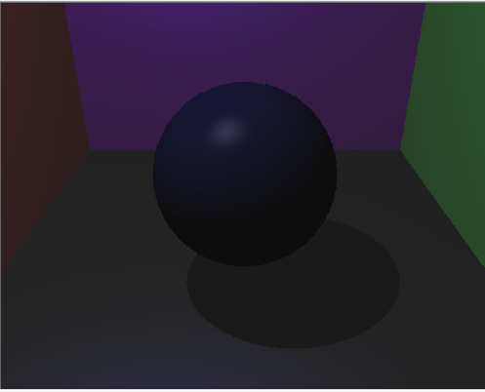
Without photon mapping

Slide 4
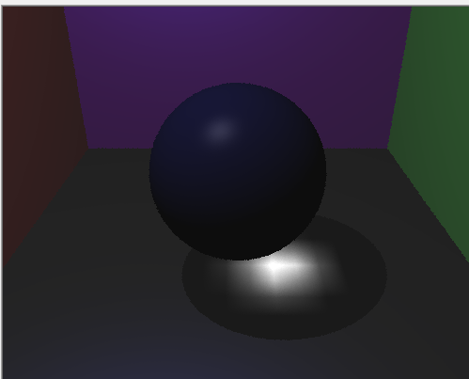
With photon mapping and Caustic effect

Slide 5
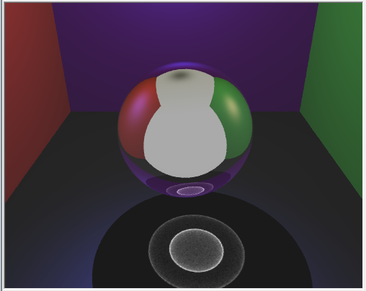

Slide 6
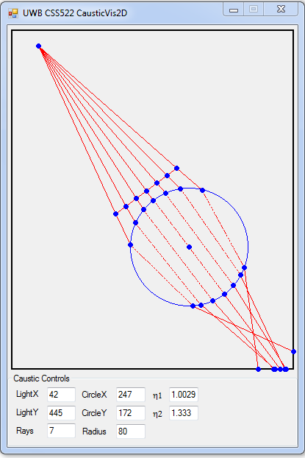
Caustic tool with 7 rays

Slide 7
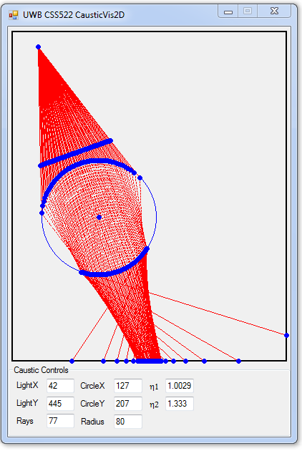
Caustic tool with 77 rays

