Slide 1
Rendering Wet Looking Objects
Ryan Hoaglan and Tim Clapp

Slide 2
Problem Statement
Given a dry object, render the object to appear wet.
Requires modeling of 3 layers: Air, Liquid, Material.
Used Snell’s Law and Fresnel’s Equations to compute reflectivity, transparency, and refraction direction based on each layer’s index of refraction

Slide 3
Implementation(s)
Proposed Solutions:
Model layers thru existing framework geometries.
Simulate layers computationally

Slide 4
Geometric Layers

Slide 5
Results

Slide 6
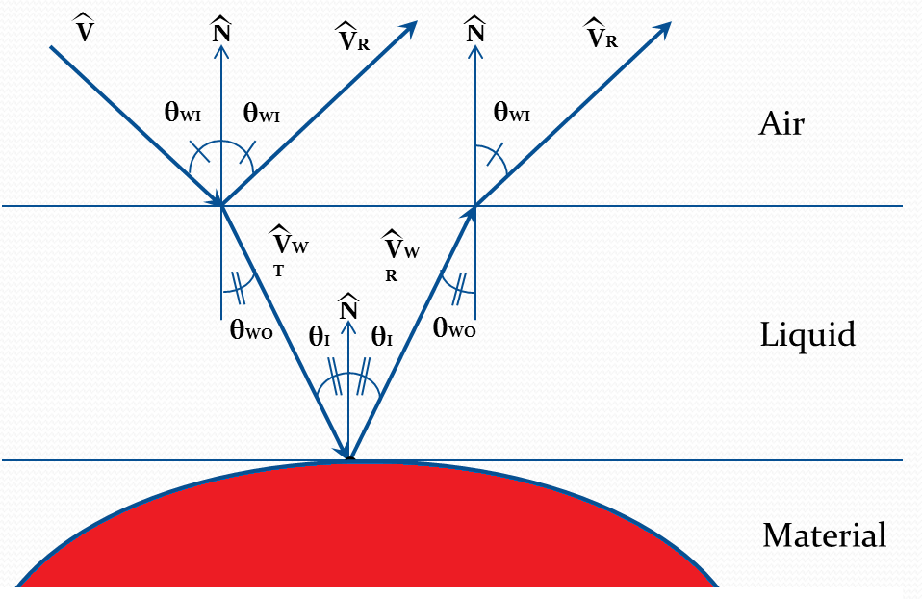
Liquid Height Map
H – Based on pixel color
from liquid map

Slide 7
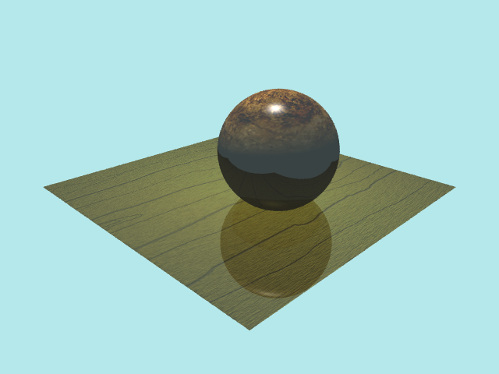
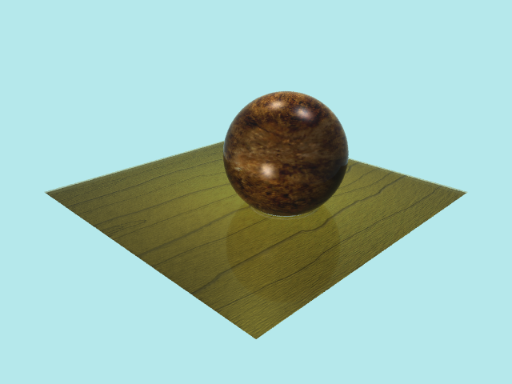
Results
Control
Two Layer Model With Constant Liquid

Slide 8
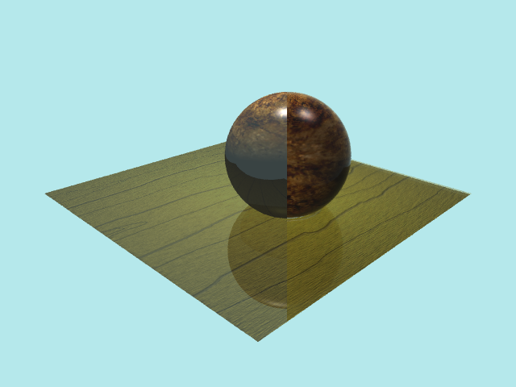
Results with Constant Liquid Height
Original Ray Tracer
Two Layer Model with Constant Liquid

Slide 9
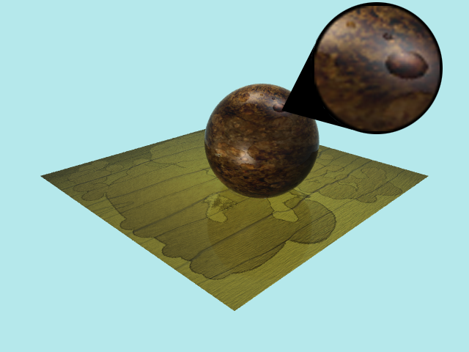
With Liquid Height Map
Darkening

Slide 10
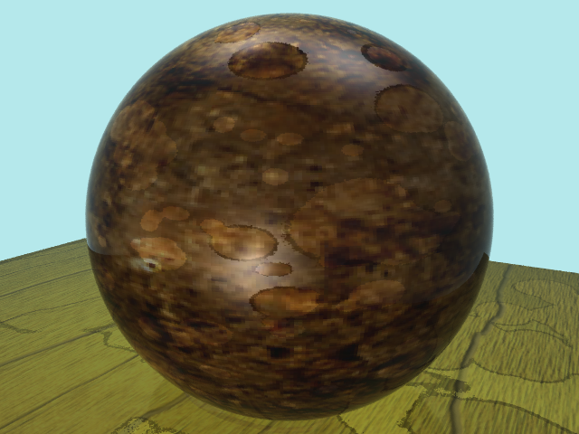
Liquid Height Mapped Sphere

