Slide 1
Rendering Wet Looking Objects
Ryan Hoaglan and Tim Clapp

Slide 2
Environmental Factors
Environmental factors play a huge part in determining the look of materials.
One such environmental factor is the presence of water.
Liquid changes the look of materials in different ways.
When inside the material:
On coarse material, such as sand and asphalt, it can appear darker when wet.
On material such as paper, it can appear more transparent.
When sitting on the surface, the material can appear more specular.

Slide 3
What Makes an Object Look “Wet”
There are two types of conditions present that cause an object to look wet.
A thin layer of liquid sitting on the surface.
Surface Modeling:
Liquid that is absorbed by the object and is underneath the surface.
Subsurface Modeling (Subsurface Scattering):

Slide 4
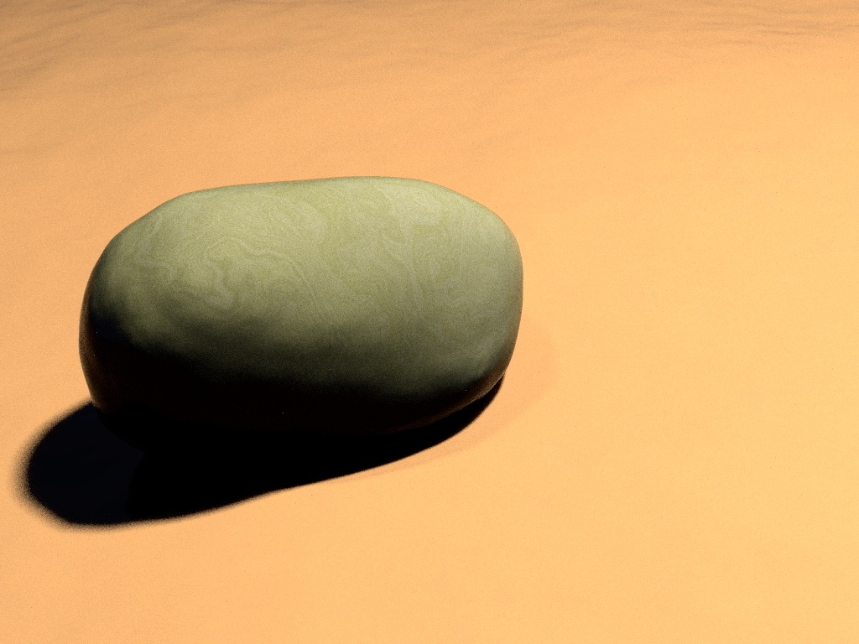
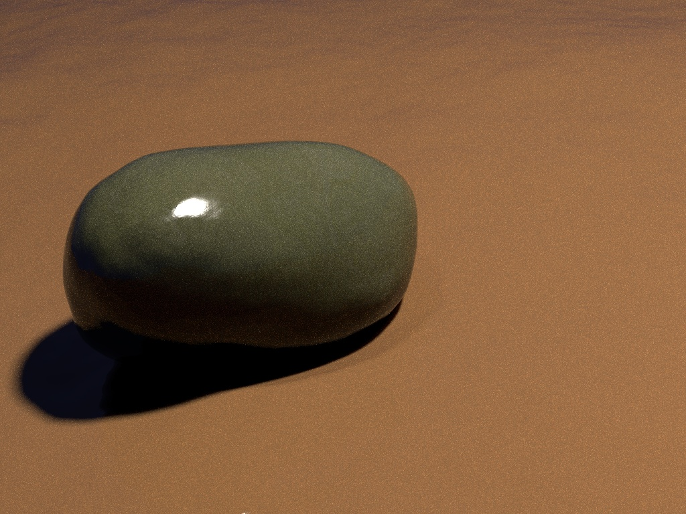
Subsurface and Surface Modeling Example
This was rendered using both surface and subsurface modeling methods
Photo example from http://graphics.ucsd.edu/~henrik/papers/rendering_wet_materials by Jensen, Wann, Legakis, and Dorsey

Slide 5
Subsurface Modeling
Also known as Subsurface Scattering.
Simulates the look of material as it absorbs liquid.
For real objects, such as sand and asphalt, water can enter and occupy the tiny gaps that were originally filled with air.

Slide 6
Scattering Property
Subsurface Scattering happens when light enters the surface of a material, interacts with the material, and then exits the surface at a different point.
The light will be reflected any number of times at irregular angles inside the material before it exits at a different angle than it would have by simple surface reflection.

Slide 7
Subsurface Scattering
Light as it interacts with subsurface particles.
Liquid
Material

Slide 8
Subsurface Scattering With Water Introduced
The presence of water underneath the material surface alters the scattering property of the material.
This is because the index of refraction is higher for liquid than it is for air, often close to the material’s refraction.
This causes the light to be refracted less because of the lower relative index of refraction.
Which causes more scattering events to occur.
Each scattering event causes light to be absorbed.

Slide 9
Surface Scattering With and Without Liquid
Without Liquid Present
With Liquid Present

Slide 10
Surface Modeling
Very similar to our reflection and refraction model from MP3, but more complicated.
The liquid layer adds another layer of reflection/refraction to the model.
Two surfaces, an air/liquid and liquid/material surface.
As light hits the air/liquid surface, part of it is reflected away, and part is refracted into the liquid layer.
Light is once again reflected/refracted on the liquid/material surface.
This part is our MP3 implementation.
As the ray reflects off the surface of the object and hits the air/liquid layer again, it is refracted once more as it goes into the air layer.

Slide 11
Surface Modeling Effect on Color
Each reflection/refraction causes light energy to be absorbed.
The energy absorption causes the surface of the object to appear darker.
N
V
VR
Air
Liquid
Material

Slide 12
Total Light Absorption
There is a possibility that light will continue to reflect beneath the surface, bouncing between the air/liquid and liquid/material layers.
This can happen when light is moving from a material with a higher density into one with a lower density, such as going from liquid to air.
If the incidence angle is above what is called the “critical angle,” all light is reflected, with none refracting into the air layer.
This can cause total light absorption, or extreme darkening, of the surface material.

Slide 13
Surface Modeling Diagram
V
N
VR
N
VR
θWI
θWI
θWI
Air
VWT
VWR
θWO
N
θWO
Liquid
θI
θI
P
VOT
Material
θO

Slide 14
Calculating Transmitted Light Radiance
To simulate the presence of liquid on the surface, we need to calculate the radiance leaving the surface.
This is done using a combination of Snell’s Law and Fresnel’s Equations to compute the reflected radiance and transmitted radiance.
Instead of using a predetermined reflection and transparency amount, we need to calculate it.

Slide 15
Fresnel’s Equations
Fresnel’s Equations are required to determine the amount of light that is reflected as well as transmitted through each layer.
Snell’s Law tells us = and =
Used for the index of refraction for each layer
n1 is the index of refraction for air layer
n2 is the index of refraction for water layer
n3 is the index of refraction for surface layer
Sin(θwi)
n1
Sin(θi)
n2
Sin(θwo)
n2
Sin(θo)
n3

Slide 16
Reflected Light Using Fresnel’s Equations
For un-polarized light, the reflection coefficient R is computed as half the sum of two parts. One being the component perpendicular to the incidence plane Rs, and the other parallel to the incidence plane Rp.
Rs_{A->L} = [n1 * cos(θwi) – n2 * cos(θwo)]/[n1 * cos(θwi) + n2 * cos(θwo)] ²
Rp_{A->L} = [n1 * cos(θwo) – n2 * cos(θwi)]/[n1 * cos(θwo) + n2 * cos(θwi)] ²
Rs_{L->S} = [n2 * cos(θi) – n3 * cos(θo)]/[n2 * cos(θi) + n3 * cos(θo)] ²
Rp_{L->S} = [n2 * cos(θo) – n3 * cos(θi)]/[n2 * cos(θo) + n3 * cos(θi)] ²
The amount of light reflected is based on R = (Rs + Rp)/2 for each layer

Slide 17
Light Transmission Between Layers
Using the amount of reflected light just calculated, calculate the amount of light transmission.
T_{A->L} = (n₁ / n₂)² (1 – R_{A->L})
T_{L->S} = (n₂ / n₃)² (1 – R_{L->S}^{k})
k is a constant used to simulate roughness on the surface.

Slide 18
Surface Liquid Representation
How is the surface liquid represented?
Physically modeling the geometry of the surface liquid.
Very expensive, both in modeling creation and render time.
Describing how the liquid will affect the reflection/refraction.
Requires additional computations, but can be done on any object geometry.
This is the approach that we are going to take.
In addition to the above, some factor mud particles into the equations to simulate standing water
Mud particles are factored in to darken the water, making it less transparent.
For example, in rendering mud puddles for road scenes.

Slide 19
Implementation
Using the amount of light reflected and refracted, we will use our existing reflection and refraction equation.
However, we will add a second layer of reflection and refraction to simulate the water layer.
To do this, we will have a gray scale image that we will use to compute the height of the liquid from the surface at any given point on the primitive.

Slide 20


Liquid Map
Highest Point
No Liquid on Surface

Slide 21
Liquid Layer
Height of the liquid will give different results

Slide 22
Potential Problems
We aren’t sure how much of the “wet” look is contributed by subsurface scattering.
We will have to make a lot of artistic decisions as we are working to get the right look.
Since we don’t has two physical layers to reflect/refract with, we have to either trace into the model to reflect/refract with the “surface” layer, or trace out of the model to reflect/refract with the “liquid” layer.

Slide 23
References
Hecht, Eugene (2002). Optics (4th ed.). Addison Wesley.
Watkins, “Fresnel Equations.” InYourFaceFotos.com
Jensen, Henrik Wann, Justin Legakis, and Julie Dorsey. “Rendering of Wet Materials.” http://graphics.ucsd.edu/~henrik/papers/rendering_wet_materials
Nakamae, Eihachiro, et al. “A Lighting Model Aiming at Drive Simulators.” Computer Graphics, Aug. 1990: 24. Print
“Polarization(waves)” wikipedia, http://en.wikipedia.org/wiki/Polarization_%28waves%29

