Slide 1
Rendering Fog Final Demo
CSS 522 Topics in Rendering
March 14,2011
Scott and Lew

Slide 2
Overview:
Background of Fog
Challenges Rendering it
Our Implementation
Results
Limitations and Future Work

Slide 3
Challenges with Physics-Based Model
Visible clouds and fog are created by millions and millions of water droplets refracting and reflecting light
This is impractical to model – it might provide a more realistic rendering but comes at the expense of an impossibly huge amount of geometry to render.
It also doesn’t make sense to define the size & position of each water droplet in a scene
The visually interesting aspects of fog come from the aggregation of these particles, rather than the particles themselves

Slide 4
Conceptual Implementation
Composite the slices and include interactions with other geometry
Multiple Fog Slices
$$\hat{L}$$

Slide 5
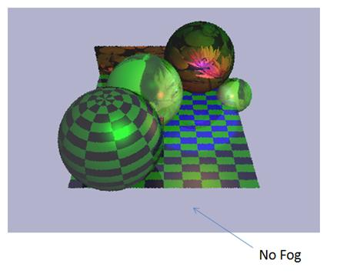
Results

Slide 6
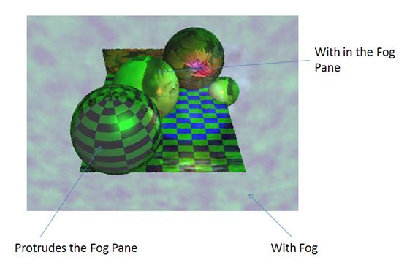
Results

Slide 7
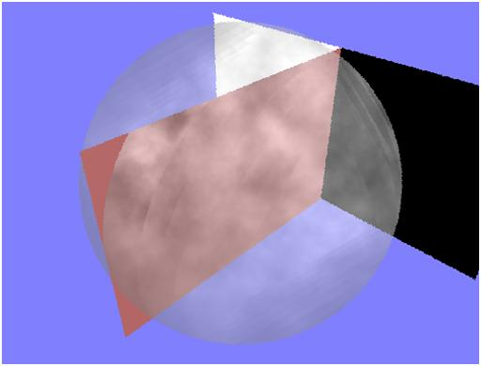
Results

Slide 8
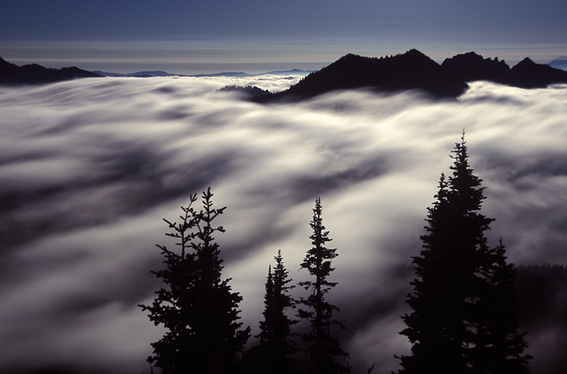
Results (haha just kidding)

Slide 9
Limitation and Future Work
With more time, create our own Fog Shader
Enhance the boundary of our fog slices. Current implementation shows obvious transition from fog to no fog.
Implement mode to switch between Perlin and Exponential methods.
User Interface for Fog Density
Current Implementation uses number of slices

Slide 10
Questions?
/

