Slide 1
Rendering Fog
CSS 522 Topics in Rendering
March 01,2011
Scott and Lew

Slide 2
Overview:
Background of Fog
Method used to simulate it
Perlin's Noise
Why Perlin's Noise is cool?
Rendering fog with Perlin's Noise
Pseudo Implementation

Slide 3
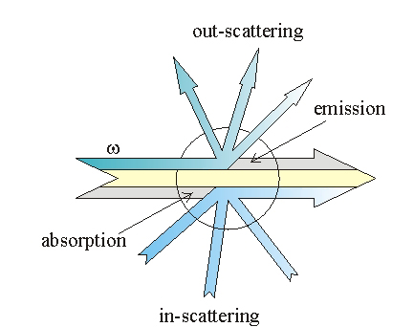
Background of Fog
Small water droplets no larger than 0.05 inches in diameter
Effects when light enters the droplet
Absorption
Emission
Out-scattering(diffusion)
In-scattering
Ref: http://www.cg.tuwien.ac.at/hostings/cescg/CESCG-2004/web/Zdrojewska-Dorota/

Slide 4
Challenges with Physics-Based Model
Visible clouds and fog are created by millions and millions of water droplets refracting and reflecting light
This is impractical to model – it might provide a more realistic rendering but comes at the expense of an impossibly huge amount of geometry to render.
It also doesn’t make sense to define the size & position of each water droplet in a scene
The visually interesting aspects of fog come from the aggregation of these particles, rather than the particles themselves

Slide 5
Previous Implementations
Approaches
Render as textures on geometry
Render as sprites
Render as texture on background
Shortcomings
Texture-based approaches doesn’t accurately reflect different camera positions
None of these approaches allow geometry to interact with the fog (can’t see the effects of placing geometry inside or behind the fog)
These also don’t capture the effects of multiple light sources or colored light

Slide 6
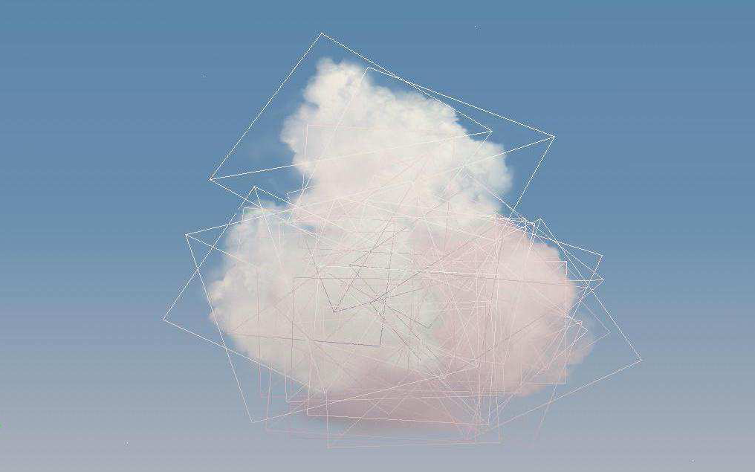
Sprite/Texture Implementation
Despite aforementioned shortcomings, the result is aesthetically appealing
Ref: http://ofb.net/~niniane/clouds-jgt.pdf

Slide 7
Conceptual Implementation
Model the area of fog as a simple geometrical object that we are already familiar with, like a box or sphere
Layer the geometry into many slices in the V direction (the viewing direction of the camera)
Fog Slices
$$\hat{V}$$

Slide 8
Conceptual Implementation
Compute random locations for clusters of mass on the slice nearest to the camera. Interpolate the mass between the clusters using some falloff function
One Fog Slice
$$\hat{L}$$

Slide 9
Conceptual Implementation
Repeat the mass clustering on the next layer, interpolating the amount of mass at each point using different randomly positioned clusters
Multiple Fog Slices
$$\hat{L}$$

Slide 10
Conceptual Implementation
Composite the slices and include interactions with other geometry
Multiple Fog Slices
$$\hat{L}$$

Slide 11
Detailed Implementation
Now that we have conceptual mass distributed in 3D space, how do we render it?
Intersect rays with our fog geometry as usual.
Determine how much mass a ray intersects with at the first layer.
Calculate how much mass the ray hit to determine the opacity of this intersection. More mass == more opacity
If the opacity < 1, shoot another ray in the same direction. It will either intersect with the next layer, another piece of geometry, or nothing at all. Compute shading until we don’t intersect with any more geometry

Slide 12
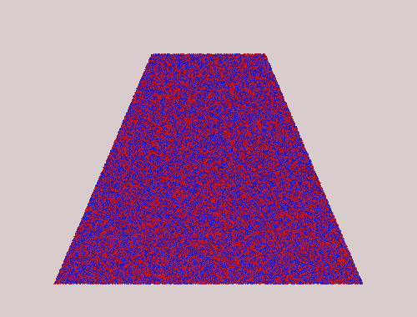
Random Mass = Ugly Noise
Random mass creates a fuzzy look like static on a TV screen
This does not look realistic because it lacks the wispy, flowing quality of volumetric fog
A better way for us to distribute mass would be to use a smarter noise functions
Random Noise

Slide 13
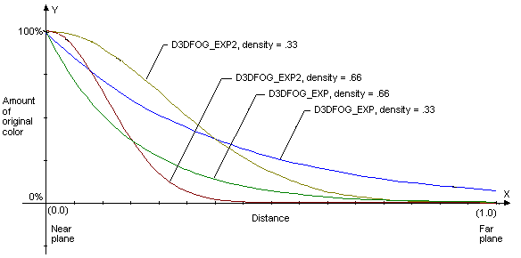
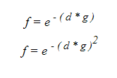
Simple Methods Used to Simulate FOG
Linear Method:
Exponential and Squared Method:
*Both implementation are cheap on computation, and are used in real time graphics systems.
*Both methods are implemented in theDirect3d and OpenGL Library
Ref: http://www.cg.tuwien.ac.at/hostings/cescg/CESCG-2004/web/Zdrojewska-Dorota/

Slide 14
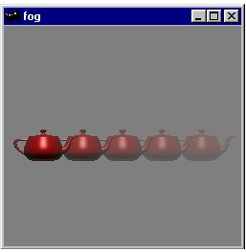
Fog Example:
Yeah, This looks Good but, it could be cooler.
If we use…
Ref: http://www.opengl.org/resources/code/samples/redbook/

Slide 15
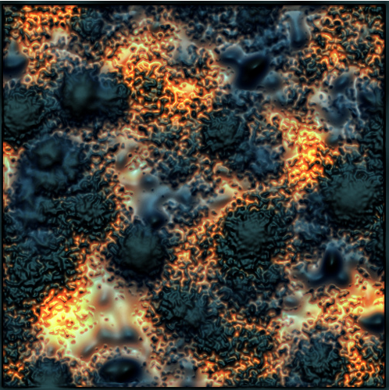
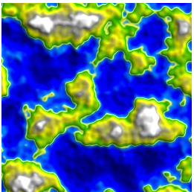
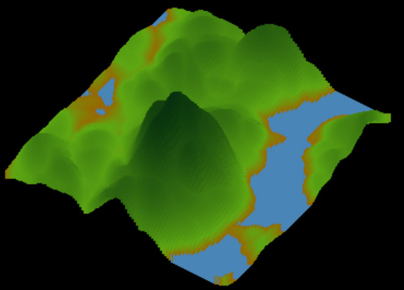
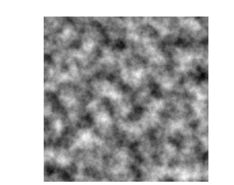
Perlin's Noise!!!!
And Looks like Fog too!
Google Images: Perlin's Noise

Slide 16
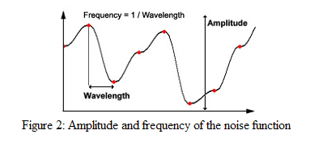
Perlin's Noise
Amplitude: is a parameter describing the range of texture colors
Because we are using a gray scale, the full spectrum will be 0-255.
Frequency: specifies the rate at which colors change in generated texture.
I.E.
Low frequency noise change gradually shifts contrasting colors slowly.
High frequency noise change shifts contrasting colors fast.

Slide 17
High Frequency Vs. Low Frequency

Slide 18
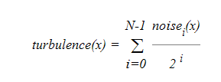
Pseudo Implementation
Where
X is a point in 3D Space
Ref: http://www.cg.tuwien.ac.at/hostings/cescg/CESCG-2004/web/Zdrojewska-Dorota/

Slide 19
Pseudo Algorithm
1. Generate a Perlin's noise texture parallel to the viewing pane
2. Compute fog factor
3. Blend colors of the scene with the fog color during Ray Trace

Slide 20
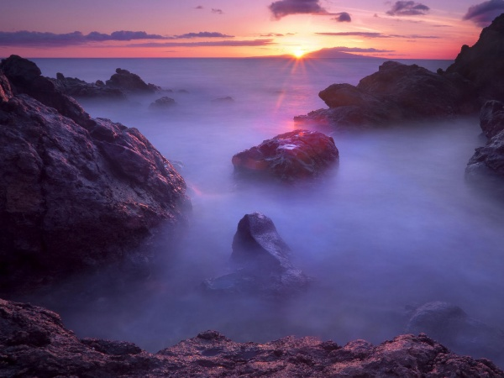
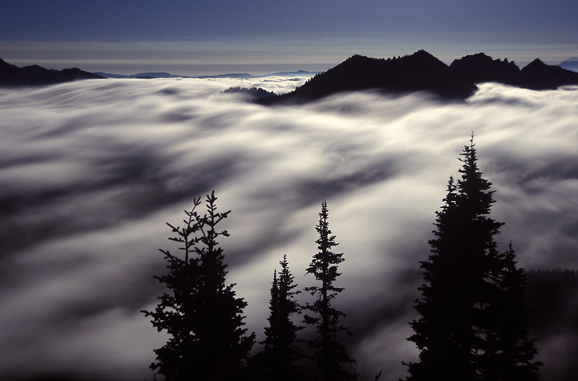

Slide 21
Questions
Ref: http://www.cg.tuwien.ac.at/hostings/cescg/CESCG-2004/web/Zdrojewska-Dorota/

