Slide 1
Stereoscopic Images

Slide 2
Stereopsis – Depth Perception
How do we perceive depth?
Left and right eyes see slightly different images
Images are forwarded to the brain
Brain combines the two images

Slide 3
Image Construction
How does the Brain combine two images into one?
Horizontal Disparity – the difference in horizontal position of a point in view between the two images
Brain implies depth based on this disparity – the greater the difference, the closer it must be.
Small disparity implies object is farther away

Slide 4
Can you see Stereoscopic Images?

Slide 5
Problem
We can simulate this phenomenon in graphics by creating two images of the same scene and combining them to form one image.
But how do you represent the information from two separate images in one image?

Slide 6
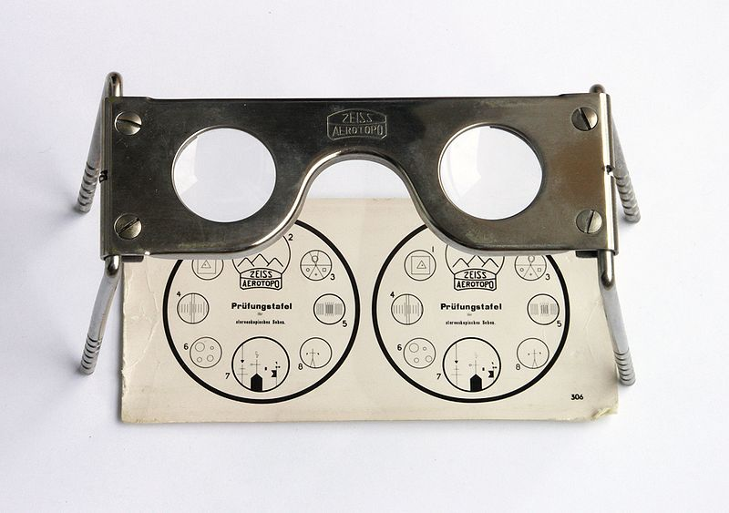
Stereoscope
One of the first solutions
Each eye can only see one
of the images
Brian combines them into
one image

Slide 7
Problem with Stereoscope
Awkward
Can’t translate well to other application such as movies
Must keep head still in a certain position

Slide 8
A better solution…..
Better to use only one actual image
What if we divided the information contained in a pixel into parts?
We could use one category of information strictly from the left image, and another category of information from the right image.

Slide 9
Share the Pixel!!
Color of a pixel – Red, Green, and Blue
Each pixel has a value for each
Use only the Red and Blue values for the left image, disregard the Green
Use only Green values for the right image, disregard the Red and Blue

Slide 10
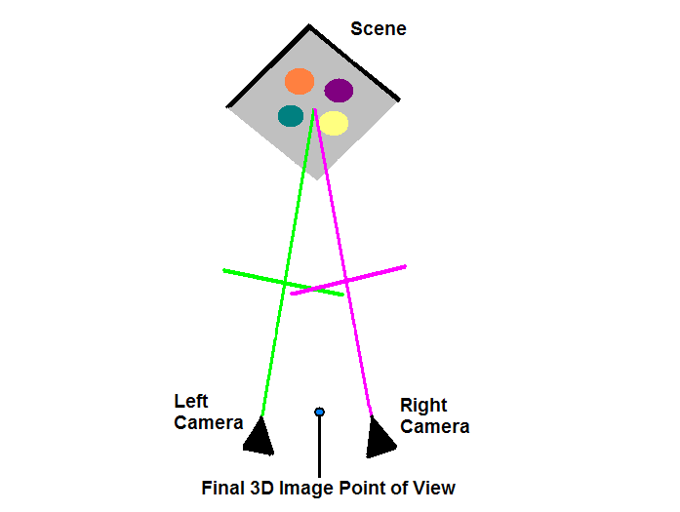
Two Cameras

Slide 11
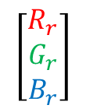
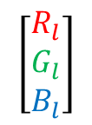
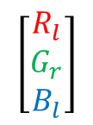
Trioscopic 3D Image
Left Image
Right Image
$$\left[\begin{matrix}R_{l} \\ G_{l} \\ B_{l}\end{matrix}\right]$$
$$\left[\begin{matrix}R_{r} \\ G_{r} \\ B_{r}\end{matrix}\right]$$
pixel
pixel
$$\left[\begin{matrix}R_{l} \\ G_{r} \\ B_{l}\end{matrix}\right]$$
pixel
Trioscopic Image

Slide 12
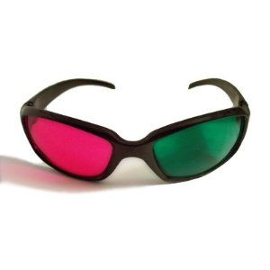
Trioscopic Glasses

Slide 13
Color Schemes
Scheme | Left eye |  |  | Right eye | Color rendering
red-green | pure red |  |  | pure green | monochrome
red-blue | pure red |  |  | pure blue | monochrome
red-cyan | pure red |  |  | pure cyan (green+blue) | color (poor reds, good greens)
anachrome | dark red |  |  | cyan (green+blue+some red) | color (poor reds)
mirachrome | dark red+lens |  |  | cyan (green+blue+some red) | color (poor reds)
Trioscopic | pure green |  |  | pure magenta (red+blue) | color (better reds, oranges and wider range of blues than red/cyan)
INFICOLOR | complex magenta |  |  | complex green | color (almost full and pleasant natural colors with excellent skin tones perception)
ColorCode 3D | amber (red+green+neutral grey) |  |  | pure dark blue (+optional lens) | color (almost full-color perception)
magenta-cyan | magenta (red+blue) |  |  | cyan (green+blue) | color (better than red-cyan)
Infitec | white (Red 629 nm, Green 532 nm, Blue 446 nm) |  |  | white (Red 615 nm, Green 518 nm, Blue 432 nm) | color (full color)

Slide 14
Light Filtering
Merge the two images so that the final image has all of its Red and Blue values only from the left image, and all of its Green values only from the right image.
Place colored cellophane filters over the eyes – one Magenta and the other Green.
The Green cellophane will filter out the green values so that the left eye only sees the Red and Blue values.

Slide 15
Light Filtering
Magenta cellophane filters out the Red and Blue values so that the right eye only sees the Green values.
This way, each eye sees a completely separate image
The Brain combines these images and infers depth based on Horizontal Disparity

Slide 16
Stereoscopy References
http://www.arachnoid.com/raytracing/anaglyphic_3d.html
http://en.wikipedia.org/wiki/Stereoscopy
http://en.wikipedia.org/wiki/RealD_Cinema
http://en.wikipedia.org/wiki/Circular_polarizer#Circular_Polarizers
http://en.wikipedia.org/wiki/Dolby_3D
http://en.wikipedia.org/wiki/Anaglyph_image#Possible_color_schemes
http://www.trioscopics.com/
http://www.3dstereo.com/viewmaster/tri-gla.html

Slide 17
Depth of Field

Slide 18
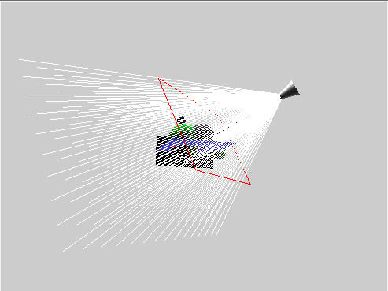
Traditional CG Camera Model
Pinhole Camera
All rays come from a single point
Perfect Focus – unrealistic

Slide 19
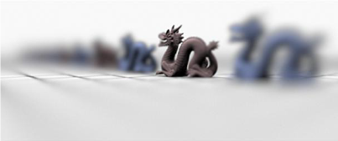
Depth of Field
The human eye has a limited depth of field
That area is “In Focus”
Other areas in the field of view appear sharper or fuzzier depending on their distance from the focal point along the viewing direction
Camera
Blur
Blur
Depth of Field

Slide 20
How do we simulate Depth of Field in Rendering?
Can create a blurring effect which is more or less severe depending on the distance from the focal point.
  In Object-space (In-Rendering)
    Distributed Ray Tracing aka stochastic ray tracing
  In Image-space (Post-Rendering)
    Per-pixel blur level control

Slide 21
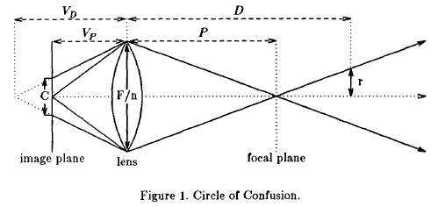
Distributed Ray Tracing
F – focal length
n – aperture number
C – circle of confusion
VP = FP/(P-F)
VD = FD/(D-F)
C = (|VD –VP|/VD) (F/n)
r = ½ (F/n) (D-P)/P
R = (-VP/D) r
R = ½ C

Slide 22
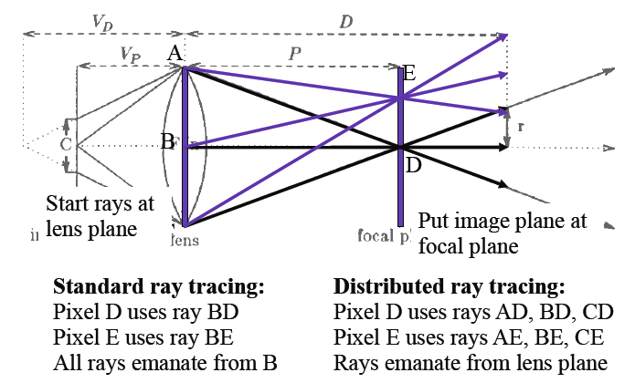
Distributed Ray Tracing

Slide 23
Per-pixel blur level control
Save the depth information for each pixel in the image.
  Depth Map!
If a pixel needs blurring, average the pixels around it – using a greater number of neighbors the more it needs to be blurred
  Gaussian blur

Slide 24
Depth of Field References
http://www.cs.berkeley.edu/~barsky/Blur/survey.pdf
http://delivery.acm.org/10.1145/810000/808590/p137-cook.pdf?key1=808590&key2=8080119921&coll=DL&dl=ACM&ip=69.91.175.135&CFID=10978387&CFTOKEN=86218611
http://luthuli.cs.uiuc.edu/~daf/courses/ComputerGraphics/Week3/distributed-final.pdf
www.csie.ntu.edu.tw/~cyy/courses/rendering/05fall/assignments/pres/slides/DRT.ppt
http://en.wikipedia.org/wiki/Depth_of_field

