Slide 1
Rendering Motion Blur
Thuan Pham & Phong Nguyen
CSS552, Winter 2011

Slide 2
Problem
Using ray tracers, add motion blur to objects in a 3D scene

Slide 3
Implementation
Geometries has motion attributes
motion direction vector
motion time
<sphere>
<center> -2 1.5 0.5 </center>
<radius> 0.4 </radius>
<material> 2 </material>
<motiondirection> 3 -1 0 </motiondirection>
<motiontime> 20 </motiontime>
</sphere>

Slide 4
Implementation
Each pixel, check to see if pixel is in the ‘motion blur’ area of each moving object
At regular intervals along motion vector length, create the geometry
Check to see if the Ray intersects with the area of motion blur
If intersects, shade pixel by combining geometry color and background color

Slide 5
Results
Increased in number of samples created (motiontime)
Less strobing
More smooth
Shows ambient and specular lighting
Does not show shadow, reflections

Slide 6
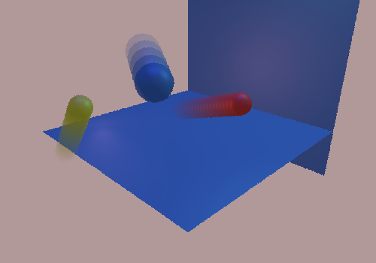
Result Image

