Slide 1
Motion Blur
Phong Nguyen & Thuan Pham
CSS 552

Slide 2
Overview
Introduction
Problem Statement
Camera
Importance of Motion Blur
Distributed Rays
Post Processing

Slide 3
Introduction
Camera or eye produce visible streaks from fast moving objects
Motion blur adds to scene’s natural appearance – not jerky
Recorded film typically already integrated
Rendered scenes need to add motion blur in

Slide 4
Problem statement
Artificially simulation the perception of moving objects
addition of motion blur to a scene or image

Slide 5
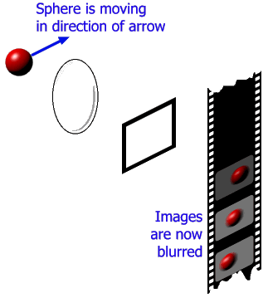
Camera
Shutter Speed/Exposure time
Longer exposure time, more motion blur
Photographic film integrates over the exposure time
Shows up as motion blur

Slide 6
Why It Is Important
We see it in the physical world
Propeller
Driving past a Picket fence
Need it to avoid Strobing Effect
Alias-in-time effect

Slide 7
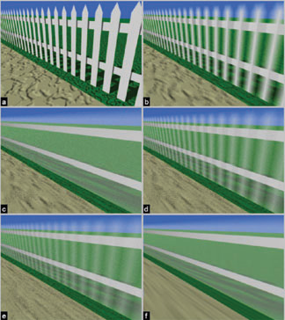
Why It Is Important

Slide 8
Strobing Effect
No motion blur
Motion blur added
http://www.youtube.com/watch?v=TNQTu1vT5do

Slide 9
Alias in Time
Alias in time as well as space
Motion blur effects can eliminate the effect
Frame rate is same as rotation speed
Example is Helicopter rotor not appearing to move

Slide 10
Games & Animation
Big topic in games and animation
Enhance the realism of rendered animation
Smoothes out game/animation appearance
Simulates the real-world and cameras works

Slide 11
General Motion Blur
ω = view direction
L_{l}(ω,t) = geometry luminance from ω at time t
g_{l}(ω,t) = geometry, equals to one if in ω direction
r(ω,t) = camera shutter closing during exposure time – not for rendering

Slide 12
Distributed Ray Tracing
Temporal Anti-aliasing
Sampling in time as well as space
Cast rays for each object’s position in frame
Multiple rays for each pixel
Object or scene is moved
Rays cast again for a new frame each objects position again
Put the frames together

Slide 13
Distributed Ray Tracing
Since every ray is shot at a different time, everything is “motion blurred”
Ray Tracing performed multiple times for all pixels in the image
Trade off is render time

Slide 16
Post Processing/Rendering
Use pre-rendered snapshots of scene
Motion blurring and rendering methods are decoupled
Motion information used for blurring
Point Spread Function – derived from the movement of the object.
Motion can only be in a straight line, not curved
Improves efficiency
Compromises Quality

Slide 17
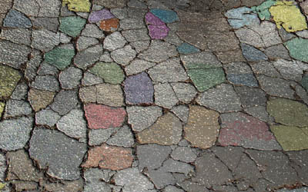
Implementation
Use post processing to render motion to a whole scene
Simulate camera motion/jerkiness

Slide 18
Questions

Slide 19
References
Fernando Navarro, Francisco J Seron, Diego Gutierrez. “Motion Blur Rendering: State of the Art”, Computer Graphics forum, Volume 30 (2011), number 1 pp 3-26.
Gilberto Rosado. “Motion Blur as a Post-Processing Effect”, http://http.developer.nvidia.com/GPUGems3/gpugems3_ch27.html
Kelvin Sung, Andrew Pearce, Changyaw Wang. “Spatial-Temporal Antialiasing”, IEEE Transactions on Visualization and Computer Graphics, Vol 8, No 2, April-June 2002.

