Slide 1
Ray Tracing - Analysis of Super-Sampling Methods
Duy & Piotr

Slide 2
The Problem
How to reconstruct a high quality image with
the least amount of samples per pixel
the least amount of resources
And preserving the image quality
without introduction of artifacts such as jagged edges, Moire patterns, etc..

Slide 3
Why is it interesting?
Reduce computation
Improve antialiasing
Efficient sampling
When is good enough?
Increasing the number of samples reduces efficiency, need to choose a number small enough to produce satisfactory results
the best technique for a given application can require three times less samples than the worst technique.

Slide 4
Super-sampling methods
Grid
Rotated-Grid
Jittered
Shirley/N-Rook
Multi-Jittered
Adaptive
Poisson Disc
Hammersley
Monte Carlo
Random (for comparison)

Slide 5
Multi-pixel Filtering
Uses neighboring pixels to determine a better color for pixels after sampling the image.
The goal is to smooth out edges without much additional computational intensity.
Filters:
Straight Averaging
Max – Min
Box
Gaussian
Mitchell
Lanczos

Slide 6
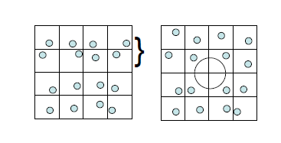
Characteristics of good sampling
Samples are uniformly distributed
Reduces clumping and gaps

Slide 7
Characteristics of good sampling
Some distance is maintained between samples points
Do not maintain constant distance in X and Y direction
* well distributed patterns = low-discrepancy (more evenly distributed)

Slide 8
Grid
Divide each pixel into an N x N grid and place one sample in the center of each cell
Combine color of each cell into one
Easy to implement and produces higher image quality
More computational intensive and aliasing can still occur if too few samples are taken

Slide 9
Grid Problem

Slide 10
Rotated Grid
Grid with rotated sample pattern (45 degrees)
Why is it better?
Avoids samples aligning on the horizontal or vertical axis
Improves antialiasing
Preserves image quality with a lower number of samples
Results in reduced run time
However, aliasing can still occur

Slide 11
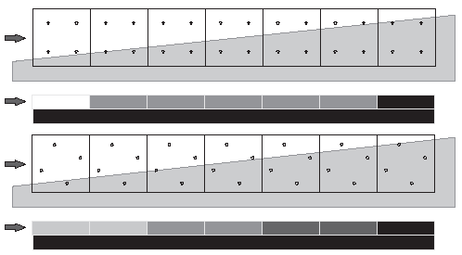
Grid vs Rotated Grid

Slide 12
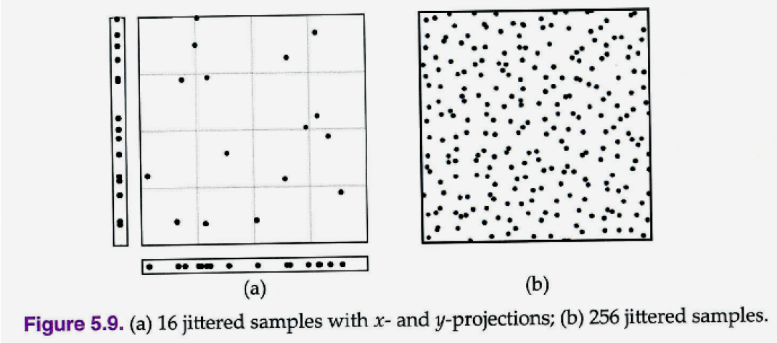
Jittered
Choose a number of samples that is a perfect square, call this n².
Divide each pixel into an n x n grid.
Randomly place a single sample within each cell of this grid.
Each pixel is said to be stratified, and the domain is the n x n grid.
Each cell is called a stratum, where strata are independent , but together cover the entire domain (i.e. no gaps or overlaps).

Slide 13
N-Rook
Developed by Shirley in 1991
Achieves more uniform distributions in the 1D projections
One sample is taken in each row and each column.
To make an N-rooks pattern
begin by placing samples along the main diagonal of the grid
then randomly shuffle the columns.

Slide 14
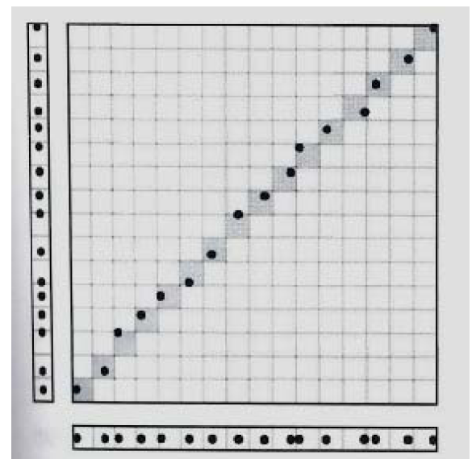
STEP 1
Randomly place one sample in each cell along the main diagonal of the grid
// generate samples
for (int p = 0; p < mImageSpec.NumSamplesPerPixel; p++)
{
for (int j = 0; j < mImageSpec.NumSamplesPerPixel; j++)
{
Vector2 pv = new Vector2();
pv.X = (j + (float)mRand.NextDouble()) / mImageSpec.NumSamplesPerPixel;
pv.Y = (j + (float)mRand.NextDouble()) / mImageSpec.NumSamplesPerPixel;
int index = (p * mImageSpec.NumSamplesPerPixel) + j ;
samples[index] = pv;
}
}

Slide 15
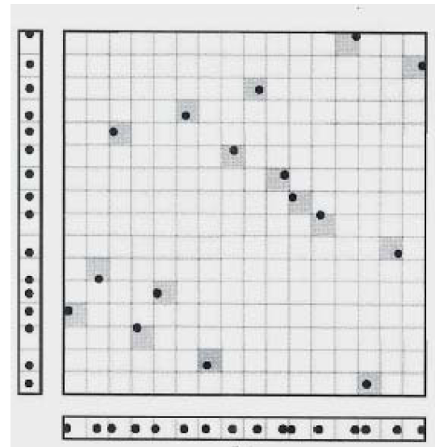
STEP 2
Randomly shuffle the x and y coordinates while maintaining the n-rooks condition
//shuffle X
for (int p = 0; p < mImageSpec.NumSamplesPerPixel; p++)
{
for (int i = 0; i < mImageSpec.NumSamplesPerPixel; i++)
{
int target = mRand.Next() % mImageSpec.NumSamplesPerPixel + p * mImageSpec.NumSamplesPerPixel;
float temp = samples[i + p * mImageSpec.NumSamplesPerPixel].X;
samples[i + p * mImageSpec.NumSamplesPerPixel].X = samples[target].X;
samples[target].X = temp;
nrook.X = temp;
}
}

Slide 16
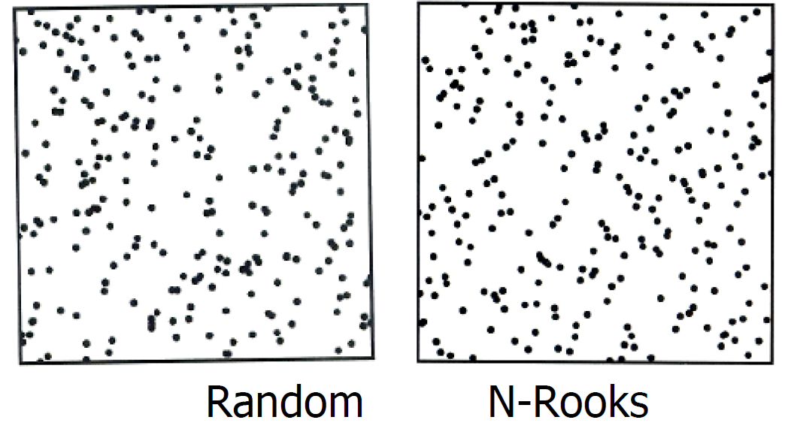
NRook Problem
Problem: We fixed the 1D projections, but ruined the 2D distribution! It is no better than that of random sampling

Slide 17
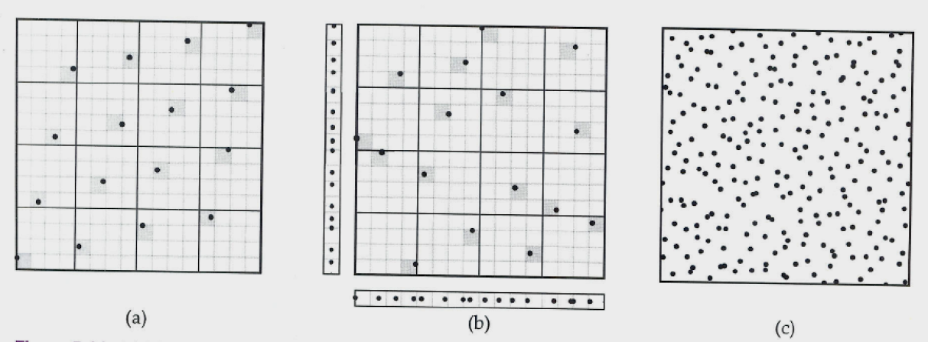
Multi-Jittered
Developed by Chui et al. in 1994.
Fix 2D distribution of n-Rooks sampling by combining n-Rooks and Jittered sampling.
Uses a two-level grid
We have n samples, where n is a perfect square.
The subgrid is n x n.
The upper level grid is √n x √n,

Slide 18
Adaptive Supersampling
Common method for reducing aliases:
Take more samples over each pixel
Ex: 16 samples per pixel to generate high quality renderings.
Combine the resulting colors using a proper filter.
Problem: High sampling rate is too heavy.
The better approach is to optimize rendering computation by adaptively firing rays only where necessary.
Image Space technique
Object Space technique

Slide 19
Image Space vs Object Space
Image Space
Subdivide problematic pixels into 4 subpixels.
Compare color of each subpixel against each other using a threshold.
If the 4 values do not differ from each other by too much, their average is used for the pixel.
Object Space
Surrounding each small object with a bounding sphere sufficiently large so that if the object projection intersects a pixel.
When one of the 4 rays intersect the sphere, the pixel is subdivided as before.

Slide 20
Image Space: Basic Idea
Find a troublesome pixel
Subdivide the pixel into 4 subpixels
Check for disparity among the 4 subpixel.
Repeat this process until a preset max limit is reached.
Final color: sum and then average.

Slide 21
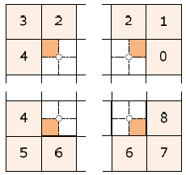
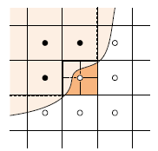
Implementation Plan
Look for jaggies along the boundary
Sample the pixel by subdivide the pixel into 4 subpixels and compare their color.

Slide 22
High Level Algorithm
For each pixel
Subdivide it into 4 sub-pixels.
Check each sub-pixel against each other with a threshold value.
If sub-pixel disparity then subdivide it more.
Repeat this process for all problematic pixel.
Recursive

Slide 23
Super-Sampling Methods Analysis
Generate Metrics to:
Compare Run Time
Compare Image Quality
Number of samples per pixel
With and without filters
Jagged Edges
Compare Level of implementation complexity

Slide 24
References
Ray Tracing from the Ground Up
Kevin Suffern
Selective and Adaptive Supersampling for Real-Time Ray Tracing
Ray Tracing With Adaptive Supersampling in Object Space
http://www.cs.uaf.edu/~genetti/Research/Papers/GI93/GI.html
Study of Supersampling Methods for Computer Graphics Hardware Antialiasing - Michael E. Goss and Kevin Wu
http://citeseerx.ist.psu.edu/viewdoc/download?doi=10.1.1.88.5741&rep=rep1&type=pdf
A Family of Inexpensive Sampling Schemes – Jon Hasselgren, Tomas Akenine Moller, Samuli Laine
http://citeseerx.ist.psu.edu/viewdoc/summary?doi=10.1.1.106.3161
Super-sampling Anti-aliasing Analyzed
http://www.x86-secret.com/articles/divers/v5-6000/datasheets/FSAA.pdf

Slide 25
Any Questions?

