Slide 1
Ray Tracing - Analysis of Super-Sampling Methods
Duy & Piotr

Slide 2
The Problem
How to reconstruct a high quality image with
the least amount of samples per pixel
the least amount of resources
And preserving the image quality
without introduction of artifacts such as jagged edges, Moire patterns, etc..

Slide 3
Super-sampling methods
Grid
Rotated-Grid
Jittered
Shirley/N-Rook
Multi-Jittered
Adaptive
Poisson Disc
Hammersley
Monte Carlo
Random (for comparison)

Slide 4
Multi-pixel Filtering
Uses neighboring pixels to determine a better color for pixels after sampling the image.
The goal is to smooth out edges without much additional computational intensity.
Filters:
Box
Gaussian
Mitchell
Lanczos

Slide 5
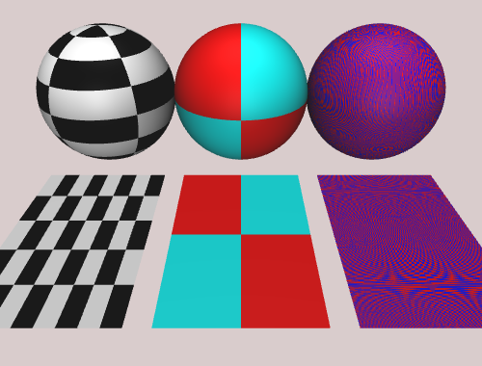
2 Samples - Multi-Threaded
Grid with 4 samples – 2.756

Slide 6

Rotated Grid with 4 samples – 2.674 seconds

Slide 7

Jitter with 4 samples – 2.583 seconds

Slide 8

Random with 2 samples – 2.631

Slide 9

Random with 4 samples - 3.001 seconds

Slide 10

NRooks with 4 samples – 2.660 seconds

Slide 11

Multi-Jitter with 8 pixels – 9.263

Slide 12
Metrics
Single Thread
Sample | Random | Grid | Jittered | RG | Multi-Jettered | Nrooks
Box Filter
2 | 5.112 | 7.436 | 7.253 | 7.413 | 22.093 | 7.368
3 | 6.197 | 13.069 | 13.377 | 13.377 | 98.456 | 13.391
4 | 7.36 | 21.416 | 21.603 | 21.452 | 296.823 | 21.449
Guassian
2 | 4.65 | 7.017 | 7.452 | 7.32 | 24.299 | 7.22
3 | 5.834 | 14.184 | 14.354 | 14.283 | 115.238 | 14.563
Multi-Thread (no filtrer)
Sample | Random | Grid | Jittered | RG | Multi-Jettered | Nrooks
2 | 2.631 | 2.756 | 2.583 | 2.675 | 9.263 | 2.66
3 | 2.422 | 5.29 | 9.311 | 5.142 | 42.984 | 5.272
9 | 5.564

