Slide 1
RAY TRACING WITH DISPERSION
CSS552 – Topics in Rendering
Winter 2011
Final Project by:
Kohei Ueda
Shivani Srikanteshwara
Mary Ann Chiramattel Kunjachan

Slide 2
What we will present today …
Introduction to dispersion
Applications of dispersion
Our objective
IOR – Snell’s law
Photon Mapping
Illustrate our solution using dispersion on photon map buffer
Conclusion and future work

Slide 3
Introduction : Dispersion
When a beam of white light enters a transparent object from air, its components of various wavelengths are refracted into different directions.
The transmitted lights form a colored strip. This phenomenon is called light dispersion.

Slide 4
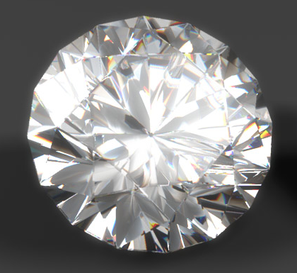
Applications
Dispersion examples :
  Rainbows,
  Fire (Dispersive colors) observed in a diamond.
  Light Dispersion is caused by the dependence of refractive indices on wavelength.
Rendered in 3D Studio MAX using the prototype ”Ghost” Ray Tracer.
The setting :
Resolution : 800 x 480
Sampling : Min 1, Max 2
0 Reflections, 8 Refractions

Slide 5
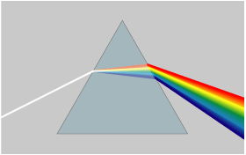
Applications
A well-known demonstration of light dispersion is a beam of white light passing through a prism.
In a prism, material dispersion causes different colors to refract at different angles, splitting light into a rainbow.

Slide 6
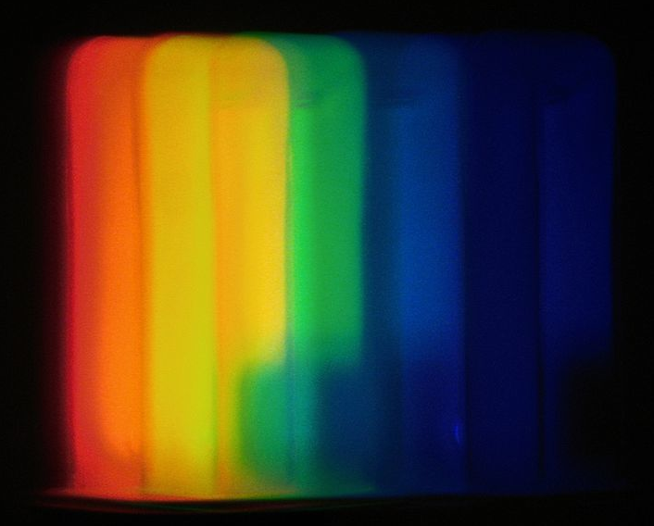
The result we are expecting
The range of color obtained after dispersion.
Our objective is to render dispersion of a white light when passed through a transparent material, it should closely match the photographs of their real-world counterparts.
A compact fluorescent lamp seen through an Amici prism

Slide 7
Why this is interesting :
Introduction to a new Technique : Photon Mapping.
Explore more about refraction and the dispersion effect on a white light when passed through a transparent material.

Slide 8
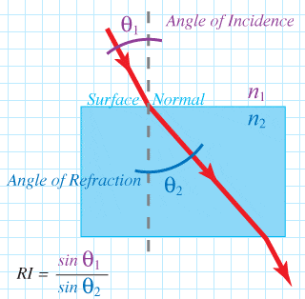
Index of Refraction
Refraction is the bending of a light wave when it enters a medium where it's speed is different. The refraction of light when it passes from a fast medium to a slow medium bends the light ray toward the normal to the boundary between the two media. The amount of bending depends on the indices of refraction of the two media and is described quantitatively by Snell's Law.
Snell's Law relates the indices of refraction n of the two media to the directions of propagation in terms of the angles to the normal.
Reference: Wikipedia

Slide 9
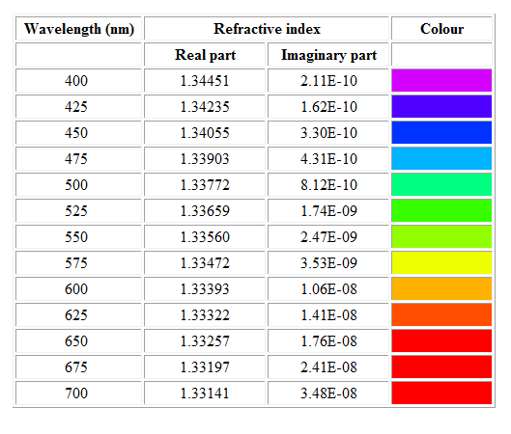
The following table shows numerical values for the refractive index as a function of wavelength in the visible part of the spectrum, together with the approximate
Reference: http://graphics.ucsd.edu/~henrik/papers/photon_map/global_illumination_using_photon_maps_egwr96.pdf

Slide 10
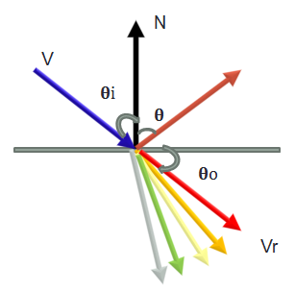
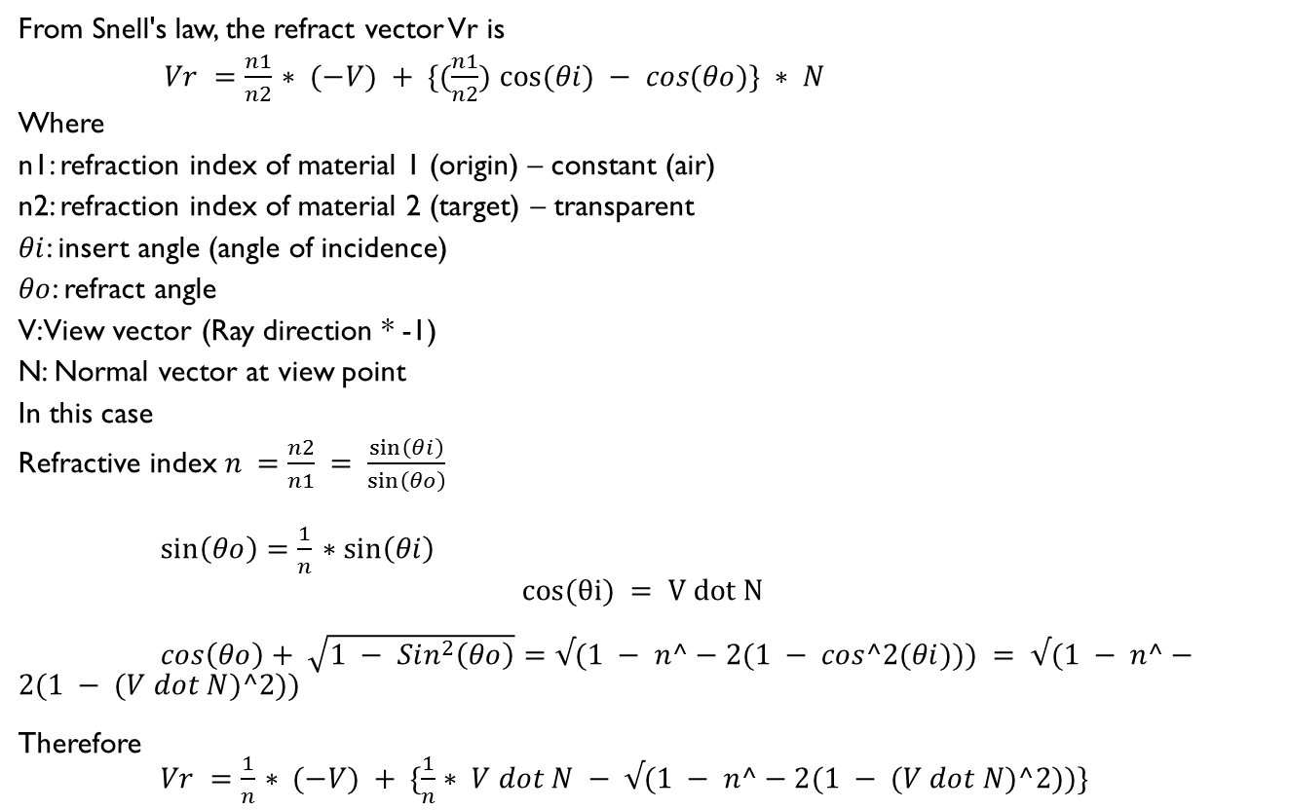
Calculating the monochromatic ray direction from Snell’s law
From Snell's law, the refract vector Vr is
$Vr =\frac{n1}{n2}$ $∗ (−V) + \{(\frac{n1}{n2})$ $cos(θi) − cos(θo)\} ∗ N$
Where
n1: refraction index of material 1 (origin) – constant (air)
n2: refraction index of material 2 (target) – transparent
$θi$: insert angle (angle of incidence)
$θo$: refract angle
V: View vector (Ray direction * -1)
N: Normal vector at view point
In this case
Refractive index$n =\frac{n2}{n1}$ $= \frac{\sin\left(θi\right)}{\sin\left(θo\right)}$
$\sin\left(θo\right)=\frac{1}{n}$ $∗\sin\left(θi\right)$
$$cos(θi) = V dot N$$
$cos\left(θo\right)+ \sqrt{1 − Sin^{2}\left(θo\right)}=√(1 − n^−2(1 − cos^2(θi))) = √(1 − n^−2(1 − (V dot N)^2))$
Therefore
$Vr =\frac{1}{n}$ $∗ (−V) + \{\frac{1}{n}∗ V dot N − √(1 − n^−2(1 − (V dot N)^2))\}$
n1
n2

Slide 11
Photon Mapping
Two-pass algorithm developed by Henrik Wann Jensen to solve rendering equations.
Used to simulate interaction of light with different objects – refraction of light through water, glass, etc. and can be extended to study spectral rendering.
Rays from the light source and rays from the camera are traced independently until some termination criterion is met, then they are connected in a second step to produce a radiance value.

Slide 12
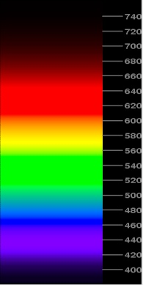
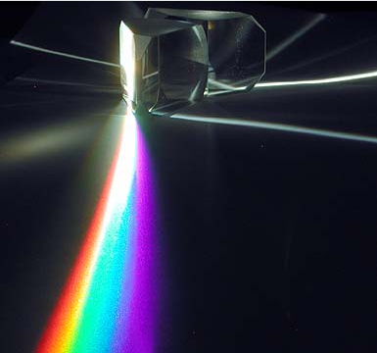
Photon Mapping effects
Spectral rendering is where a scene's light transport is modeled with real wavelengths to model the RGB components.
Reference: ompf.org

Slide 13
Our Solution
Two phase tracing
  Light Ray-tracing
    Photon Map Buffer
      For each object, aggregating color from all the light source
  Regular Ray-tracing without Phong illumination
    The color will be obtained by the Photon map buffer

Slide 14
Photon Map Buffer
Photon Map Buffer
Light-ray intersection with objects
Accumulate into buffer 2-D array
The color will be calculated from all the light sources
The final image will be created on the view plane

Slide 15
Dispersion on Photon Map
Material
Index of Refraction
  For each wavelength (color)
Original Light
(White)
θi
New Light Source
Origin (position)
Direction
Color
θo

Slide 16
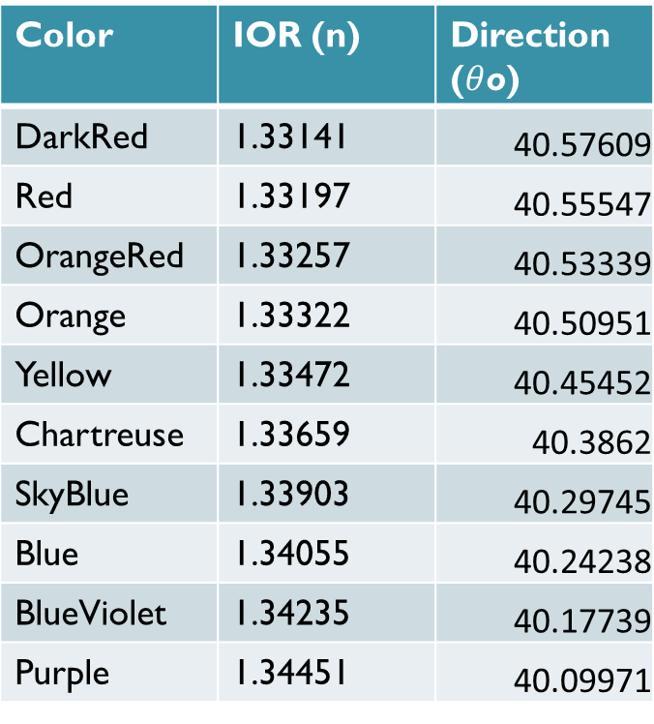
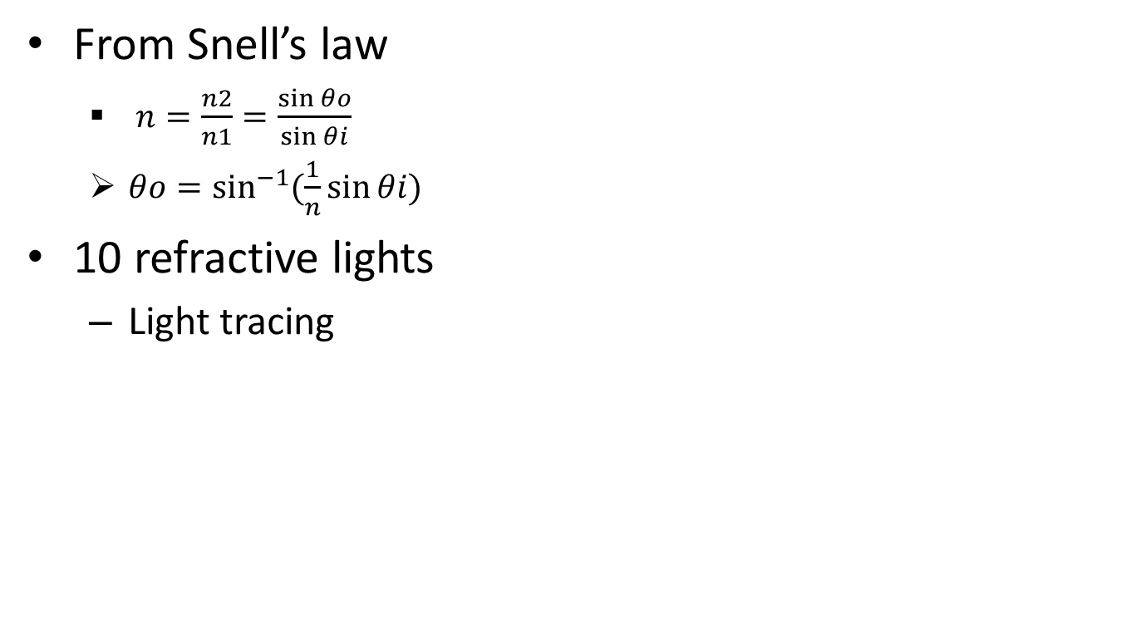

How do we get refractive lights
Color | IOR (n) | Direction ($θ$o)
DarkRed | 1.33141 | 40.57609
Red | 1.33197 | 40.55547
OrangeRed | 1.33257 | 40.53339
Orange | 1.33322 | 40.50951
Yellow | 1.33472 | 40.45452
Chartreuse | 1.33659 | 40.3862
SkyBlue | 1.33903 | 40.29745
Blue | 1.34055 | 40.24238
BlueViolet | 1.34235 | 40.17739
Purple | 1.34451 | 40.09971
From Snell’s law
  $n=\frac{n2}{n1}=\frac{\sin{θo}}{\sin{θi}}$
  $θo=\sin^{−1}{(\frac{1}{n}\sin{θi)}}$
10 refractive lights
  Light tracing
Insertion angle $θ$i = 60 degree

Slide 17
How we illuminate the dispersion
Calculate all the intersection for the light and objects which emits indirect lights

Slide 18
The Scene and what we’ll see
Light
Refractive object
Eye
Rectangle
(screen for rainbow)

Slide 19
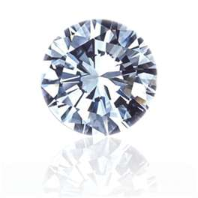
Conclusion
What we do in this project
  Ray-trace for dispersion
    Light ray-tracing (photon mapping)
Future goal
  Application to Diamond simulation ☺
    Diamond cut and illumination

Slide 20
References
[1] Rendering Light Dispersion with composite spectral model -
  http://www.cs.sfu.ca/~mark/ftp/Cgip00/dispersion_CGIP00.pdf
[2] New Techniques for Ray Tracing procedurally defined objects http://delivery.acm.org.offcampus.lib.washington.edu/10.1145/810000/801137/p91-kajiya.pdf?key1=801137&key2=5926866921&coll=DL&dl=ACM&CFID=8580776&CFTOKEN=21577878
[3] Dispersion effects on the ray tracing and reflectivity in a hybrid nematic cell under an electric field http://rmf.fciencias.unam.mx/pdf/rmf-s/52/5/52_5_041.pdf
[4] An Experiment in Simulating Dispersive Refraction in Computer Graphics http://www.mentis.ca/design/graphics/dispersion/
[5] Diamond Appearance: The Components of a Computer Model -
  http://www.gia.edu/research-resources/cut-microsite-pdfs/diamond-appearance-computer-model.pdf
[6] Diamond Design - http://www.folds.net/diamond_design/
[7] Global Illumination using photon maps - http://graphics.ucsd.edu/~henrik/papers/photon_map/
  http://graphics.ucsd.edu/~henrik/papers/photon_map/global_illumination_using_photon_maps_egwr96.pdf

Slide 21
Q & A

Slide 22
Thank You ☺

