Slide 1
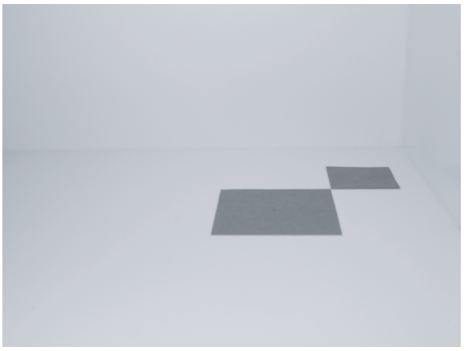
A Photograph of two papers
The Model: 2 papers
  8cm x 8cm and 5cm x 5cm
The Camera
  Simple pinhole
  No focusing capability
The Scene
  Arrangements model
  and camera
  Light sources (later)

Slide 2
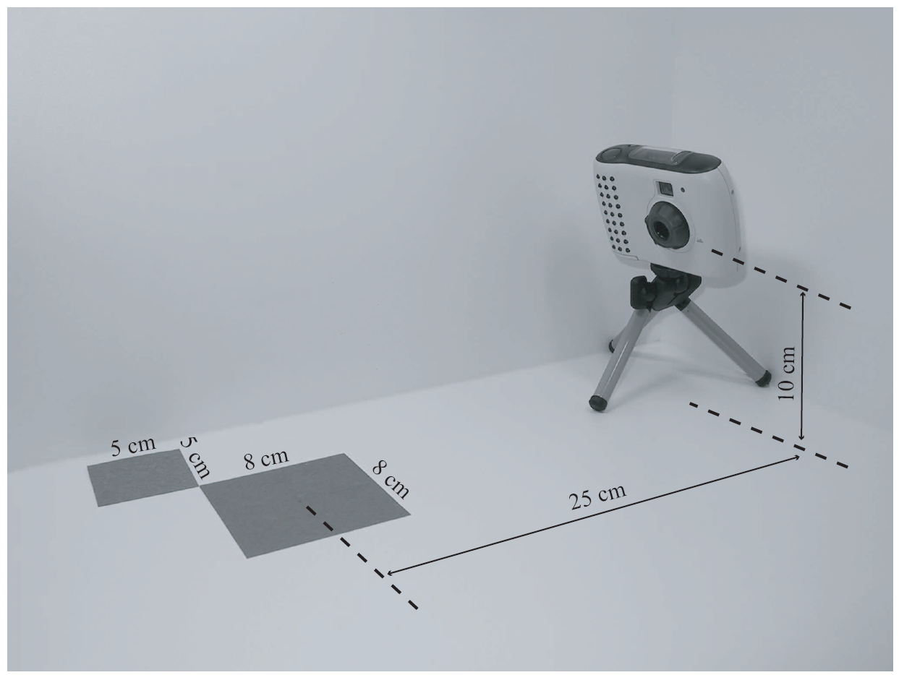
The Arrangements

Slide 3
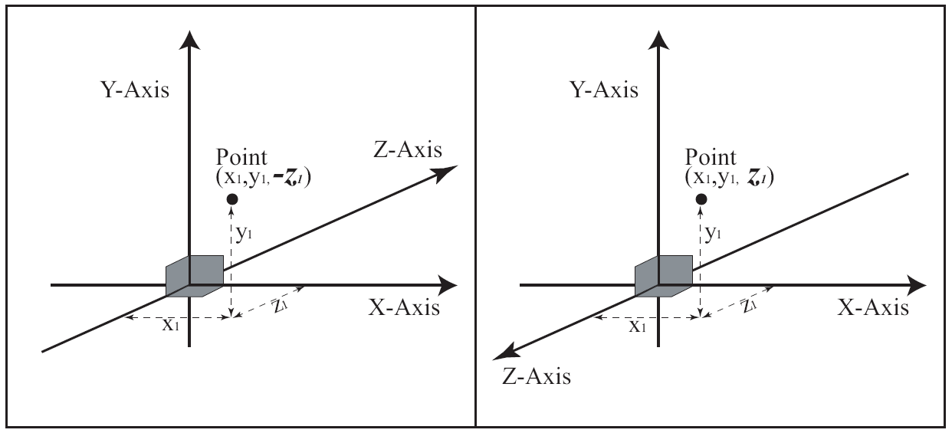
3D Coordinate Systems
Two options for Z-axis direction!
  Same position, different sign for z-value!!

Slide 4
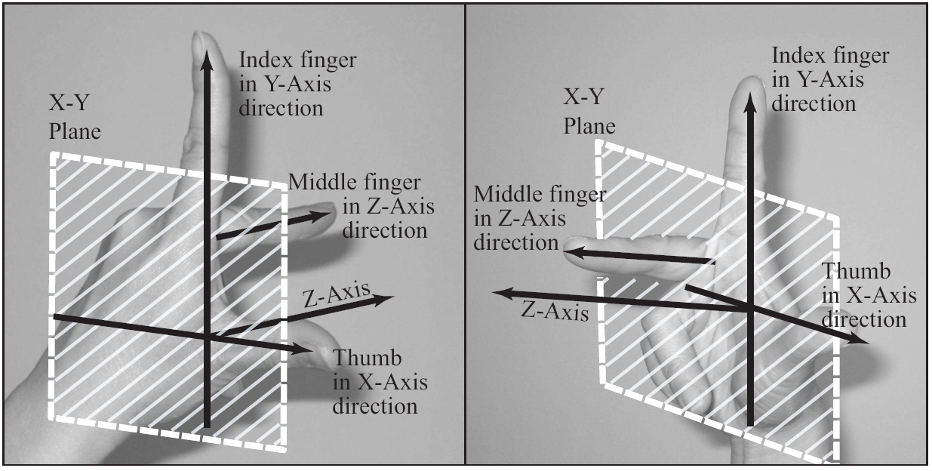
Left vs. Right Handed Systems
Right-Handed System EXCLUSIVELY!!

Slide 5
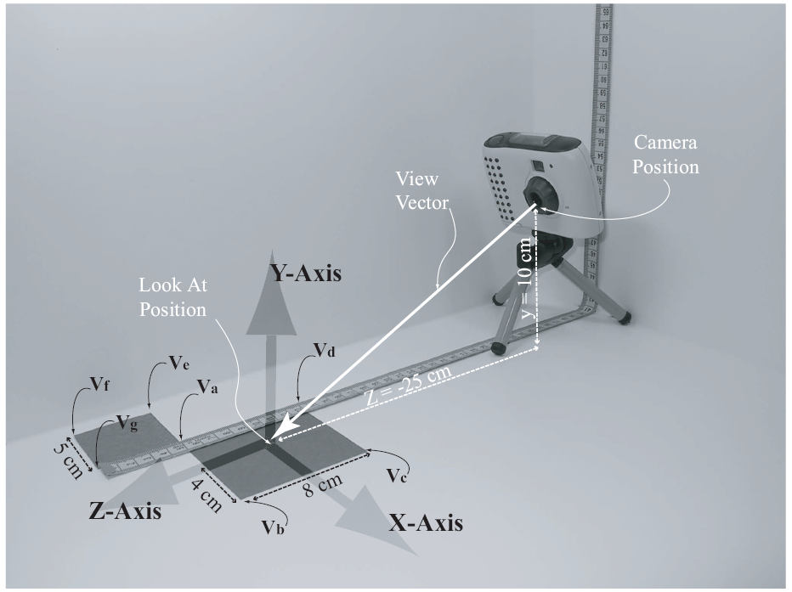
The Model and the Scene
Right-Handed Coordinate System
Convenience
  Origin
  Center of 8x8
  Units
  in cm

Slide 6
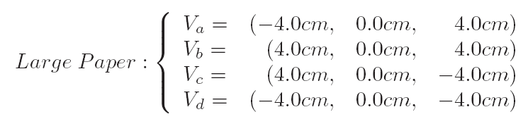
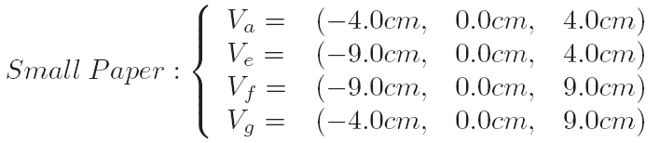
Details …

Slide 7
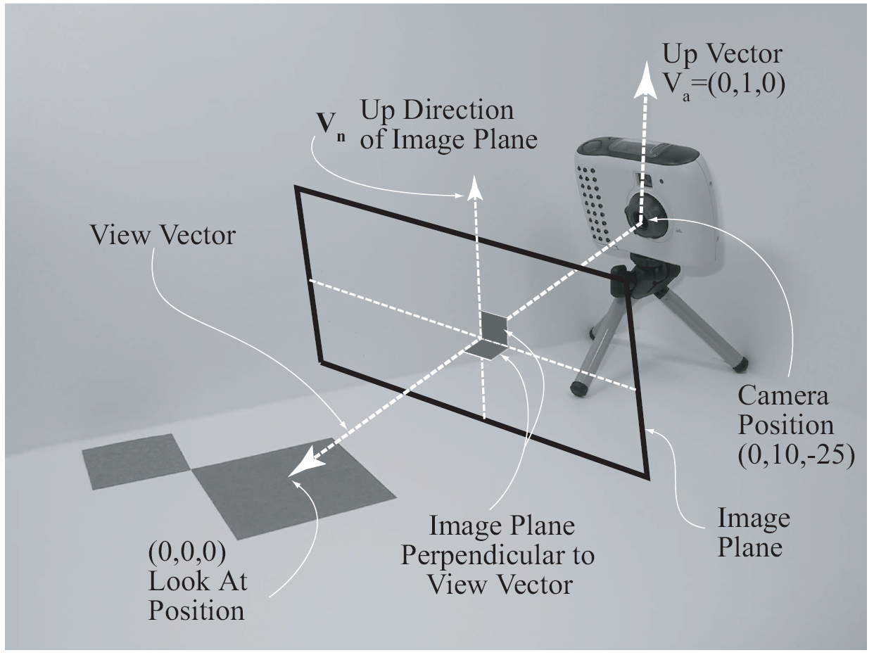
A Computer Graphics Camera
Camera position
Look at position
Up direction
Related terms:
  Image Plane
  Viewing Direction
  View Vector
Maya scene

Slide 8
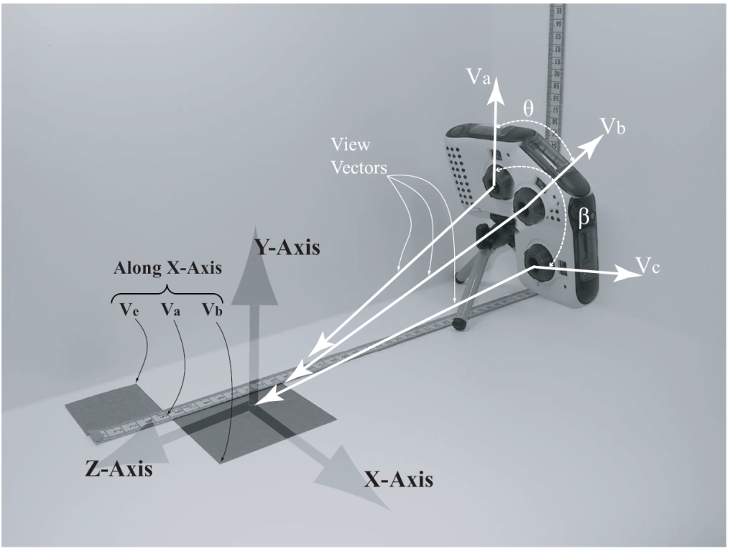
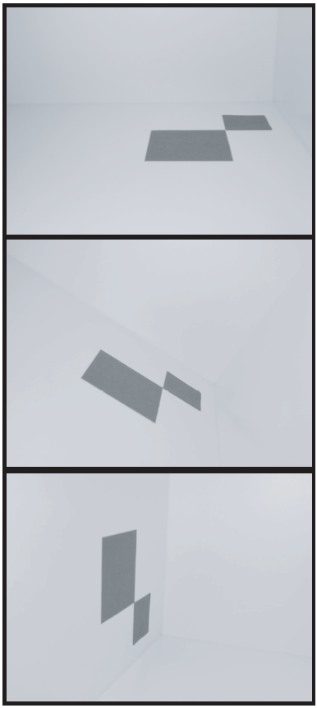
The Up Direction (Up Vector):
Also referred to as: Twist Angle
  Cannot be parallel to viewing direction
  Does not need to be normalized
  Does not need to be perpendicular to
  viewing direction

Slide 9
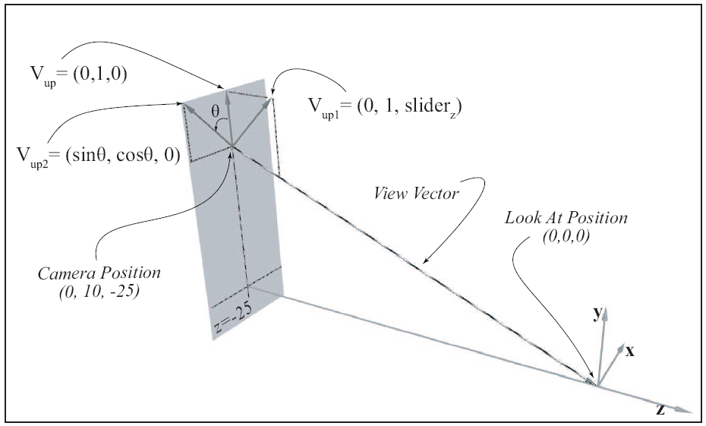


Controlling the Up Vector
z=slider:
Twist angle:
not
perpendicular
to View Vector!

Slide 10
The Visible Volume
Only geometries (primitives) inside the volume are visible
All geometries (primitives) outside are ignored
Primitives straddle the volume are Clipped!

Slide 11
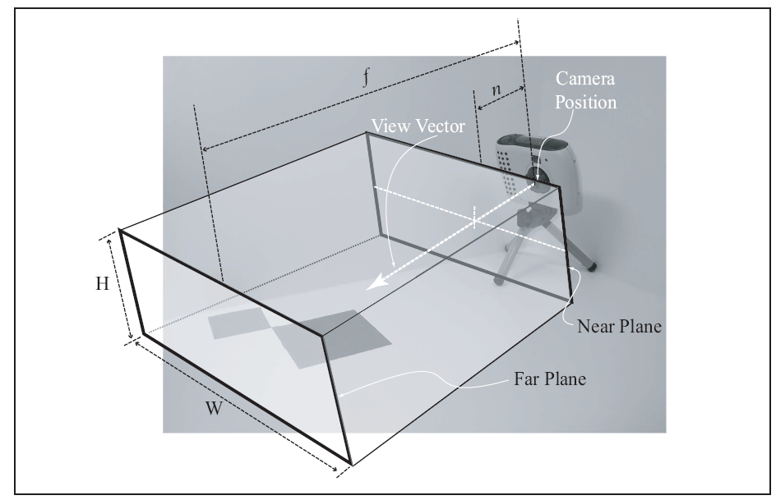


The Rectangular Visible Volume
Volume defined by:
  Near Plane (n)
  Far Plane (f)
  Width (W)
  Height (H)
For Orthographic Projection

Slide 12
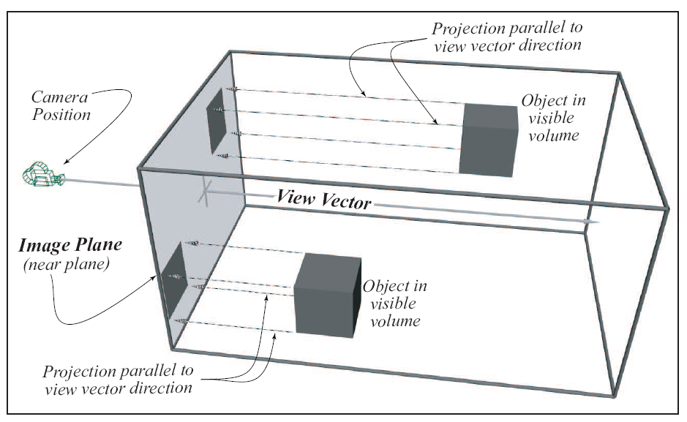
Orthographic Projection
Maya Scene

Slide 13
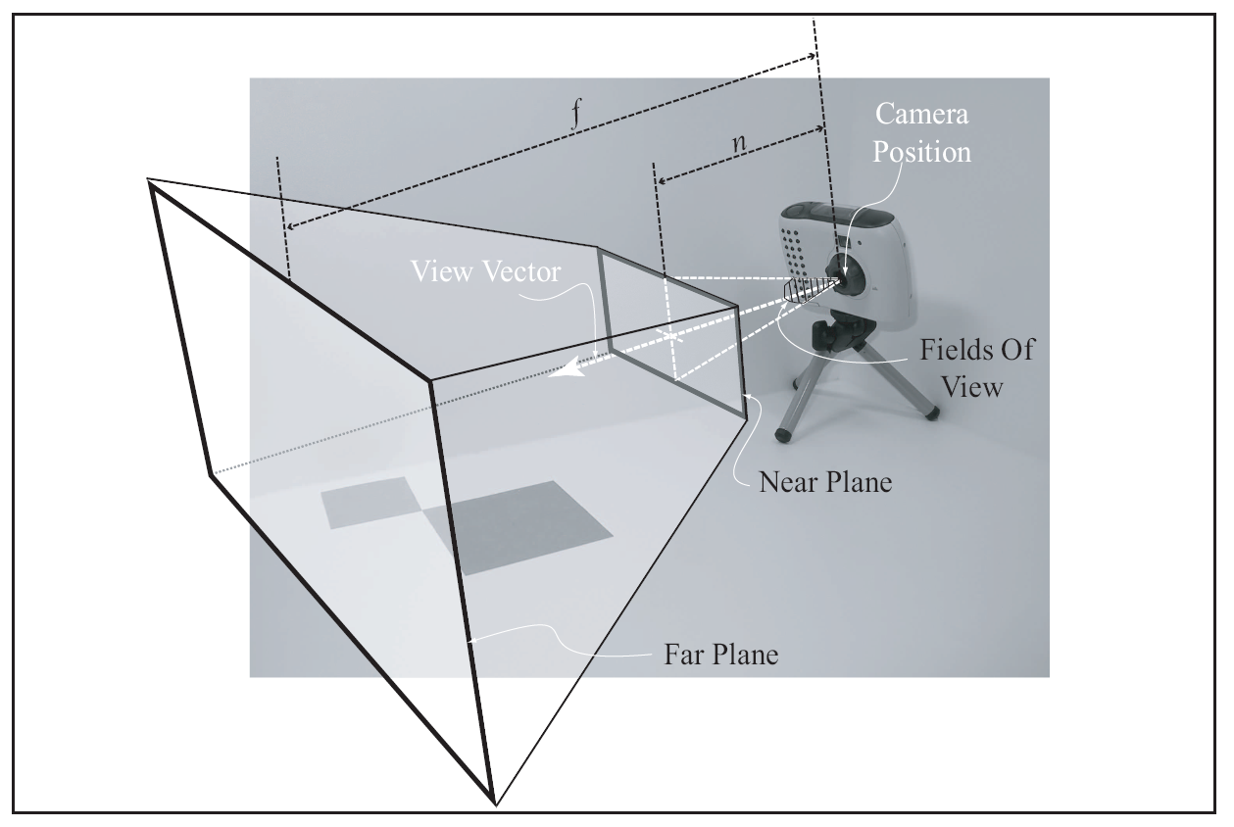
The Viewing Frustum Volume
Volume defined by:
  Near Plane (n)
  Far Plane (f)
  Fields of view (fov)
For Perspective Projection

Slide 14
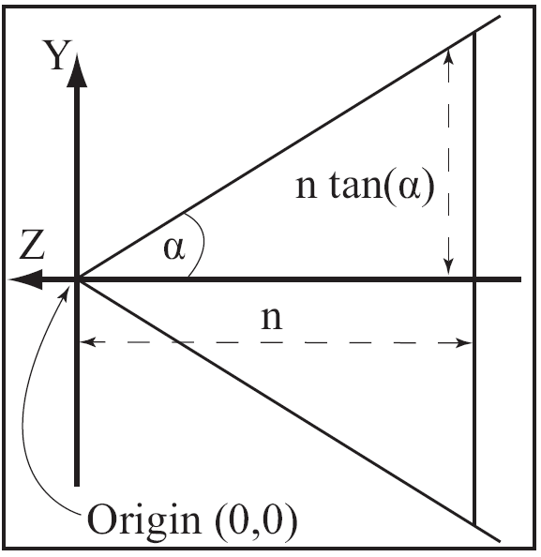



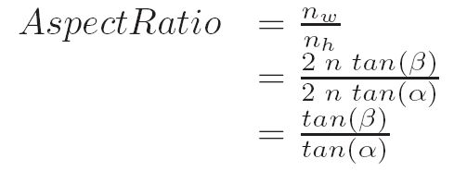
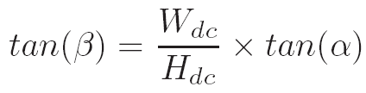

Near Plane and Aspect Ratio
Aspect Ratio
Near Plane
  Height (n_{h})
  Width (n_{w})

Slide 15
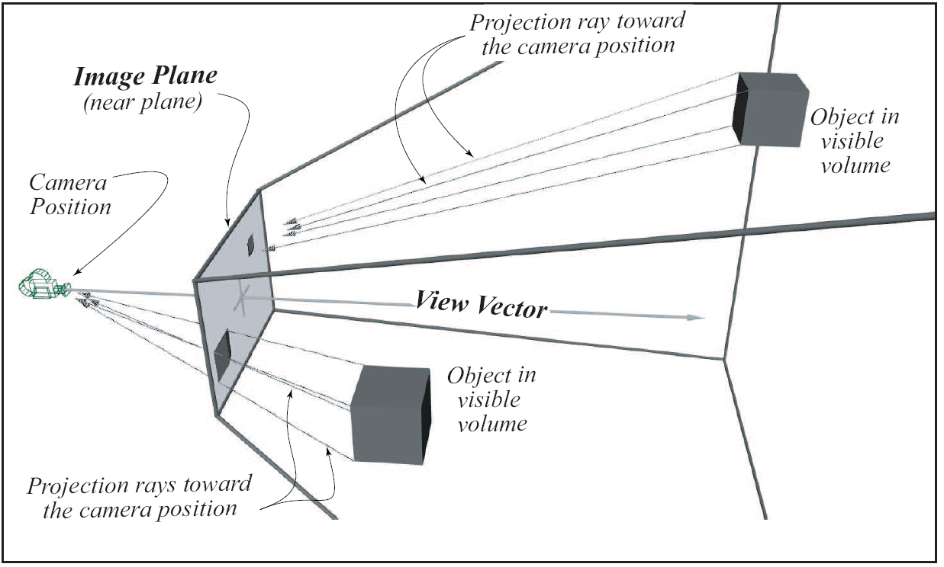
Perspective Projection

Slide 16
Orthographic vs Perspective Projection
Orthographic Projection
  Parallel projection
  Preserve size
    Good for determining relative size
Perspective Projection
  Projection along rays
  Closer objects appears larger
  Human vision!
Only work with: Perspective Projection

