Slide 1
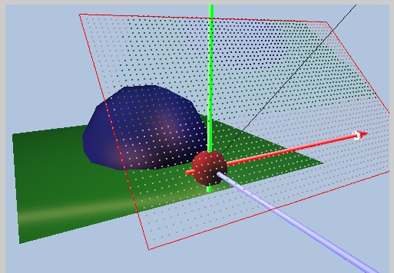
Sampling
Image Plane
Color of one pixel
Areas represented
by the pixel
Pixel is an area!!
  Square, Rectangular, or Circular?
How do we approximate the area?
  Why bother?

Slide 2


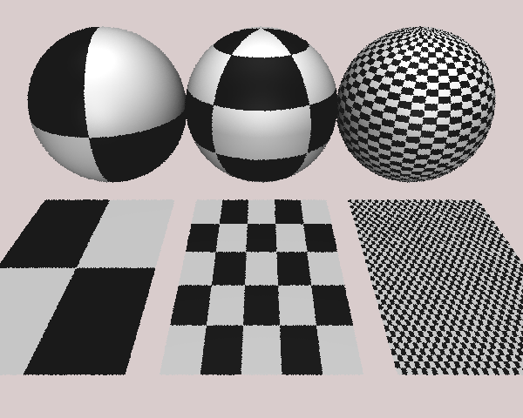
Alaising
Geometric Alias
Texture/Shading Alias

Slide 3


Shadow Alaising

Slide 4
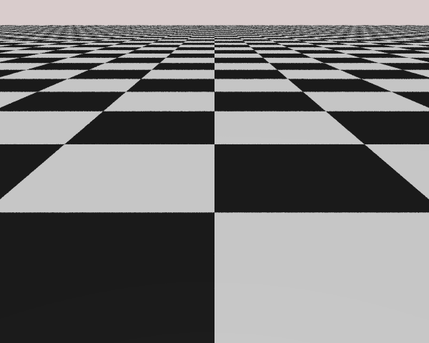
More Subtle Alaising
Should NOT see pattern!!
  Maya Scene

Slide 5
Aliasing in Time!
Wagon Wheel Effect!?
  Stroboscopic effect ☺
      http://www.youtube.com/watch?v=jHS9JGkEOmA
    Or
      http://www.youtube.com/watch?v=rVSh-au_9aM
Period=8 Unit
Period=7 Unit

Slide 6
Time/Space Analogy
Color “changes” rapidly over space
One pixel must capture many
black←→white transitions!
One frame must capture much
movement over time
Color “changes”
slowly over space
Many pixels to describe simple (no) transition
In time, object moves very slowly, many frames to capture movement
Observation: Aliasing results when …
  Changes too fast for the sampling rates!

Slide 7
How to measure: rate of change?
One line of color
Rate of Change:
  Frequency!
Frequency of images
  How to measure?
Goal:
  Appreciation for
  Nyquist frequency
Intensity of the line

Slide 8

A little math …
Approach:
  Find mathematic representation for this simple case
  Study to understand the characteristic
  Generalize to discuss aliasing we observed
Assume width of 4 (T=4)
Let’s say repeats every width of 20 (W = 2*$π$/10)

Slide 9
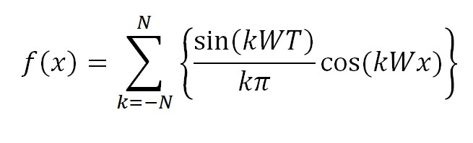
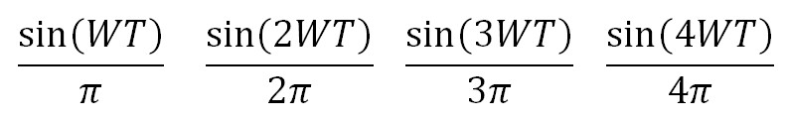


Exercise
T=4
20 (W = 2*$π$/20)
Plot:
Independent of x (pixel position)
A series of constants according to k
Cosine function in x (pixel position)
Adding a series cosine functions

Slide 10
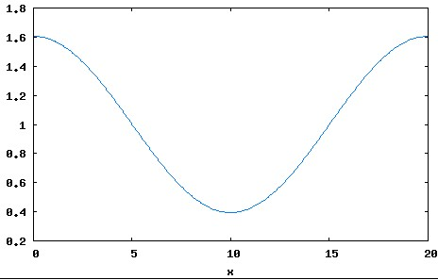
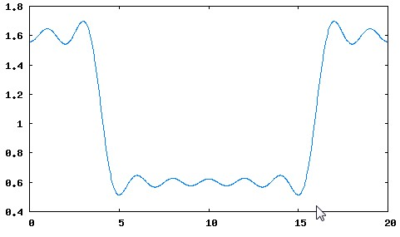
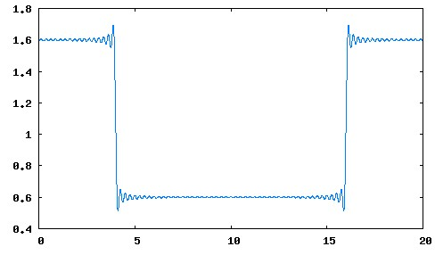
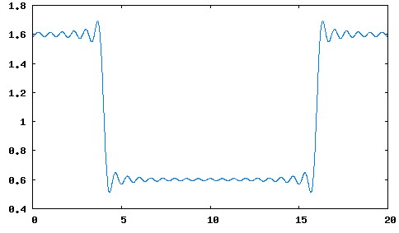

Plotting …
N = 1
T=4
20 (W = 2*$π$/20)
N = 10
N = 80
N = 20

Slide 11
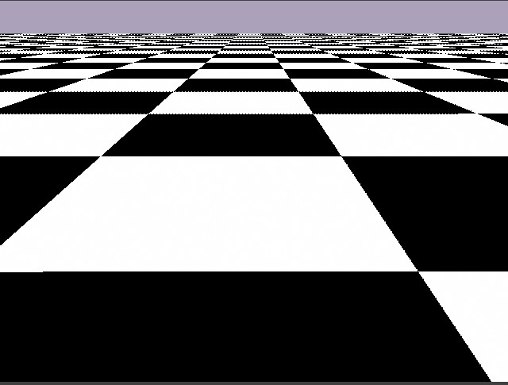
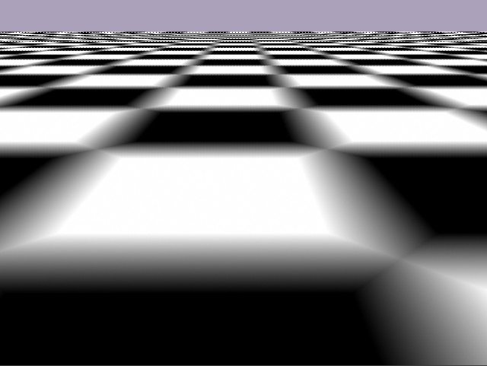
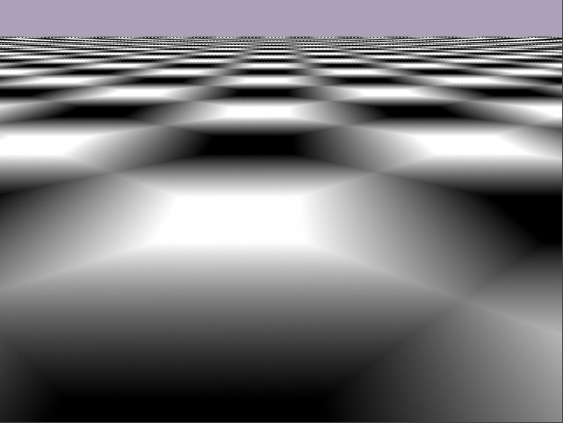
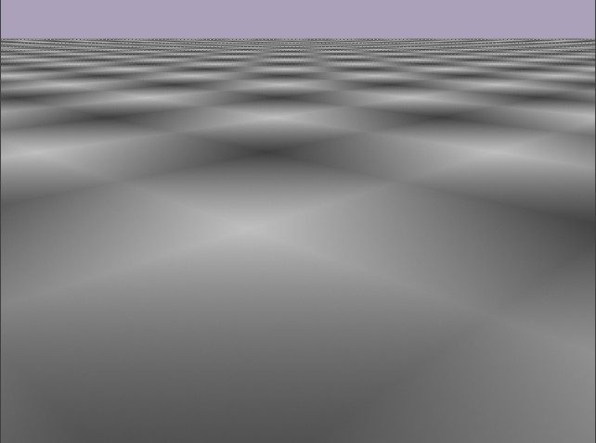
USE MAYA Renderer
N = 80
Checker:
filter=0
Offset=0
Checker:
filter=0
Offset=0.073
N = 20
N = 10
Checker:
filter=0
Offset=0.154
Checker:
filter=0
Offset=0.5
N = 1

Slide 12
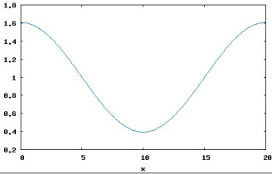
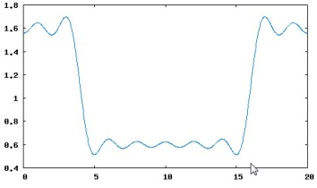
Observation
When N is small
  For each x value:
  needs small number of terms
  Smooth transitions
When N gets large:
  For each x value:
  needs large number of terms
  Sharper transitions
N controls frequency of the cosine curves:
  shape transitions: high frequency

Slide 13
What have we done?
Took an extremely simple part of an image:
  Show how to represent with math
Analyzed the math expression
  Define: high vs. low frequency
What we did not do:
  Show: any given image (function) can be expressed as a summation of sinusoidal functions
  Term: transform an image (function) to frequency domain (e.g., Fourier Transform)

Slide 14
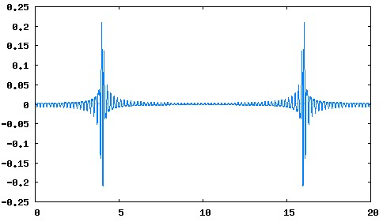
Frequency of A Signal
We have seen Square signal (function) in 1D:
Restricting N to small numbers
  corresponds to smooth the square corners
  Low pass “filtering” (only keep low frequency)
Restricting N to large numbers
  Corresponds to keep only the corners
  High pass filtering (only allow high frequency)
  E.g., only sum terms
  between 100 and 200:

Slide 15
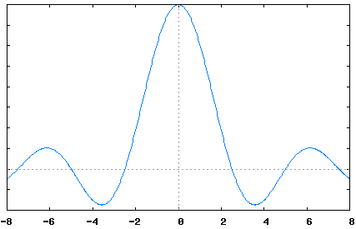
Frequency “Domain”
Plot the size of the cosine terms of functions!
E.g., the square pulse
  Can be expressed as:
Cosine functions: define how fast the signal will vary
Frequency domain is a plot of these terms against k …

Slide 16
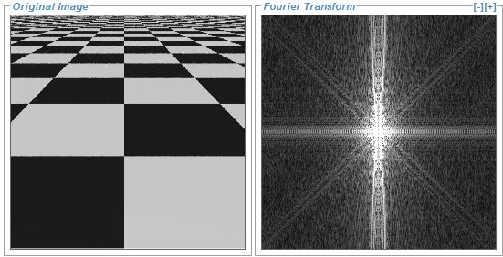
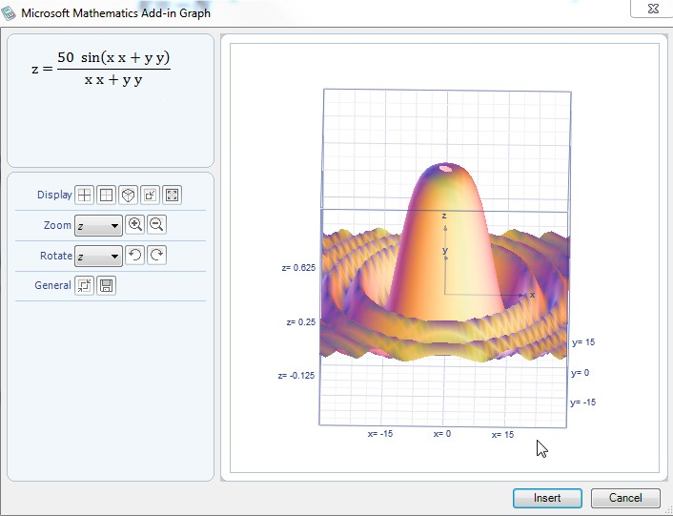
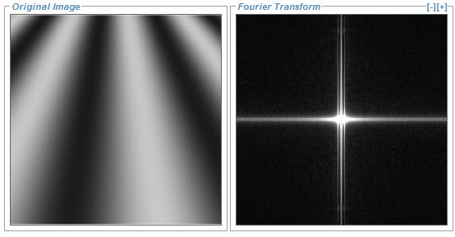
Frequency Domain: Examples
FTL-SE to try out!
Try high/low pass filtering!!
Scenes (Checker, Sine)

Slide 17

Frequency of an image
High Frequency:
  Sharp color changes
Low Frequency:
  Smooth or no change

Slide 18
Sampling Theorem
One line of color
Intensity of the line
Sample at pixel locations
Nyquist Frequency: to faithfully capture the signal
  Sample at twice the highest frequency in the signal

Slide 19
Sampling Rate
Sample locations
One scaneline
Distance between the samples:
  Small ➔ High sampling rate
  Large ➔ Low sampling rate
BAD NEWS!!
  Square signal (checker transition) has infinite frequency! (N → ∞ for

