Slide 1
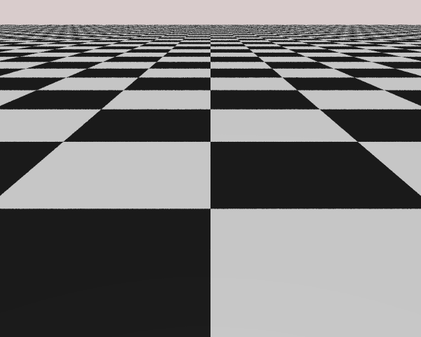
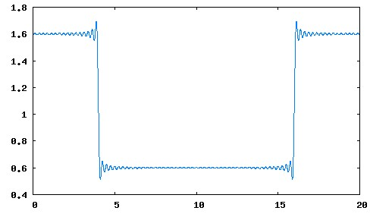
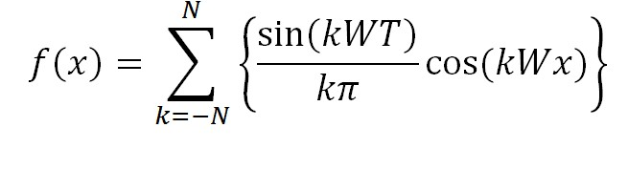
Sampling Theorem told us …
Images with checker-like transitions
Contains infinitely high frequencies (N → ∞)
To faithfully sample these signals
Sample points must be infinitely close to each other!!
N = 80

Slide 2
Reality …
Can never really sample sufficiently!!
But, these edges looks pretty good!
Looks!!
The human eye!
For now, assume we know how to compute color

Slide 3
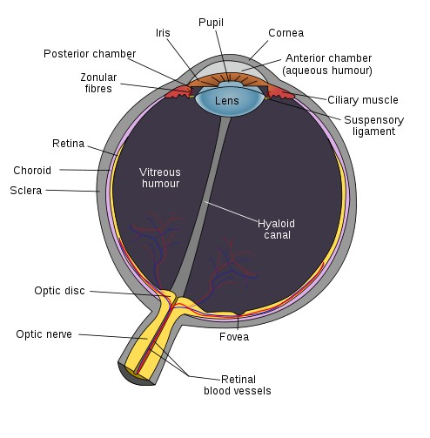
Human Eye
Some interesting facts
Rod cells:
requires only low light
b/w vision
blur, all over retina EXCEPT fovea
Cone cells:
requires bright light,
Color vision: three kinds of cone sensitive to roughly RGB wave lengths
acute, sharp image, located at the fovea
Dynamic range and adaptation
Useful fact
Lens is like a low pass filter!!
Image credit: Wikipedia: fovea
Image credit: Wikipedia (Fovea)

Slide 4
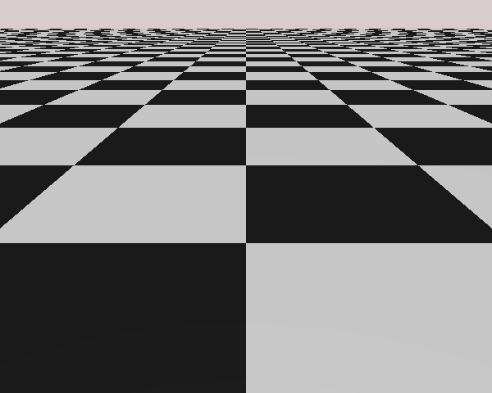
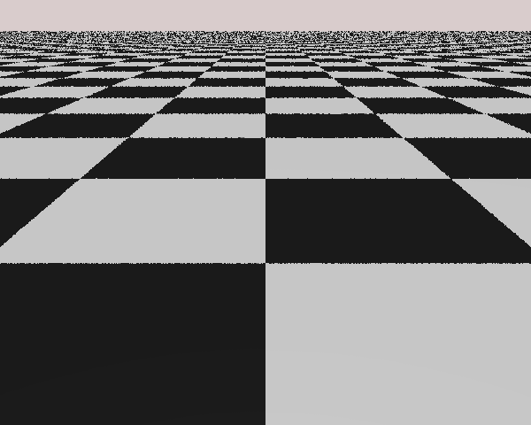
Human Eye:
Low pass filters!
Collection of pixels (at appropriate distance) looks like a continuous image
Pixel boundary (high frequency components) are “filtered” by the lens!
More sensitive to low frequency noise (error)
Less sensitive to high frequency noise (error)

Slide 5
A Closer Look
1 Sample at pixel center
Pattern is BAD!!
1 Sample at random position in pixel area
Controlled randomness is better than repeat
Randomness pushes error to higher frequency

Slide 6

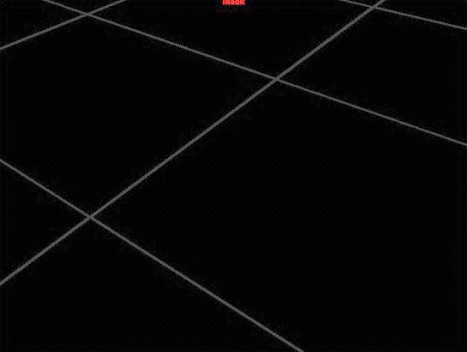
Sampling: Issues
How many samples to take
Too many: Costly
Too few: Bad Quality
Where to take the samples
Center of pixel seem important?
Why? What is important?
How to re-sample at display rate!?
This is also known as: Filtering
How to combine the samples to form the color of a single pixel?
Maya software Renderer: setAttr defaultRenderQuality.renderSample 1
Render at Highest Quality with
MinShading Samples =2 MaxShading Sample =32
Look at Mask channel

Slide 7
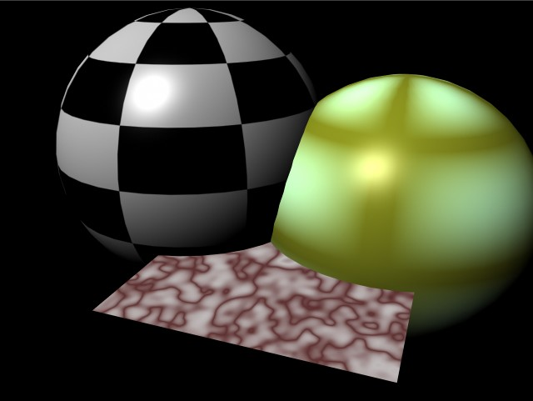
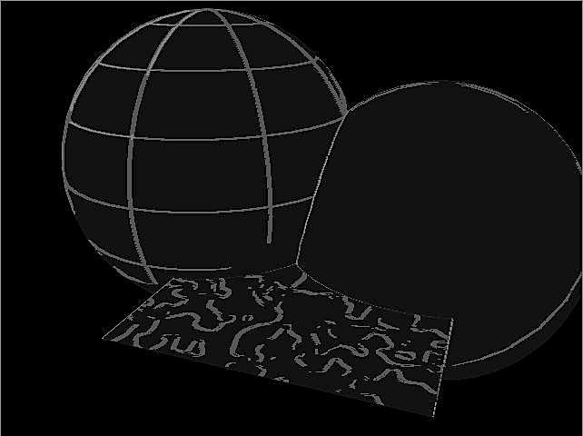
How many to take?
Fixed Rate
Simple!
Can be wasteful!
Adaptive: take more only when required
Work only when need to
Tricky to implement
No level-2
Sampling
is required!
Maya scene

Slide 8
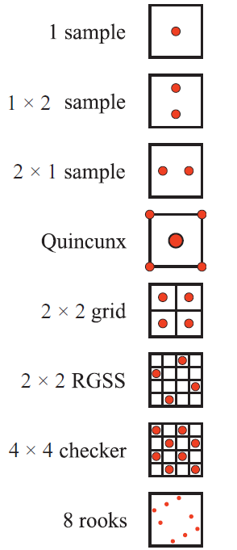
Fixed Rate Sampling
Strategies for suitable for hardware implementation
Other strategies:
Poisson Disc: eye cell distribution
Jittered
Image credit: Real Timer Rendering 3rd Ed: Fig 5-29 P. 127

Slide 9
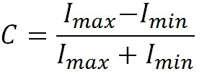
Adaptive Super Sampling
Usually 2-level (e.g., Maya Renderer)
Primary samples: compare to trigger secondary sampling
Too many levels causes complexity!
Contrast: measurement of local variation
Thresholds [Mitchell 87]
R= 0.4
G = 0.3 (easiest to trigger)
B = 0.6

Slide 10
Adaptive Super Sampling
E.g. Take 2 level-1 samples in 3x3 pixel area
Compute contrast for RGB channels separately
If any of the channel contrast > threshold
perform level-2 sampling (e.g., take 10 more samples) for all 3x3 pixels

Slide 11
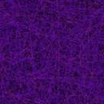
Example
3X3 Sampling Kernel
Level-1 samples
Pixels that triggered level-2 sampling
level-2 sampled pixels

Slide 12
Filtering
E.g., everyone of the 3x3 pixels contains 2 samples
How to “compute” or “re-sample” or “filter” to one pixel color?
Simplest: straight averaging!

Slide 13
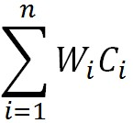
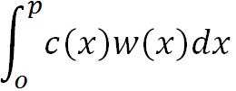

Average: Uniform weight
Pixel boundaries
Computed colors
Compute colors:
C₁ and C₂
Color = 0.5 * C₁ + 0.5 * C₂
Or
Color = W₁ * C₁ + W₂ * C₂
Or
Color = =
p
C₁
C₂
width
Weight
0.5
W(x)
0.5p
0.5p
x
Areas = 0.5!

Slide 14
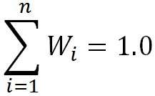
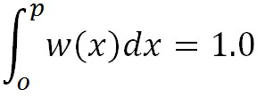
The “Weight” Function
Pixel boundaries
Computed colors
Total Weight Must = 1.0!
Why?
So
and
Other Function satisfies condition will also do!!
Filter KERNEL
p
C₁
C₂
width
Weight
0.5
W(x)
x

Slide 15
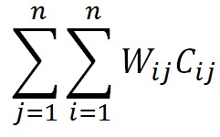
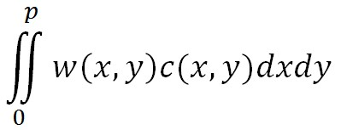


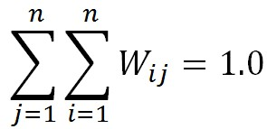
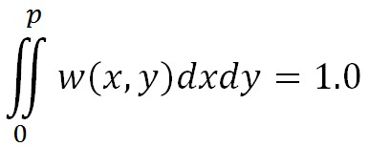
In 2D Space
Pixel boundaries
Color =
Uniform filter kernel
It is still true that:
Weight = 0.25
W(x,y) =
Pixel width = p
Volumes = 0.25!

Slide 16
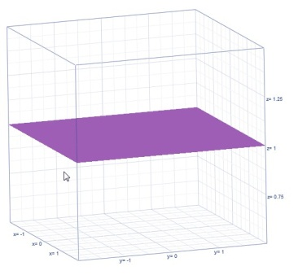
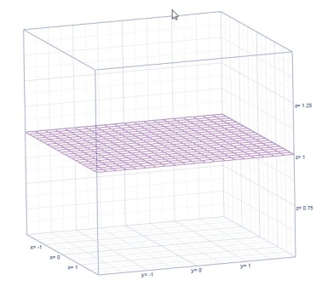
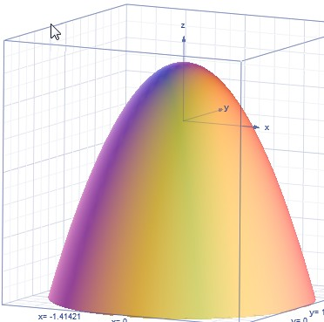
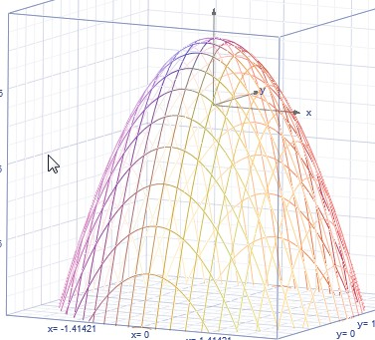
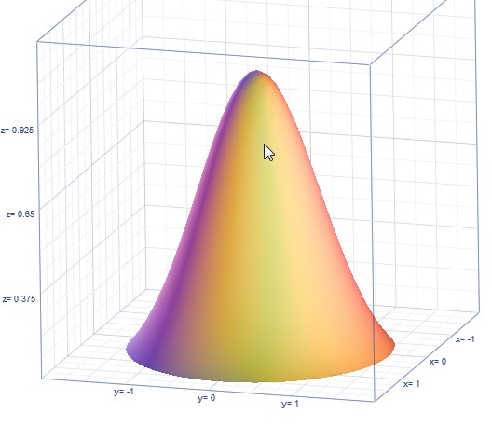
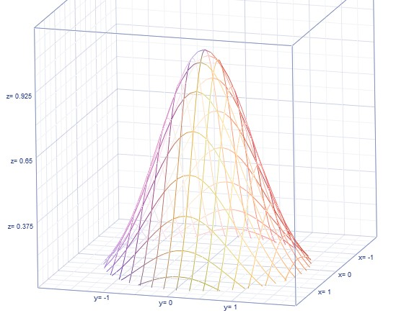
Filter Kernels
Constant: Box (uniform)
Linear: Tent, Triangle
Quadratic
Gaussian

Slide 17
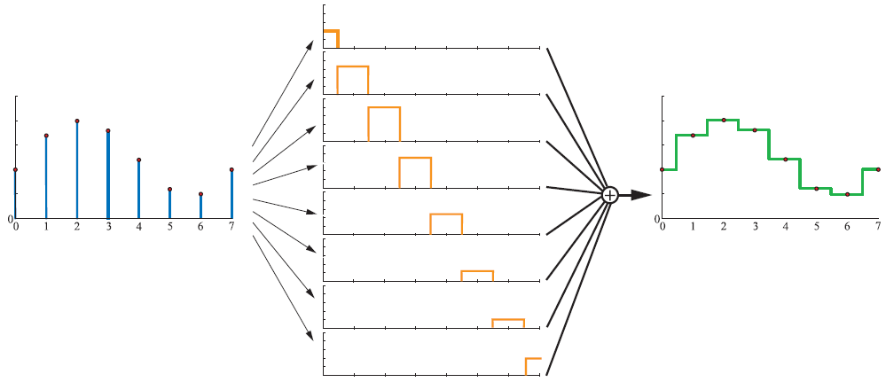
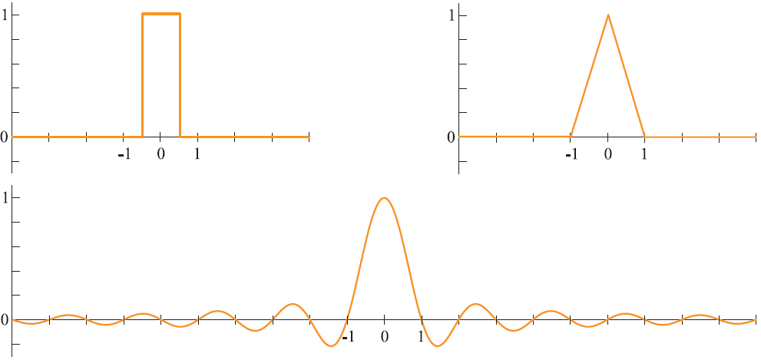
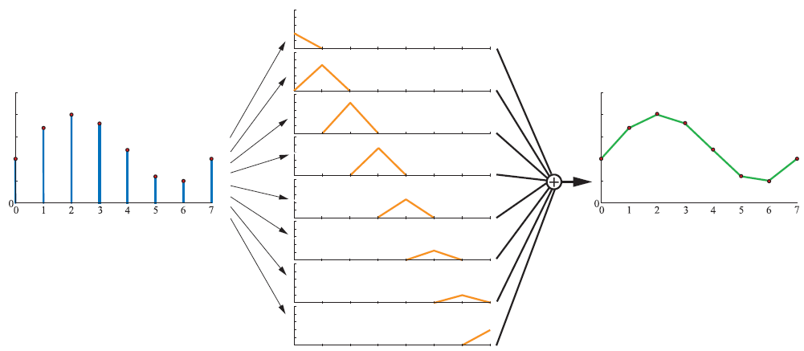
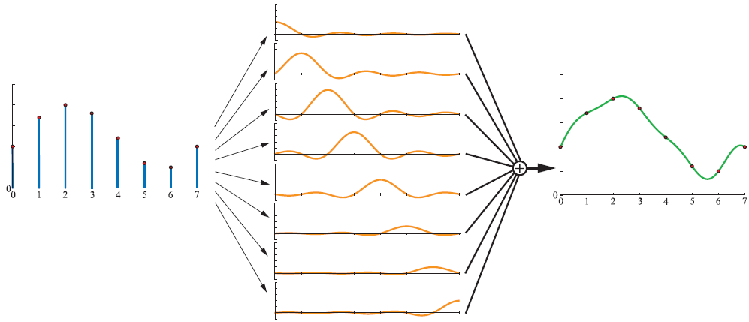
Filtering Illustrated
Image credit: Real Timer Rendering 3rd Ed: Fig 5-22 – 5-25 P. 120 – P 122

Slide 18
Kernel Support
Filter Kernel
Weight still sums to 1.0
Wider than a pixel!!
Multi-pixel filtering
Kernel support is more than a pixel
Kernel width
Aliasing: too narrow
Blurry: too wide
samples
Pixel boundaries

Slide 19
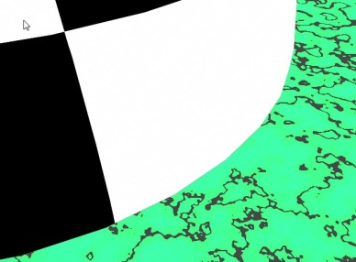
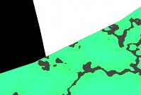

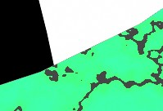
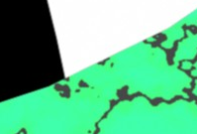
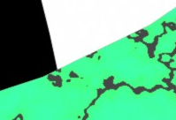
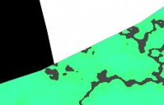
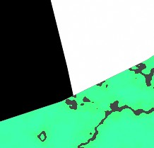
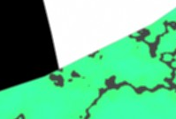
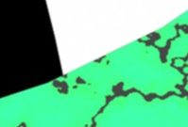
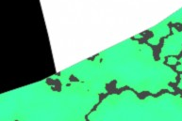
Examples: scene
Box: 1x1
Triangle: 1x1
Quad: 1x1
Box: 2x2
Triangle: 2x2
Quad: 2x2
No Filter
Box: 3x3
Triangle: 3x3
Quad: 3x3

Slide 20
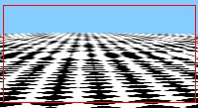






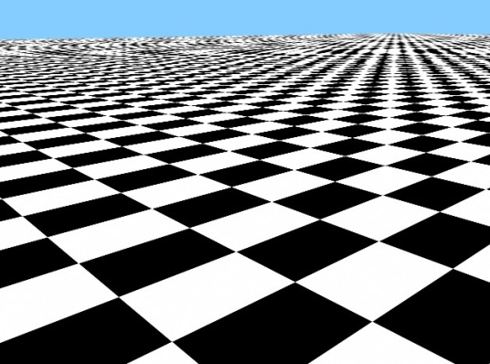



Checker Example
No Filter
Box
Triangle
Quad
1x1
2x2
3x3

