Slide 1
Antialiasing Miniaturized Textures
Final Project Demo
CSS 552 – Prof. Sung
Daniel R. Lewis
June 10, 2013

Slide 2
Review: Texture Minification
Pixel footprints contain multiple texels
Pixel Footprint
Texel
Grid

Slide 3
Review: Point Sampling
Value comes from texel that happens to be at the intersection position
Can be a poor representation of the area
Left: point sampling in action

Slide 4
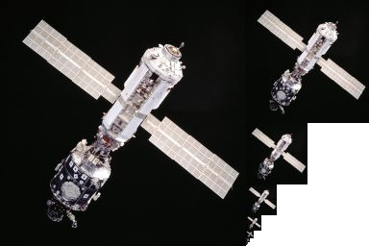
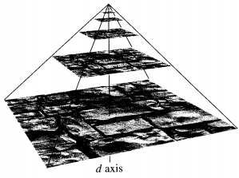
Review: Mipmapping
Image credit: Wikipedia(a)
Image credit: Akenine-Moller et al.
d

Slide 5
Review: Summed Area Tables
(0,0)
v
v1
v2
jt
jb
v0
v3
u
il
ir
I(i,j) = tc(i,j) + I(i−1,j) + I(i,j−1) − I(i−1,j−1)
C = ( I(ir,jb) − I(ir,jt) − I(il,jb) + I(il,jt) ) / ((ir − il)(jb − jt))

Slide 6
Finding d (Corrected)
d ∝ || longest_pixel_footprint_edge ||
Do not do this (mea culpa):
lpe = || longest_pixel_footprint_edge ||
d = 1 − ( lpe / texture_width )
Do this instead:
lpe = || longest_pixel_footprint_edge ||
m = mipmap_count − 1
d = (m − min(m, log2(1 / lpe))) / m

Slide 7
Limitations, Future Work
No support for supersampling
Makes mipmapping look bad
Reflected or refracted rays are always point sampled
Color (diffuse) textures only
Implicit textures unsuported
With a starting resolution, could make an explicit texture from an implicit texture, go from there

Slide 8
Questions?

