Slide 1
BVH
Student: Jack Chang

Slide 2
Introduction
Problem:
Ray intersection test needs to go through each objects
Cost: O(n)
Solution approaches:
Spatial subdivision
Primitive subdivision

Slide 3
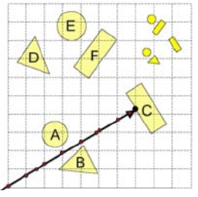
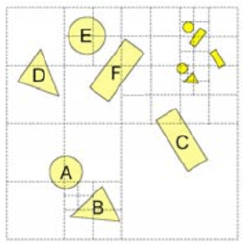
Spatial subdivision
Such as…
Uniform grid
K-D tree
Oct-tree
Uniform grid
Oct-tree

Slide 4
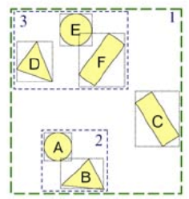
Primitive subdivision
Instead of working with space, work with the problems themselves.
In 1976, James Clark proposed the first hand-constructed BVH.

Slide 5
BVH
Key questions
How to define the bounding volume?
How to construct the hierarchy?
How to search the hierarchy?

Slide 6
1. Definition of bounding volume
Types
Sphere
AABB ( Axis aligned bounding box)
OBB (Oriented bounding box)
K-Dop (K direction discrete orientation polytope)

Slide 7
AABB
3 common representation
Min Max
Min HWD
Center Radius
Point min;
Point max;
Point min;
float d[3];
Point c;
float r[3];

Slide 8
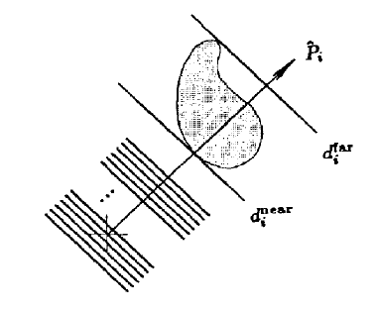
Kay–Kajiya Slab-based Volumes
Kay–Kajiya Slab-based Volumes (1986)
struct Slab
{
float n[3];
float dNear;
float dFar;
};

Slide 9
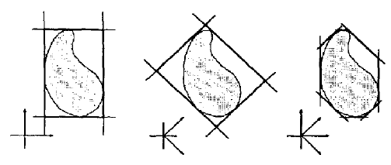
Kay–Kajiya Slab-based Volumes
Kay–Kajiya Slab-based Volumes (1986)

Slide 10
K-DOP
Similar to the Kay-Kajiya’s slab-based volume
But normal are defined as fixed set of axes shared among all BVs.
struct DOP6
{
float min[3];
float max[3];
};

Slide 11
Which bounding volume is best?
It depends…

Slide 12
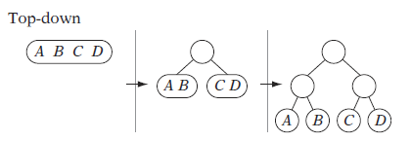
2. Hierarchy construction
3 approaches
Top-Down
Bottom-Up
Insertion

Slide 13
2. Hierarchy construction
3 approaches
Top-Down
Bottom-Up
Insertion

Slide 14
2. Hierarchy construction
3 approaches
Top-Down
Bottom-Up
Insertion

Slide 15
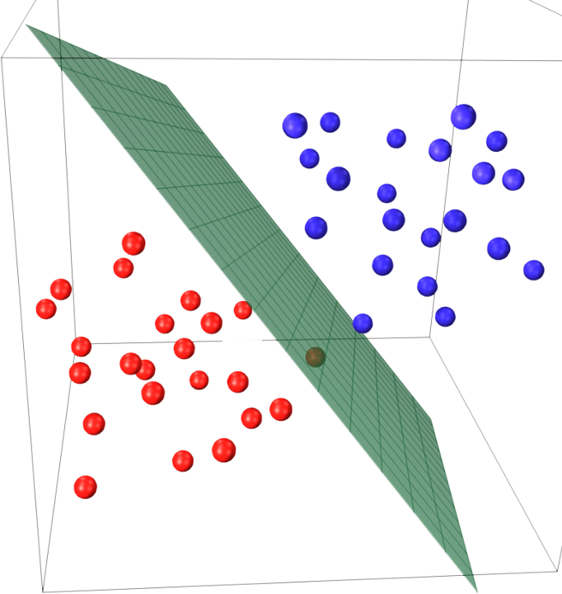
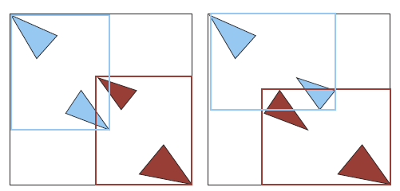
Top-Down construction
Recursive procedure
Splitting hyperplane to divide the input set.

Slide 16
Rearrange & Partition
Choice of Axis
Local x, y, and z coordinate
Axis through the two most distant points

Slide 17
Rearrange & Partition
Choice of splitting point
Objects Median
Objects Mean
Spatial Mean

Slide 18
Example Code – Tree Construction
void BuildTopDownBVH(BVHNode treeNode, ArrayList objects)
{
Node newNode = new Node();
treeNode.add(newNode);
newNode.BoundingVolume = ComputeBoundingVolume(objects);
if( objects.Count <= 1)
{
newNode.Type = LEAF;
newNode.Objects = objects;
}
else
{
newNode.Type = NODE;
int splitIdx = RearrangeAndPartitionObjects(objects);
BuildTopDownBVH(newNode.LeftTree, objects.Subset(0, splitIdx));
BuildTopDownBVH(newNode.RightTree, objects.Subset(splitIdx, objects.Count);
}
}

Slide 19
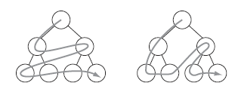
3. Hierarchy search
2 fundamental tree traversing
BFS ( Breadth first search )
DFS ( Depth first search )

Slide 20
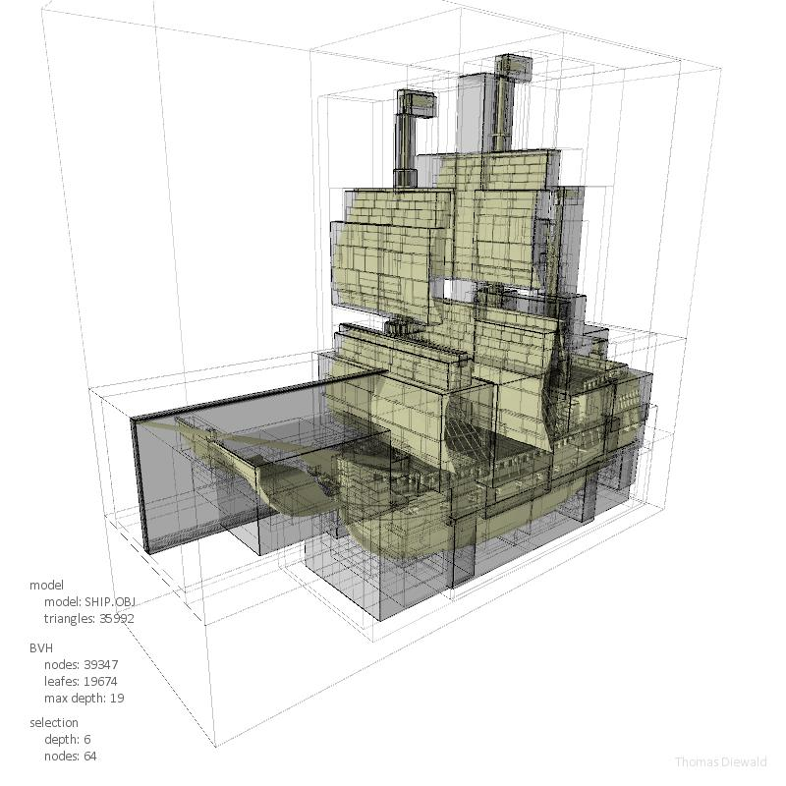
Summary
What I have talked about…
Definition of bounding volume
Hierarchy construction
Hierarchy search
And what I have NOT talked about…
SAH ( Surface area heuristic )
Compact BVH
Informed traversal

