Slide 1
Barycentric Coordinates
S. Dame CSS522 Notes
2/9/2011

Slide 2








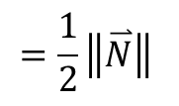
Area of a Triangle
$${=\frac{1}{2}\left\|\overset{⃑}{N}\right\|}_{ }$$
$$Area of \left(P_{0},P_{1},P_{2}\right)$$
P₂
$$where:$$
$$\overset{⃑}{V_{1}}=P_{1}−P_{0}$$
$$\overset{⃑}{V_{2}}$$
P₁
$$\overset{⃑}{N}$$
$$\overset{⃑}{V_{2}}=P_{2}−P_{0}$$
$$\overset{⃑}{V_{1}}$$
$$\overset{⃑}{N}=\overset{⃑}{V_{1}}×\overset{⃑}{V_{2}}$$
P₀

Slide 3





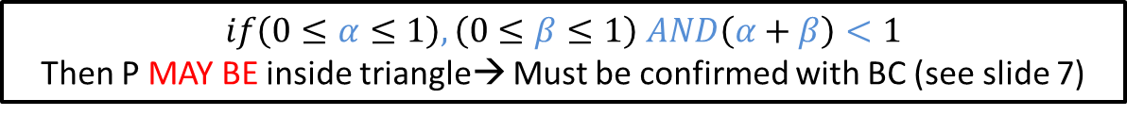






Determining if P inside Triangle
(Note: this is NOT Barycentric Coordinates)
$$P_{0}$$
$$α$$
$$β$$
$$\overset{⃑}{V_{1}}$$
$$\overset{⃑}{V_{2}}$$
P
$$P_{1}$$
$$P_{2}$$
$$\overset{⃑}{V_{2}}=\overset{⃑}{P_{2}}−\overset{⃑}{P_{0}}$$
$$α=\overset{⃑}{P}∙\overset{⃑}{V_{2}}$$
$$\overset{⃑}{V_{1}}=\overset{⃑}{P_{1}}−\overset{⃑}{P_{0}}$$
$$β=\overset{⃑}{P}∙\overset{⃑}{V_{1}}$$
$$if\left(0≤α≤1\right), \left(0≤β≤1\right) AND\left(α+β\right)<1$$
Then P MAY BE inside triangle→ Must be confirmed with BC (see slide 7)

Slide 4

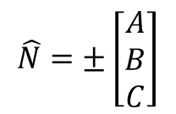




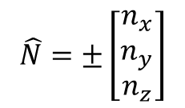

Triangle Intersection
Equation of a plane
$$Ax +By+Cz+D=0$$
Normal Vector(s)
$$\overset{⃑}{V_{2}}$$
$$\overset{⃑}{V_{1}}$$
$$\hat{N}=±\left[\begin{matrix}A \\ B \\ C\end{matrix}\right]$$
P₀
$$\overset{⃑}{N}=\overset{⃑}{V_{1}}×\overset{⃑}{V_{2}}$$
$$\hat{N}=±\left[\begin{matrix}n_{x} \\ n_{y} \\ n_{z}\end{matrix}\right]$$
P₂
$$\overset{⃑}{V_{2}}=P_{2}−P_{0}$$
P₁
P₀
$$\overset{⃑}{V_{1}}=P_{1}−P_{0}$$

Slide 5




Triangle Intersection
(P_{1,}P₂)
Side view of triangle
D
$$\hat{N}$$
$$\overset{⃑}{V}$$
P₀
$$\overset{⃑}{V}=P_{0}$$
$$D=\overset{⃑}{V}∙\hat{N}$$

Slide 6






Triangle Intersection (continued)
Side view of triangle
$${ray= E}_{0}+t∙\hat{V}$$
$$\hat{N}$$
$$t_{0}$$
$$\hat{V}$$
$${intersection point= E}_{0}+t_{0}∙\hat{V}$$
E₀
$$t_{0}=\frac{−D−(\hat{N}∙E_{0})}{\hat{V}∙\hat{N}}$$

Slide 7

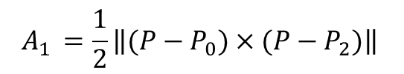

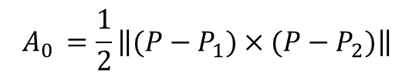
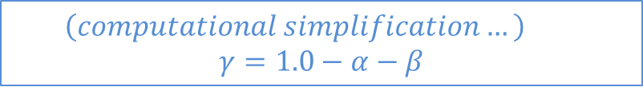

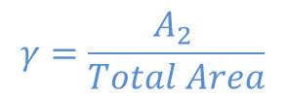


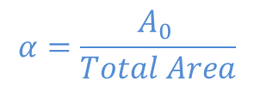
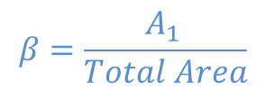



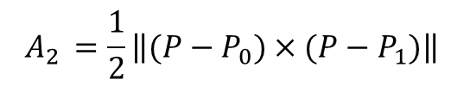
Barycentric Coordinates ($α,β$, $γ$)
One slight attention. Assuming:
V1 = P1 - P0
V2 = P2 - P0
N = V1 x V2 (slide-4)
Slide-7:
N0 = (P0-P) X (P2-P)
if (Dot(N0, N) < 0)
P is outside!! (Normal N0 is in the wrong direction!!)
A0 = 0.5 * N0.Length()
alpha = A0 / TotalArea
if (alpha > 1)
P is outside!
N1 = (P2-P) X (P0-P)
if (Dot(N1, N) < 0)
P is outside!!
A1 = 0.5 * N1.Length();
beta = A1 / TotalArea
if (beta > 1)
P is outside
gamma = 1 - alpha - beta
if (gamme < 0)
P is outside
$$P_{0}(u_{0},v_{0})$$
$$A_{2}$$
$$P$$
$$A_{1}$$
$$A_{0}$$
$$P_{1}(u_{1},v_{1})$$
$$P_{2}(u_{2},v_{2})$$
$$A_{0 }{=\frac{1}{2}\left\|(P−P_{1})×(P−P_{2})\right\|}_{ }$$
$$α=\frac{A_{0 }}{Total Area}$$
$$A_{1 }{=\frac{1}{2}\left\|(P−P_{0})×(P−P_{2})\right\|}_{ }$$
$$β=\frac{A_{1 }}{Total Area}$$
$$A_{2 }{=\frac{1}{2}\left\|(P−P_{0})×(P−P_{1})\right\|}_{ }$$
$$γ=\frac{A_{2 }}{Total Area}$$
$$α+β+γ =1.0$$
$$\left(computational simplification…\right)$$
$$γ=1.0−α−β$$

Slide 8









Support for Interpolation
$$P_{0}(u_{0},v_{0})$$
$$A_{2}$$
$$(u_{p},v_{p})$$
$$A_{1}$$
$$A_{0}$$
$$P_{1}(u_{1},v_{1})$$
$$P_{2}(u_{2},v_{2})$$
$$u_{p}=αu_{0}+βu_{1}+γu_{2}$$
$$v_{p}=αv_{0}+βv_{1}+γv_{2}$$

