Slide 1
The idea (in 2D)
Original normal
New normal
Change surface position (along original normal direction) by texel value
Geometry positions that corresponds to integer texel positions
Actual (integer) texel positions that can be read from file
texture index position from visible position (float)

Slide 2
The idea (in 3D)
New normal
Original normal
6. Use displaced heights to re-compute surface normal
1. texture index position from visible position (float)
5. Use interpolated value as height displacement
4. Linearly interpolated from actual texel read out
2. The four bounding integer texel positions that file texture can provide values
3. Compute geometry positions that corresponds to these texel indices
Interpolate

Slide 3
The Spaces
1. Computed visible point (Word space)
7. Transform from UV space to world space for the 4 texel positions, and use interpolated (next slide) texture results!
2. Transform to UV space
3. Transform to texel position the corresponds exactly to the visible point (float)
UV space
6. Transform these texel positions back to UV space
4. bounding texel positions that can be read from file
(u0,v1)
Index=(u,v1)
(u1,v1)
Index=(u,v)
(u0,v0)
Index=(u1,v)
Index=(u,v0)
(u1,v0)
5. Compute UV vertex along integer UV-grid (u0, u1, v0, v1) grid

Slide 4

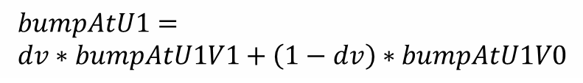



The Interpolated Texture
$$bumpAtU1= \\ dv∗bumpAtU1V1+\left(1−dv\right)∗bumpAtU1V0$$
Texel position that corresponds exactly to the visible point (float): (u,v)
$$bumpAtU0V0$$
$$bumpAtU1V1$$
$$bumpAtU0V0$$
1-dv
du=u-u0
dv=v-v0
1-du
$$bumpAtU1V0$$
$$bumpAtV0=du∗bumpAtU1V0+\left(1−du\right)∗bumpAtU0V0$$

Slide 5












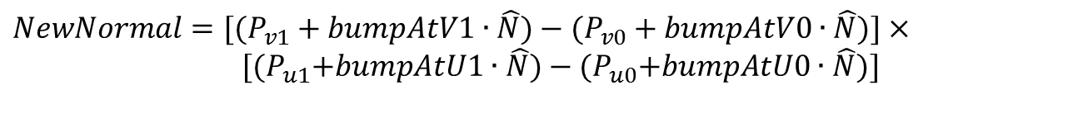
The Geometry
New normal
$$P_{v1}+bumpAtV1∙\hat{N}$$
$$P_{u0}+bumpAtU0∙\hat{N}$$
$$bumpAtV1$$
$$P_{u1}+bumpAtU1∙\hat{N}$$
$$bumpAtU0$$
$$P_{v1}$$
$$P_{u0}$$
$$bumpAtU1$$
$$P_{v0}$$
$$P_{u1}$$
$$P_{v0}+bumpAtV0∙\hat{N}$$
$$bumpAtV0$$
${NewNormal=[(P}_{v1}+bumpAtV1∙\hat{N})−(P_{v0}+bumpAtV0∙\hat{N})]$ $×$
${ [(P}_{u1}+bumpAtU1∙\hat{N})−{(P}_{u0}+bumpAtU0∙\hat{N})]$

Slide 6

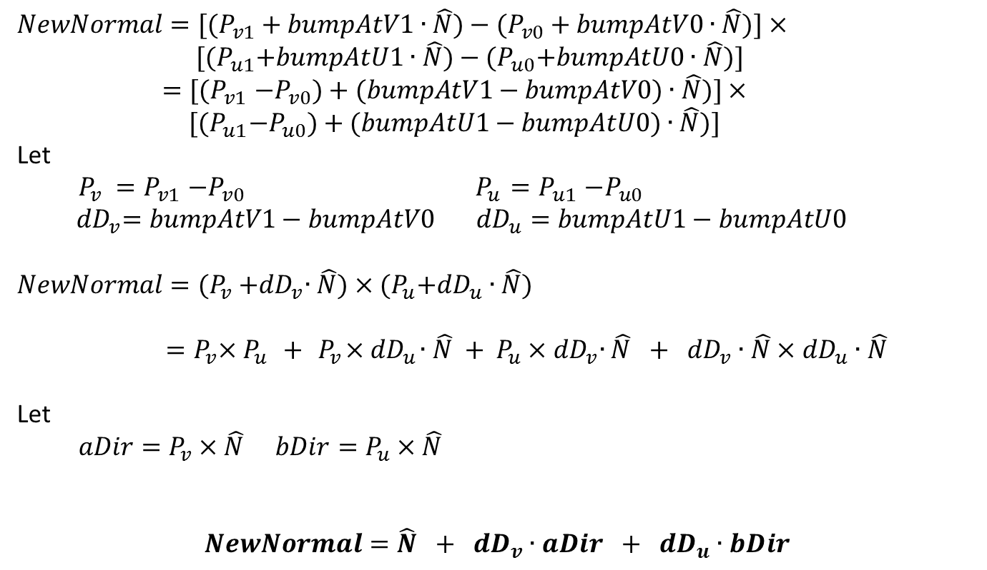

The Algebra
${NewNormal=[(P}_{v1}+bumpAtV1∙\hat{N})−(P_{v0}+bumpAtV0∙\hat{N})]$ $×$
${ [(P}_{u1}+bumpAtU1∙\hat{N})−{(P}_{u0}+bumpAtU0∙\hat{N})]$
${=[(P}_{v1}−P_{v0})+(bumpAtV1−bumpAtV0)∙\hat{N})]×$
${ [(P}_{u1}−P_{u0})+(bumpAtU1−bumpAtU0)∙\hat{N})]$
Let
$P_{v} {=P}_{v1}−P_{v0}{ P}_{u} {=P}_{u1}−P_{u0}$
$${ dD}_{v}=bumpAtV1−bumpAtV0{ dD}_{u}=bumpAtU1−bumpAtU0$$
${NewNormal=(P}_{v}{+dD}_{v}∙\hat{N})$ $×{(P}_{u}{+dD}_{u}∙\hat{N})$
$${ =P}_{v}×P_{u}{ + { P}_{v}×dD}_{u}∙\hat{N} {+ P_{u}×dD}_{v}∙\hat{N} + {dD}_{v}∙\hat{N}×{dD}_{u}∙\hat{N}$$
Let
$aDir=P_{v}×\hat{N}$ $bDir=P_{u}×\hat{N}$
$NewNormal=\hat{N} + {dD}_{v}∙aDir$ $+ {dD}_{u}∙bDir$
$$0$$
$$\hat{N}$$

