Slide 1
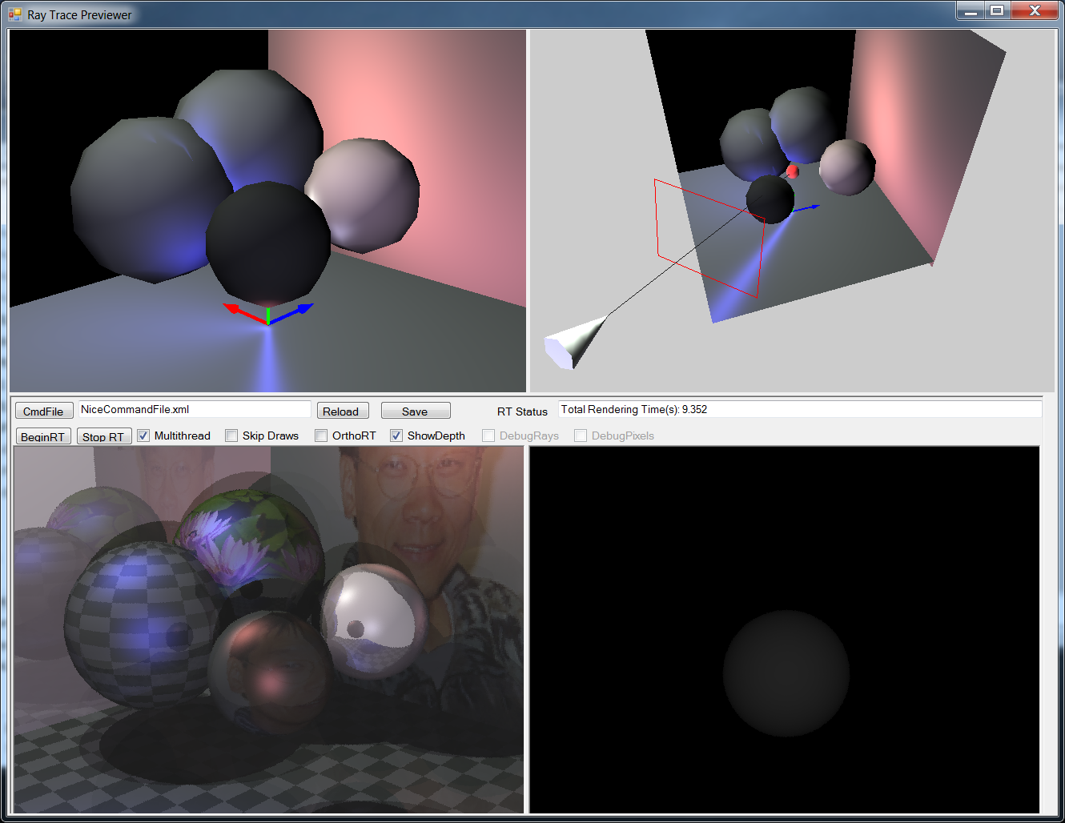
Simple Ray Tracing Framework
Interactive Preview
Interactive Control
Depth or Mask Image
Ray Trace Image

Slide 2
Technologies
C#
  Just another programming language
WinForm:
  GUI Application Development
  not covered in this class
Interactive Viewing:
  XNA (can be OGL or D3D)
  To be covered in second half

Slide 3
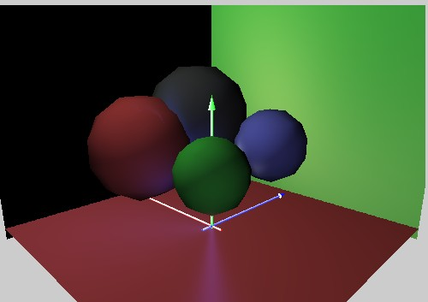
The Scene
Describe by XML (text) file!
Four major components
  Image Spec (Film in a camera)
  The Camera
  Environment (Lighting condition)
  The Objects
    Geometry: spheres and polygons
    Material properties

Slide 4
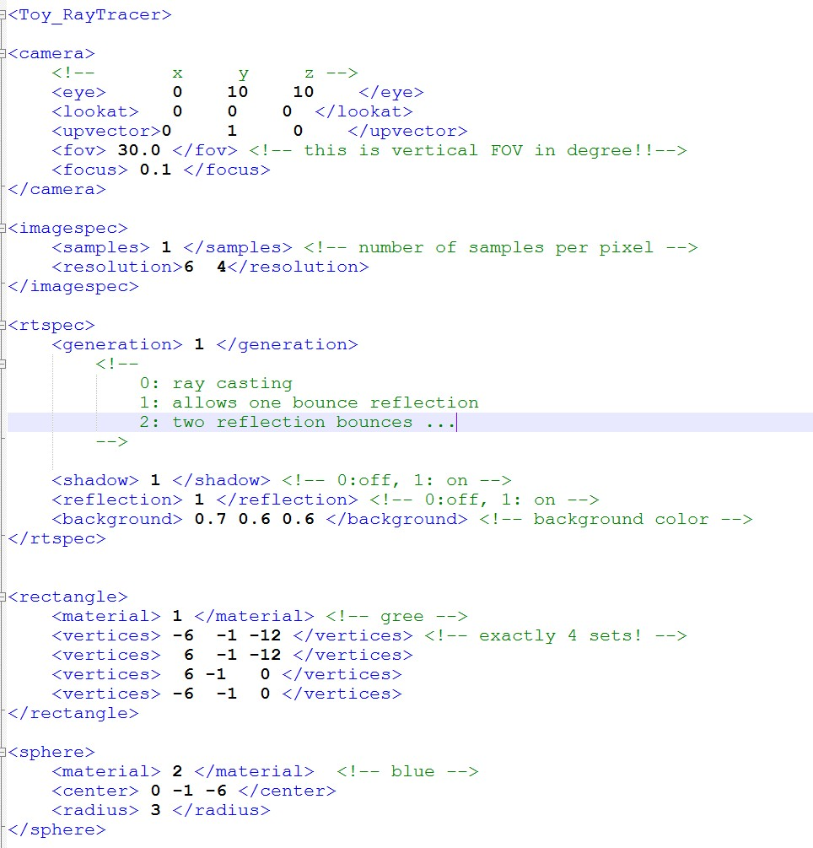
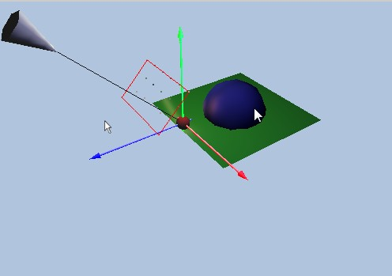
XML Scene Description
Similar to Maya’s .ma file
  Extremely simpler version!!
Example Command File
Camera: eye
Camera: lookat

Slide 5
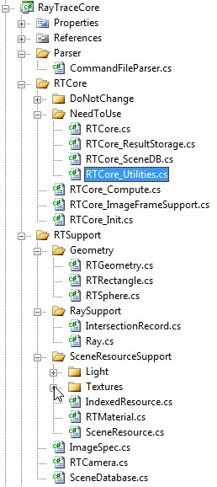
Source Code Structure
Two Projects:
  3DPreviewer: Shell container
  RayTracer: Our source code
    Parser (translate XML into data structure)
    RTCore: Shading, Image representation:
      DoNotChange: RT thrade support (later)
      NeedToUse: Shading, Utilities
    RTSupport
      Geometry
      RaySupport:
        Ray and IntersectionRecord
      SceneResourceSupport
        Texture, Light, Materials
  2 libraries:
    GUI, Graphics, 2 MVC Support

Slide 6
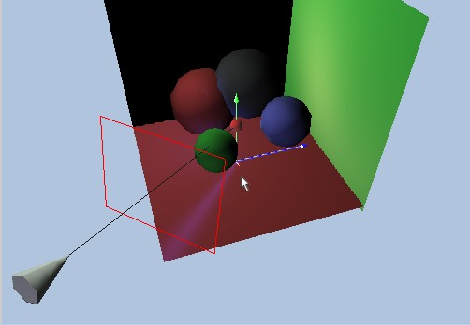
Representation
SceneDatabase
ImageSpec
Geometry
RTCamera
IntersectionRecord
Ray
Link to StarterProject

Slide 7
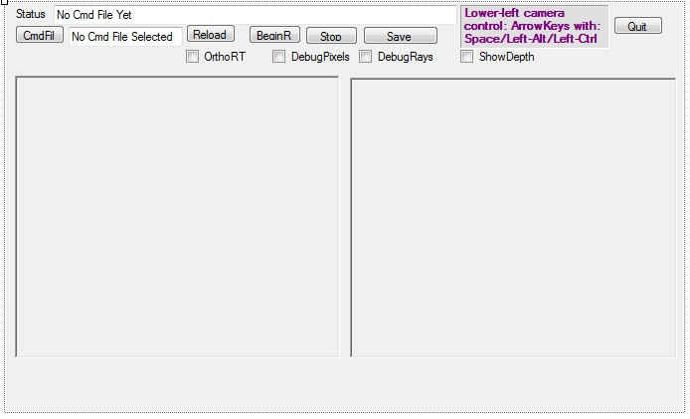
RTWindow.cs: App Container
App Window Shell
In WindowsForm

Slide 8
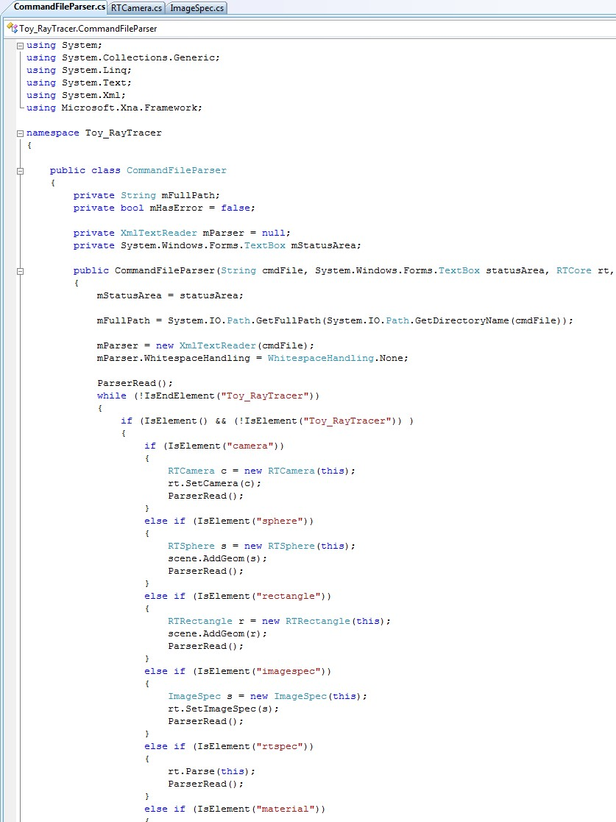
Parser.cs: XML Parser
Translates Command File into data structures
In RayTracer: Parser/CommandFileParser.cs

Slide 9
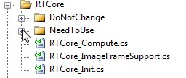
RTCore: Folder
DoNotChange Folder:
  No need to even examine the source
  Thread support (to cover later in the quarter)
NeedToUse Folder
  Need to understand the code
  No need to change
Three files: Compute, ImageFrameSupport, and Init
  Essential to understand
  Necessary for 3D Viewing and Camera implementation

Slide 10
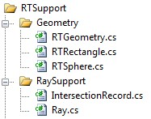
Geometry and RaySupport
Geometry
  geometries in the scene
  For now only: Rectangles and Spheres
  No need to worry until much later
Ray
  Ray: Origin + Direction
    Ray constructor: TAKES 2 positions!!
  IntersectionRecord

Slide 11
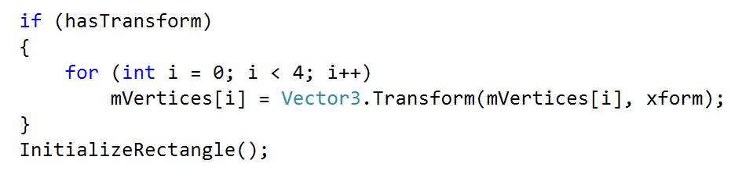
Transformation
The <xform> tag
The implementaiton in
  RTGeometry_ParseXForm.cs
  Rectangle::Parsing at the end:

Slide 12
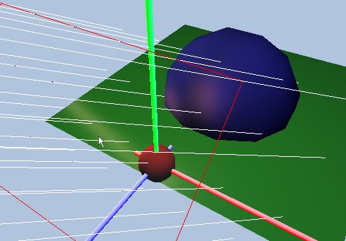
Geometry and RaySupport
Ray
Sphere
Rectangle
IntersectionRecord

Slide 13
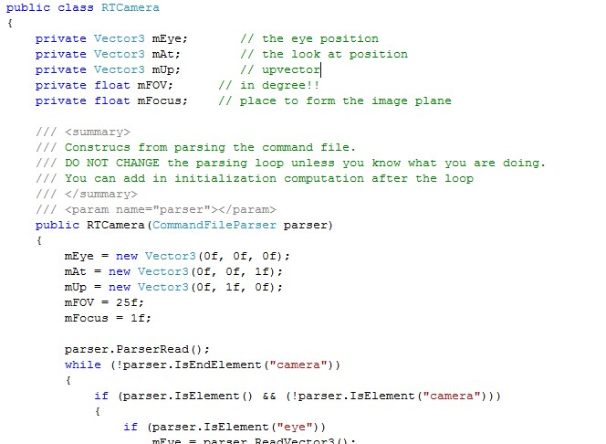
RTCamera:
mEye
mAt

Slide 14
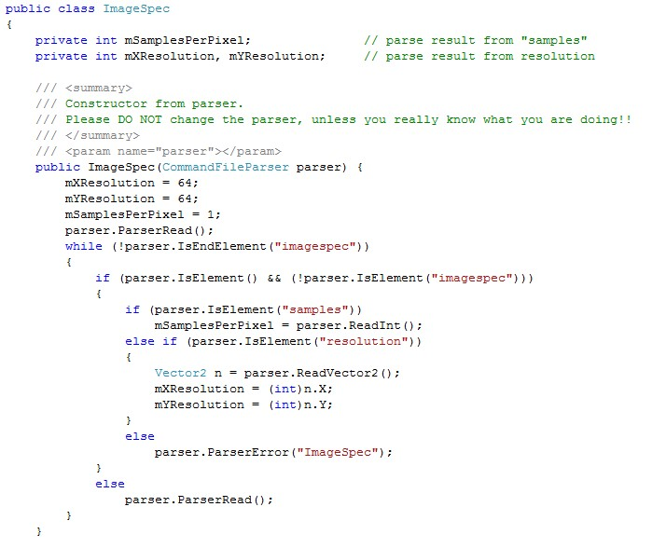
ImageSpec:
Resolution
Must Compute Each Pixel Location!!

Slide 15
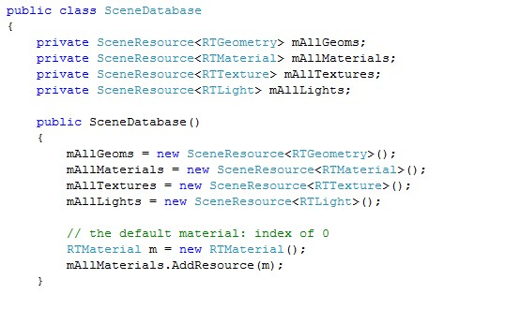
SceneDataBase
Contains all the scene resources
  Geometries, Textures, Materials, Lights
Simple index tables for each resource

Slide 16
Calling Sequence
RTWindow::BeginRT() /* from BeginRT Button
  Create and Init: image, mask, depth buffers
RTCore::BeginRTThread
  In RTCore/DoNotChange/RTCore_Thread.cs
  one/more separate thread(s) call to
RTCore::ComputeImage
  In RTCore/RTCore_Compute.cs
  Loop through all pixels, for each pixel
  Compute visibility, coverage, depth

Slide 17
Important Functions
RTCore::ComputeVisibility()
  In RTCore/RTCore_Visibility.cs
  Use -1 for exceptGeomIndex for now
RTCore::ComputeShading()
  In RTCore/RTCore_Shade.cs
  Use 0 for generation for now

