Slide 1
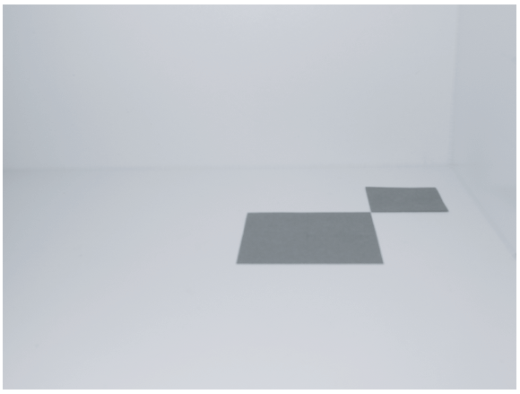
A Photograph of two papers
The Model: 2 papers
8cm x 8cm and 5cm x 5cm
The Camera
Simple pinhole
No focusing capability
The Scene
Arrangements model and camera
Light sources (later)

Slide 2
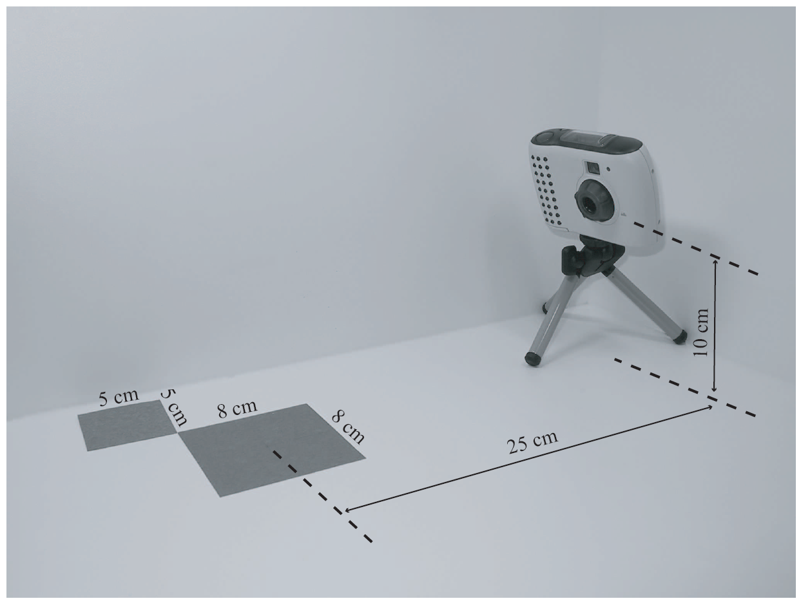
The Arrangements

Slide 3
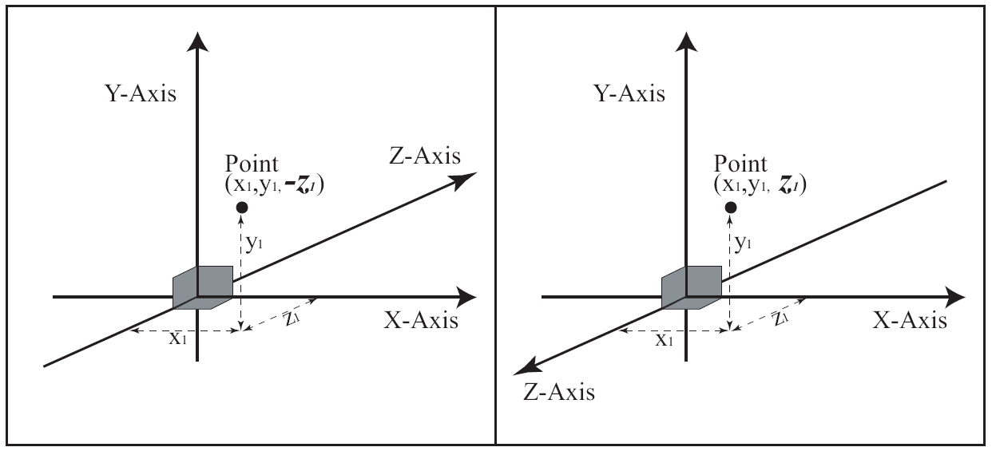
3D Coordinate Systems
Two options for Z-axis direction!
Same position, different sign for z-value!!

Slide 4
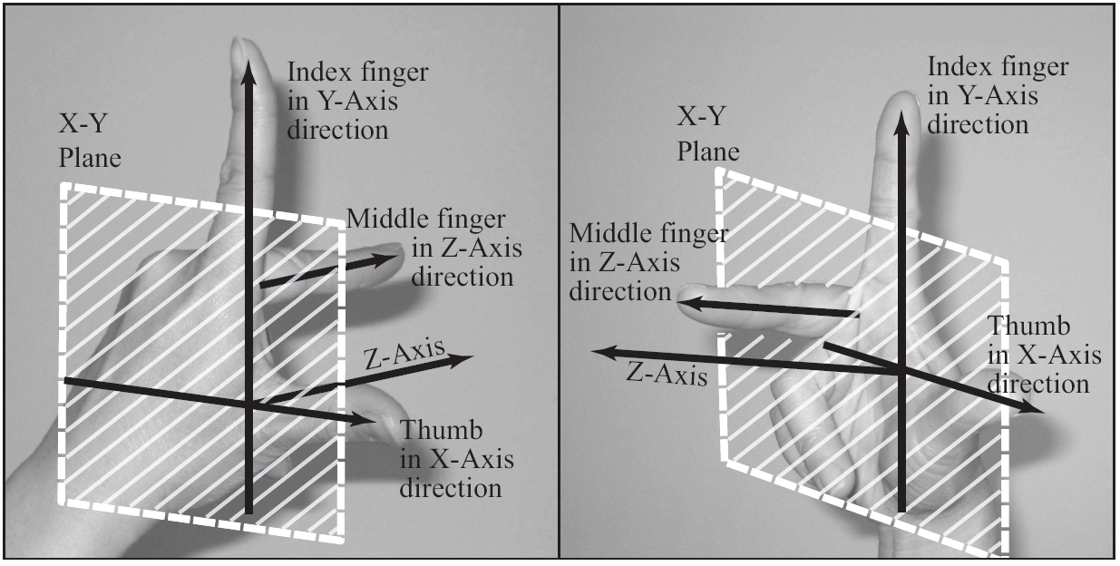
Left vs. Right Handed Systems
Right-Handed System EXCLUSIVELY!!

Slide 5
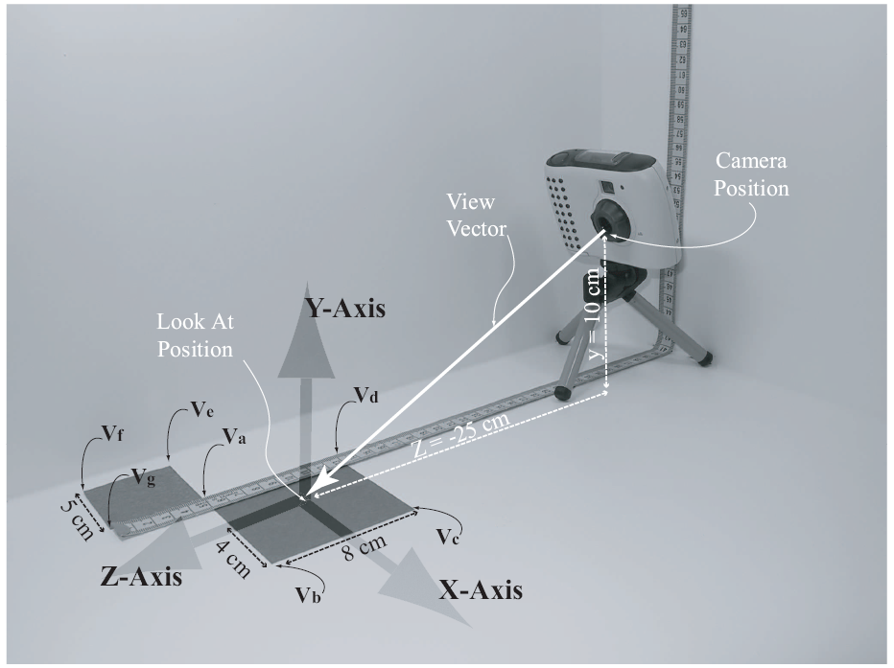
The Model and the Scene
Right-Handed Coordinate System
Convenience
Origin Center of 8x8
Units in cm

Slide 6
Details …

Slide 7
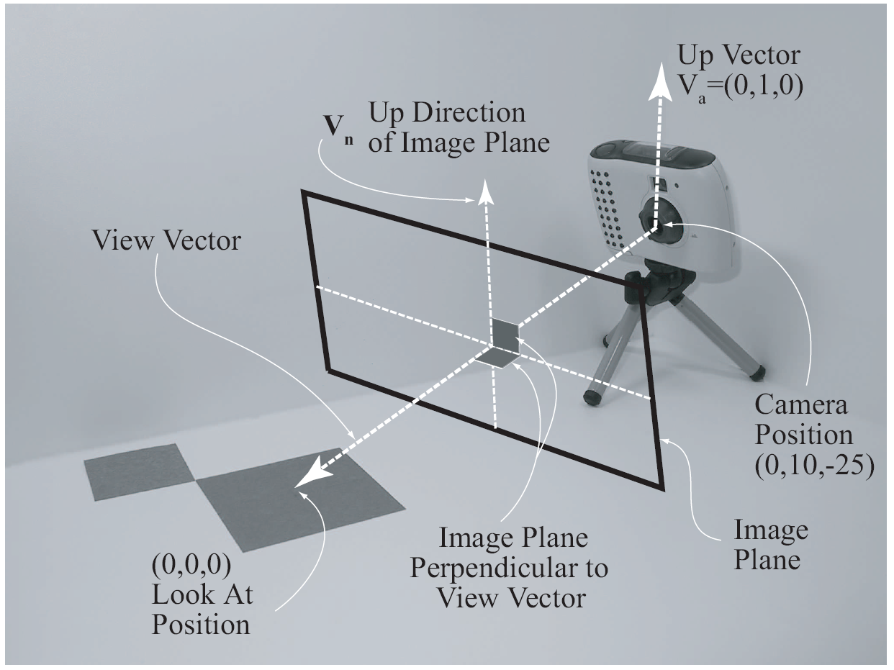
A Computer Graphics Camera
Camera position
Look at position
Up direction
Related terms:
Image Plane
Viewing Direction
View Vector
Maya scene

Slide 8
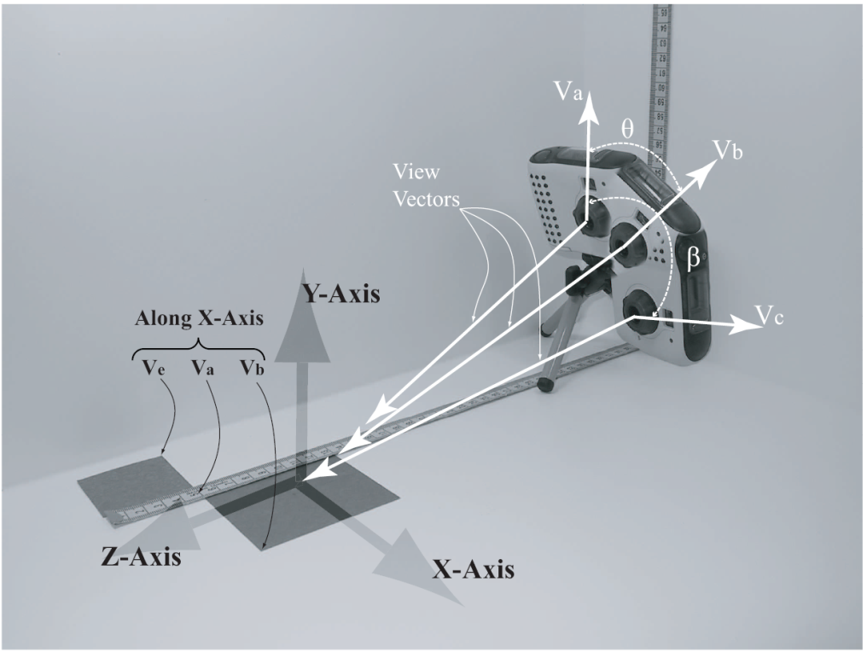
The Up Direction (Up Vector):
Also referred to as: Twist Angle
Cannot be parallel to viewing direction
Does not need to be normalized
Does not need to be perpendicular to viewing direction

Slide 9
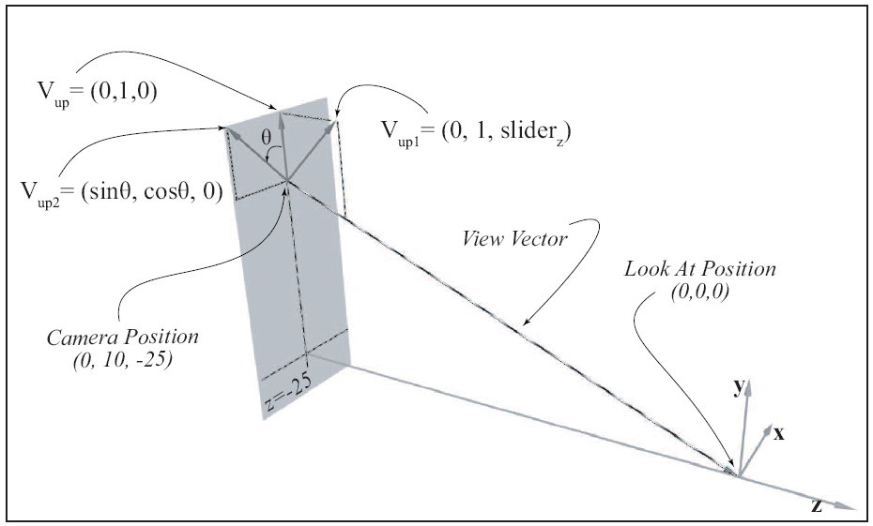
Controlling the Up Vector
z=slider:
Twist angle:
not perpendicular to View Vector!

Slide 10
The Visible Volume
Only geometries (primitives) inside the volume are visible
All geometries (primitives) outside are ignored
Primitives straddle the volume are Clipped!

Slide 11
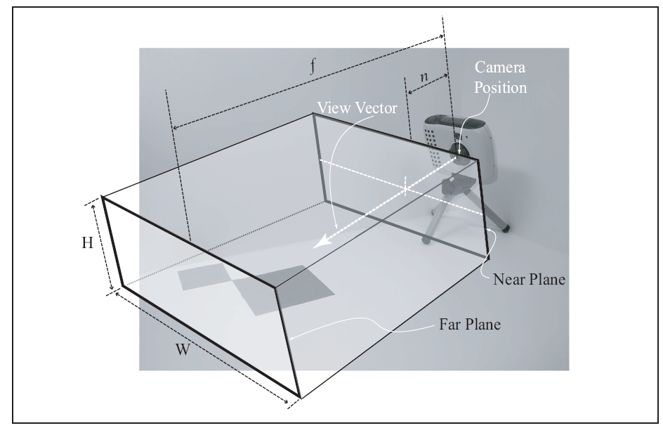
The Rectangular Visible Volume
Volume defined by:
Near Plane (n)
Far Plane (f)
Width (W)
Height (H)
For Orthographic Projection

Slide 12
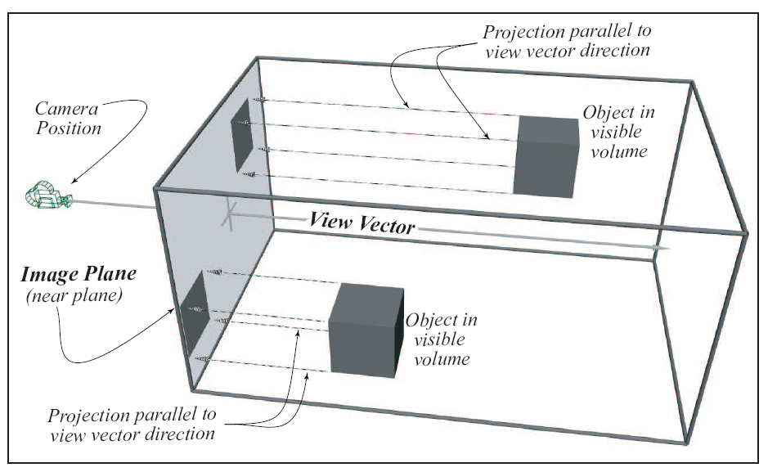
Orthographic Projection
Maya Scene

Slide 13
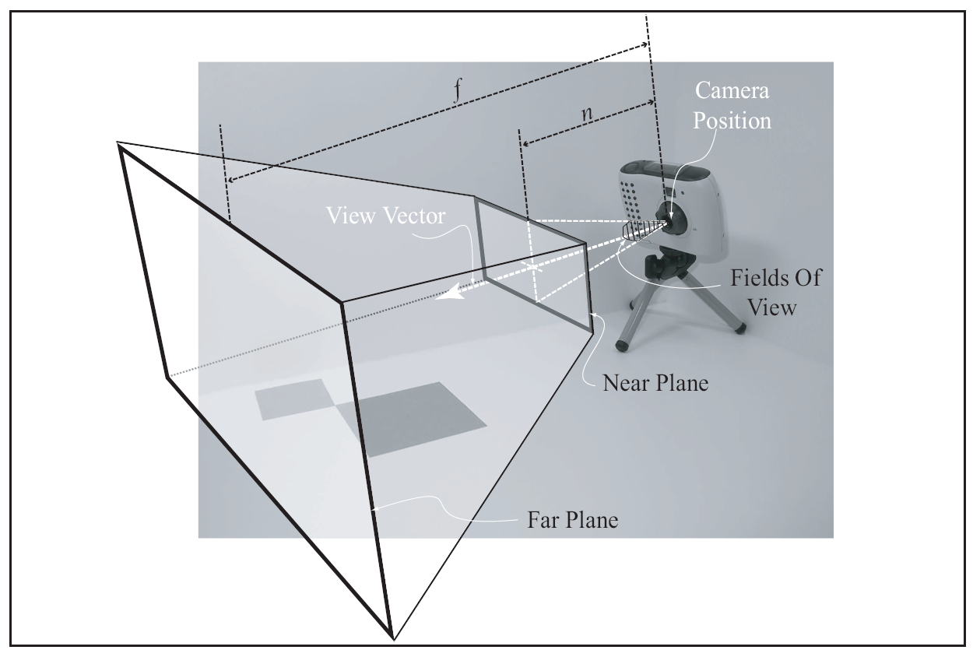
The Viewing Frustum Volume
Volume defined by:
Near Plane (n)
Far Plane (f)
Fields of view (fov)
For Perspective Projection

Slide 14
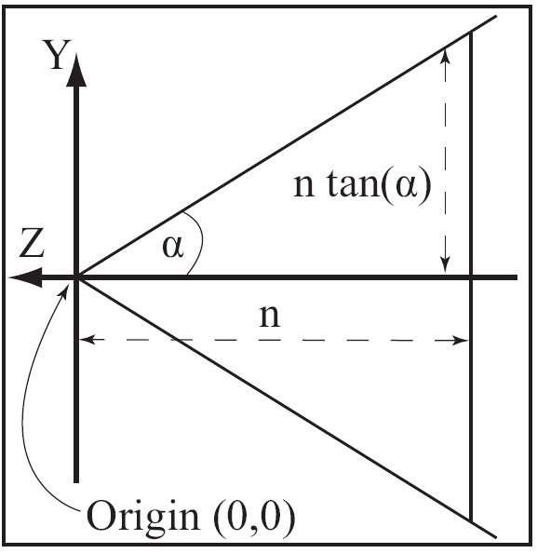
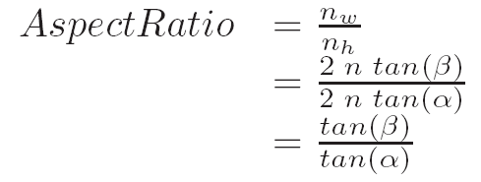
Near Plane and Aspect Ratio
Aspect Ratio
Near Plane
Height (n_{h})
Width (n_{w})

Slide 15
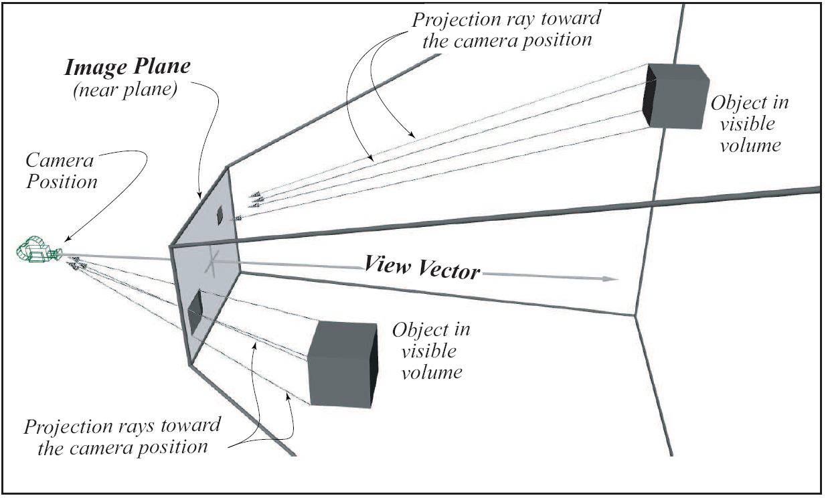
Perspective Projection

Slide 16
Orthographic vs Perspective Projection
Orthographic Projection
Parallel projection
Preserve size
Good for determining relative size
Perspective Projection
Projection along rays
Closer objects appears larger
Human vision!
Only work with: Perspective Projection

