Slide 1
Orthogonal Base
Cartesian Coordinate System
Unit vectors: i, j, k
Normalized to each other
Unique representation for each position!!
Convenient!
Works in general:
N dimension space
ANY N normalized orthogonal vectors will do!!
Infinite number of Cartesian coordinate systems in 3D space!!
But we already know this

Slide 2
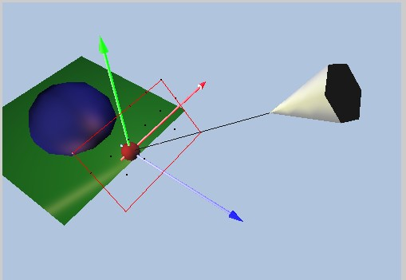
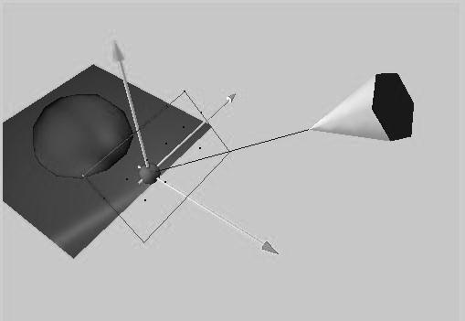
Camera Space
Orthonormal base at the camera
View/Up/Side
V/U/W axis
All perpendicular
Also known as:
Eye Space
View Space
Up Direction (U)
Eye
At
View Direction (V)
Side Direction (W)

Slide 3
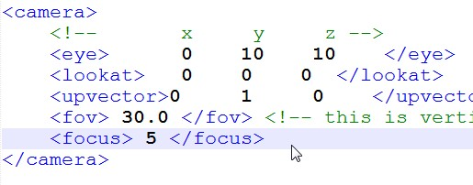
Recall: Scene Description
Camera is defined by:
Eye, lookat, and UpVector
Viewing Direction
Defined by Eye and At
Notice:
UpVector is usually NOT perpendicular to View Direction!!
Easier for user to specify sent of “up”
UpVector
Eye
At

Slide 4
Compute Camera Base
Viewing Direction (V)
V = At - Eye
Remember:
UpVector may not be perpendicular to V
W = UpVector x V
W is perpendicular to both UpVector and V
UpVector
Eye
At
V
W

Slide 5
Compute Up Direction (U)
U = V x W
U, V, and W are perpendicular!!
Normalize to form a Cartesian Coordinate!
UpVector
U
Eye
At
V
W

Slide 6
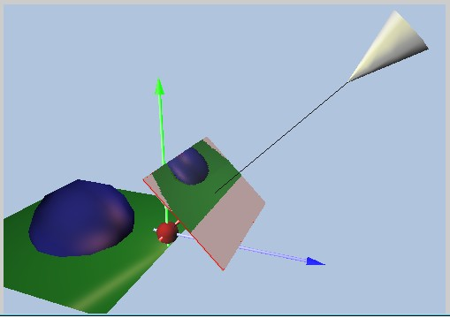
Recall: Image Plane (Scene XML)
Eye
focus
focus distance away from the Eye
Resolution defined in the XML file to be Rx by Ry pixels
Always perpendicular to the viewing direction V
Image Plane

Slide 7
Image Plane Height
Eye
Image Plane
focus
Height
fov: fields of view
Is vertical angle
Distance between Eye and Image Plane: focus
Image Plane Height: Height = 2 * focus * tan (fov/2)
fov

Slide 8
Image Plane Width
Resolution: Rx by Ry
Computed: Height
Width is “proportional”
Width = (Rx / Ry) * Height
Aspect Ratio: Width/Height
Height
Width

Slide 9
Cartesian Coordinate on Image Plane
2D, Requires
2 Perpendicular
Unit Vectors
Origin: Lower-Left Corner
Remember
U, V, W from Camera Space
Image plane perpendicular to V
U in the vertical direction of Image Plane
W in the horizontal direction of image plane!
U
Image Plane
V
U
W
W
Lower Left

Slide 10
Image Plane Location
Eye
Image Plane
Let Center = C
C = Eye + focus * V
focus
C

Slide 11
Lower Left Corner
Upper Left (Pul)
C
Normalize: U, W
Dimension: W x H
Upper-Left Corner:
Pul = C – (Width/2) * W + (Height/2) * U
U
Image Plane
W

Slide 12
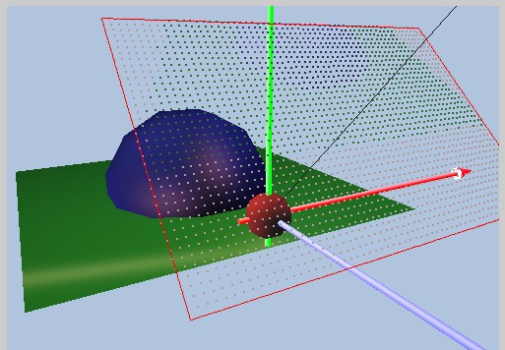
Pixel Size:
Image Resolution:
Rx by Ry
Image Size:
Width by Height
Dimension of each pixel
Width: pw = Width / Rx
Height: ph = Height / Ry
Pul
Image Plane
Pixels

Slide 13
Pixel Location:
Index i
Pll
U
Index j
Assume pixel indexing
Begin from upper left
i increase towards right
j increase towards down
pw: width of a pixel
ph: height of a pixel
U and W are normalized
Pul is index [0][0]
Pixel[0][0] location = Pul
Pixel[i][j] location is: Pij = Pul – (i * pw) * W – (j * ph) * U
W
Image Plane

