Slide 1
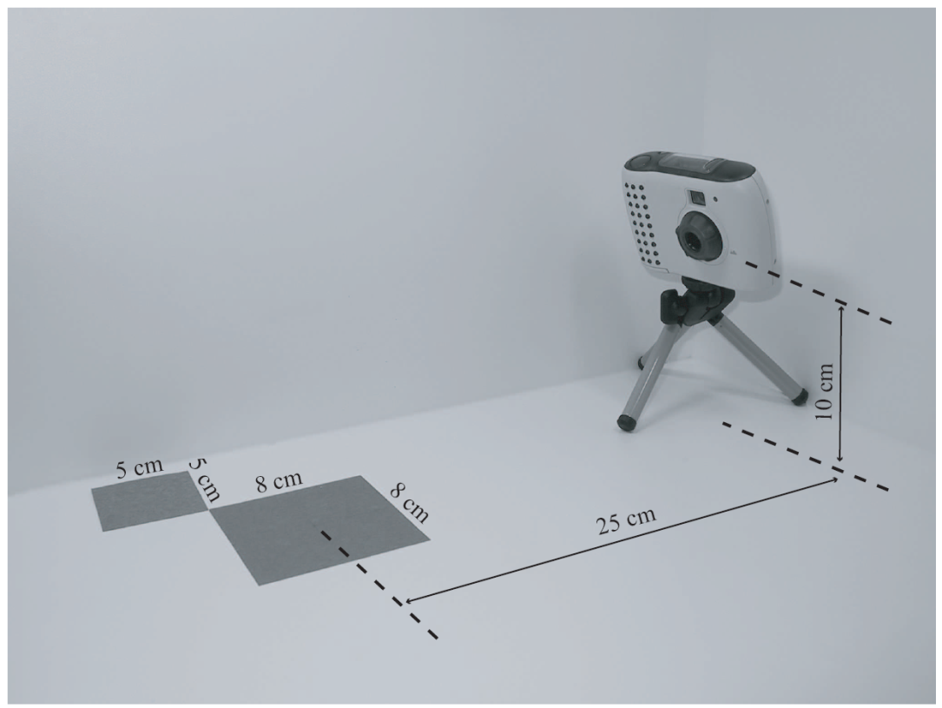
Illumination Model
How to compute color to represent a scene
As in taking a
photo in real life:
  Camera
  Lighting
  Object
    Geometry
    Material
Illumination model:
  Combine all to produce a color
Light source
Camera
material property
Object geometry (shape, size, location)

Slide 2


Ambient Light
Simplest model: when all lights are off!
Still sees color!
  Why?
  How to model?
    is the “ambient” light
    is the object’s “ambient” material property!
A “Vector” equation: RGB
Blend, flat, no 3D features

Slide 3
Diffuse Reflection
Intensity of paper in relation with light source
In coming energy: is scattered uniformly in all directions according to the “facing” of the paper
Normal Vector
of the paper

Slide 4
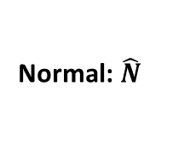
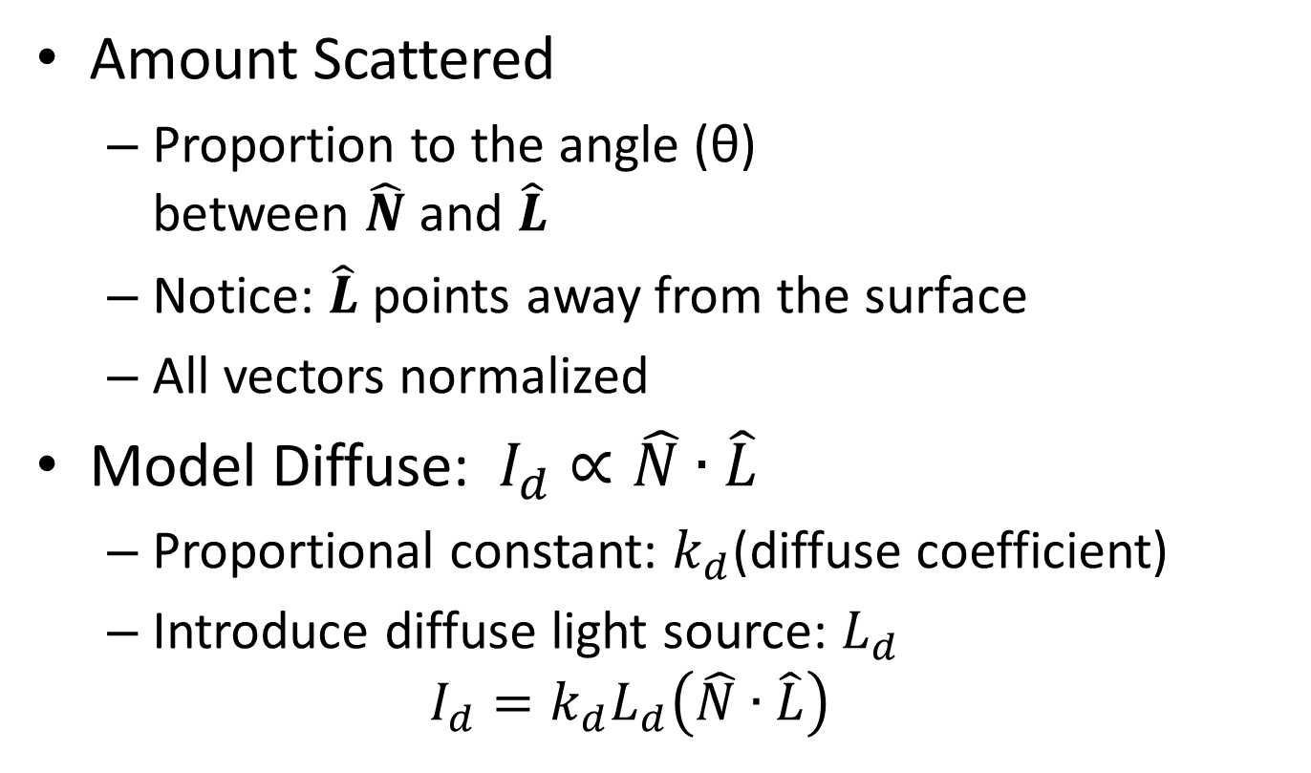
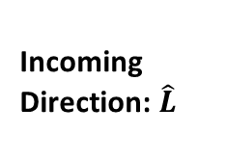
Model Diffuse Reflection
Normal: $\hat{N}$
θ
Incoming Direction: $\hat{L}$
Amount Scattered
  Proportion to the angle (θ)
  between $\hat{N}$ and $\hat{L}$
  Notice: $\hat{L}$points away from the surface
  All vectors normalized
Model Diffuse:$I_{d}∝\hat{N}∙\hat{L}$
  Proportional constant: $k_{d}$(diffuse coefficient)
  Introduce diffuse light source: $L_{d}$
  $$I_{d}=k_{d}L_{d}\left(\hat{N}∙\hat{L}\right)$$

Slide 5
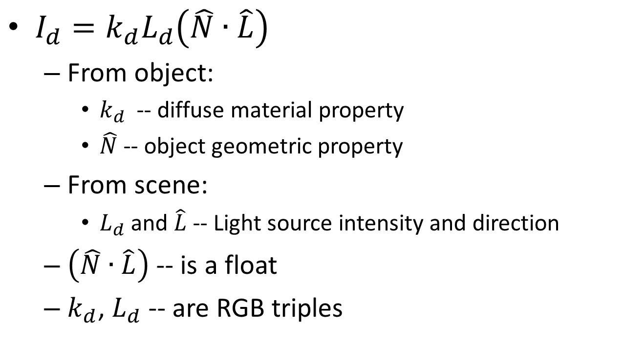
Diffuse Lighting
Normal: $\hat{N}$
θ
Incoming Direction: $\hat{L}$
$I_{d}=k_{d}L_{d}\left(\hat{N}∙\hat{L}\right)$
  From object:
    $k_{d}$ -- diffuse material property
    $\hat{N}$-- object geometric property
  From scene:
    $L_{d}$ and $\hat{L}$-- Light source intensity and direction
  $\left(\hat{N}∙\hat{L}\right)$ -- is a float
  $k_{d}$, $L_{d}$ -- are RGB triples

Slide 6
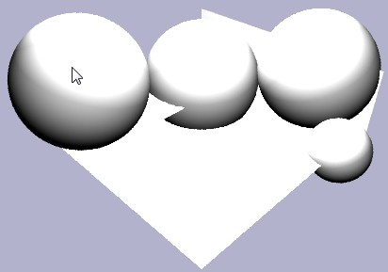
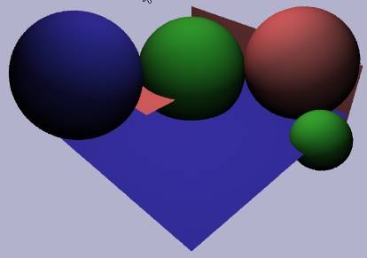
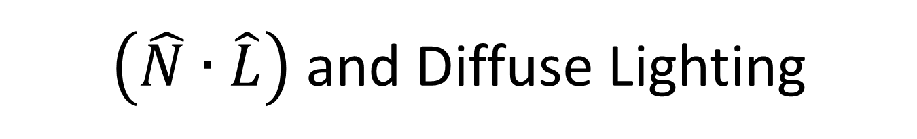


$\left(\hat{N}∙\hat{L}\right)$ and Diffuse Lighting
$$I=\left(\hat{N}∙\hat{L}\right)$$
$$I_{d}=k_{d}L_{d}\left(\hat{N}∙\hat{L}\right)$$

Slide 7
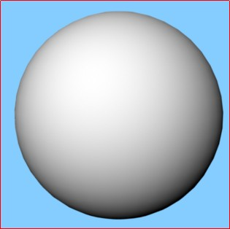
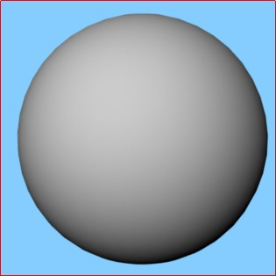
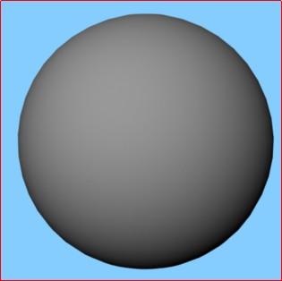
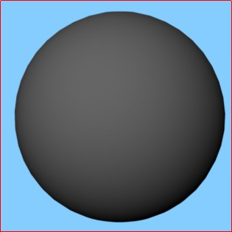
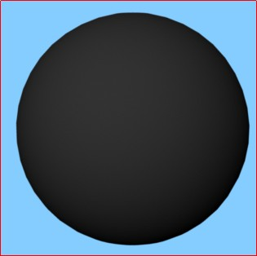
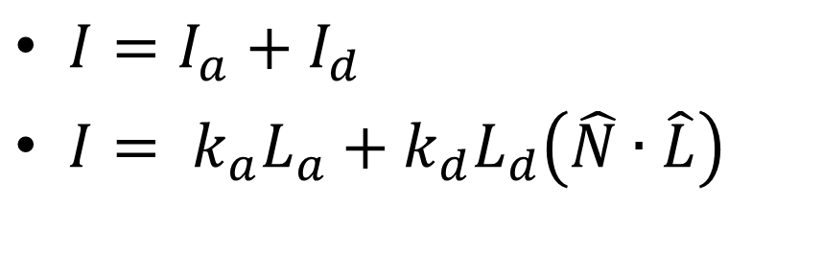
Combine: Ambient and Diffuse
$I=I_{a}+I_{d}$
$I= k_{a}L_{a}+k_{d}L_{d}\left(\hat{N}∙\hat{L}\right)$
kd(1,1,1)
kd(0.8)
kd(0.6)
kd(0.4)
kd(0.2)

Slide 8
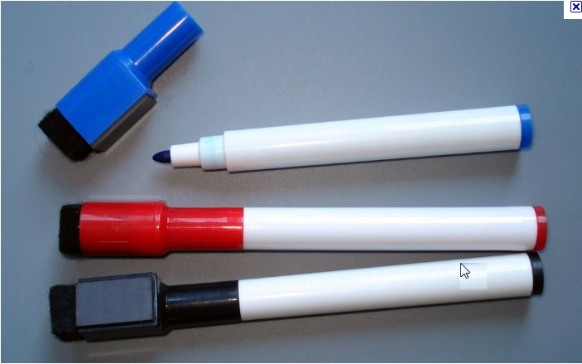
Look at my White Board Marker!
What are these? “shinning” white stuff?
Image credit:
Some random site selling random stuff
Reflection of
Light Sources!!
Visible: scattered energy is a function of how far from mirror reflection direction
In coming energy:
is scattered mainly in the mirror reflection direction

Slide 9

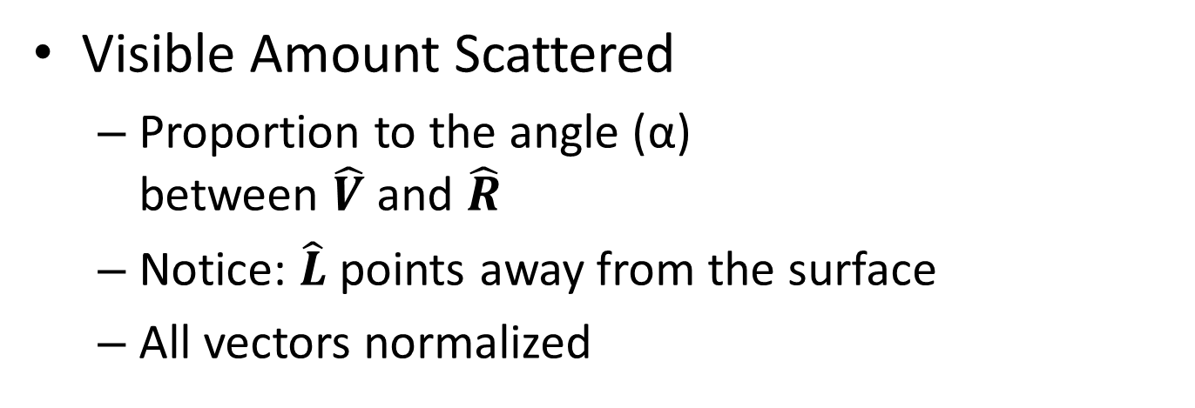
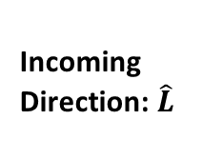
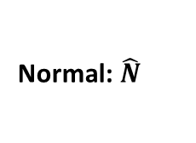
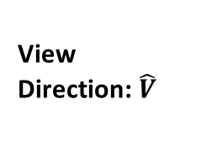
Model Specular Reflection
View Direction: $\hat{V}$
Normal: $\hat{N}$
Incoming Direction: $\hat{L}$
α
Reflection Direction of Light: $\hat{R}$
θ
Visible Amount Scattered
  Proportion to the angle (α)
  between $\hat{V}$ and $\hat{R}$
  Notice: $\hat{L}$points away from the surface
  All vectors normalized

Slide 10






Specular Reflection
$I_{s}∝\hat{V}∙\hat{R}$
  Proportional constant:
  $k_{s}$(specular coefficient)
  Specular light source: $L_{s}$
    $I_{s}=k_{s}L_{s}\left(\hat{V}∙\hat{R}\right)$
From object:
  $k_{s}$ -- specular material property
  $\hat{N}$-- object geometric property
From scene:
  $L_{s}$ and $\hat{L}$-- Light source intensity
  and direction
  $\hat{V}$-- is defined by camera
  $\left(\hat{V}∙\hat{R}\right)$ -- is a float
  $k_{s}$, $L_{s}$-- are RGB triples
$$\hat{V}$$
$$\hat{N}$$
$$\hat{L}$$
α
$$\hat{R}$$
θ
But, where does $\hat{R}$ come from??

Slide 11
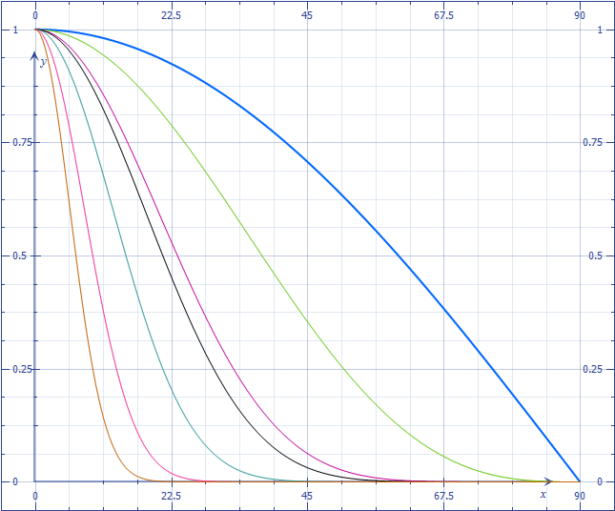





Inadequacy of $\hat{V}∙\hat{R}$
$I_{s}=k_{s}L_{s}\left(\hat{V}∙\hat{R}\right)$
Introduce: n – shinningness
$I_{s}=k_{s}L_{s}{\left(\hat{V}∙\hat{R}\right)}^{n}$
$$\hat{V}$$
$$\hat{N}$$
α
$$\hat{L}$$
$$\hat{V}∙\hat{R}$$
Drops off too slowly
$$\hat{R}$$
θ
Need to control drop off rate
α
90$°$

Slide 12
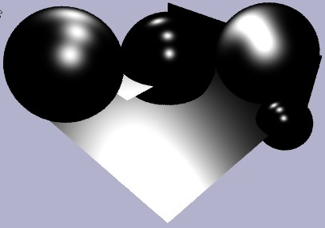
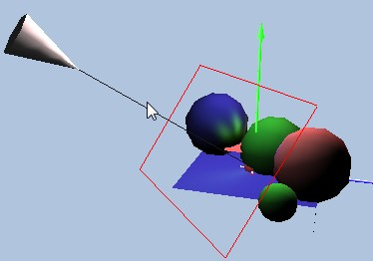
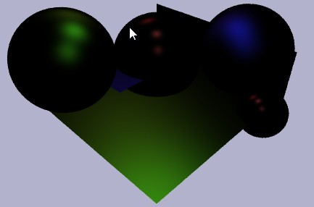


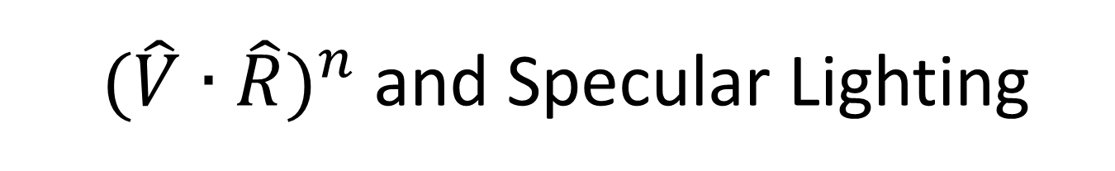
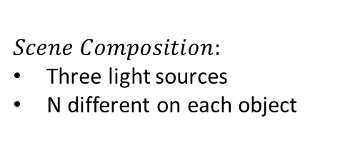




${ (\hat{V}∙\hat{R})}^{n}$ and Specular Lighting
$n=5$0
$$n=1$$
$n=1$0
$$n=10$$
$$I={\left(\hat{V}∙\hat{R}\right)}^{n}$$
$$Scene Composition:$$
Three light sources
N different on each object
$$I_{s}=k_{s}L_{s}{\left(\hat{V}∙\hat{R}\right)}^{n}$$

Slide 13
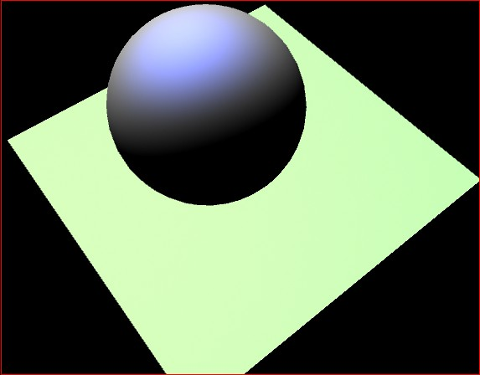
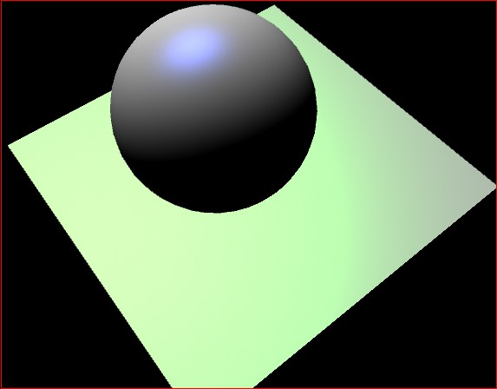
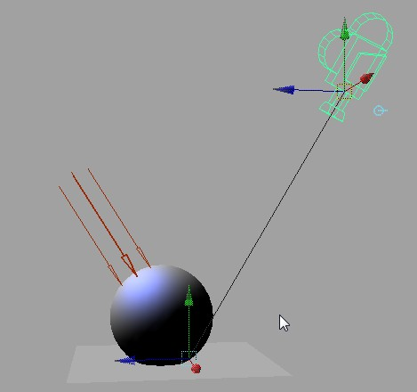

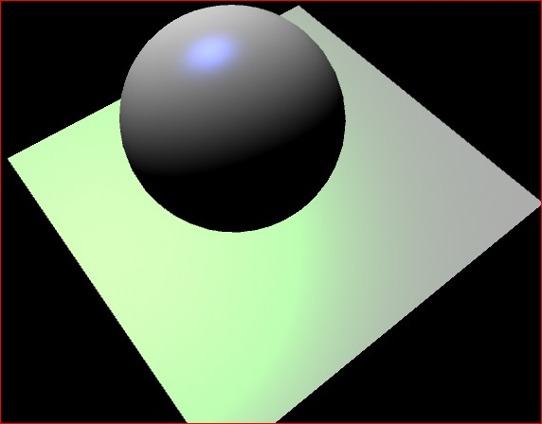
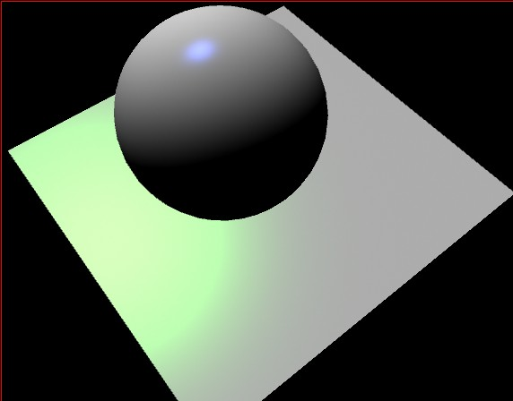


Combine all:
$$I=I_{a}+I_{d}+I_{s}$$
$$I=k_{a}L_{a}+k_{d}L_{d}\left(\hat{N}∙\hat{L}\right)+k_{s}L_{s}{\left(\hat{V}∙\hat{R}\right)}^{n}$$
n=2
n=10
Scene Composition
n=20
n=50

Slide 14





The Reflection Halfway Vector
$\hat{R}=2\left(\hat{N}∙\hat{L}\right)\hat{N}−\hat{L}$
  Must compute
  for each pixel
  Very expensive!!
Introduce halfway vector ($\hat{H}$)
  $\hat{H}=\left(\frac{\hat{V}+\hat{L}}{2}\right)$
  $I_{s}=k_{s}L_{s}{\left(\hat{N}∙\hat{H}\right)}^{n}$
$$\hat{V}$$
$$\hat{N}$$
$$\hat{L}$$
α
$$\hat{R}$$
θ
$$\hat{H}$$
$$\hat{N}$$
$$\hat{L}$$
$$\hat{V}$$

Slide 15




The Phong Illumination Model
$I=k_{a}L_{a}+k_{d}L_{d}\left(\hat{N}∙\hat{L}\right)+k_{s}L_{s}{\left(\hat{V}∙\hat{R}\right)}^{n}$
All graphics hardware implements (maybe
small variation
of this mode)
  E.g., the H vector
$$\hat{N}$$
$$\hat{L}$$
$$\hat{R}$$

Slide 16
Evaluating the Phong Model
Question:
  How to improve the model?
Non-physically based
  Based on “observation”
  E.g., specularity: as n increase the area under the curve decreases
    Large n => less energy in the scene!
  E.g., “Ambient” term
    Color bleeding

Slide 17
Recently : describe/simulate physics
Radiance: Light energy in a direction
  Think river: flow of energy over cross section area
Irradiance: Radiance received from fixed incoming area
BRDF: (material properties)
  Bi-directional Reflectance Distribution Function
  How energy reflect across surfaces
  Angular and Spectrum dependencies
Challenges:
  Difficult to model correctly
  Computationally costly
  What is the ultimate goal?
    looks good vs. looks real

Slide 18
Recently: physics only if ..
As long as it looks good, who cares?
  Games, Movies, etc.
Physics: Looks real
  But: does it look “good”?

