Slide 1
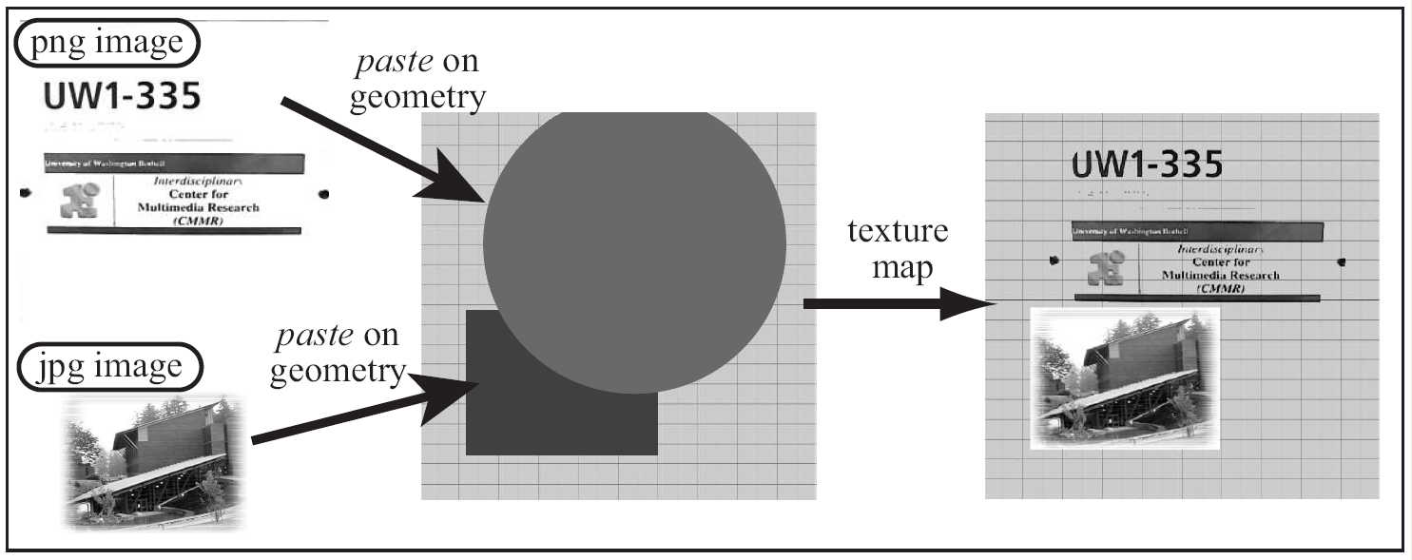
File Texture Mapping
Pasting images on primitives

Slide 2
File Texture and Mapping
File Texture: an image file
  A 2D array of color stored in a file
    Texel: each color element in the file
  Any image or digital photograph
  Images are stored in formatted files:
    E.g.: gif, jpg, tiff, png.
Mapping: “pasting on”
  Paste the image (file texture) on a given primitive

Slide 3
Texture Coordinates
Mapping: matching of coordinates
  A coordinate system on image file
    (st) - coordinate
  A coordinate system on primitive
    (uv) - coordinate
Mapping:
  Match the two coordinate systems!

Slide 4
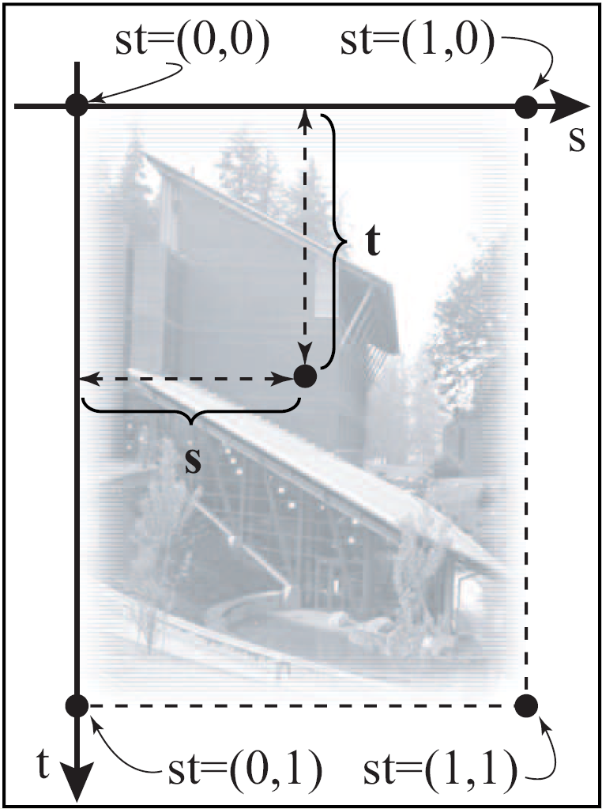
Implicit st – Coordinate System
implicitly defined on
all file textures
  Origin: upper-left corner
  s-Axis: Right-wards
  t-axis: down-wards
  Range: 0.0 to 1.0
  Coverage: always the
  entire image!

Slide 5
Explicit uv – Coordinate System
uv are
  Defined on the Primitives
  Defined by, us, the programmers!
Each vertex of a primitive:
  A Position: (x, y, z)
  A Color: (r, g, b)
  NOW: Texture Coordinate (u, v)

Slide 6
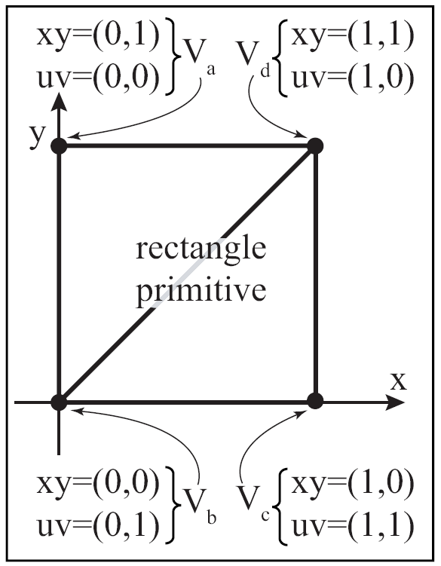
Example of defining uv: rectangle

Slide 7
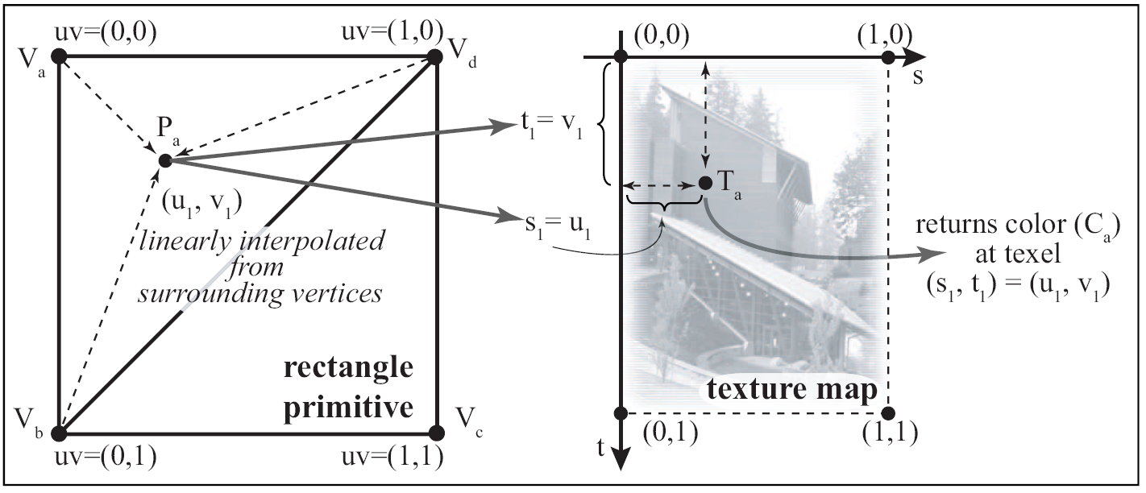
Mapping: Texel lookup
Texel color (C_{a}) used as color of primitive

Slide 8
Programming File Texture
We must define uv-coordinate on primitives
Select/Load an image file into the graphics API
Define how texel will be used
Enable texture mapping before drawing the primitive

Slide 9
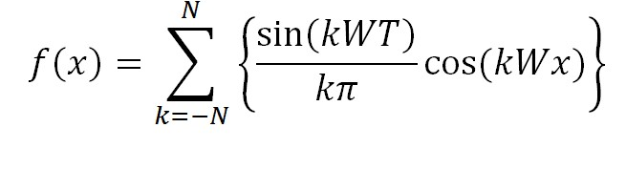
Texture Mapping
Sample locations
One scaneline
Distance between the samples:
  Small ➔ High sampling rate
  Large ➔ Low sampling rate
BAD NEWS!!
  Square signal (checker transition) has infinite frequency! (N → ∞ for

Slide 10
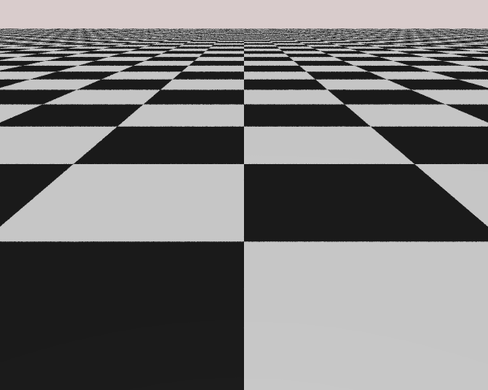
One line of pixels
Intensity of the pixels

