Slide 1
Rendering Depth Perception through Distributed Ray Tracing
Ryan May, Ruth Ogunnaike, Craig Shih

Slide 2

Depth Perception and Image Focus
•Depth perception is the visual ability to perceive the world in three dimensions (3D) and the distance of an object.
•It is difficult to recognize the distance of an object (and between objects) in an image or world without defining depth of the object(s) in view

Slide 3
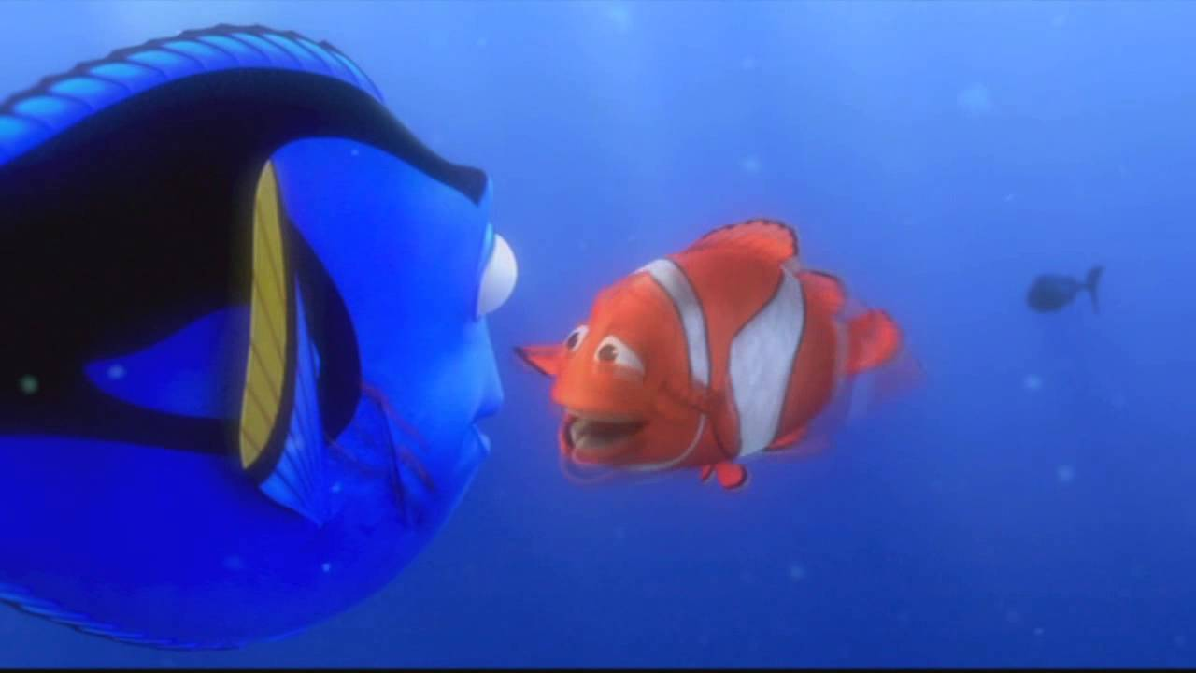
Objects in image…

Slide 4
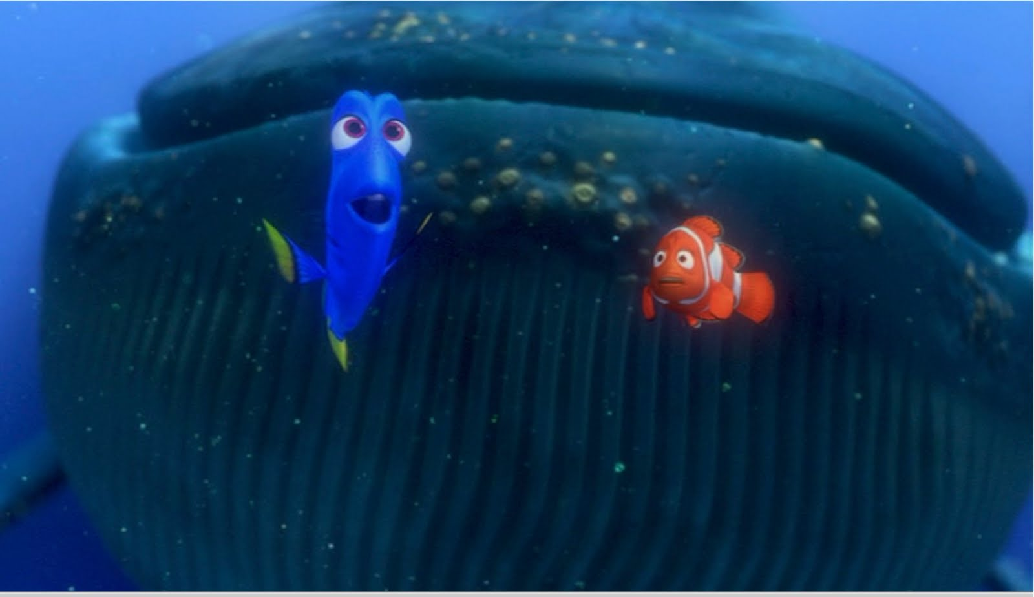
…may be larger than they appear

Slide 5
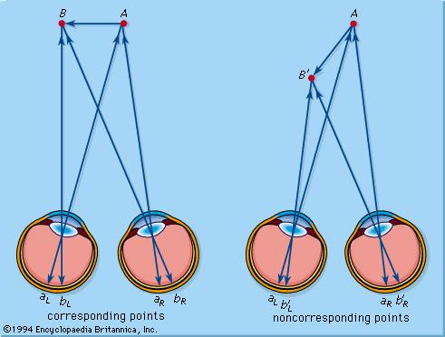
Basic Human Vision

Slide 6

Camera Model

Slide 7

Scene Scale and Focus Ability

Slide 8
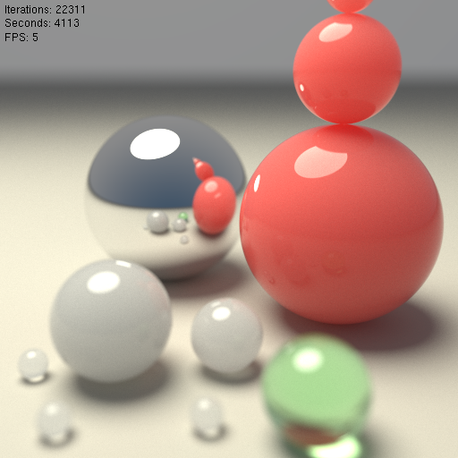
Scene Scale and Focus Ability

Slide 9
Rendering Depth Perception Techniques
Distributed Ray Tracing
  Depth of Field
Post processing
  Gaussian Filter Techniques
  Bilateral filter techniques

Slide 10
  Gaussian Filter Techniques
Gaussian filters weigh pixels based on their distance from the center of the convolution filter. (Convolution takes two images as input(an image and the kernel filter) and produces a third image as output).
The Gaussian filter is a local and linear filter that smoothens the whole image irrespective of its edges or details
  Noise is blurred while preserving the features of the image
  Tackle inaccuracies in the depth maps
  Aims at eliminating edge effects by weight contribution of neighborhood pixels to their closeness to the center (computes the weighted sum of the pixels in a window centered at a pixel).
With increasing window size, edges are lost.
  A Gaussian kernel gives less weight to pixels further from the center of the window

Slide 11

Gaussian filters (Contd.)
Gaussian Function
σ = size of the window
GC[I]p = Gaussian filter applied on image I.
p, q = 2-dimensional pixel coordinates.
Iq = intensity values of pixels p and q.
wp = window centered at pixel p.
Gσ (||p − q||) = normalized Gaussian function (space)
Convolution with self is another Gaussian
  So can smooth with small-width kernel, repeat, and get same result as larger-width kernel would have
Only considers the spatial distance of the pixels to compute the weights in a filter kernel.
It does not preserve edges

Slide 12
Bilateral filter techniques
  The bilateral filter is an edge-preserving filter.
  For a given pixel, its denoised counterpart is obtained by the weighted average of its neighbors, where the weights are given by some function that depends on their color similarity and image distance.
It considers the difference in the intensity values (in addition to the spatial distance of the pixels).
  Dissimilar pixels that e.g., occur at edges of the processed image are maintained.
  Spatial and intensity closeness are combined to ensure that only nearby similar pixels are considered in the smoothing process
Bilateral filters can be slow especially for large spatial kernels (the number of pixels)

Slide 13
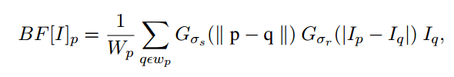
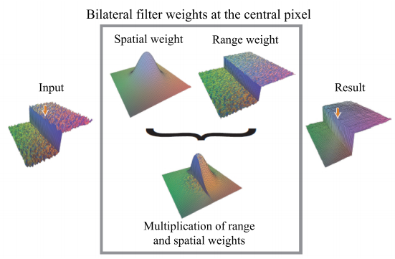
Bilateral filter (Contd.)
BF[I] = bilateral filter applied on image I.
p, q = 2-dimensional pixel coordinates.
Ip, Iq = intensity values of pixels p and q.
wp = window centered at pixel p.
Wp =normalized term of the pixel weights
Gσs (||p − q||) = spatial weight (decreases the
influence of distant pixels)
Gσr (||p − q ||) = range weight (decreases the
influence of dissimilar pixels in color or intensity).
σs, σr = the standard deviation of the spatial filter Gσs and the range filter Gσr .
Source: Matej Nezveda, 2014

Slide 14
Solution and Implementation Strategy

Slide 15
Depth of Field through Distributed Ray Tracing
Normal Ray Tracing (What we’ve done so far in class)
  Similar to a pinhole camera where all light is focused through one specific point
    Uses one single point as the origin of all rays traced through the world
  Entire image is sharp and focused
Distributed Ray Tracing
  Removes the restriction of having one single point
  Ray origins are distributed over a specific interval
  Similar a camera lens that includes an aperture
    Aperture - an opening, hole, or gap.

Slide 16
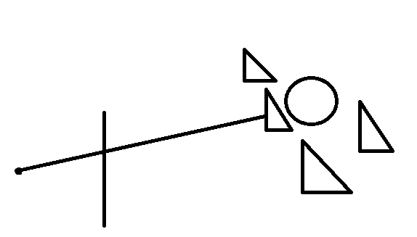
Normal Ray tracing
Ray
(i,j) pixel position
Eye position
Scene
Image plane

Slide 17
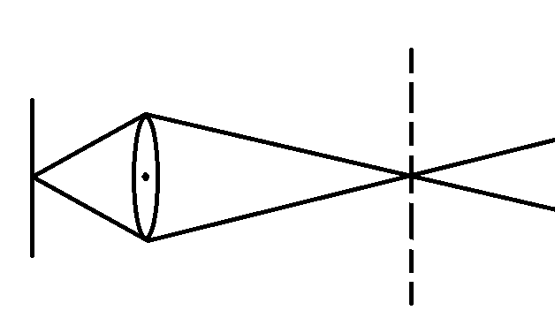
Lens Covexity and Depth of Field
lens
Image plane
Focal plane
Notes:
Explain how the lens concavity effects the rays traced.
Explain how the focal plane is found in real life as in the concavity of the lens will effect where the focal plane is at

Slide 18
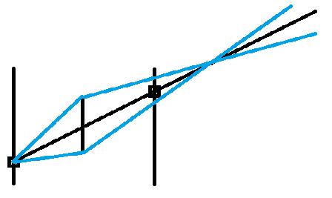
Working solutions for Depth of field
Two ways of thinking about this
  Image plane prior lens (IPprior)
    Requires the image to be flipped at the end of the process
  Image plane after lens (IPafter)
    Doesn’t require image to be flipped at the end of the process
    More directly related to how we’ve been performing ray tracing in class
Primary Ray
Focal distance
Secondary Ray
Lens center (eye position)
IPprior
IPafter

Slide 19
Working solutions for Depth of field
Modify RTCamera
  mEye as lens center
  Radius for lens will be read in from XML file
  Focal distance will be read in from XML file
getRandomLensPosition() function will be implemented in RTCamera
  Returns a random Vector3 that is within the radius with center mEye
  Uses Side Direction and UP Vector to determine x,y position (relative to the viewing direction)
    Generate a random angle
      angle = Rand.NextDouble()*Math.PI*2
      randRadius = Math.Sqrt(Rand.NextDouble()) * radius
        The random is sqrt here because without sqrt random, the random points will be more concentrated towards the center.
        This is because the mean distance between 2 neighboring points is smaller near the center then it is on the outer edges resulting in a higher density near the center.
      x = Math.cos(angle) * randRadius
      y = Math.sin(angle) * randRadius
      randomPos = mEye + (x * SideDirection) + (y * UpVector)
Notes:
The problem is that the mean distance between 2 neighboring points is
smaller near the center then it is at the circumference. So the number
of points near the center is packed tighter -> the point density (nr of points
per partial volume) is higher. Depending on the application this might
or might not be acceptable.

Slide 20
Working solutions for Depth of field
getFocalPoint(Ray r) function will be implemented in RTCamera
  Returns a Vector3 focal point
  focalPoint = mCamera.EyePosition + (primaryRay * focalDistance)
Secondary Rays can now be generated from the RandomLensPosition to the focalPoint
Visibility will then be computed for each of the secondary rays

Slide 21
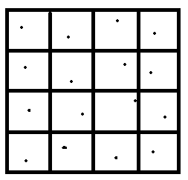
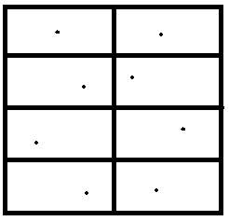
Jitter Sampling
Since distributed ray tracing requires the averaging of multiple intersection points color to return each pixel color, a sampling method will need to be chosen
Jitter Sampling – each point in each broken up section is randomly selected – overall box is one pixel
Will be implementing 8 samples per pixel

Slide 22
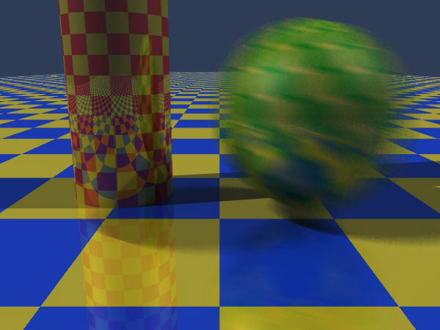
Motion Blur
Apply stochastic sampling to time as well as space
Assign a time as well as an image position to each ray
The result is still-frame motion blur and smooth animation

Slide 23
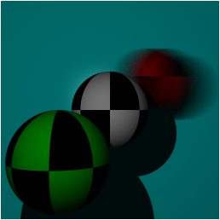
Motion Blur
Create a time element to each ray
Have a List of positions for each object in the field. If List is size == 1 then no motion. If more than one than motion.
  Based on the time of the ray, will check a certain position for the object when computing intersection
Having the rays intersecting at different “times” will result in a motion blur effect if enough samples are taken.
Image taken from UNC

Slide 24
Potential Problems with distributed ray tracing
Number of samples required to produce a accurate well rendered picture is usually 50 samples or higher
  Expensive to compute that many samples
Time to render will take longer than post processing.

Slide 25
Benefits of Distributed Ray Tracing for Depth of Field
Since visibility is calculated from multiple points (whereas postprocessing is still calculated from a single point)
  Results in a more accurate depiction of depth of field
Allows for other effects such as Motion Blur, Area Light to be implemented.

Slide 26
References
[1] R. Baltazar, “Adding Realistic Camera Effects to the Computer Graphics Camera Model,” 2012.
[2] B. A. Barsky and T. J. Kosloff, “Algorithms for rendering depth of field effects in computer graphics,” in Proceedings of the 12th WSEAS international conference on Computers, 2008, vol. 2008.
[3] B. A. Barsky, D. R. Horn, S. A. Klein, J. A. Pang, and M. Yu, “Camera Models and Optical Systems Used in Computer Graphics: Part I, Object-Based Techniques,” in Computational Science and Its Applications — ICCSA 2003, V. Kumar, M. L. Gavrilova, C. J. K. Tan, and P. L’Ecuyer, Eds. Springer Berlin Heidelberg, 2003, pp. 246–255.
[4] J. D. Pfautz, Depth perception in computer graphics. University of Cambridge, 2000.
[5] N. Tai and M. Inanici, “Depth perception in real and pictorial spaces: A computational framework to represent and simulate the built environment,” in Proceedings of the 14th International Conference on Computer Aided Architectural Design Research in Asia, Yunlin (Taiwan), 2009, pp. 543–552.
[6] R. L. Cook, T. Porter, and L. Carpenter, “Distributed Ray Tracing,” in Proceedings of the 11th Annual Conference on Computer Graphics and Interactive Techniques, New York, NY, USA, 1984, pp. 137–145.
[7] P. Lebreton, A. Raake, M. Barkowsky, and P. Le Callet, “Evaluating depth perception of 3D stereoscopic videos,” Selected Topics in Signal Processing, IEEE Journal of, vol. 6, no. 6, pp. 710–720, 2012.
[8]Matej N., “Evaluation of Depth Map Post-processing Techniques for Novel View Generation“, Vienna University of Technology, 2014
[9] Yung-Yu C., Ramesh R., Fredo D., Sylvain P., Soonmin B., “Digital Visual Effects: Bilateral filtering” , DigiVFX, 2010

