Slide 1
Projection Texture Mapping
ROBERT BEZIRGANYAN & ADEDAYO ODESILE
CSS 552 RESEARCH PRESENTATION

Slide 2
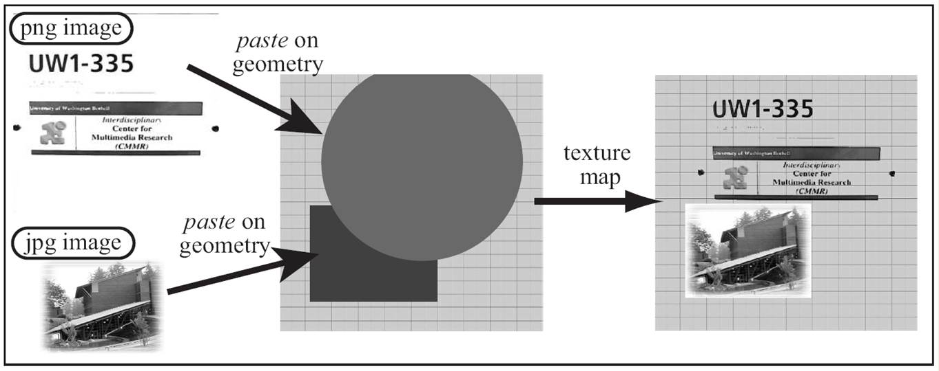
What is Texture Mapping?
Wrapping a primitive with a complex surface.
Source: Prof K. Sung, CSS 552 Texture Mapping Class Slides

Slide 3


Why Texture Map?
Because it looks good.
Because it’s fun.
(Default answers we give when Professor Kelvin throws an open question to the class).
Because it provides a means of specifying complex and realistic surfaces for different objects in a scene.
(Too serious/formal).

Slide 4
Our Ray-Tracer currently supports UV texture mapping
We define a UV coordinate space for each geometry.
For every sampled point on the geometry, we convert its position to a UV coordinate.
UV coordinate is mapped to ST coordinate space to retrieve a texel for the pixel.
(X,Y,Z) -> (u,v) -> (S,T)->Texel

Slide 5
Our Ray-Tracer currently supports UV texture mapping
AND WE’RE DONE!!!

Slide 6
Why do we still need another form of texture mapping?
UV Texture-mapping is quite restrictive (i.e. no varieties).
Implementation is tightly coupled to geometry (UV has to come from geometry).
Defining the UV coordinate space for a mesh is daunting.
We want to put more fun in texture mapping.

Slide 7
Projection Texture Map
A texture projector is defined per object/per scene (depending on the implementation) and attached to an existing texture to be projected.
The projector serves as a texel lookup for sampled points in the geometry(ies) within its scope. [No need for UV from geometry]
The projector could either be perspective or orthographic in nature.
Texture Projector
Texture Projector
………….
……………
Perspective Texture Projection
Orthographic Texture Projection
Geometry
Geometry

Slide 8
Advantages of projection mapping
Could be scoped to geometry or to the scene.
It is more intuitive in nature.
It lends itself to more interesting use-cases due to the flexibility in specifying properties of the texture projector.
The main idea is modelled around the type of projector used to project the texture.

Slide 9
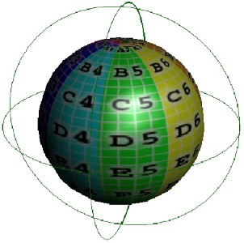
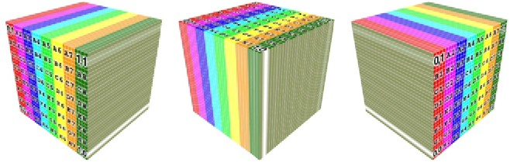
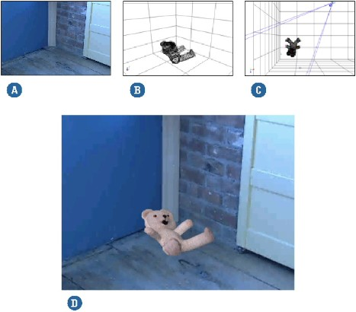
Some Types of Texture Projectors
Planar Projector: project a texture along an axis onto the specified plane.
Spherical Projector: project a texture onto an object like its wrapped in a spherical projector.
Camera Projector: projects a texture from the camera onto the object’s surface.
Source: http://softimage.wiki.softimage.com/xsidocs/tex_basicproc_TypesofTextureProjection.htm

Slide 10
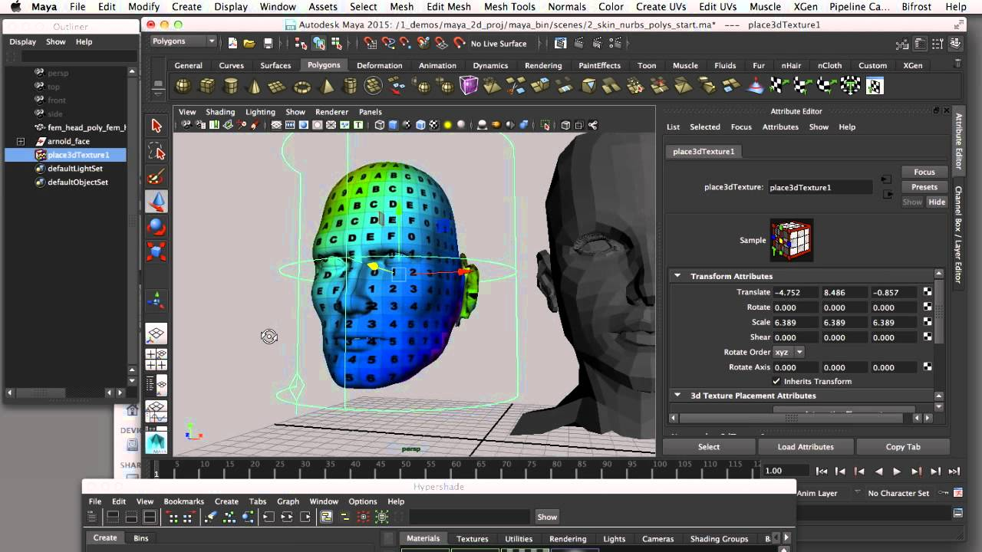
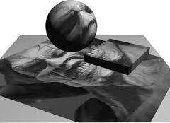
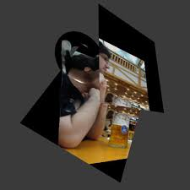
http://developer.nvidia.com
Projection Texture Mapping on Maya (Google Images)
http://www.inf.ufrgs.br/~hgdebarba/CMP249.html

Slide 11
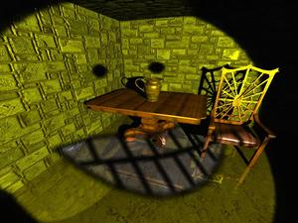
Projection Texture Map is NOT Light Texture Map
✓
✗
Affects Material Color
Affects Light Color

Slide 12
Our Scope of Implementation
We have decided to implement an object scoped planar texture projector in both parallel and perspective mode.
If time permits, we would implement other interesting texture projectors like the spherical or camera projector.

Slide 13
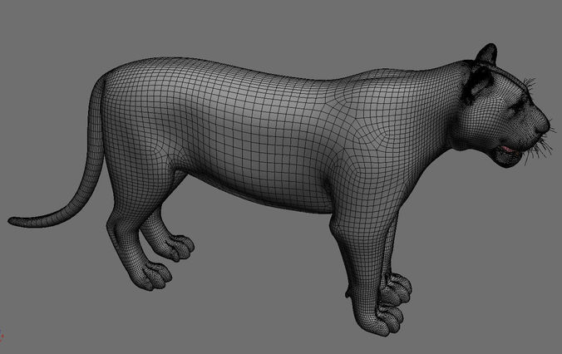
A More In-depth Look
Our implementation revolves around finding the bounding box of an object
We select the top (in Y direction) of the bounding box to be the image plane for the projector
Orthographic
Perspective
https://www.cgtrader.com/3d-models/animals/mammal/awesome-tiger-3d-model

Slide 14
RTMesh
RtMesh is a class that represents a 3D model created from mesh (many RTTriangles)
Includes the Projector object and the bounds of the complex object
Identified with a unique ID
Stored in Scene Database as an indexed Resource just like materials and lights
Abstracts the idea of getting diffuse color

Slide 15
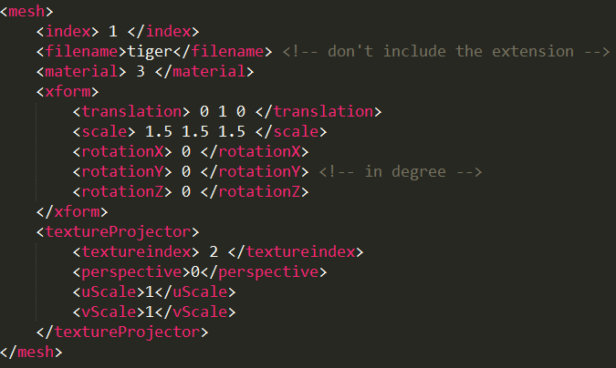
Sample Command File for RTMesh

Slide 16
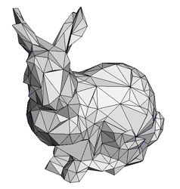
RTTriangle Modifications
Each RT Triangle holds a mesh id to represent the mesh they belong to
  Invalid id means that the triangle doesn’t belong to any mesh
http://www.cs.rpi.edu/~cutler/classes/advancedgraphics/F05/assignments/assignment2/bunny_badsimp_1.jpg

Slide 17
Other Modifications
Need to implement the ability for texture placement on the RTRectangle in order to scale the projected texture
Now, the RTGeometries are responsible for getting their Diffuse Color (Kd)
UV(0.75,0.75)
UV(0.25,0.25)

Slide 18
Implementation Risk
Our current implementation is designed around only mesh objects, we hope to extend it to other primitives before final demonstration.

