Slide 1
PROJECTION TEXTURE MAP
ADEDAYO ODESILE & ROBERT BEZIRGANYAN
CSS 552 – TOPICS IN RENDERING

Slide 2
PROBLEM
UV Texture mapping is less flexible due to its tight coupling with the geometry.
Defining UV coordinates for mesh is daunting.
SOLUTION
Projection Texture mapping to the rescue.

Slide 3
SCOPE OF IMPLEMENTATION
There are several ways of projecting texture on objects ranging from planar to spherical, cubic, etc.
We decided to implement planar perspective, planar orthographic and spherical texture projection for meshes.
Planar orthographic
Planar Perspective
Spherical

Slide 4
Implementation
Defined a new scene resource RTMesh to group all mesh triangles by their respective mesh.
Specified texture projectors for any mesh to be texture mapped in the scene file.
An hierarchical object abstraction RTTextureProjector was defined to hold texture projectors in memory.
Bounding points (min and max) were extracted from RTTriangle parser for meshes to specify bounds for texture projection plane/sphere depending on the projection type.
Diffuse color lookup task was moved from material to the geometry to ease texel lookup from projector.
Texture projection plane was abstracted as a geometry to allow for texel ray intersection.
Intersection point was mapped to a texel with conventional UV mapping.
An horizontal and vertical scaling factor was specified for texture projector in the scene file.
RTRectangle (projection plane for planar) and RTSphere (projection for spherical) was modified to allow for scaling of computed UV values.

Slide 5
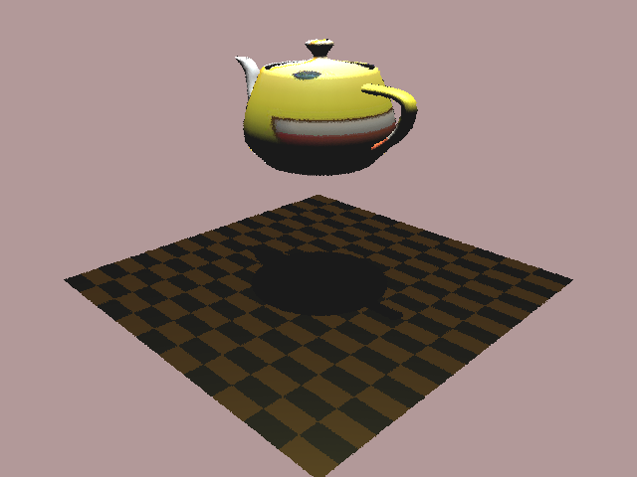
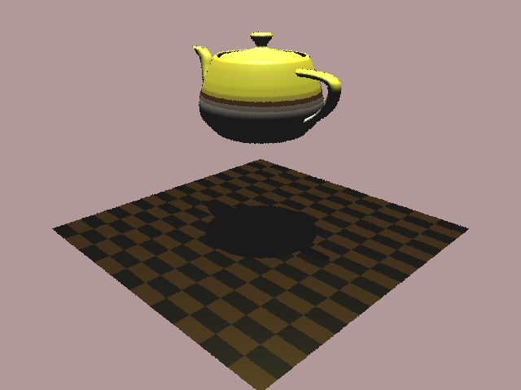
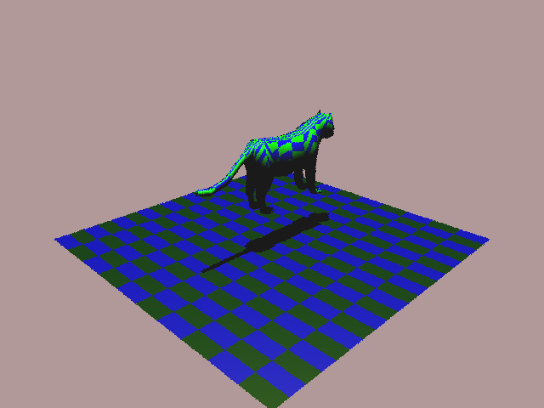
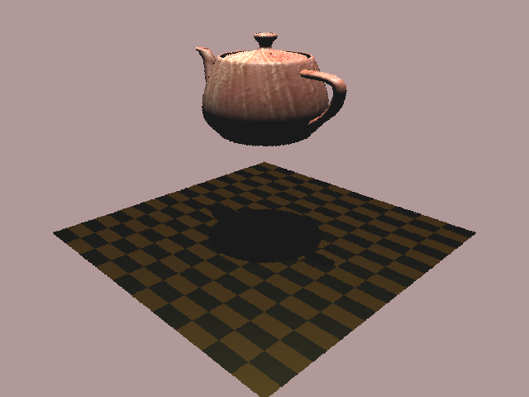
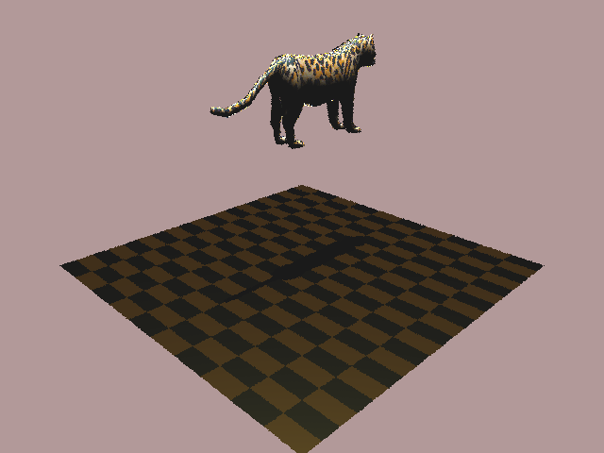
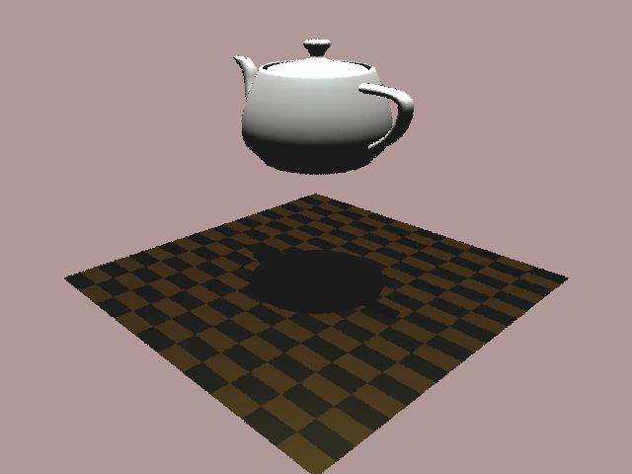
Sample results
Teapot (Spherical [x1 scale])
Teapot (Spherical [x0.25 scale])
Checkered Tiger (Planar Orthographic)
Clay teapot
Leopard
Ceramic Teapot

Slide 6
Bad shadowing
This was caused by triangles within a mesh intersecting with other triangles that belonged to the same mesh.
To take care of this we implemented a separate shadow visibility computation for mesh that uses an exceptMeshId in contrast to exceptGeomId.

Slide 7
DEMO

