Slide 1
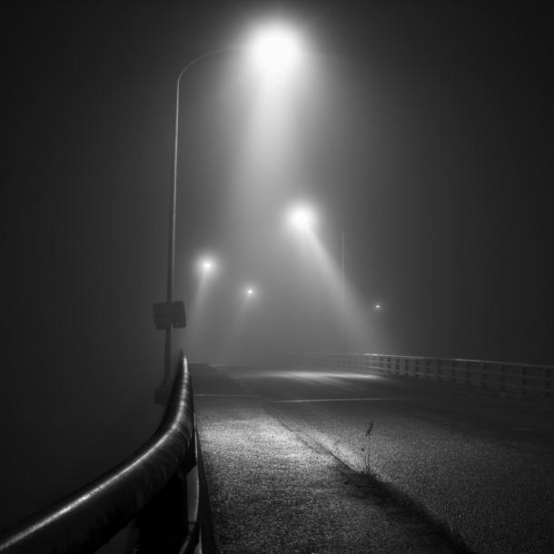
Volumetric Lighting Effects
By Thomas Brown and Albert Ng

Slide 2
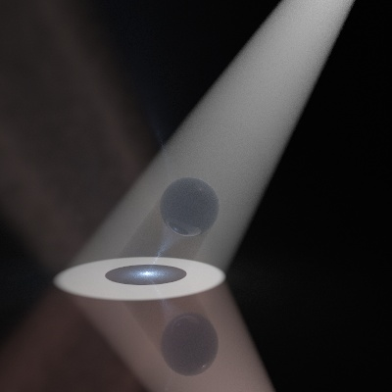
Review
Volumetric Lighting:
Creates a volume of light so that it can interact with objects
Fog:
Particle cloud
Hard to implement in current RayTracer
Needs to interact with light, which doesn’t interact with any geometries aside from casting rays

Slide 3
Review
Previous solution:
Make millions of tiny RTGeometries to simulate particles
Get garbage look to particle cloud
Our solution:
Make volumes to simulate particle cloud effects
Compute density over the volume of geometries
Utilize Perlin’s Noise to get a nice fog look

Slide 4
Code/Implementation
Created a VolumeIntersectionRecord
Kept track of entry and exit position
Kept track of entry and exit normals (useful for refraction)
Kept track of distance traveled along the record’s ray
Created Fog class
Density (Light, Average, Thick)
Resolution (Low, Medium, High, Ultrahigh)
Type (Uniform, Perlin, Snowglobe, Ramp)
Assigned geometries fog index for resource lookup

Slide 5
Code/Implementation
Used Beer-Lambert Law for attenuation
Had to rush project and make sure things look good, not implemented as thoroughly as we’d like
Just used for visibility attenuation (for light) and not for considering opacity of the fog
Utilized Perlin’s Noise
Updated SceneDatabase
Easy to write in a fog as a separate resource in a xml file

Slide 6
Code/Implementation
Example XML entry:
<fog>
<type>perlin</type>
<index>1</index>
<color>1 1 1</color>
<density>light</density>
<resolution>high</resolution>
<blockLight>1</blockLight>
</fog>

Slide 7
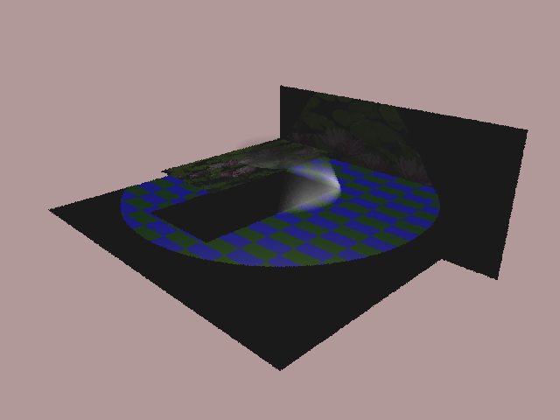
Results
Ramp Fog Inside of Cone (Average Density)

Slide 8
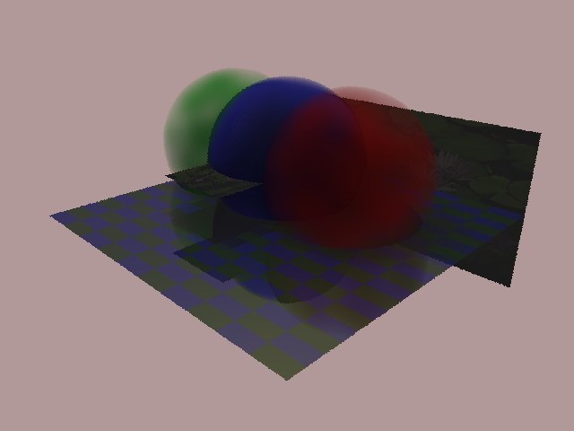
Results
Ultrahigh Resolution of Colored Perlin Fog Inside of Spheres

Slide 9
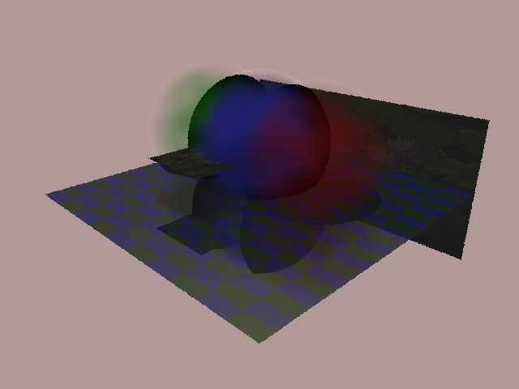
Results
Snowglobe Fog Inside of Spheres

Slide 10
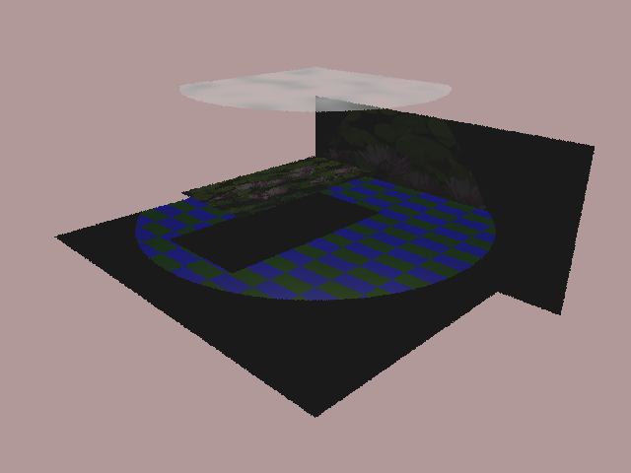
Results
Perlin Rectangle (Visibility not correctly attenuated by fog opacity)

Slide 11
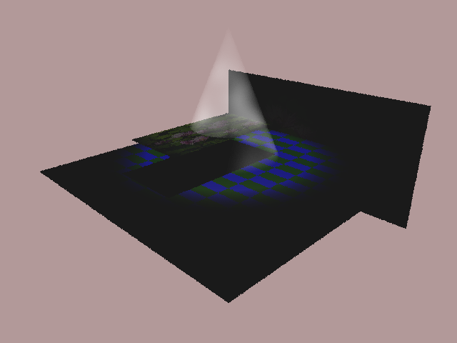
Results
Light Density Perlin Cone

Slide 12
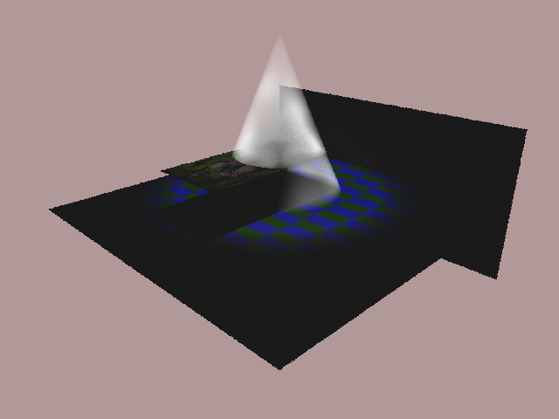
Results
Average Density Perlin Cone

Slide 13
Results
High Density Perlin Cone (Blocks Light)

Slide 14
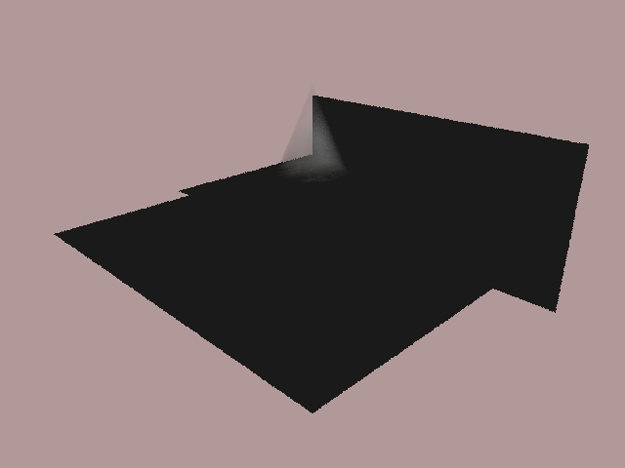
Results
Average Density Perlin Cone (Light inside Fog)

Slide 15
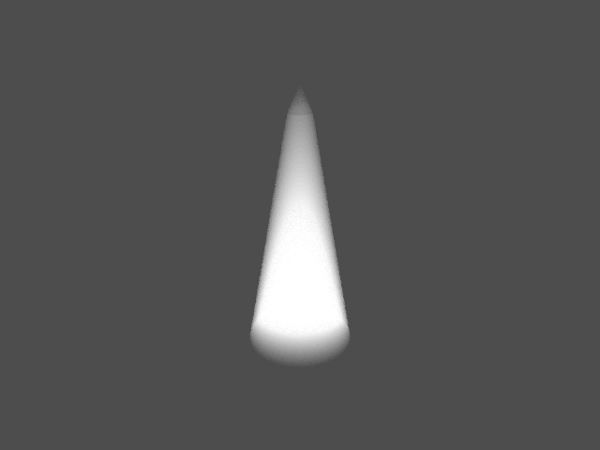
Results
Cones with Uniform Density

Slide 16
Cone with Perlin’s Noise

Slide 17
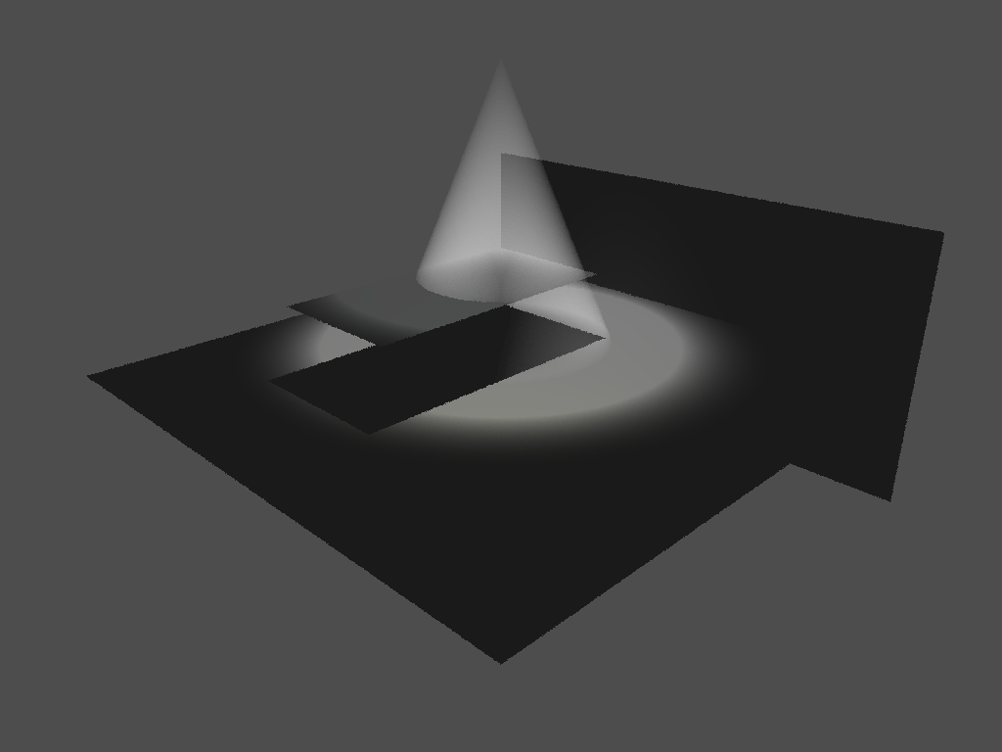

Slide 18
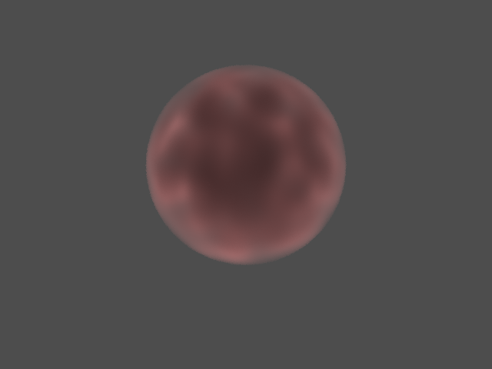

Slide 19
Remaining Problems
2D Objects aren’t treated like thick fogs due to their non-existent volume
Should be handled in code, but isn’t working properly
Fog opacity calculations don’t use Beer-Lambert’s Law
Had to make it look good
Ran out of time to fine tune and apply it as wanted
Assigning specific aspects of fog like a ramp’s cutoff height or a snowglobe’s border length have to be hard-coded in
Simple to add to XML
Ran out of time
Should make a “Quick” Resolution that utilizes the endpoints of 3D geometries to calculate everything (i.e. no sampling)

Slide 20
Thanks

