Slide 1
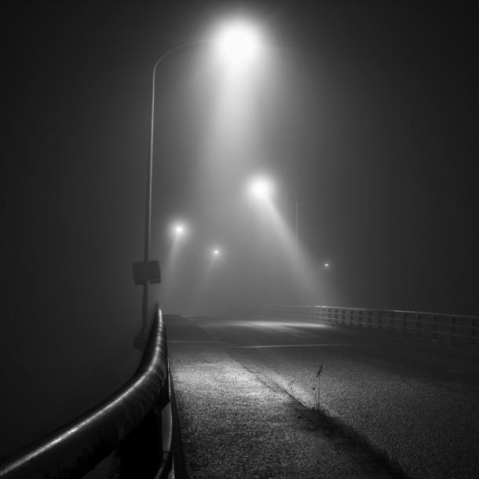
An Approximation of Volumetric Lighting
By Thomas Brown and Albert Ng

Slide 2
What We’ll Discuss...
What is Volumetric Lighting?
What’s the problem?
What’s our solution?
What are some issues we might encounter?

Slide 3
What is Volumetric Lighting?
Volumetric lighting gives lighting a 3D volume that can interact with other aspects of a scene
It can interact with items like fog or solid objects to create interesting lighting effects
Volumetric lighting can produce effects like:
Headlights in a foggy night
Sunlight coming through a window
Smoke blocking one’s view

Slide 4
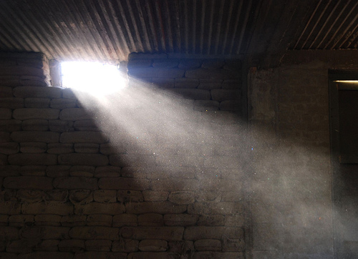
Pictures of Volumetric Lighting
Light Through A Window

Slide 5
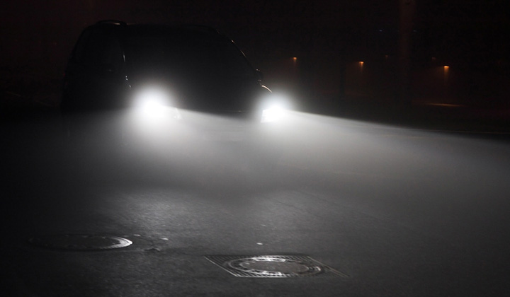
Headlights in Fog

Slide 6
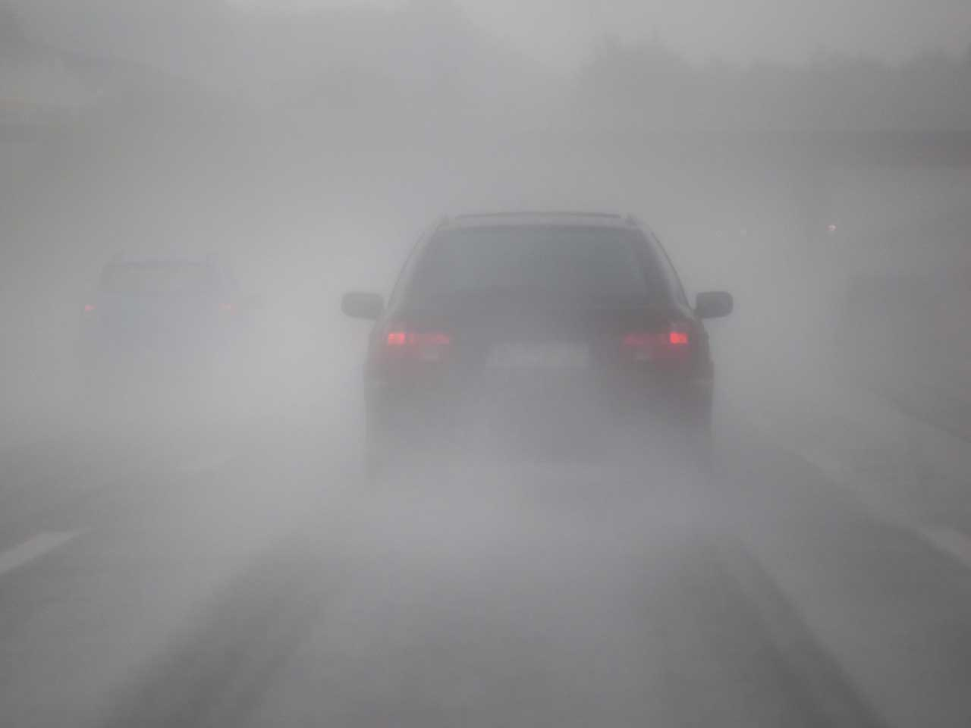
Obscured Vision

Slide 7
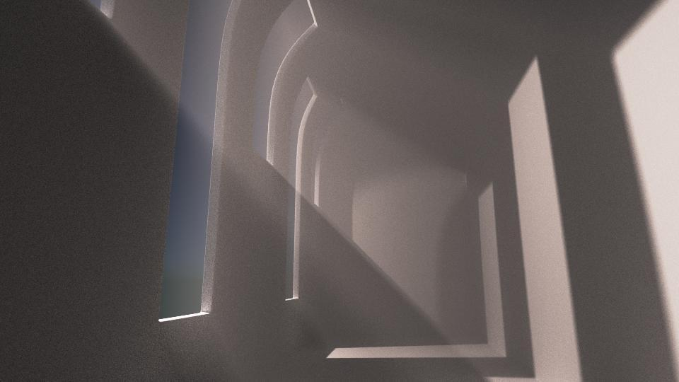
A Graphics Render of Volumetric Lighting

Slide 8
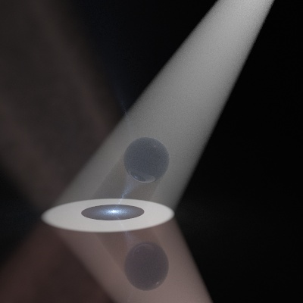
Another Graphics Render of Volumetric Lighting

Slide 9
The Problem
Must model interaction of light with billions of tiny particles representing fog or dust clouds
Refraction and reflection can add to the complexity
Must be feasible in terms of memory, computation time, and resources
Has to interact with the scene
Needs to look good
General volumes
Light attenuation
Light refraction/reflection
Fog should look like fog, not random noise

Slide 10
Analyzing Our Options
We can either:
Create a large number of tiny geometries that represent the particles suspended in the scene
Accurate!
SLOW
Create fog textures
Very fast!
Can get stretched
Won’t interact with the scene well
Create a geometry that can correctly represent and produce volumetric lighting effects
Slower than texture mapping
Looks decent
Can interact with the scene
More complicated to implement

Slide 11
Our Solution
Create geometries that will realistically represent lights or fog
Add a 3D cone as it a common geometry in volumetric lighting
Alter IntersectionRecord calculations to calculate both entry and exit points
Find a pseudo-random number generator that will give us somewhat similar results as we traverse a 3D environment
Normal RNG is terrible! Numbers aren’t related at all, will just give noise
Perlin’s Noise is perfect!
Approximate the density of particles inside the volume
Calculate light exposure/attenuation
Calculate shading along a ray

Slide 12
Aspects of Our Solution
Make 3D Geometries
Start with a cone
Intersect a ray with a cone
Update IntersectionRecord to work with 3D Geometries
Ray-marching
Density
Perlin’s Noise
Beer-Lambert’s Law

Slide 13
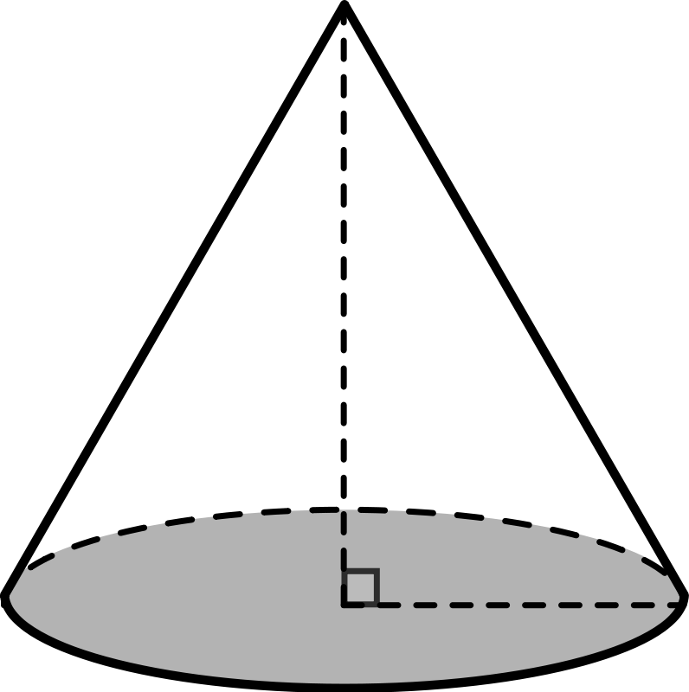
Cones

Slide 14
Cones
Cones are very common
Streetlamps
Spotlights
Headlights
Cylinder with one face having an area of 0
Requires:
Apex (Tip)
Direction of the Cone (from the apex to the base)
Length of the Cone (along the direction vector)
Angle between the direction vector and a side of the cone
Need to implement ray-cone intersections

Slide 15
Cones
Several types of intersections:
Ray could completely miss the cone
Ray could technically intersect the cone, but the cone is behind the ray’s origin
The ray could touch the cone at a single tangential point
The ray could enter AND exit the cone
The ray could originate inside of the cone and exit at a single point
Must consider intersections with:
The sides
The cone base

Slide 16
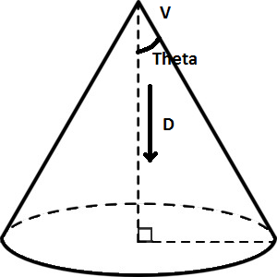
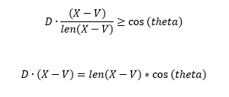
Cones: The Math
D = direction of the cone
V = apex of the cone
X = point within the bounds of the cone’s sides
Theta = cone’s half-angle

Slide 17
Cones: The Math

Slide 18
Cones: The Math

Slide 19
Cones: The Math

Slide 20
Cones: The Math

Slide 21
Cones: The Math

Slide 22
Cones: The Math

Slide 23
Cones: The Math

Slide 24
Cones: The Math

Slide 25
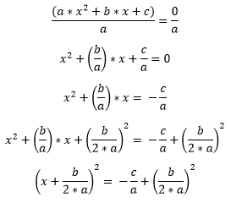
The Normal Quadratic Equation Derivation

Slide 26
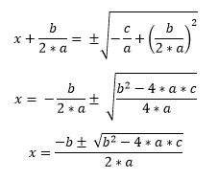
The Normal Quadratic Equation Derivation

Slide 27
Special Quadratic Equation Derivation

Slide 28
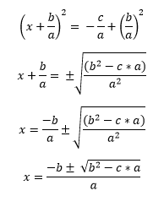
Special Quadratic Equation Derivation

Slide 29
Matrix Multiplication

Slide 30
Cones: Base Intersection
Have to check for ray intersection with cone’s base
Check to see if ray intersects with cone base’s plane
If it does, check to see if the ray is less than the base’s radius away from the base’s center
Can’t tell where a ray will intersect with the cone, or which points will be closer
Have to store all found intersection distances
Compare distances and choose two closest ones
If ray started inside the cone, set the hitDistance to 0

Slide 31
Updating IntersectionRecord
Need to update to work with 3D Geometries
Needs to keep track of entry point AND exit point
Should track entry and exit normals for easy refraction ray calculations
Should track length of ray between entry and exit point
Only existing 3D Geometry is the RTSphere
Just need to add exit point and exit normal
Exit point already calculated, just not stored in IntersectionRecord
Exit normal is just the normalized vector from the center of the sphere to the exit point
Need to consider 2D Geometries
Exit point will be the entry point
Exit normal will be the reversed entry normal

Slide 32
Ray-Marching
Sample along a ray’s length at set intervals
Sum and weigh values as you go along the ray
Pros:
Allows checking of information at points that is not necessarily continuous along the direction of the ray
Light exposure
Density
Color (for multi-colored 3D objects)
Results in better looking images
Cons:
Takes extra time
Similar to super-sampling

Slide 33
Density of Particles
Uniform density
Opaque coloring
Ramp or gradient of density
Can simulate gravity
Can simulate increasing thickness
Statistical approach
Randomness as to whether a ray “hits a particle”
Unique algorithms
Whatever you want to program in

Slide 34
How to Get the “Fog” Look
Use a pseudorandom number generator?
No similarity between two values close together in 3D space
Instead of fog, RNGs will give us pure noise
Bad choice
Texture map?
Same fog time and time again
Bad choice
Pseudorandom number generator that takes into account closeness between two points in 3D space?
Could work well for fog

Slide 35
Perlin’s Noise
Random number generator that utilizes multi-dimensional space
As you cross small spaces, values are somewhat similar to each other
Great for fog randomness
Uses a stored 3D grid of vectors
Each “box” has a vector and the bounds of the box
How It Works:
Input x, y, z coordinates to get a box and a point in that box
Make vectors to the point to all 8 corners of the box
Dot product the stored vector with all 8 point-to-corner vectors
The interpolated dot product gives a float that acts as a semi-random number!

Slide 36
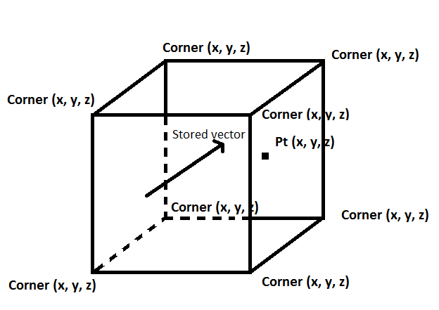

Slide 37
Perlin’s Noise
How to average values:
Simple averaging won’t work
Need to linearly interpolate values between pairs of points along an axis
Choose an axis of change (x, y, z, etc.)
Calculate how close the chosen point’s x (or y or z) value is to the left point’s x (or y or z) value to get a normalized weight (between 0 and 1)
Multiply the weight by the left dot product and (1 - weight) by the right dot product to get the linearly interpolated dot product
Complete for all axes
Will go from 8 points to interpolate to 4 points to 2

Slide 38
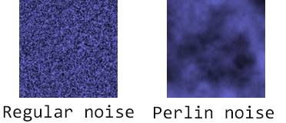
Pseudorandom Number Generator vs. Perlin Noise

Slide 39
Perlin Noise
Already implemented in MP5!
Code from New York University in RTTextureType_Noise gives an efficient construction of the Perlin’s Noise algorithm
Just need to pass in x, y, z coordinates for a point in 3D space
Problems:
Values aren’t guaranteed to be between 0 and 1
Could be negative
Need to cap values
Not accessible, so it needs to be taken out from RTTextureType_Noise
Opportunities:
Can alter values or homogenize them to make fog look blurrier and thicker
Can bump up value to reduce “empty” space and produce more fog, or vice versa

Slide 40
Beer-Lambert Law
Calculates intensity of light as it passes through a medium
Uses e (base of natural logarithm) (~2.7183)
The equation we will use is
I = Io * e^(Cx)
I = end intensity
Io = initial intensity
C = Concentration coefficient
x = Distance through the medium or the number of particles passed
Provides natural light attenuation dropoff equation for our fog!

Slide 41
Summary
Calculate entry and exit points of a 3D object
Update IntersectionRecord
If the geometry intersected is not 100% opaque (i.e. transparency of the material stored is > 0.0f)...
Calculate a refraction ray
Calculate the attenuation of light throughout the fog if the geometry has one
Collide with the next object
Use Perlin’s Noise and Beer-Lambert’s Law to calculate light dropoff and add some randomness to our fog

Slide 42
Remaining Problems
Account for interaction between objects inside the volume and the volume itself
Reflection
Shadows
i.e last example picture
Should account for the attenuation of light as it travels along the volume, as the particles in the volume are absorbing the incoming light as it travels along the volume
Could utilize ray-marching, but it’ll be slower

Slide 43
Thanks!

Slide 44
References
"GPU Gems 2." GPU Gems. Web. 28 Feb. 2016. <http://http.developer.nvidia.com/GPUGems2/gpugems2_chapter08.html>
"GPU Gems 3." - Chapter 13. Volumetric Light Scattering as a Post-Process. Web. 09 Mar. 2016. <http://http.developer.nvidia.com/GPUGems3/gpugems3_ch13.html>
Zoren, Denis. Ray Tracing II. New York: N.p., 2016. Web. 1 Mar. 2016 <http://mrl.nyu.edu/~dzorin/rend05/lecture2.pdf>
Marschner, Steve. Volumetric Path Tracing. N.p., 2016. Web. 28 Feb. 2016 <http://www.cs.cornell.edu/courses/cs6630/2012sp/notes/09volpath.pdf>
Eberly, David. Intersection of a Line and a Cone. N.p., 2016. Web. 28 Feb. 2016 <http://www.geometrictools.com/Documentation/IntersectionLineCone.pdf >
Ilya Baran, Jiawen Chen, et al. 2010. A Hierarchical Volumetric Shadow Algorithm for Single Scattering. acm Transactions on Graphics. Article no. 178. <http://groups.csail.mit.edu/graphics/volumeshadows/vs.pdf>
Perlin, Ken. "Ken's Academy Award." Ken's Academy Award. Web. 3 Mar. 2016. <http://mrl.nyu.edu/~perlin/doc/oscar.html#noise>
"Beer-Lambert Law." Beer-Lambert Law. Web. 3 Mar. 2016. <http://life.nthu.edu.tw/~labcjw/BioPhyChem/Spectroscopy/beerslaw.htm>
Wikipedia:
"Lambert Law." Wikipedia. Wikimedia Foundation. Web. 2 Mar. 2016. <https://en.wikipedia.org/wiki/Beer–Lambert_law>
"Volume Ray Casting." Wikipedia. Wikimedia Foundation. Web. 28 Feb. 2016. <https://en.wikipedia.org/wiki/Volume_ray_casting>
"Perlin Noise." Wikipedia. Wikimedia Foundation. Web. 28 Feb. 2016. <https://en.wikipedia.org/wiki/Perlin_noise>

