Slide 1
Environment Mapping
Michael Tanaya , Hua ming Chen

Slide 2
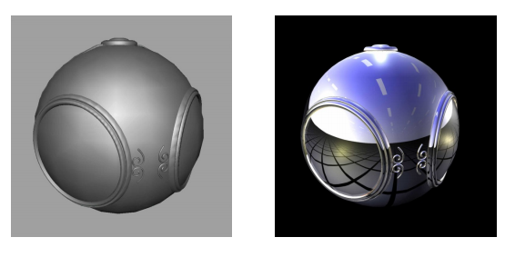
Environment mapping
Used to create appearance of reflective and refractive surface without global ray tracing calculation.

Slide 3
The “problem”
Current System uses global ray tracing to calculate reflection and refraction
very expensive.
For complex curved surfaces, we have to go through expensive ray tracing and/or lighting calculation.

Slide 4
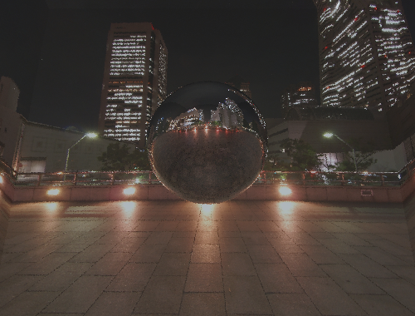
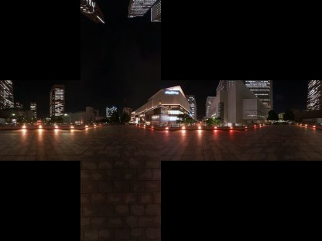
Example Using MP4
Custom Command Files with 6 image color texture mapped to RTrectangle and use ray tracing for reflection

Slide 5
The proposed solution
Create new texture type
Instead of using global ray tracing, we are going to use 6 camera to compute the index of the environment texture and use the corresponding texel to color the pixel in the surface.
Map the texture directly onto the surface.

Slide 6
The new texture type
Called Cubic
Will have a center point vertex and focus
Containing 6 bitmap pictures.
The normal vertex of each 6 planes will point to the center point to create a cube.
Have a function to get and calculate picture

Slide 7
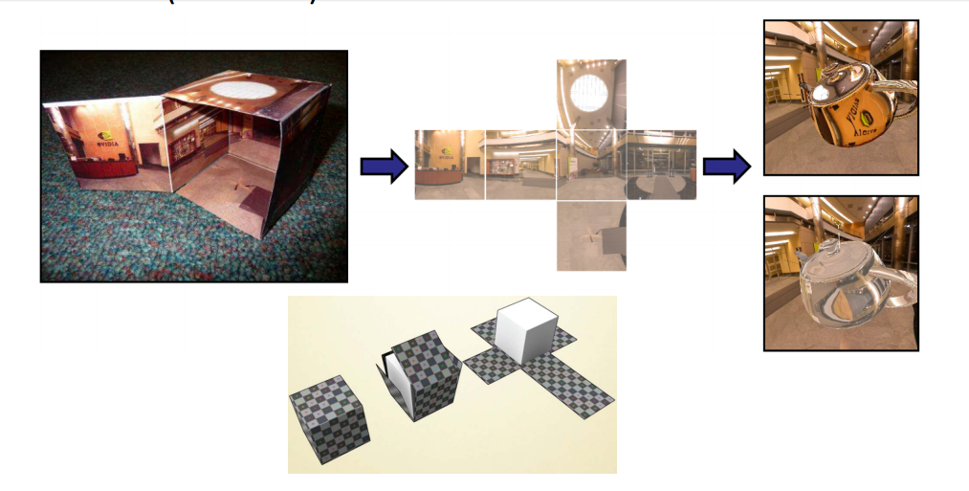
Cubic Environment Mapping
Picture 2 Cube mapping explained (copied from Worcester Polytechnic Institute lecture slides)

Slide 8
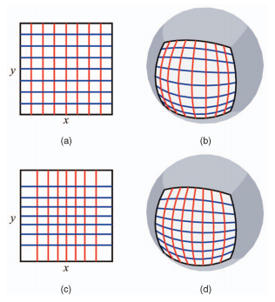
The Challenge
Cube mapping isn’t sampling evenly on sphere.
The most simple and cheap way is sampling more in middle of rectangle. We need to find an effect sampling algorithm

Slide 9
Other tools to look at
https://www.clicktorelease.com/code/spherical-normal-mapping/

Slide 10
Environment Mapping
Thank you!
Any Question?

