Slide 1
Orthonormal Basis
Cartesian Coordinate System
  Unit vectors: i, j, k
  Normalized to each other
  Unique representation for each position!!
  Convenient!
Works in general:
  N dimension space
    ANY N normalized orthogonal vectors will do!!
  Infinite number of Cartesian coordinate systems in 3D space!!
    But we already know this

Slide 2
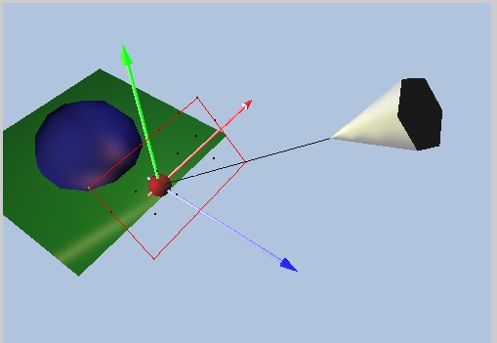
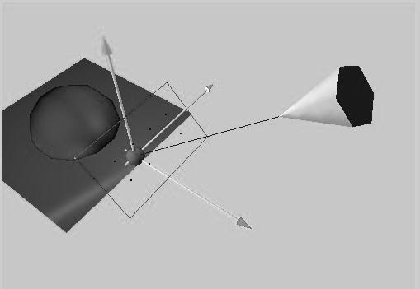
Camera Space
Orthonormal basis at the camera
  View/Up/Side
  V/U/W axis
  All perpendicular
Also known as:
  Eye Space
  View Space
Up Direction (U)
Eye
At
View Direction (V)
Side Direction (W)

Slide 3
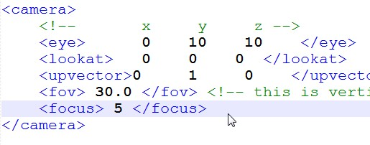
Recall: Scene Description
Camera is defined by:
  Eye, lookat, and UpVector
Viewing Direction
  Defined by Eye and At
Notice:
  UpVector is usually
  NOT perpendicular to
  View Direction!!
  Easier for user to specify
  sent of “up”
UpVector
Eye
At

Slide 4
Compute Camera Basis
Viewing Direction (V)
  V = At - Eye
Remember:
  UpVector may not be
  perpendicular to V
W = UpVector x V
W is perpendicular
to both UpVector and V
UpVector
Eye
At
V
W

Slide 5
Compute Up Direction (U)
U = V x W
U, V, and W are
perpendicular!!
Normalize to
form a Cartesian Coordinate!
UpVector
U
Eye
At
V
W

Slide 6
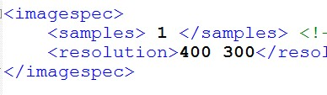
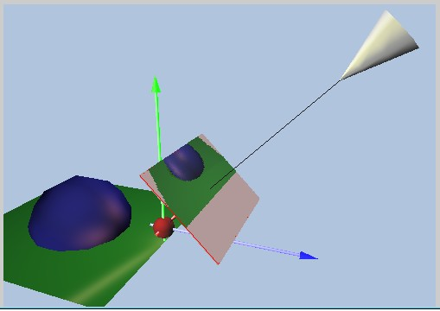
Recall: Image Plane (Scene XML)
Eye
focus
focus distance
away from the Eye
Resolution defined
in the XML file to be
M by N pixels
Always perpendicular to the viewing direction V
Image Plane

Slide 7
Image Plane Height
Eye
Image Plane
focus
Height
fov: fields of view
  Is vertical angle
Distance between
Eye and Image Plane: focus
Image Plane Height:
Height = 2 * focus * tan (fov/2)
fov

Slide 8
Image Plane Width
Resolution: M by N
  Aspect ratio = M/N
Computed: Height
Width = Aspect Ratio * Height
Height
Width

Slide 9
Cartesian Coordinate on Image Plane
2D, Requires
  2 Perpendicular
  Unit Vectors
Origin:
Lower-Left Corner
Remember
  U, V, W from
  Camera Space
Image plane perpendicular to V
  U in the vertical direction of Image Plane
  W in the horizontal direction of image plane!
U
Image Plane
V
U
W
W
Lower
Left

Slide 10
Image Plane Location
Eye
Image Plane
Let Center = C
C = Eye + focus * V
focus
C

Slide 11
Lower Left Corner
Upper
Left (Pul)
C
Normalize: U, W
Dimension: W x H
Upper-Left Corner:
Pul = C – (Width/2) * W + (Height/2) * U
U
Image Plane
W

Slide 12
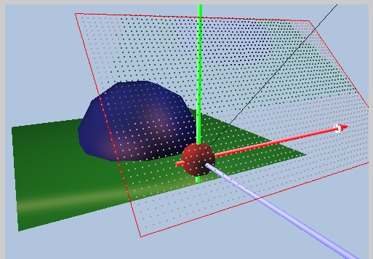
Pixel Size:
Image Resolution:
  M by N
Image Size:
  Width by Height
Dimension of each pixel
  Width: pw = Width / M
  Height: ph = Height / N
Pul
Image Plane
Pixels

Slide 13
Pixel Location:
Index i
Pll
U
Index j
Assume pixel indexing
  Begin from upper left
  a increase towards right
  b increase towards down
  pw: width of a pixel
  ph: height of a pixel
  U and W are normalized
Pul is index [0][0]
  Pixel[0][0] location = Pul
Pixel[a][b] location is:
Pab = Pul – (a * pw) * W – (b * ph) * U
W
Image Plane

Slide 14
Orthonormal Basis
What is an orthonormal basis in 3D?
  T/F: Given a 3D room, there are four best unique orthonormal basis can we define, one at each of the corners.

Slide 15
Eye/Camera/View Space
  How does a computer graphics user specify the eye space
  In general when our users define the camera, can we expect the up vector to be perpendicular to the viewing direction?
  By convention, X/Y/Z-axes are mapped to
  Side vector is the cross product of: (order matters!!):
  Up vector is the cross product of: (order matters!!):

