Slide 1
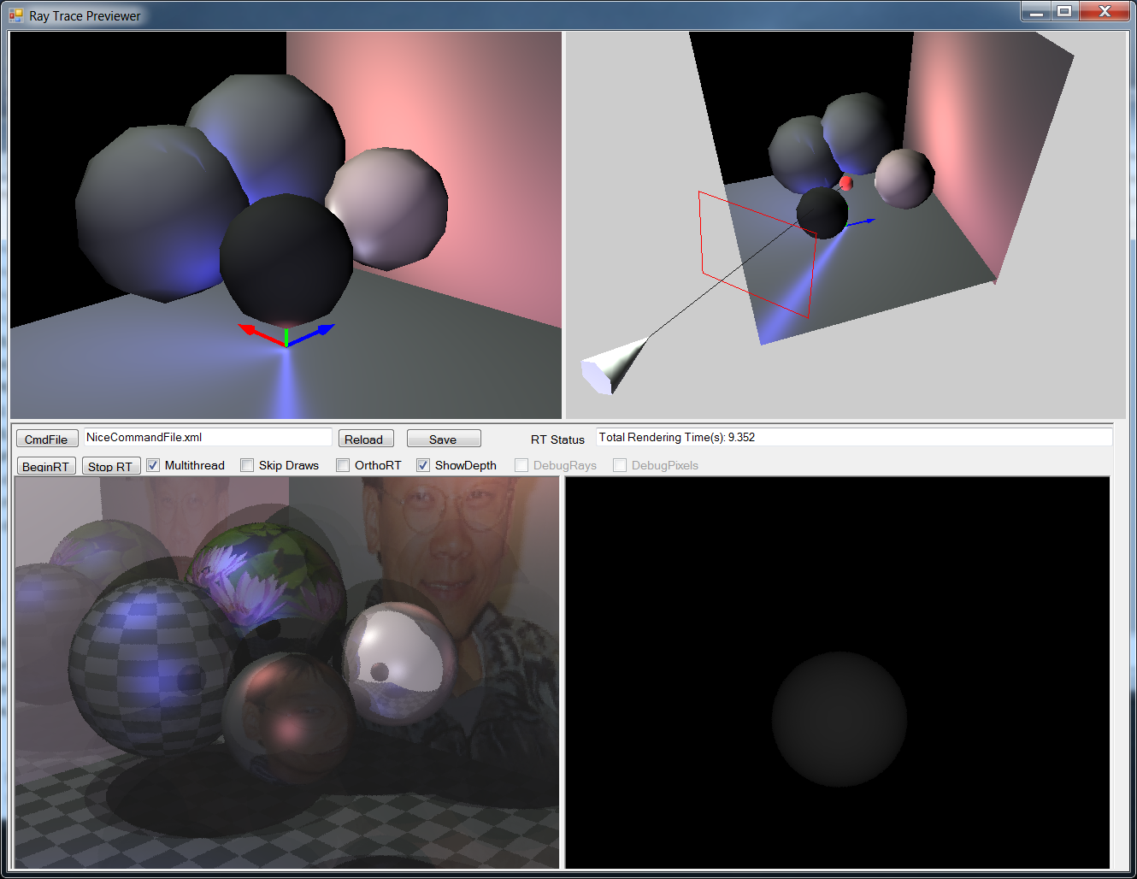
Simple Ray Tracing Framework
Interactive Preview
Interactive Control
Depth or Mask Image
Ray Trace Image

Slide 2
Technologies
C#
Just another programming language
WinForm:
GUI Application Development
not covered in this class
Interactive Viewing:
XNA (can be OGL or D3D)
To be covered in second half

Slide 3
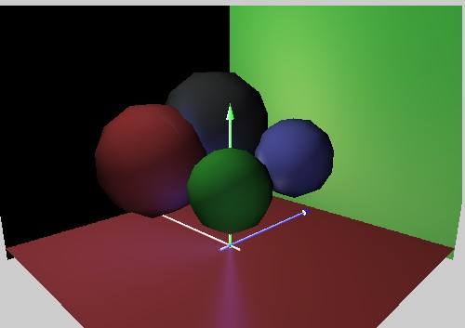
The Scene
Describe by XML (text) file!
Four major components
Image Spec (Film in a camera)
The Camera
Environment (Lighting condition)
The Objects
Geometry: spheres and polygons
Material properties

Slide 4
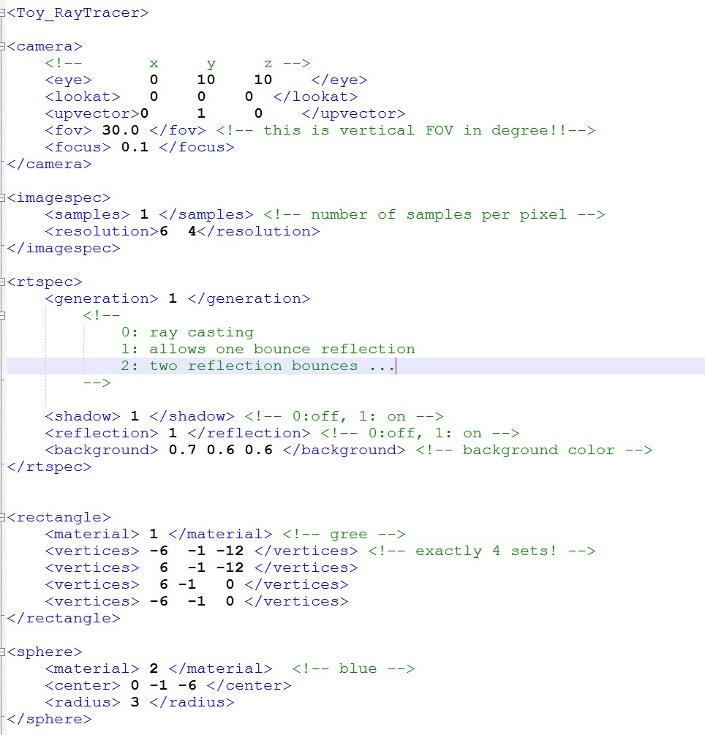
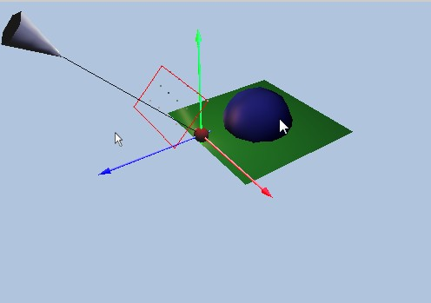
XML Scene Description
Similar to Maya’s .ma file
Extremely simpler version!!
Example Command File
Camera: eye
Camera: lookat

Slide 5
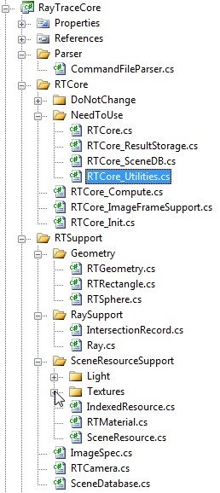
Source Code Structure
Two Projects:
3DPreviewer: Shell container
RayTracer: Our source code
Parser (translate XML into data structure)
RTCore: Shading, Image representation:
DoNotChange: RT thrade support (later)
NeedToUse: Shading, Utilities
RTSupport
Geometry
RaySupport:
Ray and IntersectionRecord
SceneResourceSupport
Texture, Light, Materials
2 libraries:
GUI, Graphics, 2 MVC Support

Slide 6
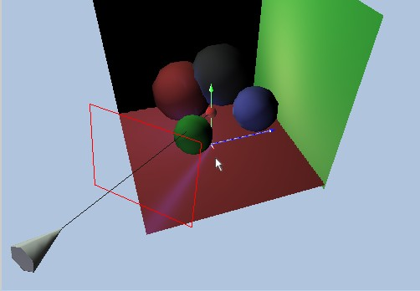
Representation
SceneDatabase
ImageSpec
Geometry
RTCamera
IntersectionRecord
Ray

Slide 7
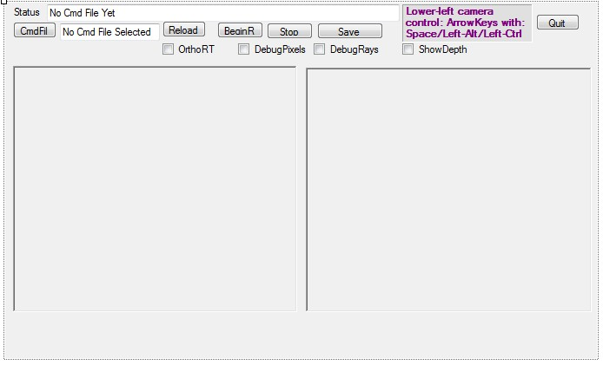
RTWindow.cs: App Container
App Window Shell
In WindowsForm

Slide 8
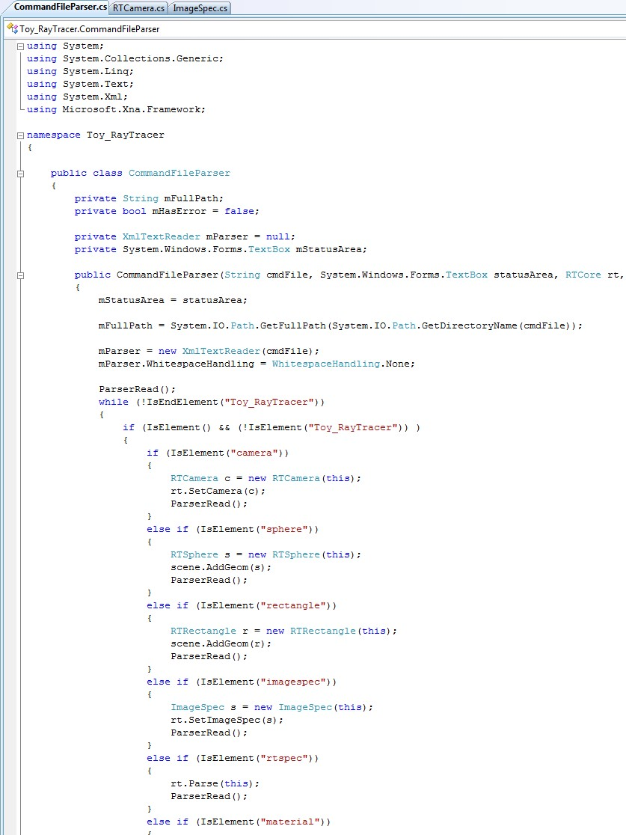
Parser.cs: XML Parser
Translates Command File into data structures
In RayTracer: Parser/CommandFileParser.cs

Slide 9
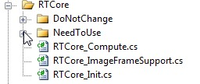
RTCore: Folder
DoNotChange Folder:
No need to even examine the source
Thread support (to cover later in the quarter)
NeedToUse Folder
Need to understand the code
No need to change
Three files: Compute, ImageFrameSupport, and Init
Essential to understand
Necessary for 3D Viewing and Camera implementation

Slide 10
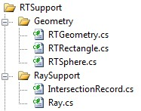
Geometry and RaySupport
Geometry
geometries in the scene
For now only: Rectangles and Spheres
No need to worry until much later
Ray
Ray: Origin + Direction
Ray constructor: TAKES 2 positions!!
IntersectionRecord

Slide 11
Transformation
The <xform> tag
The implementaiton in
RTGeometry_ParseXForm.cs
Rectangle::Parsing at the end:

Slide 12
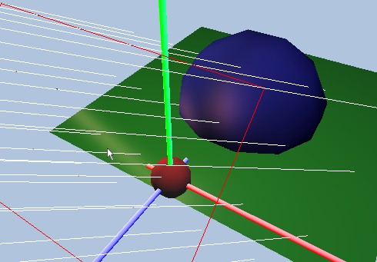
Geometry and RaySupport
Ray
Sphere
WATCH OUT!!
Ray direction is assumed to be normalized!!
Rectangle
IntersectionRecord

Slide 13
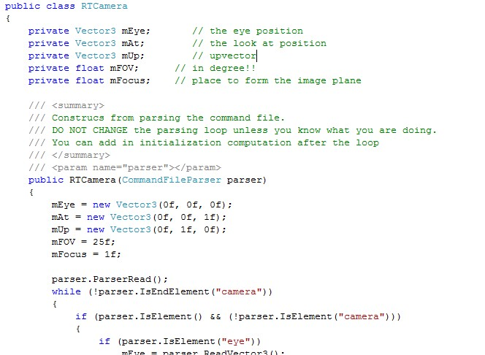
RTCamera:
mEye
mAt

Slide 14
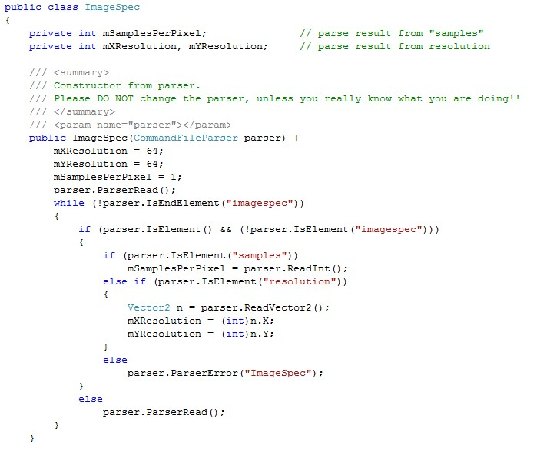
ImageSpec:
Resolution
Must Compute Each Pixel Location!!

Slide 15
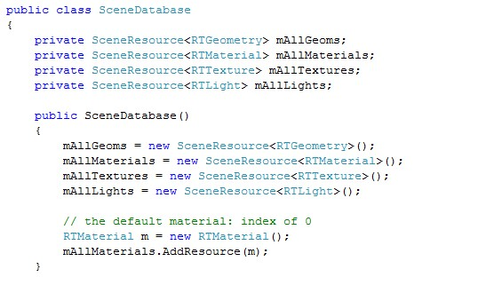
SceneDataBase
Contains all the scene resources
Geometries, Textures, Materials, Lights
Simple index tables for each resource

Slide 16
Calling Sequence
Parsing:
When done creates RTCore(): RTCore.cs [constructor]
Calls RTCore.FirstTimeInit() [RTCore_Init.cs]
You don’t care:
RTWindow::BeginRT() /* from BeginRT Button
Create and Init: image, mask, depth buffers
RTCore::BeginRTThread
In RTCore/DoNotChange/RTCore_Thread.cs
one/more separate thread(s) call to
You care again:
RTCore::ComputeImage
In RTCore/RTCore_Compute.cs
Loop through all pixels, for each pixel
Compute visibility, coverage, depth

Slide 17
Important Functions
RTCore::ComputeVisibility()
In RTCore/RTCore_Visibility.cs
Use -1 for exceptGeomIndex for now
RTCore::ComputeShading()
In RTCore/RTCore_Shade.cs
Use 0 for generation for now

