Slide 1
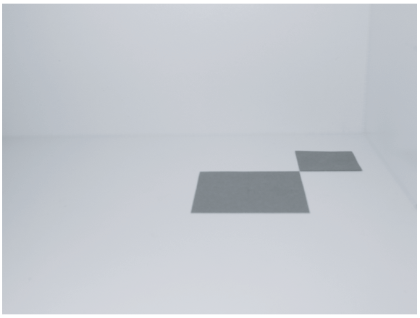
A Photograph of two papers
The Model: 2 papers
8cm x 8cm and 5cm x 5cm
The Camera
Simple pinhole
No focusing capability
The Scene
Arrangements model and camera
Light sources (later)

Slide 2
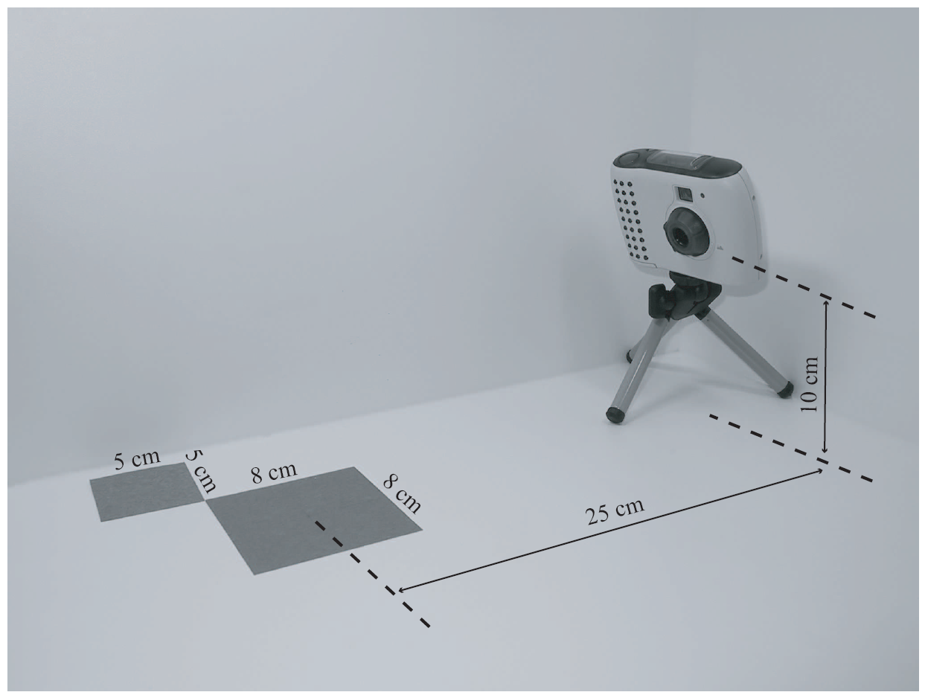
The Arrangements

Slide 3
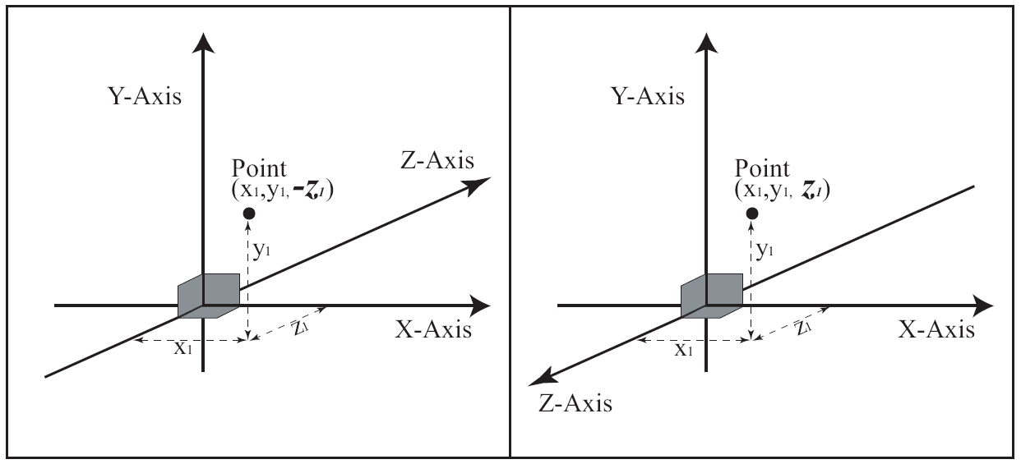
3D Coordinate Systems
Two options for Z-axis direction!
Same position, different sign for z-value!!

Slide 4
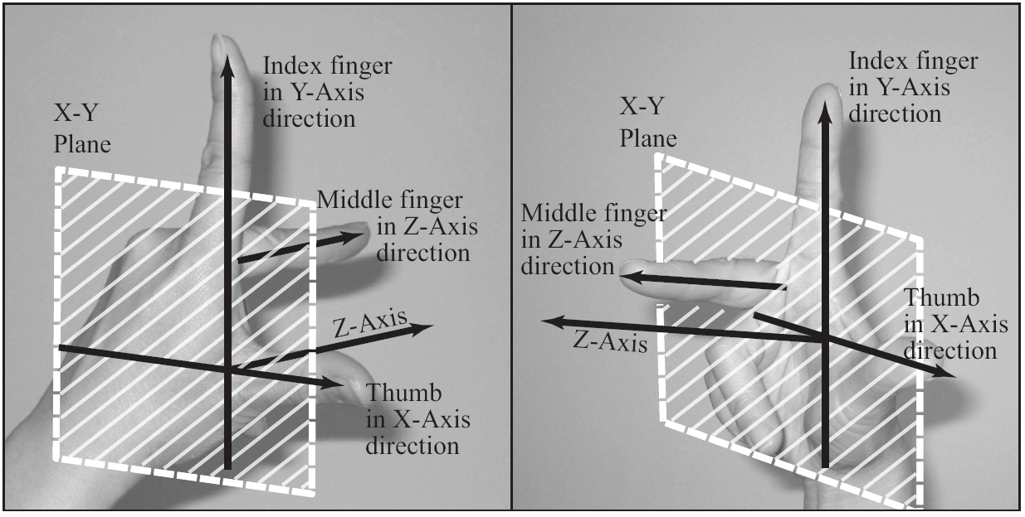
Left vs. Right Handed Systems
Right-Handed System EXCLUSIVELY!!

Slide 5
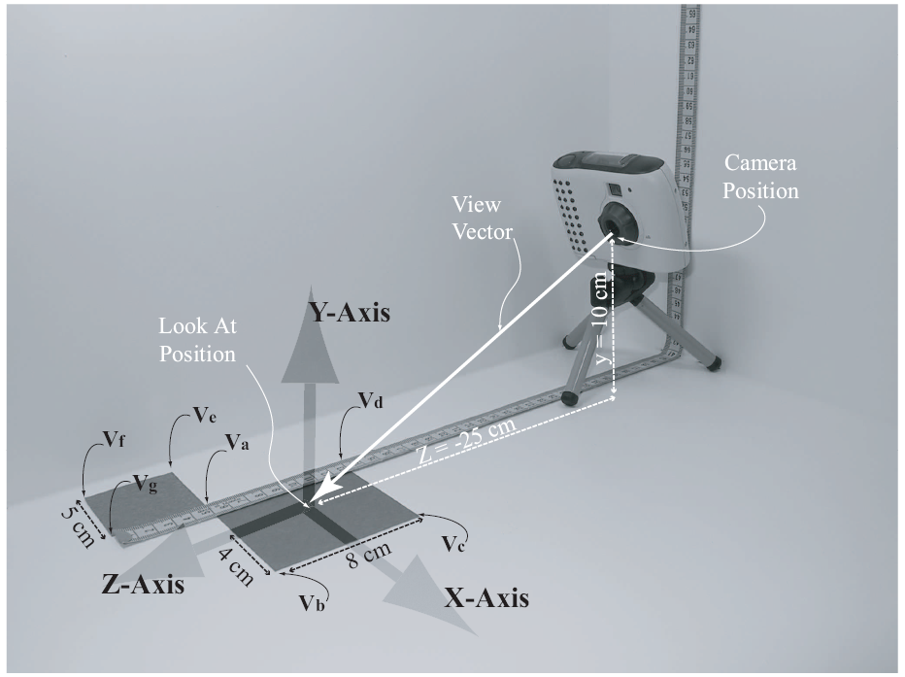
The Model and the Scene
Right-Handed Coordinate System
Convenience
Origin Center of 8x8
Units in cm

Slide 6
Details …

Slide 7
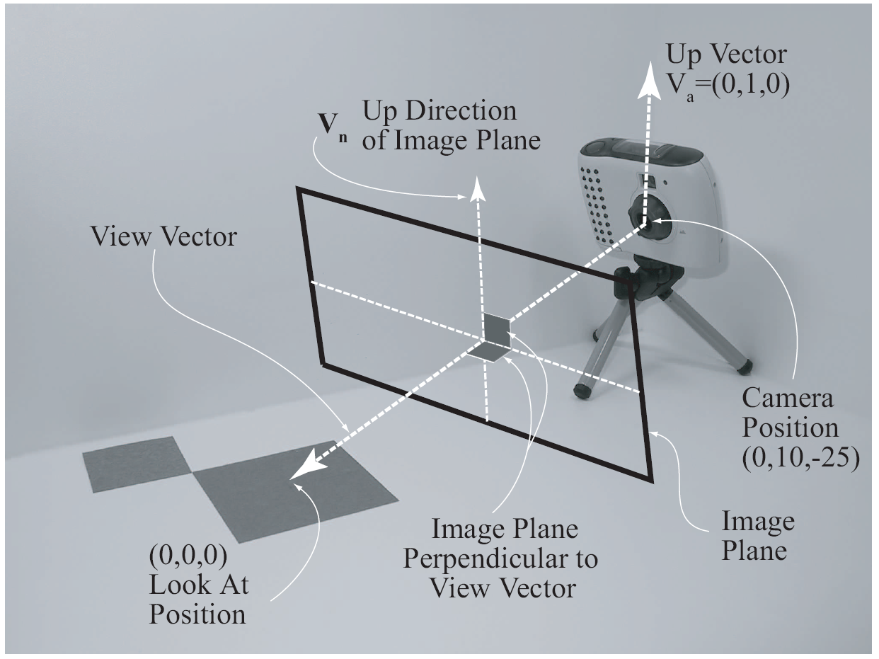
A Computer Graphics Camera
Camera position
Look at position
Up direction
Related terms:
Image Plane
Viewing Direction
View Vector
Maya scene

Slide 8
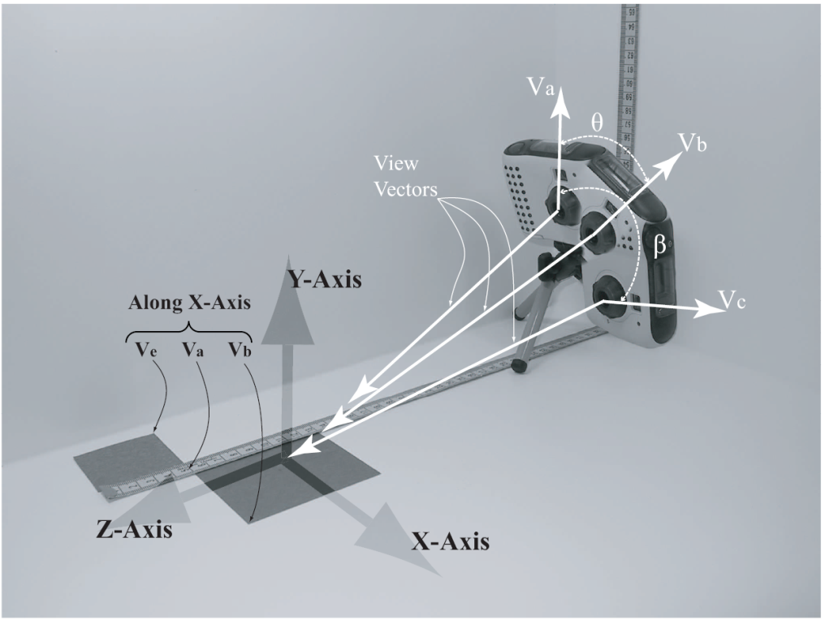
The Up Direction (Up Vector):
Also referred to as: Twist Angle
Cannot be parallel to viewing direction
Does not need to be normalized
Does not need to be perpendicular to viewing direction

Slide 9
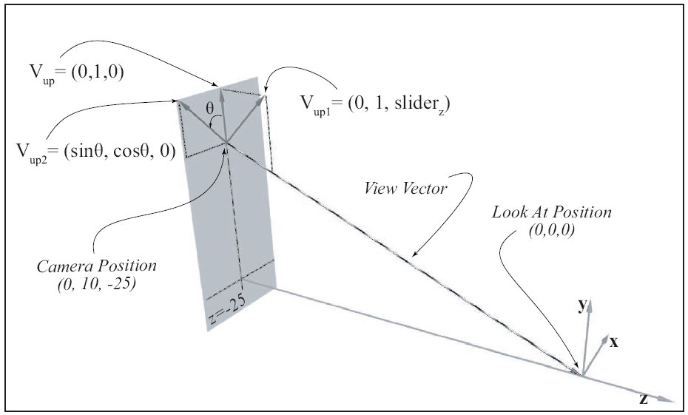
Controlling the Up Vector
z=slider:
Twist angle:
not perpendicular to View Vector!

Slide 10
The Visible Volume
Only geometries (primitives) inside the volume are visible
All geometries (primitives) outside are ignored
Primitives straddle the volume are Clipped!

Slide 11
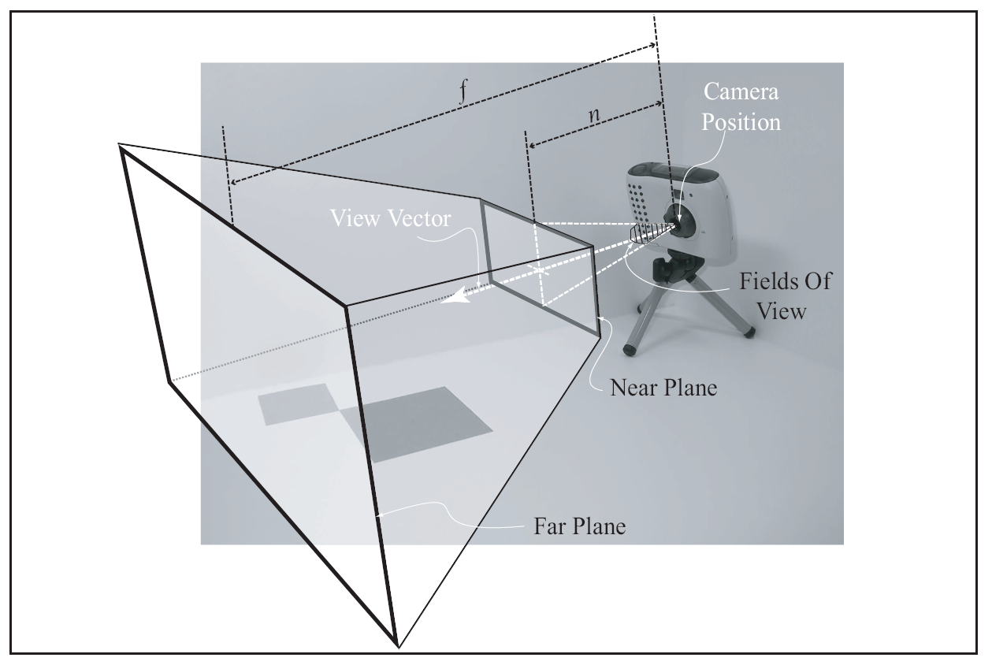
The Viewing Frustum Volume
Volume defined by:
Near Plane (n)
Far Plane (f)
Fields of view (fov)
For Perspective Projection

Slide 12
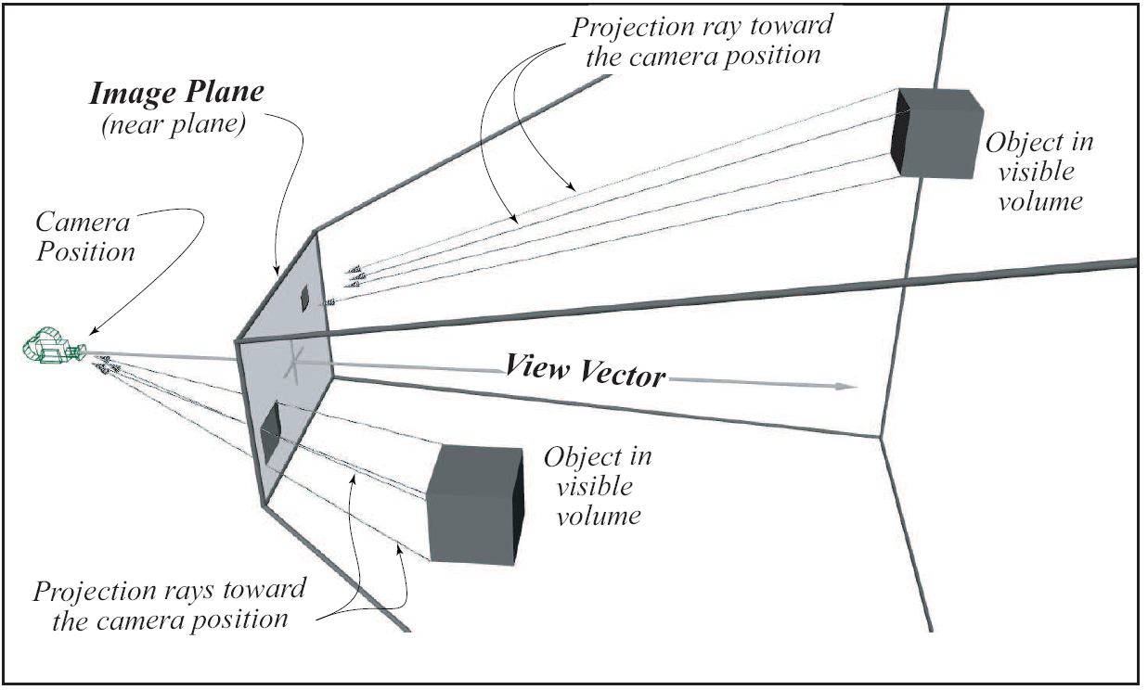
Perspective Projection

Slide 13
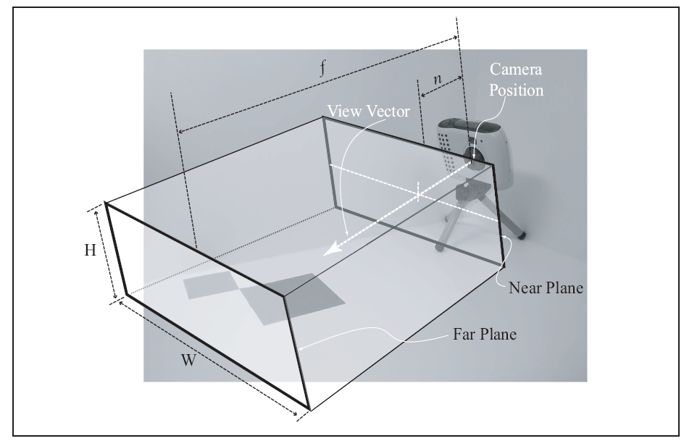
The Rectangular Visible Volume
Volume defined by:
Near Plane (n)
Far Plane (f)
Width (W)
Height (H)
For Orthographic Projection

Slide 14
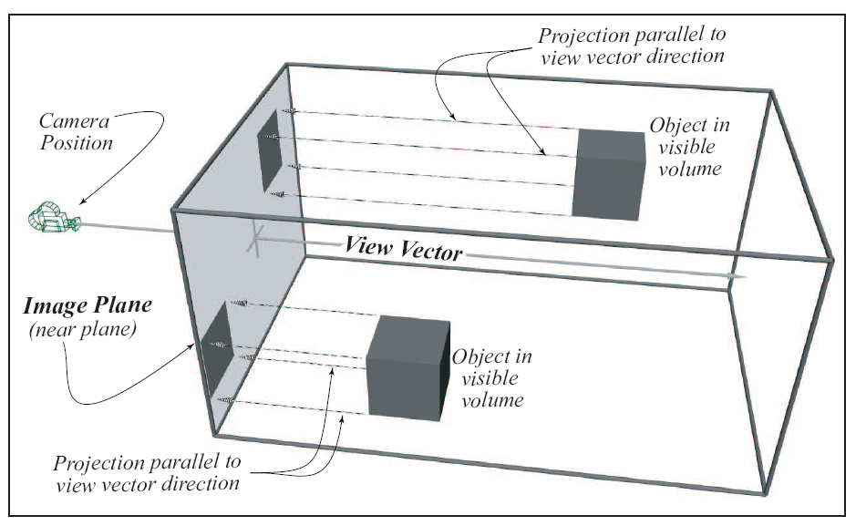
Orthographic Projection
Maya Scene

Slide 15
Orthographic vs Perspective Projection
Orthographic Projection
Parallel projection
Preserve size
Good for determining relative size
Perspective Projection
Projection along rays
Closer objects appears larger
Human vision!
Only work with: Perspective Projection

Slide 16
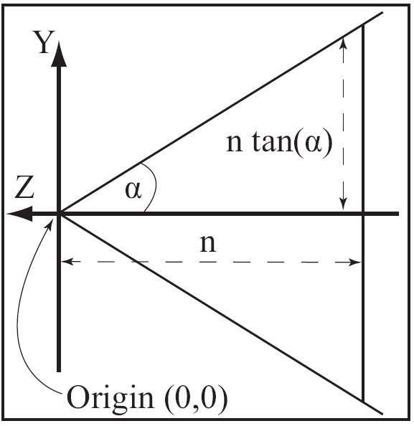
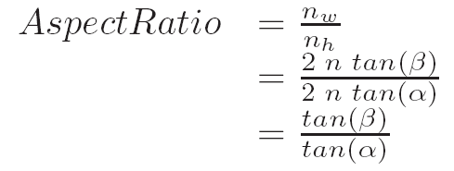
Near Plane and Aspect Ratio
Aspect Ratio
Near Plane
Height (n_{h})
Width (n_{w})

Slide 17
Aspect Ratio
What is the aspect ratio of the following:
PAL: 720x576 is 5:4 or 5/4 = 1.24
NTSC is complicated ☺ (4 : 3)?
720P HD: 1280x720 is 16:9 or 16/9 = 1.777
1080P HD: 1920x1080 is 16:9
My image:
640x480 4:3
20x20 1:1

Slide 18
What is my Image Plane Size?
Eye at: (0, 0, 20)
At: (0, 0, 0)
Up: (0, 1, 0)
Near plane distance: 10
FOV: 90-degree
Aspect ratio: 4:3
If FOV defines horizontal field?
If FOV defines vertical field?

Slide 19
How about now?
Eye at: (x1, y1, z1)
At: (x2, y2, z2)
Near plane distance: d
FOV: θ
Aspect ratio: α
If FOV defines horizontal field?
If FOV defines vertical field?

Slide 20
Review questions
The two types of projections discussed:
What are the two elements that define a projection
What defines a computer graphics camera?
What is the difference between the cameras for a perspective and orthographic projection?
What is the difference between the viewing volumes of a perspective and orthographic projection?

Slide 21
Parallel (Orthographic) Projection
What is the main advantage of orthographic projection?
What is the shape of the visible volume?
What is the camera position in relation to the image plane?

Slide 22
Perspective Projection
Why are the near/far plane distances important?
Increase FOV will make objects larger or smaller?
Image plane
What is the relationship between viewing direction and image plane?
Up vector we specify must always be perpendicular to the viewing direction?
What is the shape of the visible volume?
Far away objects appear smaller/larger?

