Slide 1
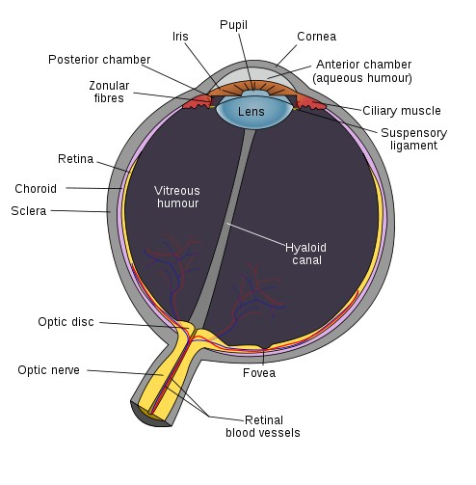
Human Eye
Some interesting facts
  Rod cells:
    requires only low light
    b/w vision
    blur, all over retina EXCEPT fovea
  Cone cells:
    requires bright light,
    Color vision: three kinds of cone sensitive to roughly RGB wave lengths
    acute, sharp image, located at the fovea
  Dynamic range and adaptation
Useful fact
  Lens is like a low pass filter!!
Image credit:
Wikipedia: fovea
Image credit: Wikipedia (Fovea)

Slide 2
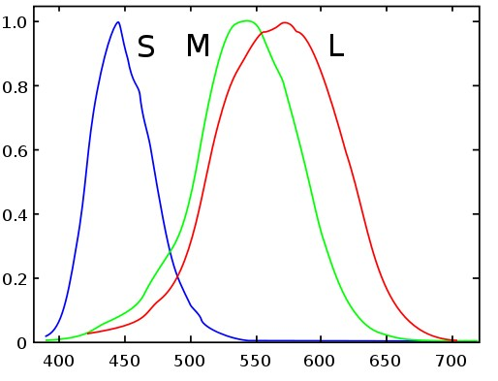
Color?
Colorimetry
  Measurement description of color
Remember our eye?
  3 types of Cone cells: S M L
  Each responsive to different
  visible wavelength!
Color representation:
  based on three components!
Color perception is SUBJECTIVE!
  CIE Standardization effort (self reading)
Image credit:
Wikipedia: cone cells

Slide 3
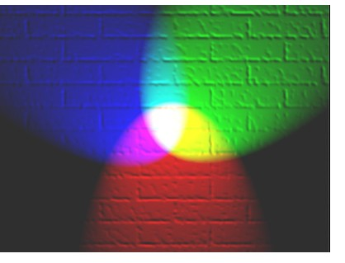
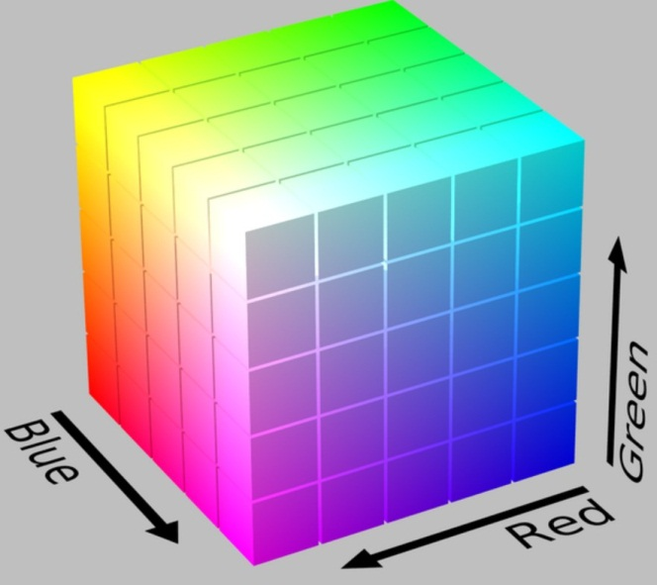
RGB: Additive Color
(R, G, B): 0 – off, 1 – full on
  Components are added
  E.g., Our eyes, CRT, LCD, Projector
  RGB – most often used
  range between 0 to 1
  RGB: a Color Cube
B (1,0,0)
G (0,1,0)
Image credit:
Wikipedia: Additive Color
R (1,0,0)

Slide 4
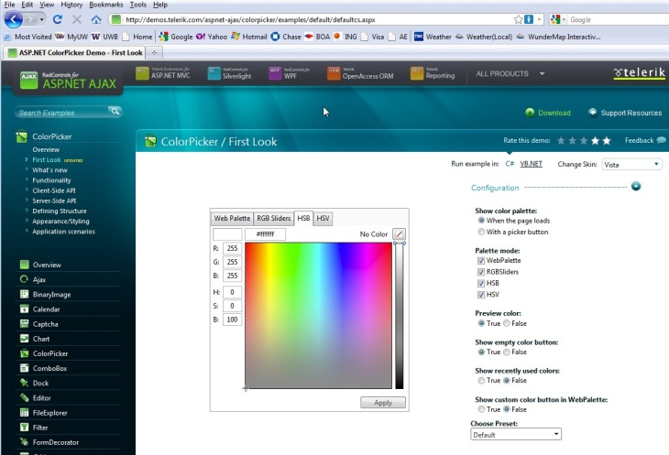
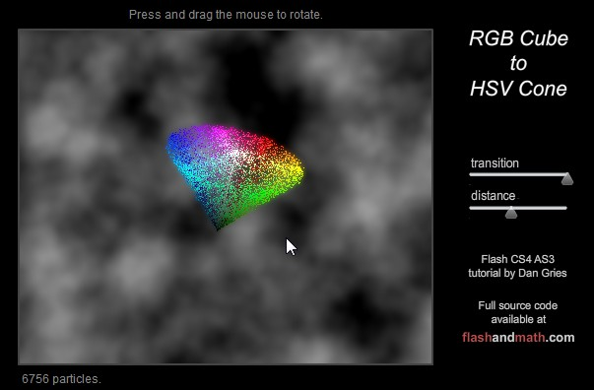
Additive Color
Easier for human to
  separate color from “intensity”
HSV Hue, Saturation, Value
  HSL (Luminosity, Lightness)
  HSB (Blackness?)
  Demo: http://demos.telerik.com/aspnet-ajax/colorpicker/examples/default/defaultcs.aspx
  RGB to HSV Demo: http://www.flashandmath.com/advanced/color/RGBtoHSV.html

Slide 5
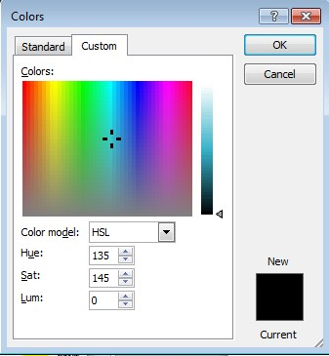
Additive Color: Example
Microsoft Office Color Picker
Hue: Which color.
Range: 0 to 360, degrees around the cone circumference (MS normalized this to 0 to 255)
Luminosity: the “intensity” or brightness.
Range: 0 to 100, height of the cone (MS normalized this to 0 to 255)
Saturation: how colorful.
Range: 0 to 100, distance from the center of the cone (MS normalized this to 0 to 255)

Slide 6
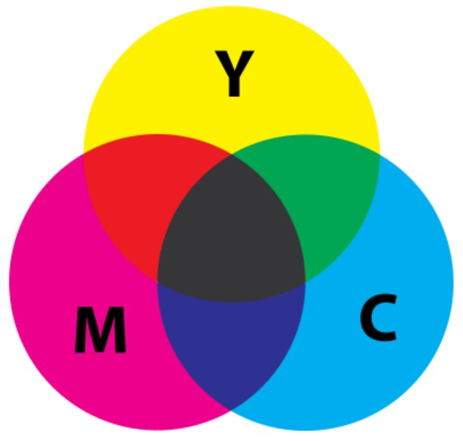
Subtractive Color
The expensive printer cartridges
CMY – filtering white color
  Each acts as a filter of (1,1,1)
E.g., Black on White Paper: (1,1,1)
  Through Y filter => (1,1,0)
  Through M filter =>(1,0,0)
  Through C filter => (0,0,0)
The filter (ink pigment) leaks
  Black is not very black
  That’s why the separate black cartridge
Yellow (1, 1, 0)
Image credit:
Wikipedia: Subtractive Color
Cyan (0, 1, 1)
Magenta (1, 0, 1)

Slide 7
Example
If I want to show red color: (1, 0, 0) on White
  Use Yellow: (1, 1, 0) → white filters to yellow
  Use Magenta: (1, 0, 1) → yellow filters to red
  DO NOT use Cyan: (0, 1, 1)
If I want to show blue color (0, 0, 1) on white
  DO NOT use yellow:
  Use Magenta: (1, 0, 1) → white filters to magenta
  Use Cyan: (0, 1, 1) → magenta filters to blue

