Slide 1
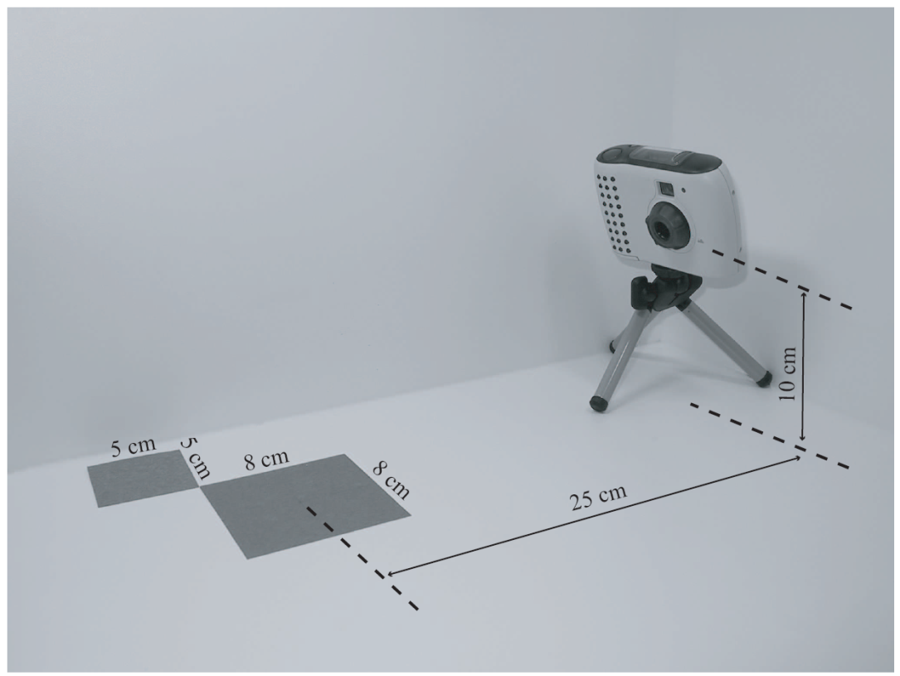
Illumination Model
How to compute color to represent a scene
As in taking a
photo in real life:
  Camera
  Lighting
  Object
    Geometry
    Material
Illumination model:
  Combine all to produce a color
Light source
Camera
material property
Object geometry (shape, size, location)

Slide 2


Ambient Light
Simplest model: when all lights are off!
Still sees color!
  Why?
  How to model?
    is the “ambient” light
    is the object’s “ambient” material property!
A “Vector” equation: RGB
Blend, flat, no 3D features

Slide 3
Diffuse Reflection
Intensity of paper in relation with light source
In coming energy: is scattered uniformly in all directions according to the “facing” of the paper
Normal Vector
of the paper

Slide 4
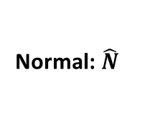
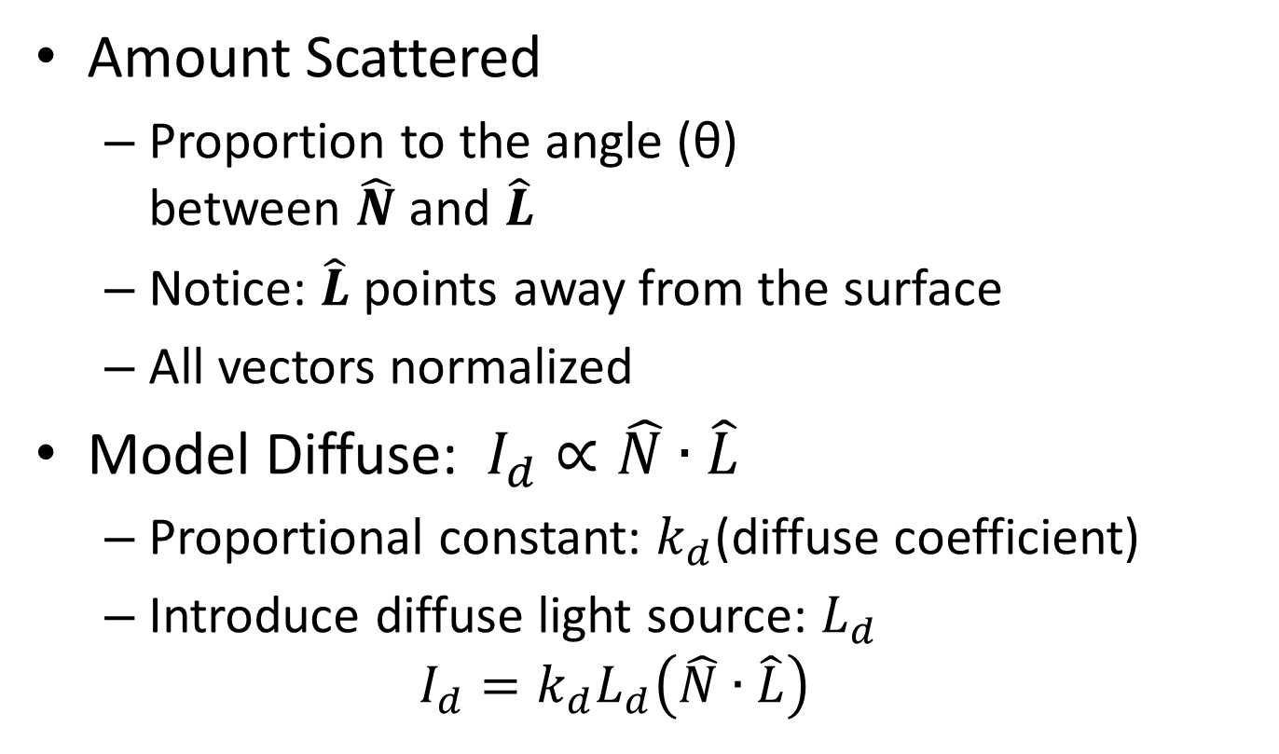
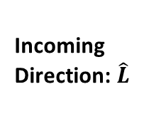
Model Diffuse Reflection
Normal: $\hat{N}$
θ
Incoming Direction: $\hat{L}$
Amount Scattered
  Proportion to the angle (θ)
  between $\hat{N}$ and $\hat{L}$
  Notice: $\hat{L}$points away from the surface
  All vectors normalized
Model Diffuse:$I_{d}∝\hat{N}∙\hat{L}$
  Proportional constant: $k_{d}$(diffuse coefficient)
  Introduce diffuse light source: $L_{d}$
  $$I_{d}=k_{d}L_{d}\left(\hat{N}∙\hat{L}\right)$$

Slide 5
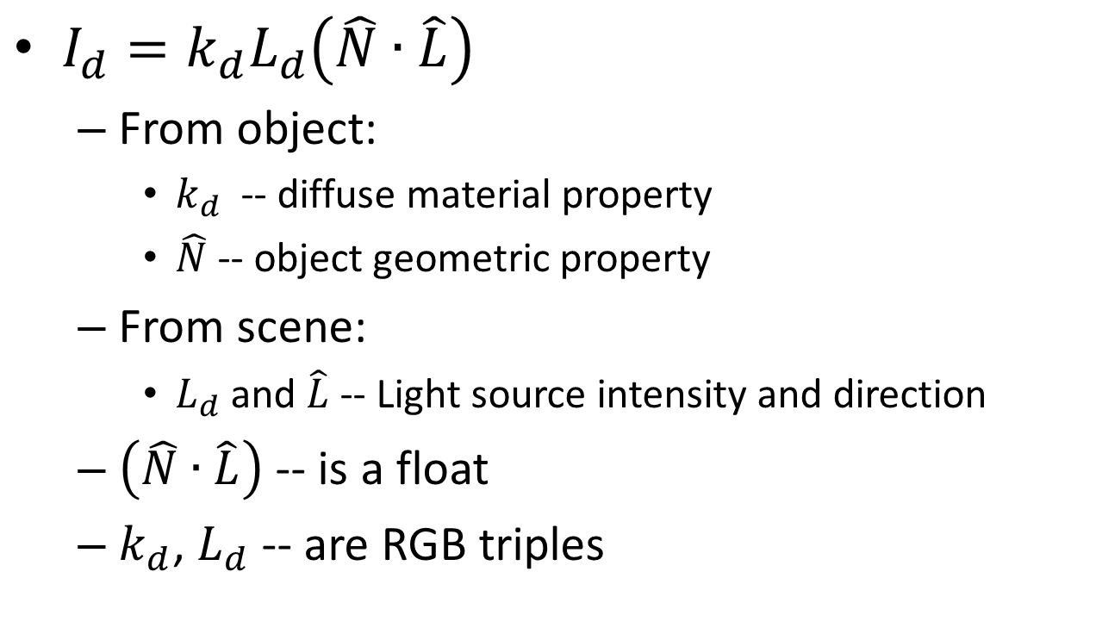
Diffuse Lighting
Normal: $\hat{N}$
θ
Incoming Direction: $\hat{L}$
$I_{d}=k_{d}L_{d}\left(\hat{N}∙\hat{L}\right)$
  From object:
    $k_{d}$ -- diffuse material property
    $\hat{N}$-- object geometric property
  From scene:
    $L_{d}$ and $\hat{L}$-- Light source intensity and direction
  $\left(\hat{N}∙\hat{L}\right)$ -- is a float
  $k_{d}$, $L_{d}$ -- are RGB triples

Slide 6
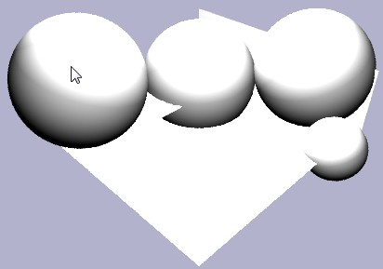
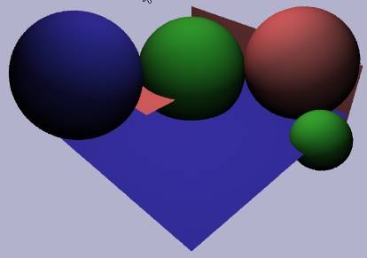
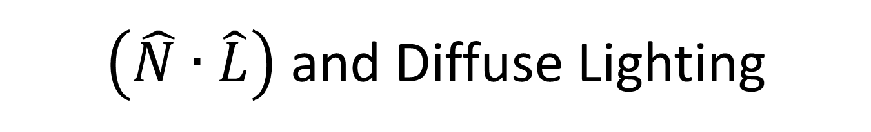


$\left(\hat{N}∙\hat{L}\right)$ and Diffuse Lighting
$$I=\left(\hat{N}∙\hat{L}\right)$$
$$I_{d}=k_{d}L_{d}\left(\hat{N}∙\hat{L}\right)$$

Slide 7
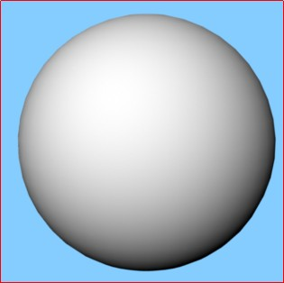
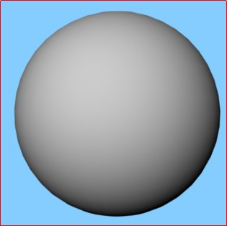
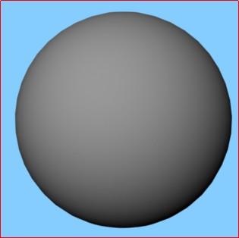
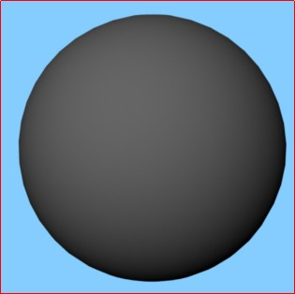
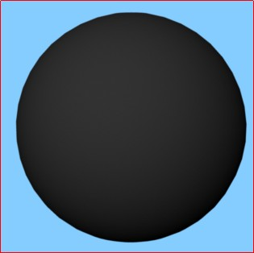
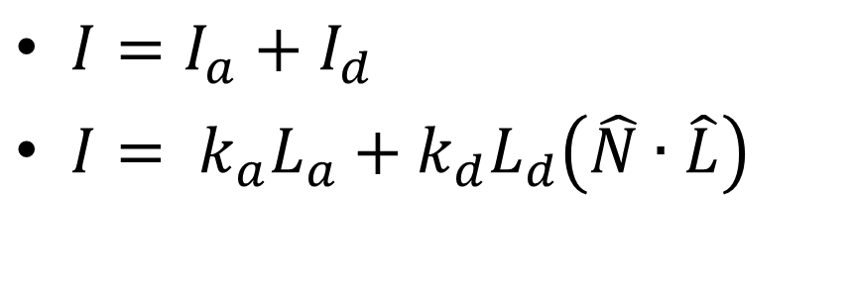
Combine: Ambient and Diffuse
$I=I_{a}+I_{d}$
$I= k_{a}L_{a}+k_{d}L_{d}\left(\hat{N}∙\hat{L}\right)$
kd(1,1,1)
kd(0.8)
kd(0.6)
kd(0.4)
kd(0.2)

Slide 8
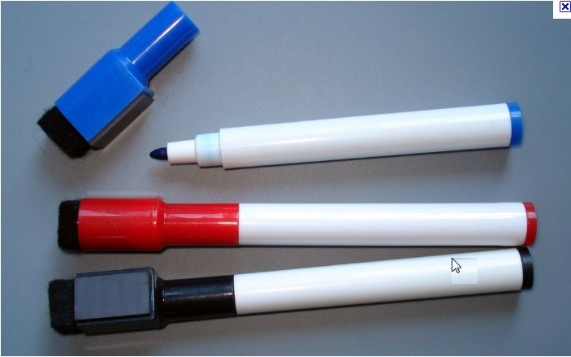
Look at my White Board Marker!
What are these? “shinning” white stuff?
Image credit:
Some random site selling random stuff
Reflection of
Light Sources!!
Visible: scattered energy is a function of how far from mirror reflection direction
In coming energy:
is scattered mainly in the mirror reflection direction

Slide 9

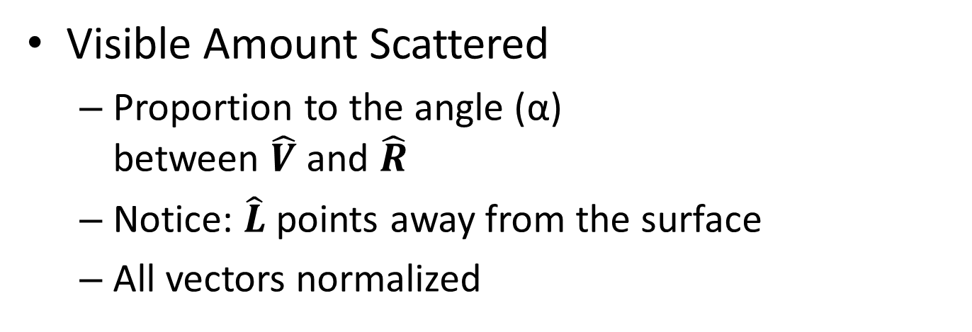
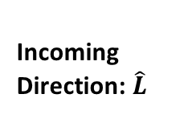
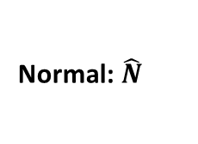
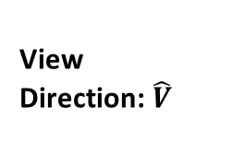
Model Specular Reflection
View Direction: $\hat{V}$
Normal: $\hat{N}$
Incoming Direction: $\hat{L}$
α
Reflection Direction of Light: $\hat{R}$
θ
Visible Amount Scattered
  Proportion to the angle (α)
  between $\hat{V}$ and $\hat{R}$
  Notice: $\hat{L}$points away from the surface
  All vectors normalized

Slide 10






Specular Reflection
$I_{s}∝\hat{V}∙\hat{R}$
  Proportional constant:
  $k_{s}$(specular coefficient)
  Specular light source: $L_{s}$
    $I_{s}=k_{s}L_{s}\left(\hat{V}∙\hat{R}\right)$
From object:
  $k_{s}$ -- specular material property
  $\hat{N}$-- object geometric property
From scene:
  $L_{s}$ and $\hat{L}$-- Light source intensity
  and direction
  $\hat{V}$-- is defined by camera
  $\left(\hat{V}∙\hat{R}\right)$ -- is a float
  $k_{s}$, $L_{s}$-- are RGB triples
$$\hat{V}$$
$$\hat{N}$$
$$\hat{L}$$
α
$$\hat{R}$$
θ
But, where does $\hat{R}$ come from??

Slide 11
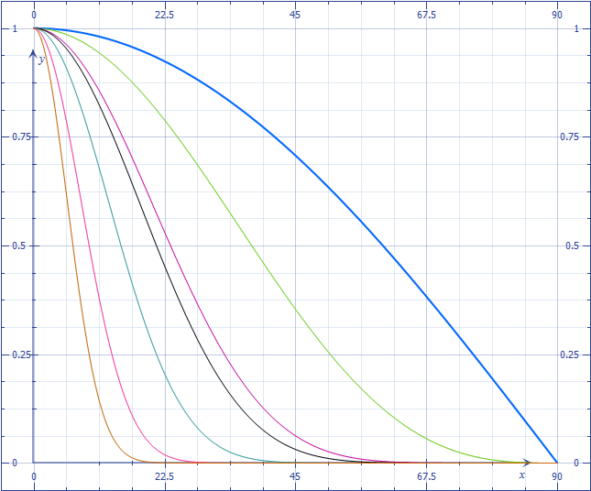





Inadequacy of $\hat{V}∙\hat{R}$
$I_{s}=k_{s}L_{s}\left(\hat{V}∙\hat{R}\right)$
Introduce: n – shininess
$I_{s}=k_{s}L_{s}{\left(\hat{V}∙\hat{R}\right)}^{n}$
$$\hat{V}$$
$$\hat{N}$$
α
$$\hat{L}$$
$$\hat{V}∙\hat{R}$$
Drops off too slowly
$$\hat{R}$$
θ
Need to control drop off rate
α
90$°$

Slide 12
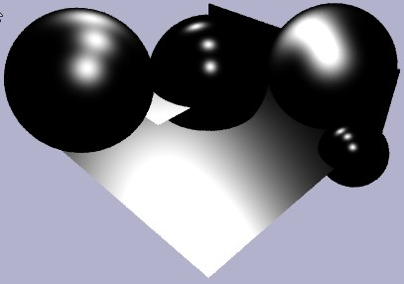
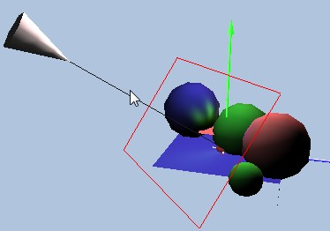
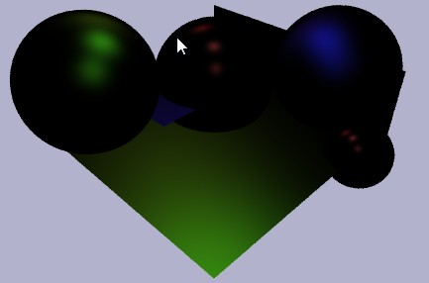


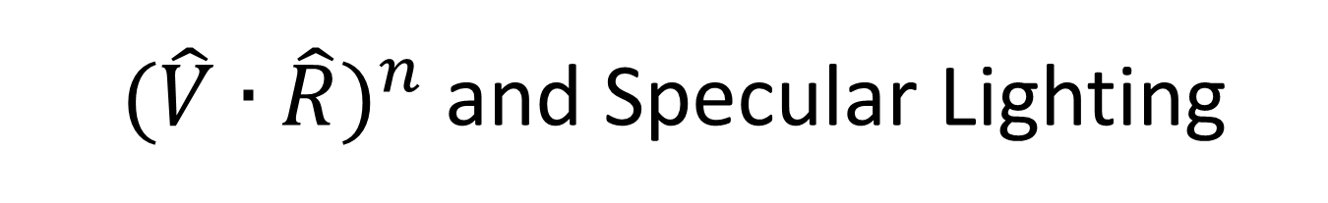
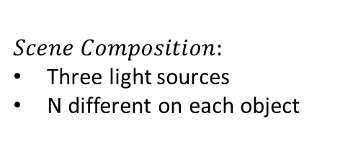




${ (\hat{V}∙\hat{R})}^{n}$ and Specular Lighting
$n=5$0
$$n=1$$
$n=1$0
$$n=10$$
$$I={\left(\hat{V}∙\hat{R}\right)}^{n}$$
$$Scene Composition:$$
Three light sources
N different on each object
$$I_{s}=k_{s}L_{s}{\left(\hat{V}∙\hat{R}\right)}^{n}$$

Slide 13
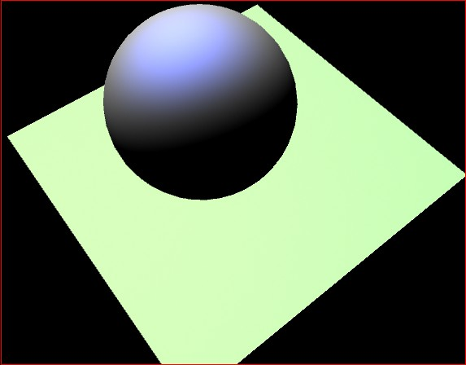
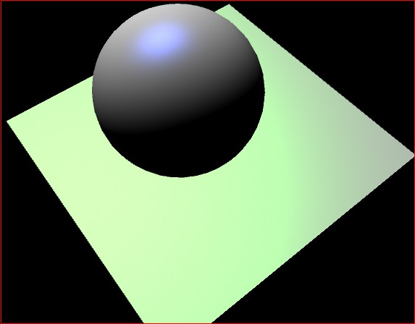
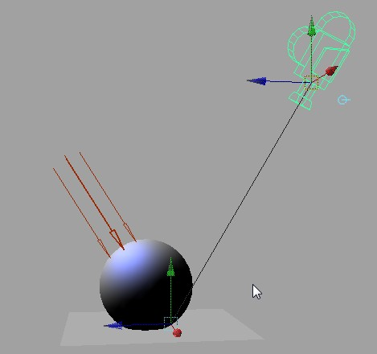

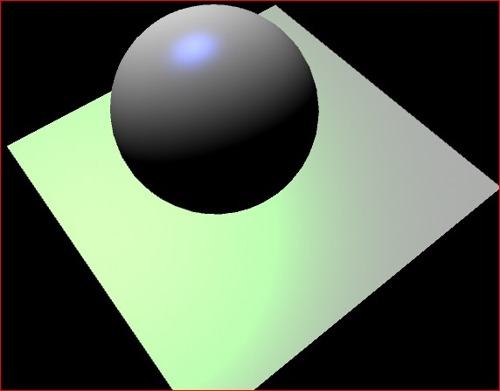
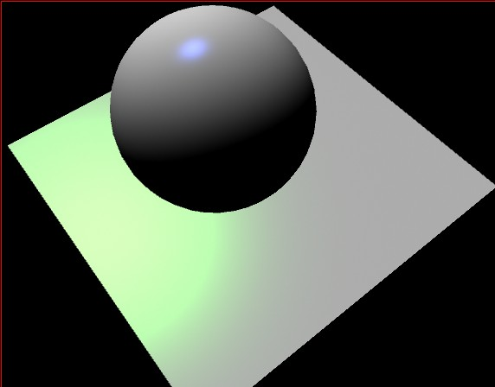


Combine all:
$$I=I_{a}+I_{d}+I_{s}$$
$$I=k_{a}L_{a}+k_{d}L_{d}\left(\hat{N}∙\hat{L}\right)+k_{s}L_{s}{\left(\hat{V}∙\hat{R}\right)}^{n}$$
n=2
n=10
Scene Composition
n=20
n=50

Slide 14





The Reflection Halfway Vector
$\hat{R}=2\left(\hat{N}∙\hat{L}\right)\hat{N}−\hat{L}$
  Must compute
  for each pixel
  Very expensive!!
Introduce halfway vector ($\hat{H}$)
  $\hat{H}=\left(\frac{\hat{V}+\hat{L}}{2}\right)$
  $I_{s}=k_{s}L_{s}{\left(\hat{N}∙\hat{H}\right)}^{n}$
$$\hat{V}$$
$$\hat{N}$$
$$\hat{L}$$
α
$$\hat{R}$$
θ
$$\hat{H}$$
$$\hat{N}$$
$$\hat{L}$$
$$\hat{V}$$

Slide 15




The Phong Illumination Model
$I=k_{a}L_{a}+k_{d}L_{d}\left(\hat{N}∙\hat{L}\right)+k_{s}L_{s}{\left(\hat{V}∙\hat{R}\right)}^{n}$
All graphics hardware implements (maybe
small variation
of this mode)
  E.g., the H vector
$$\hat{N}$$
$$\hat{L}$$
$$\hat{R}$$

Slide 16
Evaluating the Phong Model
Question:
  How to improve the model?
Non-physically based
  Based on “observation”
  E.g., specularity: as n increase the area under the curve decreases
    Large n => less energy in the scene!
  E.g., “Ambient” term
    Color bleeding

Slide 17
Recently : describe/simulate physics
Radiance: Light energy in a direction
  Think river: flow of energy over cross section area
Irradiance: Radiance received from fixed incoming area
BRDF: (material properties)
  Bi-directional Reflectance Distribution Function
  How energy reflect across surfaces
  Angular and Spectrum dependencies
Challenges:
  Difficult to model correctly
  Computationally costly
  What is the ultimate goal?
    looks good vs. looks real

Slide 18
Recently: physics only if ..
As long as it looks good, who cares?
  Games, Movies, etc.
Physics: Looks real
  But: does it look “good”?

Slide 19
Lighting/Illumination vs Shading
Lighting and Illumination
  Probably means the same thing
  scene lit/illiuminated by light sources
Shading: usually mean Gouraud Shading
  Color interpolation from vertices vs Flat Shading
    Should have nothing to do with lights
  D3D example (General Cylinder Example)
  Maya example (Shading -> Flat shading)

Slide 20
Review questions …

Slide 21
Ambient Light
T/F:
  Changing the ambient light position will affect the illumination computation
  Ambient light source color must be a number between 0 to 1

Slide 22
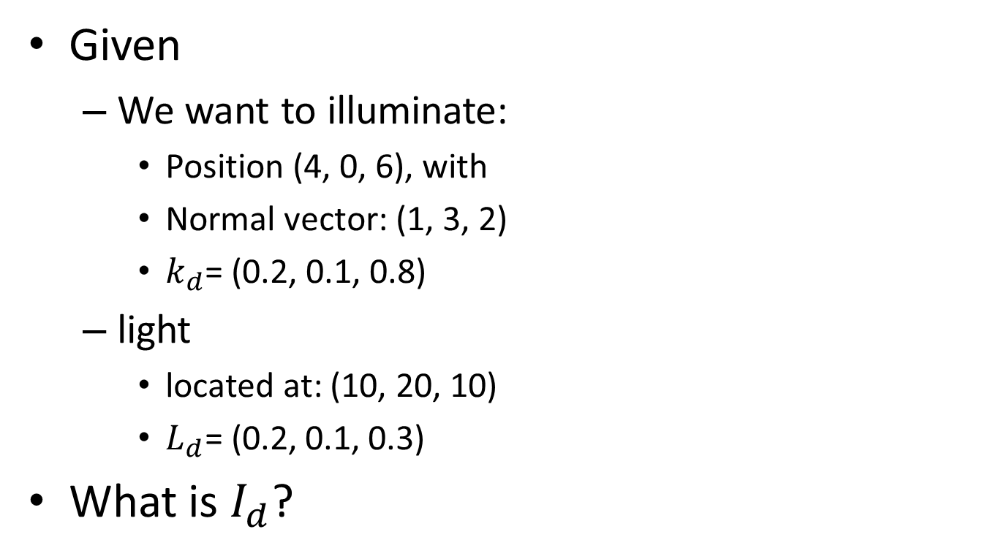
Diffuse Reflection
Given
  We want to illuminate:
    Position (4, 0, 6), with
    Normal vector: (1, 3, 2)
    $k_{d}$= (0.2, 0.1, 0.8)
  light
    located at: (10, 20, 10)
    $L_{d}\text{= (0.}\text{2}\text{, 0.}\text{1}\text{, 0.}\text{3}\text{)}$
What is $I_{d}$?

Slide 23
Specular Reflection
The three elements that must participate are:
  The object, to provide what vector(s)?
  The light, to provide what vector(s)?
  The eye (camera), to provide what vector(s)?
Of these vectors, which is the most expensive to compute?
What are the effects of increasing n?

Slide 24
Phong model
The 3D feature of Phong illuminated object is main a result of which component?
T/F:
  Specularity models reflection of objects.
  Shadow is properly modeled by the Phong model we have learned.
  The RGB components of colors must be within the range of 0 to 1

