Slide 1
Vector Review Questions
Point is a position
T/F:
Vector: has length
Vector: has direction
Vector: has a position
T/F: The following vectors are same/different
vector from (1, 3) to (4, 7)
Vector from (-3, -6) to (0, -2)
Vector from (10, 30) to (40, 70)
What are the directions defined by each of the above vectors?
Which of the vectors are in the same direction?

Slide 2
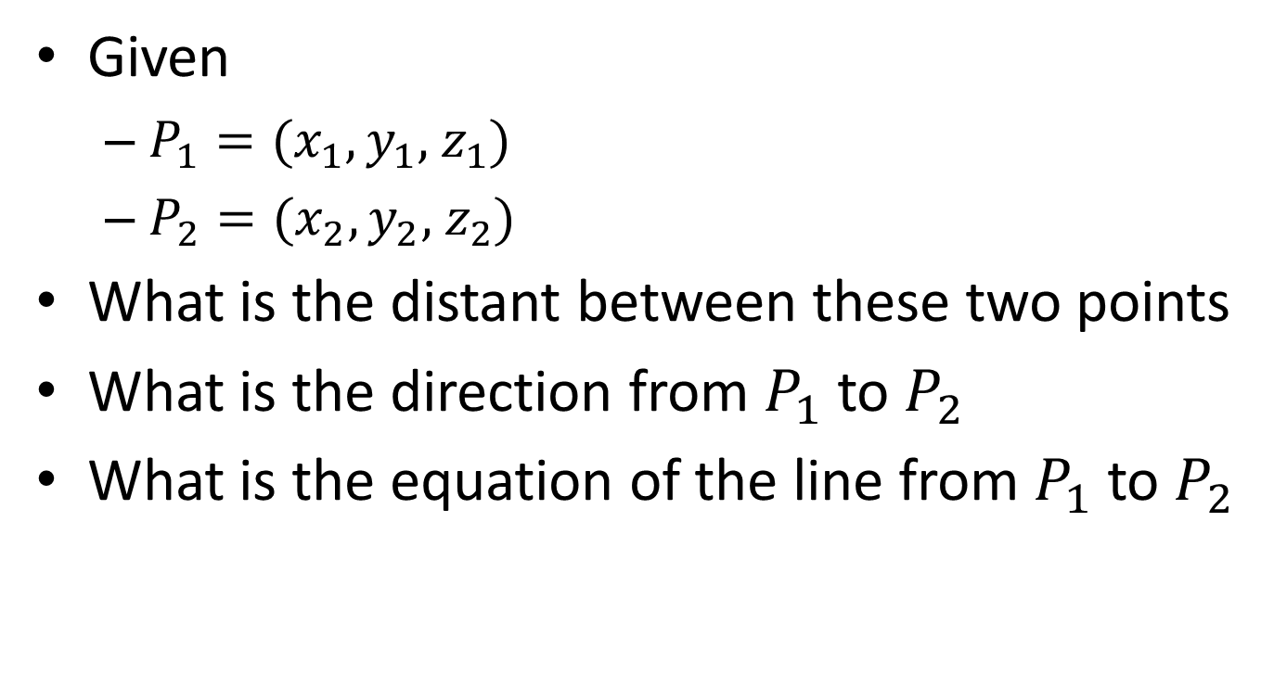
Lines
Given
$P_{1}=(x_{1},y_{1},$ $z_{1})$
$P_{2}=(x_{2},y_{2},$ $z_{2})$
What is the distant between these two points
What is the direction from $P_{1}$ to $P_{2}$
What is the equation of the line from $P_{1}$ to $P_{2}$

Slide 3
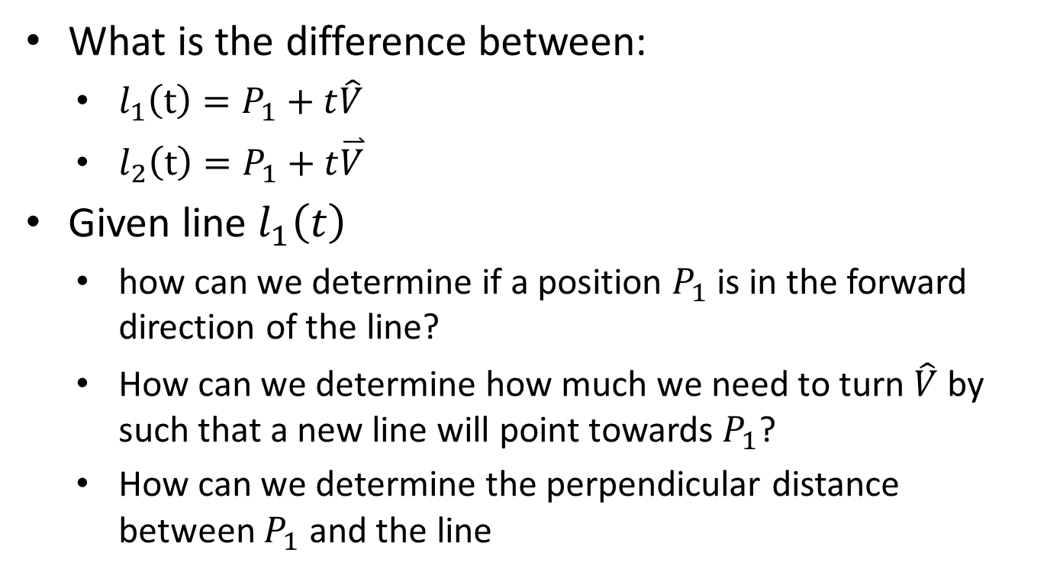
Dot product
What is the difference between:
$l_{1}\left(t\right)=P_{1}+t\hat{V}$
$l_{2}\left(t\right)=P_{1}+t\overset{⃑}{V}$
Given line $l_{1}\left(t\right)$
how can we determine if a position $P_{1}$ is in the forward direction of the line?
How can we determine how much we need to turn $\hat{V}$ by such that a new line will point towards $P_{1}$?
How can we determine the perpendicular distance between $P_{1}$ and the line

Slide 4

Cross Product
Given vectors: $\overset{⃑}{V}$ and $\overset{⃑}{U}$
What does it mean if $\overset{⃑}{V}×\overset{⃑}{U}=0$ (or very small)
What is the relationship between
$\overset{⃑}{V}×\overset{⃑}{U}$ and $\overset{⃑}{U}×\overset{⃑}{V}$

