Slide 1




The Phong Illumination Model
$I=k_{a}L_{a}+k_{d}L_{d}\left(\hat{N}∙\hat{L}\right)+k_{s}L_{s}{\left(\hat{V}∙\hat{R}\right)}^{n}$
Problems: does not describe
  Reflection
  Refraction
  Shadow
Generalize $I$ to describe
the above
$$\hat{N}$$
$$\hat{L}$$
$$\hat{R}$$

Slide 2











Reflective/Transparency
$${\text{P}}_{r}$$
$$\hat{N}$$
  $\hat{V}:$ viewing direction
  $\hat{V_{r}}$: mirror reflection direction
  $\hat{V_{t}}$: transmission direction
  $P$: visible position
  ${\text{P}}_{r}$: visible position along $\hat{V_{r}}$
  ${\text{P}}_{t}$: visible position along $\hat{V_{t}}$
  $\hat{N}:$ Normal vector at visible position P
  $ν$: Reflectivity at visible position P
  Material property: value between 0 to 1
  $τ$: Transparency at visible position P
  Material property: value between 0 to 1
  Note: for typical materials:
  $ν$ + $τ$ < 1
$$\hat{V}$$
$$\hat{V_{r}}$$
$${\text{θ}}_{i}$$
$${\text{θ}}_{i}$$
$$P$$
Medium 1
Medium 2
$${\text{θ}}_{o}$$
$$\hat{V_{t}}$$
$${\text{P}}_{t}$$

Slide 3




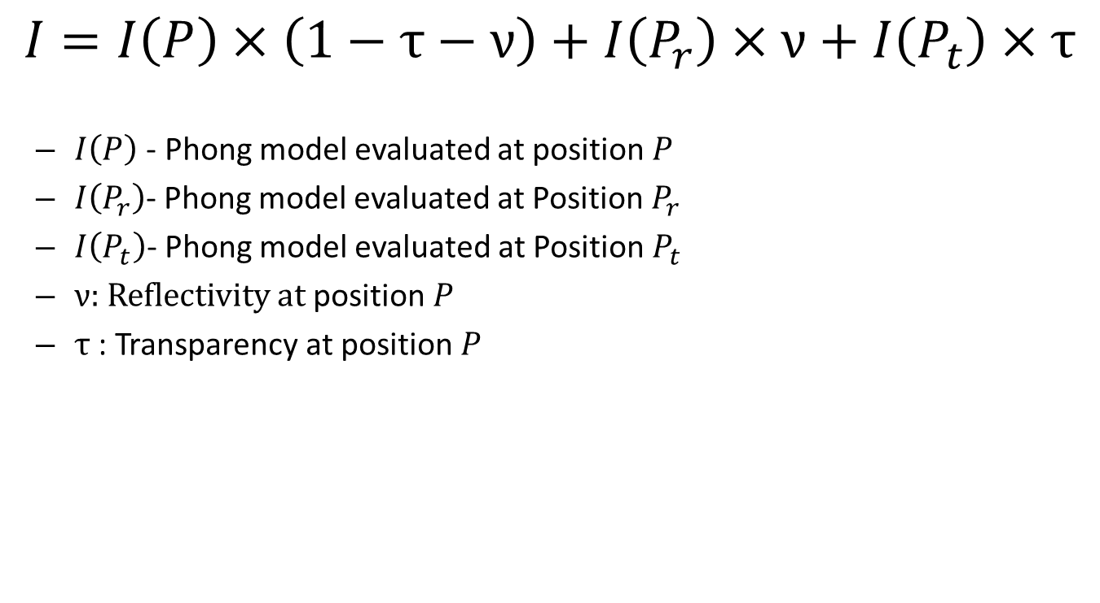






Support for Reflection and Refraction
$$I=I\left(P\right)×\left(1−τ−ν\right)+I\left(P_{r}\right)×ν+I\left(P_{t}\right)×τ$$
  $I\left(P\right)$ - Phong model evaluated at position $P$
  $I\left(P_{r}\right)$- Phong model evaluated at Position $P_{r}$
  $I\left(P_{t}\right)$- Phong model evaluated at Position $P_{t}$
  $ν$: Reflectivity at position $P$
  $τ$ : Transparency at position $P$
$${\text{P}}_{r}$$
$$\hat{N}$$
$$\hat{V}$$
$$\hat{V_{r}}$$
$${\text{θ}}_{i}$$
$${\text{θ}}_{i}$$
$$P$$
$${\text{θ}}_{o}$$
$$\hat{V_{t}}$$
$${\text{P}}_{t}$$

Slide 4







$\hat{V_{t}}$: Refraction Direction
η: refraction index
  When traveling from medium 1 to 2
$\text{η}=\frac{\sin{{\text{θ} }_{i}}}{\sin{{\text{θ} }_{o}}}$
$\hat{V_{t}}=−[\frac{\hat{V}}{η}+(\cos{θ_{o}}−\frac{\cos{θ_{i}}}{η})\hat{N}$
$$\hat{N}$$
$$\hat{V}$$
$${\text{θ} }_{i}$$
Medium 1
Medium 2
$${\text{θ} }_{o}$$
$$\hat{V_{t}}$$

Slide 5






Reflection Direction
$\hat{V_{r}}=2\cos{θ_{i}}\hat{N}−\hat{V}$
Or
$\hat{V_{r}}=2(\hat{N}∙\hat{V})\hat{N}−\hat{V}$
$$\hat{N}$$
$$\hat{V}$$
$$\hat{V_{r}}$$
$${\text{θ}}_{i}$$
$${\text{θ}}_{i}$$

