Slide 1
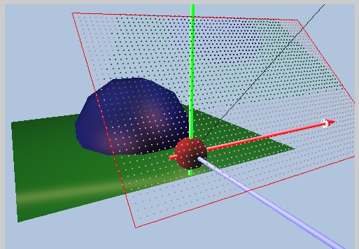
Sampling
Image Plane
Color of one pixel
Areas represented
by the pixel
Pixel is an area!!
  Square, Rectangular, or Circular?
How do we approximate the area?
  Why bother?

Slide 2
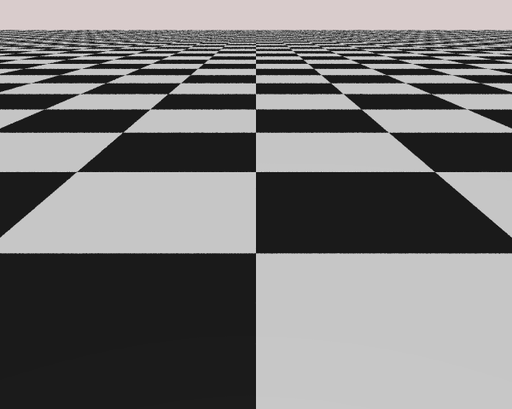
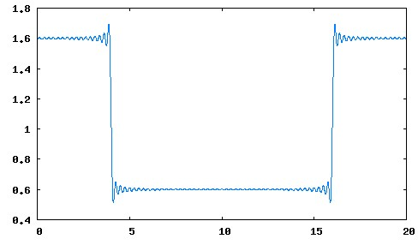
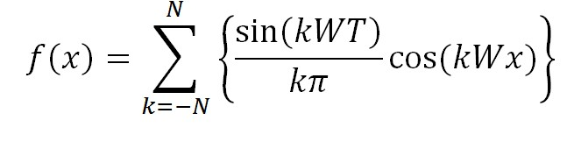
Sampling Theorem told us …
Images with checker-like transitions
  Contains infinitely high frequencies (N → ∞)
To faithfully sample these signals
  Sample points must be infinitely close to each other!!
N = 80

Slide 3
Reality …
Can never really
sample sufficiently!!
But, these edges
looks pretty good!
Looks!!
The human eye!
  For now, assume we know how to compute color

Slide 4
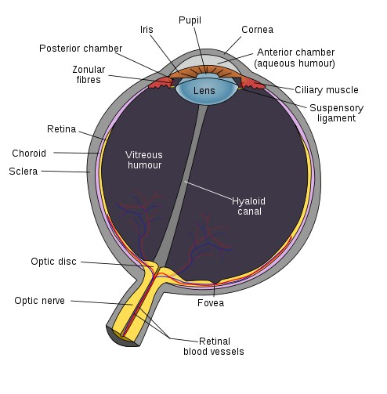
Human Eye
Some interesting facts
  Rod cells:
    requires only low light
    b/w vision
    blur, all over retina EXCEPT fovea
  Cone cells:
    requires bright light,
    Color vision: three kinds of cone sensitive to roughly RGB wave lengths
    acute, sharp image, located at the fovea
  Dynamic range and adaptation
Useful fact
  Lens is like a low pass filter!!
Image credit:
Wikipedia: fovea
Image credit: Wikipedia (Fovea)

Slide 5
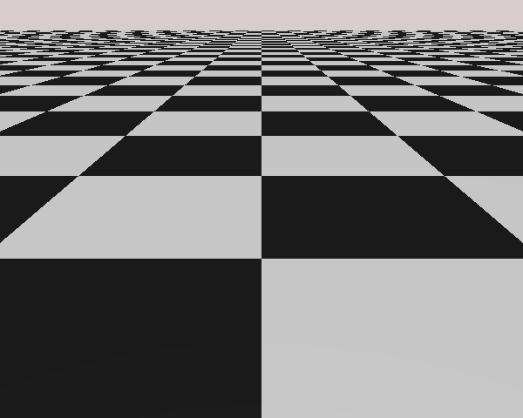
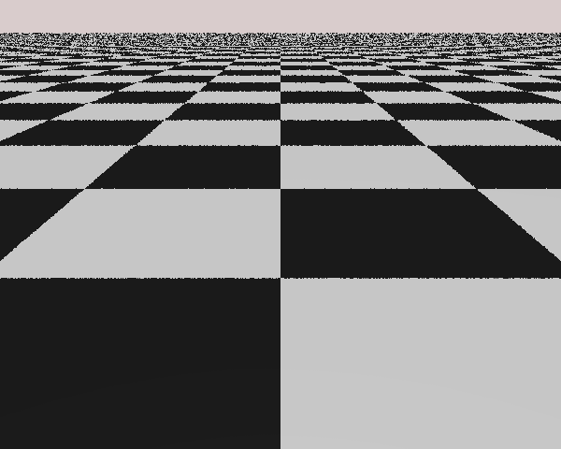
Human Eye:
Low pass filters!
  Collection of pixels (at appropriate distance) looks like a continuous image
    Pixel boundary (high frequency components) are “filtered” by the lens!
More sensitive to
low frequency noise (error)
Less sensitive to
high frequency noise (error)

Slide 6
A Closer Look
1 Sample at
pixel center
    Pattern is BAD!!
1 Sample at
random position
in pixel area
Controlled randomness is better than repeat
  Randomness pushes error to higher frequency

Slide 7

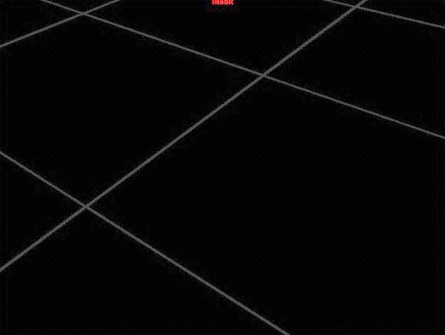
Sampling: Issues
How many samples to take
  Too many: Costly
  Too few: Bad Quality
Where to take the samples
  Center of pixel seem important?
  Why? What is important?
How to re-sample at display rate!?
  This is also known as: Filtering
  How to combine the samples to form the color of a single pixel?
Maya software Renderer:
setAttr defaultRenderQuality.renderSample 1
Render at Highest Quality with
MinShading Samples =2 MaxShading Sample =32
Look at Mask channel

Slide 8
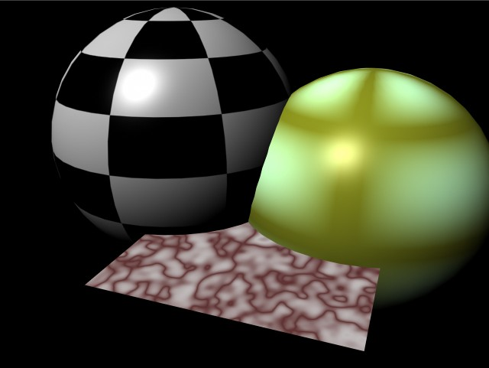
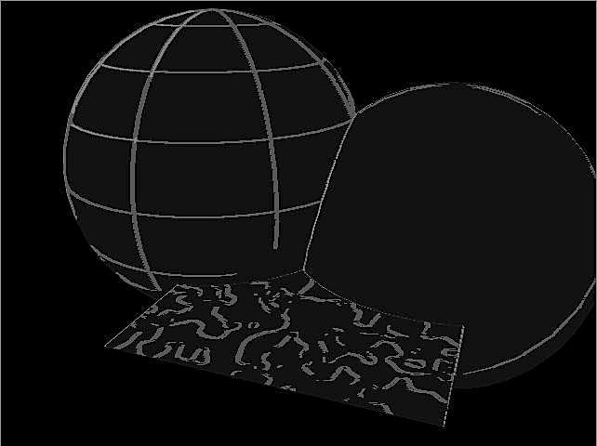
How many to take?
Fixed Rate
  Simple!
  Can be wasteful!
Adaptive: take more only when required
  Work only when need to
  Tricky to implement
No level-2
Sampling
is required!
Maya scene

Slide 9
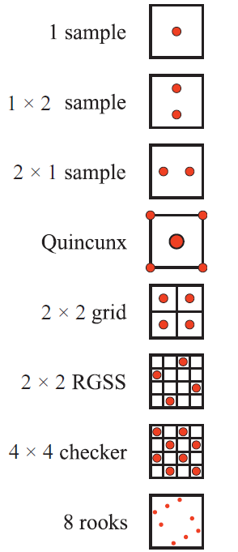
Fixed Rate Sampling
Strategies for suitable for
hardware implementation
Other strategies:
  Poisson Disc: eye cell distribution
  Jittered
Image credit:
Real Timer Rendering
3rd Ed: Fig 5-29 P. 127

Slide 10
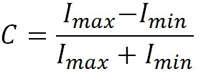
Adaptive Super Sampling
Usually 2-level (e.g., Maya Renderer)
  Primary samples: compare to trigger secondary sampling
  Too many levels causes complexity!
Contrast: measurement of local variation
  Thresholds [Mitchell 87]
  R= 0.4
  G = 0.3 (easiest to trigger)
  B = 0.6

Slide 11
Adaptive Super Sampling
E.g. Take 2 level-1 samples
in 3x3 pixel area
Compute contrast for RGB channels separately
If any of the channel contrast > threshold
perform level-2 sampling (e.g., take 10 more samples) for all 3x3 pixels

Slide 12
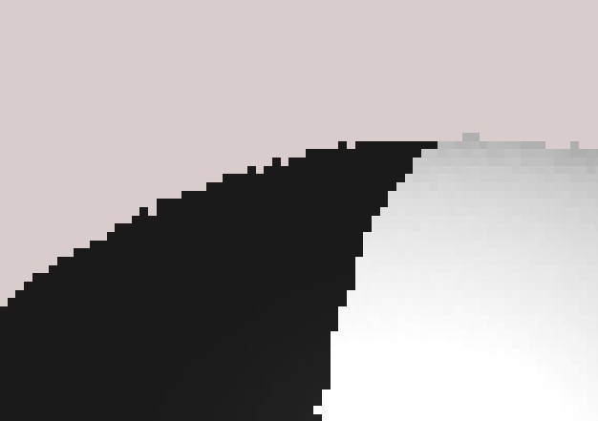
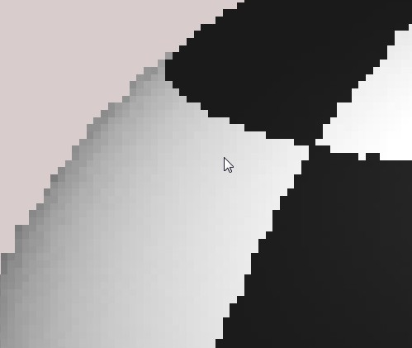
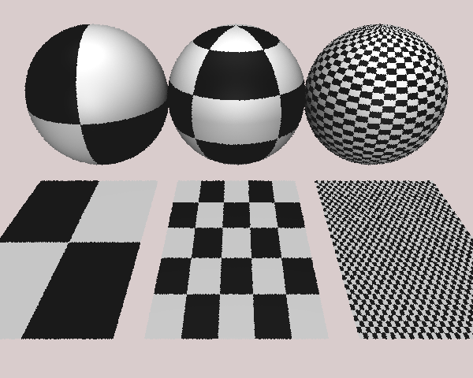
Alaising
Geometric Alias
Texture/Shading Alias

Slide 13
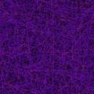
Example
3X3 Sampling Kernel
Level-1 samples
Pixels that triggered level-2 sampling
level-2 sampled pixels

Slide 14
Filtering
E.g., everyone of the 3x3 pixels
contains 2 samples
How to “compute” or “re-sample” or “filter”
to one pixel color?
Simplest: straight averaging!

Slide 15
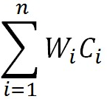
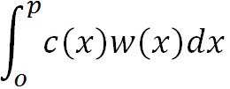

Average: Uniform weight
Pixel boundaries
Computed colors
Compute colors:
    C₁ and C₂
Color = 0.5 * C₁ + 0.5 * C₂
    Or
Color = W₁ * C₁ + W₂ * C₂
    Or
Color = =
p
C₁
C₂
width
Weight
0.5
W(x)
0.5p
0.5p
x
Areas = 0.5!

Slide 16
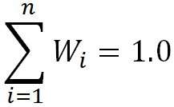
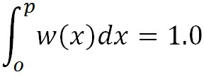
The “Weight” Function
Pixel boundaries
Computed colors
Total Weight Must = 1.0!
  Why?
  So
  and
Other Function satisfies
condition will also do!!
Filter KERNEL
p
C₁
C₂
width
Weight
0.5
W(x)
x

Slide 17
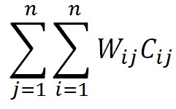
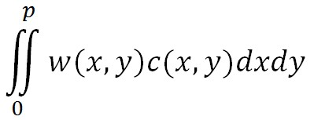


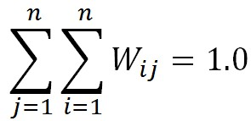
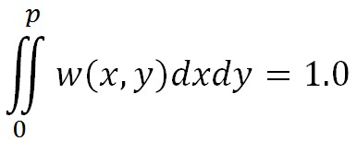
In 2D Space
Pixel boundaries
Color =
Uniform filter kernel
It is still true that:
Weight = 0.25
W(x,y) =
Pixel width = p
Volumes = 0.25!

Slide 18
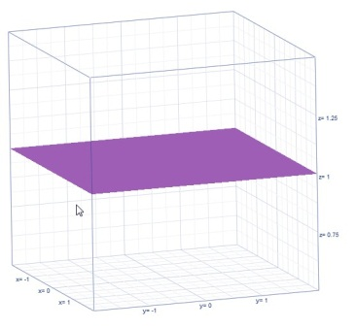
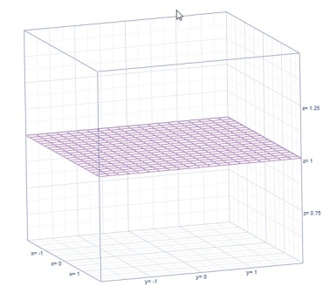
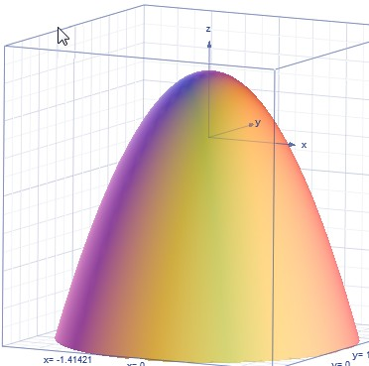
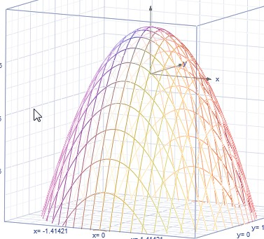
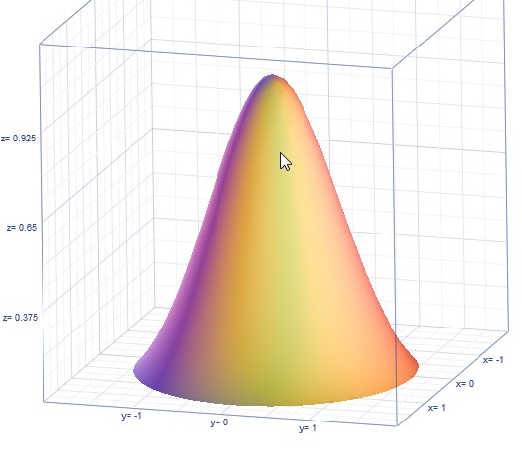
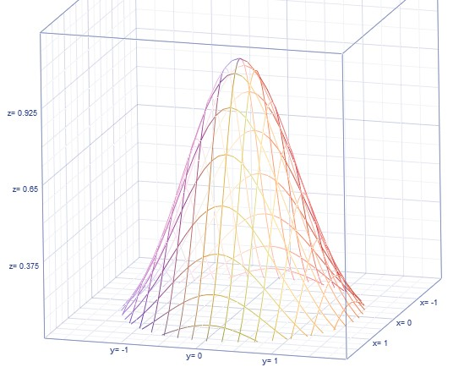
Filter Kernels
Constant: Box (uniform)
Linear: Tent, Triangle
Quadratic
Gaussian

Slide 19
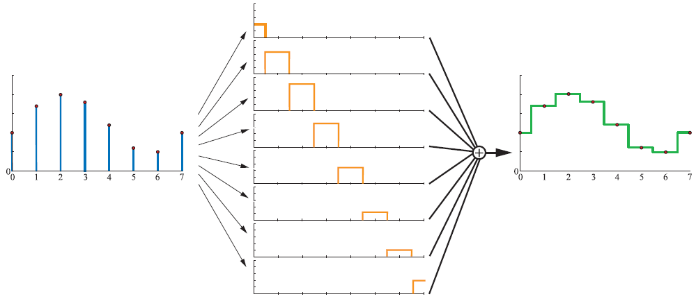
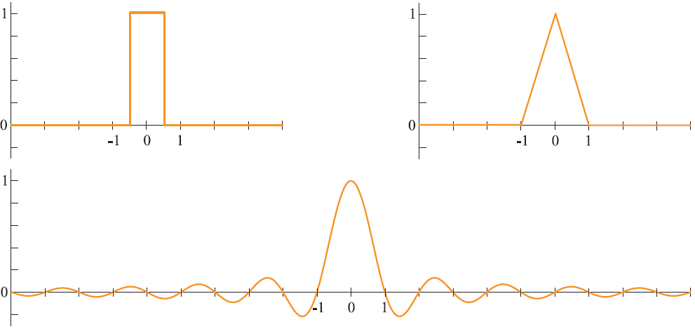
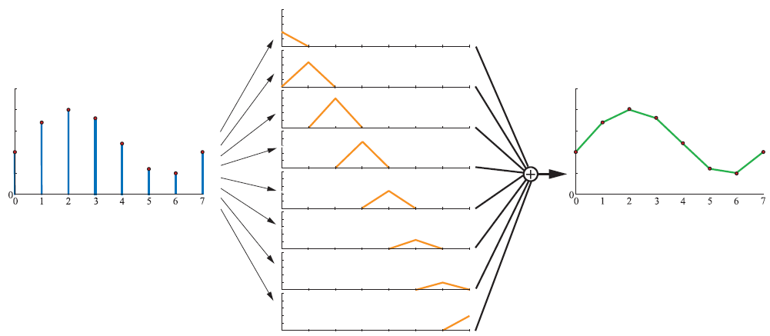
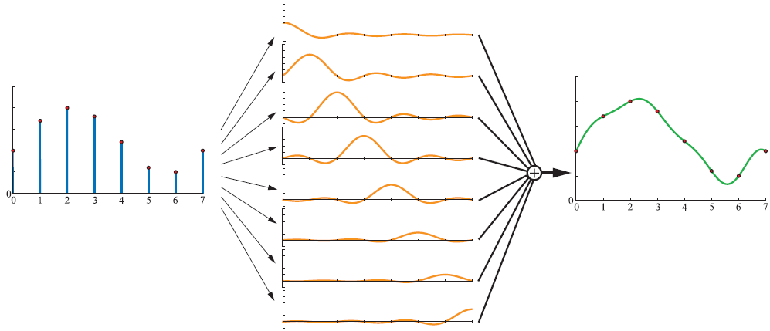
Filtering Illustrated
Image credit:
Real Timer Rendering
3rd Ed: Fig 5-22 – 5-25 P. 120 – P 122

Slide 20
Kernel Support
Filter Kernel
Weight still sums to 1.0
Wider than a pixel!!
Multi-pixel filtering
  Kernel support is more than a pixel
Kernel width
  Aliasing: too narrow
  Blurry: too wide
samples
Pixel boundaries

Slide 21
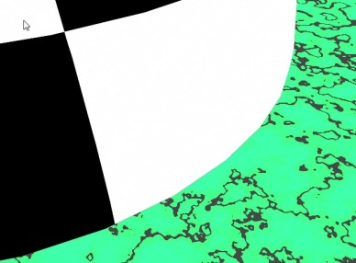
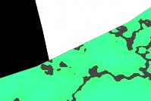

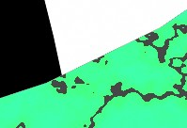
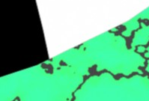
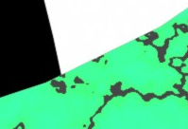
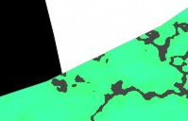
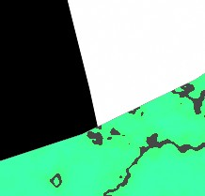
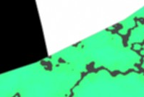
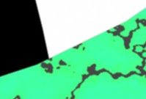
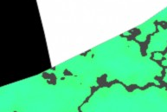
Examples: scene
Box: 1x1
Triangle: 1x1
Quad: 1x1
Box: 2x2
Triangle: 2x2
Quad: 2x2
No Filter
Box: 3x3
Triangle: 3x3
Quad: 3x3

Slide 22
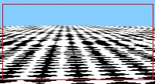






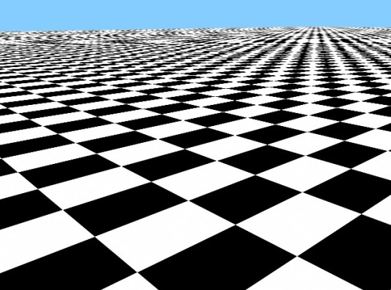



Checker Example
No Filter
Box
Triangle
Quad
1x1
2x2
3x3

