Slide 1
Machine Learning
Data

Slide 2
Data topics
Types of attributes
Data quality issues
Transformations
Visualization
Types of datasets
Preprocessing
Summary statistics

Slide 3
What is data?
Collection of data objects and their attributes
An attribute is a property or characteristic of an object
  Examples: eye color of a person, temperature, etc.
  Attribute is also known as variable, field, characteristic, or feature
A collection of attributes describe an object
  Object is also known as record, point, case, sample, entity, or instance
Attributes
Objects

Slide 4
Attribute values
Attribute values are numbers or symbols assigned to an attribute
Distinction between attributes and attribute values
  Same attribute can be mapped to different attribute values
    Example: height can be measured in feet or meters
  Different attributes can be mapped to the same set of values
    Example: Attribute values for ID and age are integers
    But properties of attribute values can be different
      ID has no limit but age has a maximum and minimum value

Slide 5
Types of attributes
There are different types of attributes
  Nominal
    Examples: ID numbers, eye color, zip codes
  Ordinal
    Examples: rankings (e.g., taste of potato chips on a scale from 1-10), grades, height in {tall, medium, short}
  Interval
    Examples: calendar dates, temperatures in Celsius or Fahrenheit.
  Ratio
    Examples: temperature in Kelvin, length, time, counts

Slide 6
Properties of attributes
The type of an attribute depends on which of the following properties it possesses:
  Distinctness: = ≠
  Order: < >
  Addition: + -
  Multiplication: * /
  Nominal attribute: distinctness
  Ordinal attribute: distinctness & order
  Interval attribute: distinctness, order & addition
  Ratio attribute: all four properties

Slide 7
Attribute Type
Description
Examples
Statistical Operations
Nominal
The values of a nominal attribute are just different names, i.e., nominal attributes provide only enough information to distinguish one object from another. (=, ≠)
zip codes, employee ID numbers, eye color, sex: {male, female}
mode, entropy, contingency correlation, χ² test
Ordinal
The values of an ordinal attribute provide enough information to order objects. (<, >)
hardness of minerals, {good, better, best},
grades, street numbers
median, percentiles, rank correlation, run tests, sign tests
Interval
For interval attributes, the differences between values are meaningful, i.e., a unit of measurement exists.
(+, - )
calendar dates, temperature in Celsius or Fahrenheit
mean, standard deviation, Pearson's correlation, t and F tests
Ratio
For ratio variables, both differences and ratios are meaningful. (*, /)
temperature in Kelvin, monetary quantities, counts, age, mass, length, electrical current
geometric mean, harmonic mean, percent variation

Slide 8
Attribute Level
Allowed Transformations
Comments
Nominal
Any permutation of values
If all employee ID numbers were reassigned, would it make any difference?
Ordinal
An order preserving change of values, i.e.,
new_value = f(old_value)
where f is a monotonic function.
An attribute encompassing the notion of { good, better best } can be represented equally well by values, e.g.
{1, 2, 3} or {0.5, 1, 10}.
Interval
new_value = a * old_value + b where a and b are constants
The Fahrenheit and Celsius temperature scales differ in terms of where their zero value is and the size of a unit (degree).
Ratio
new_value = a * old_value
Length can be measured in meters or feet.

Slide 9
Discrete and continuous attributes
Discrete attribute
  Has only a finite or countably infinite set of values
  Examples: zip codes, counts, or the set of words in a collection of documents
  Often represented as integer variables.
  Note: binary attributes are a special case of discrete attributes
Continuous attribute
  Has real numbers as attribute values
  Examples: temperature, height, or weight.
  Practically, real values can only be measured and represented using a finite number of digits.
  Continuous attributes are typically represented as floating-point variables.

Slide 10
Types of data sets
Record
  Data matrix
  Document data
  Transaction data
Graph
  World Wide Web
  Molecular structures
Ordered
  Spatial data
  Temporal (time series) data
  Sequential data
  Genetic sequence data

Slide 11
Record data
Data that consists of a collection of records, each of which consists of a fixed set of attributes

Slide 12
Data matrix
If data objects have the same fixed set of numeric attributes, then the data objects can be thought of as points in a multi-dimensional space, where each dimension represents a distinct attribute.
Such data set can be represented by an m x n matrix, where there are m rows, one for each object, and n columns, one for each attribute

Slide 13
Document data
Each document becomes a ‘term’ vector,
  each term is a component (attribute) of the vector
  the value of each component is the number of times the corresponding term occurs in the document.
 | team | coach | play | ball | score | game | win | lost | timeout | season
document 1 | 3 | 0 | 5 | 0 | 2 | 6 | 0 | 2 | 0 | 2
document 2 | 0 | 7 | 0 | 2 | 1 | 0 | 0 | 3 | 0 | 0
document 3 | 0 | 1 | 0 | 0 | 1 | 2 | 2 | 0 | 3 | 0

Slide 14
Transaction data
A special type of record data, where
  Each record (transaction) involves a set of items.
  For example, consider a grocery store. The set of products purchased by a customer during one shopping trip constitute a transaction, while the individual products that were purchased are the items.

Slide 15
Graph data
Examples: Generic graph and HTML Links

Slide 16
Chemical data
Benzene molecule: C₆H₆

Slide 17
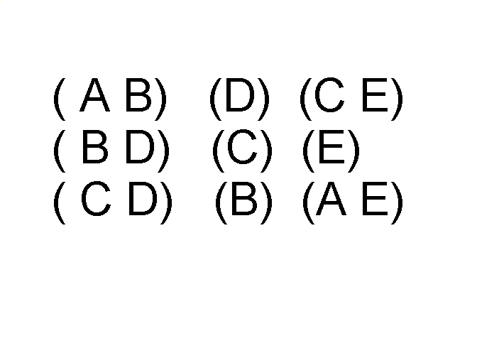
Ordered data
Sequences of transactions
Items/Events
An element of the sequence

Slide 18
Ordered data
Genomic sequence data

Slide 19
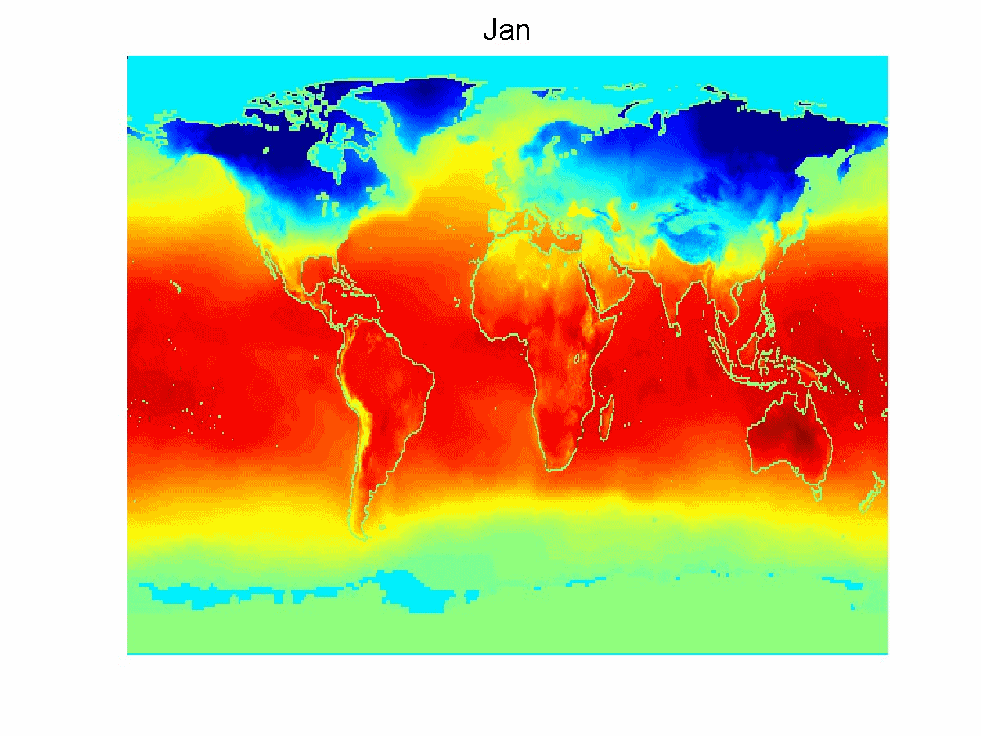
Ordered data
Spatio-temporal data
Average monthly temperature of land and ocean

Slide 20

Stages of knowledge extraction
Interpretation /
evaluation
Knowledge
Machine learning
Transformation
Patterns
Preprocessing
Transformed
data
Selection
Preprocessed
data
Data
Target
data
Notes:
Preprocessing: data cleaning, de-noising
Transformation: aggregation, normalization, feature creation, feature selection

Slide 21
Data quality
What kinds of data quality problems?
How can we detect problems with the data?
What can we do about these problems?
Examples of data quality problems:
  noise and outliers
  missing values
  duplicate data

Slide 22
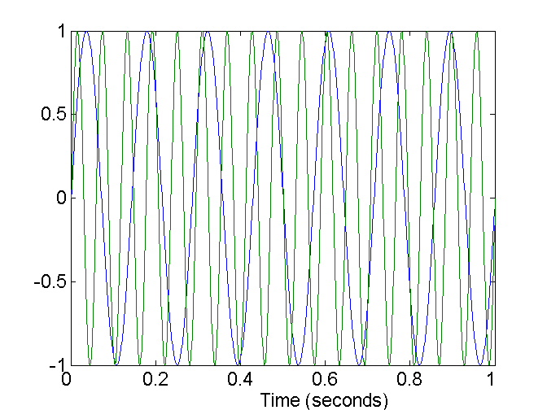
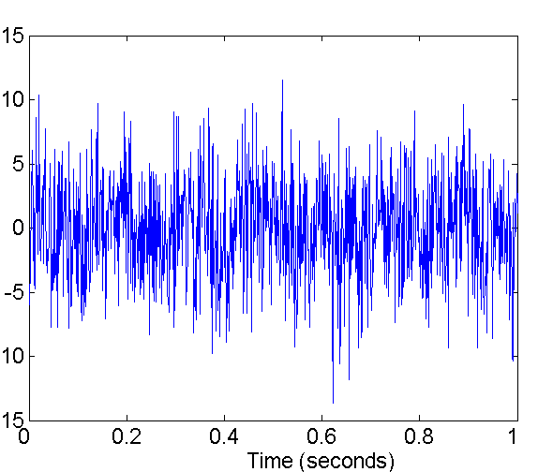
Noise
Noise refers to random modification of original values
Examples:
  distortion of a person’s voice when talking on a poor phone
  “snow” on television screen
Two sine waves
Two sine waves + noise

Slide 23
Noise
Dealing with noise
  Mostly you have to live with it
  Certain kinds of smoothing or averaging can be helpful
  In the right domain (e.g. signal processing), transformation to a different space can get rid of majority of noise

Slide 24
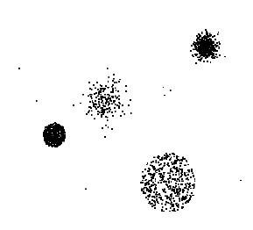
Outliers
Outliers are data objects with characteristics that are considerably different than most of the other data objects in the data set

Slide 25
Outliers
Dealing with outliers
  There are robust statistical methods for detecting outliers
  In some situations, you want to get rid of outliers
    but be judicious – they may carry useful, even important
    information
  In other situations, the outliers are the objects of interest
    anomaly detection

Slide 26
Missing values
Reasons for missing values
  Information is not collected
  (e.g., people decline to give their age and weight)
  Attributes may not be applicable to all cases
  (e.g., annual income is not applicable to children)
Handling missing values
  Eliminate data objects
  Estimate missing values (imputation)
  Ignore the missing value during analysis
  Replace with all possible values (weighted by their probabilities)

Slide 27
Duplicate data
Data set may include data objects that are duplicates, or almost duplicates of one another
  Major issue when merging data from heterogeous sources
Example:
  Same person with multiple email addresses
Data cleaning
  Includes process of dealing with duplicate data issues

Slide 28
Data preprocessing
Aggregation
Sampling
Discretization and binarization
Attribute transformation
Feature creation
Feature selection
  Choose subset of existing features
Dimensionality reduction
  Create smaller number of new features through linear or nonlinear combination of existing features

Slide 29
Aggregation
Combining two or more attributes (or objects) into a single attribute (or object)
Purpose
  Data reduction
    Reduce the number of attributes or objects
  Change of scale
    Cities aggregated into regions, states, countries, etc.
  More “stable” data
    Aggregated data tends to have less variability

Slide 30
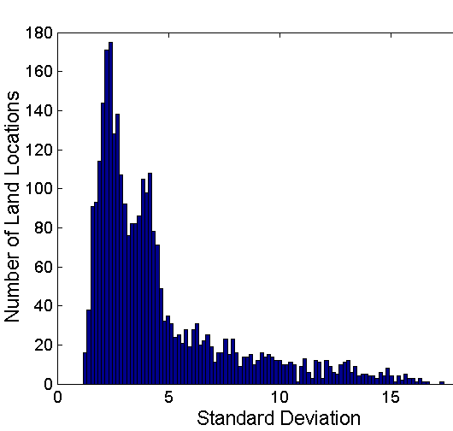
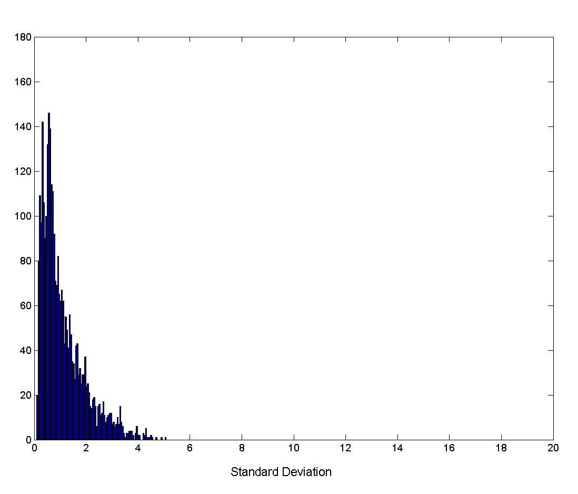
Aggregation
Variation of precipitation in Australia
Standard deviation of average monthly precipitation
Standard deviation of average yearly precipitation

Slide 31
Sampling
Sampling is the main technique employed for data selection.
  Often used for both preliminary investigation of the data and the final data analysis.
Statisticians sample because obtaining the entire set of data of interest is too expensive or time consuming.
Sampling is used in data mining because processing the entire set of data of interest is too expensive or time consuming.

Slide 32
Sampling
The key principle for effective sampling is the following:
  Using a sample will work almost as well as using the entire data set, provided the sample is representative.
  A sample is representative if it has approximately the same distribution of properties (of interest) as the original set of data

Slide 33
Types of sampling
Simple random sampling
  There is an equal probability of selecting any particular item.
Sampling without replacement
  As each item is selected, it is removed from the population.
Sampling with replacement
  Objects are not removed from the population as they are selected for the sample.
    Same object can be selected more than once.
Stratified sampling
  Split the data into several partitions; then draw random samples from each partition.
  Example: During polling, you might want equal numbers of male and female respondents. You create separate pools of men and women, and sample separately from each.

Slide 34

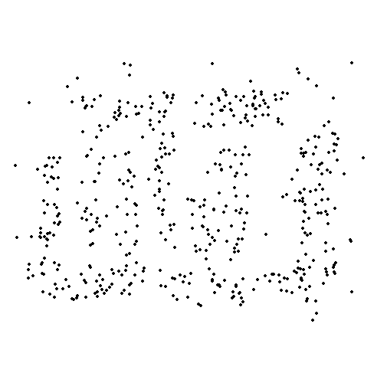
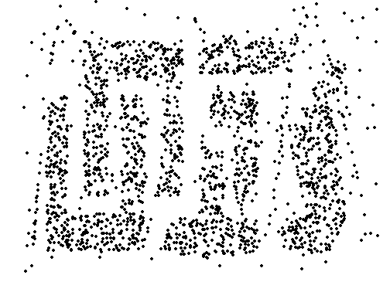
Sample size
8000 points 2000 Points 500 Points

Slide 35
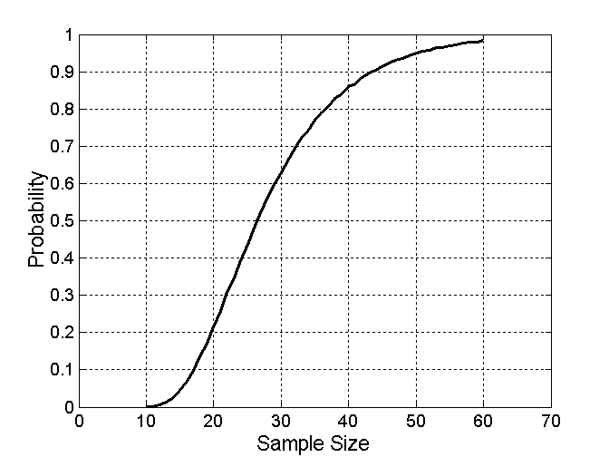

Sample size
What sample size is necessary to get at least one object from each of 10 equal-sized groups?

Slide 36
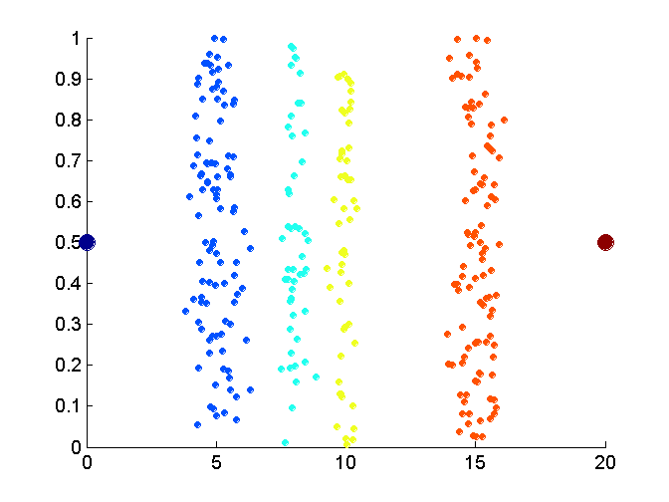
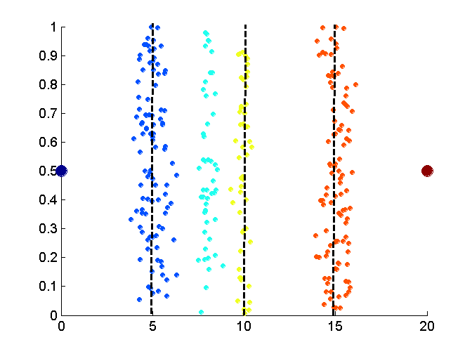
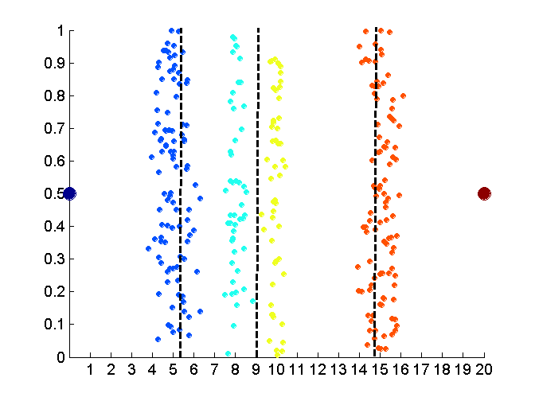
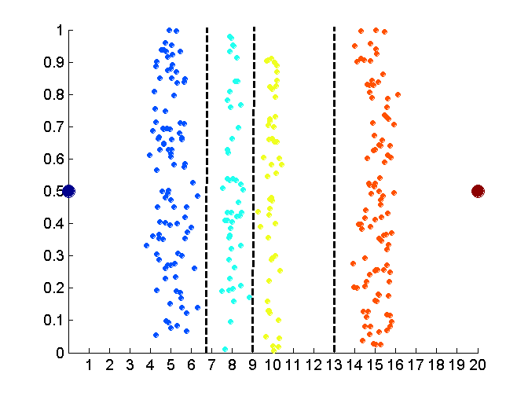
Approaches to discretization
Original attribute values
Equal interval width
Equal frequency
k-means

Slide 37
Attribute transformation
Definition:
A function that maps the entire set of values of a given attribute to a new set of replacement values, such that each old value can be identified with one of the new values.

Slide 38
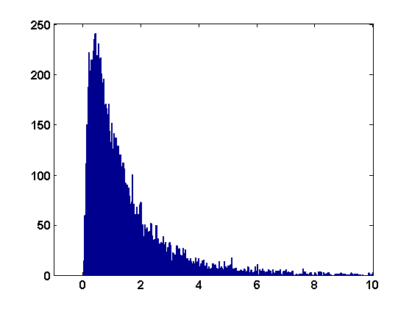
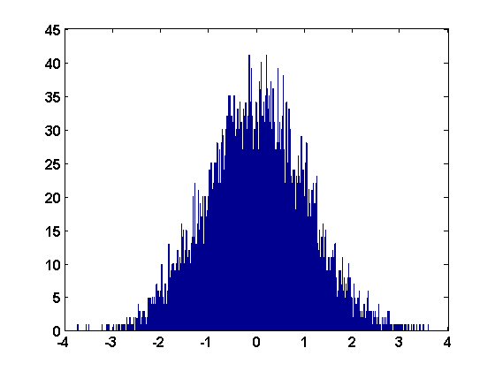
Attribute transformation
Simple functions
  Examples of transform functions:
  x^{k} log( x ) e^{x} | x |
  Often used to make the data more like some standard distribution, to better satisfy assumptions of a particular algorithm.
    Example: discriminant analysis explicitly models each class distribution as a multivariate Gaussian
log( x )

Slide 39
Attribute transformation
Standardization or normalization
  Usually involves making attribute:
  mean = 0
  standard deviation = 1
    in MATLAB, use zscore() function
  Important when working in Euclidean space and attributes have very different numeric scales.
  Also necessary to satisfy assumptions of certain algorithms.
    Example: principal component analysis (PCA) requires each attribute to be mean-centered (i.e. have mean subtracted from each value)

Slide 40
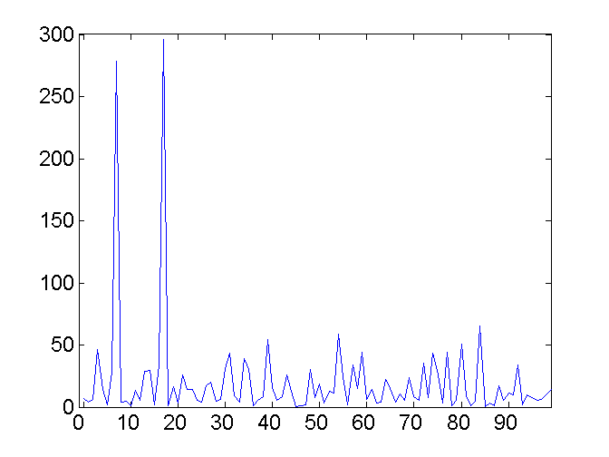
Transform data to a new space
Fourier transform
  Eliminates noise present in time domain
Two sine waves
Two sine waves + noise
Frequency

Slide 41
Summary statistics and visualization
Let’s use a tool that’s good at those things …
PowerPoint isn’t it

Slide 42
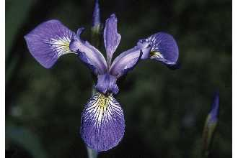
Iris dataset
Many exploratory data techniques are nicely illustrated with the iris dataset.
  Dataset created by famous statistician Ronald Fisher
  150 samples of three species in genus Iris (50 each)
    Iris setosa
    Iris versicolor
    Iris virginica
  Four attributes
    sepal width
    sepal length
    petal width
    petal length
  Species is class label
Iris virginica. Robert H. Mohlenbrock. USDA NRCS. 1995. Northeast wetland flora: Field office guide to plant species. Northeast National Technical Center, Chester, PA. Courtesy of USDA NRCS Wetland Science Institute.

