Slide 1
Machine Learning Math Essentials Part 2

Slide 2
Gaussian distribution
Most commonly used continuous probability distribution
Also known as the normal distribution
Two parameters define a Gaussian:
Mean μ location of center
Variance σ² width of curve

Slide 3
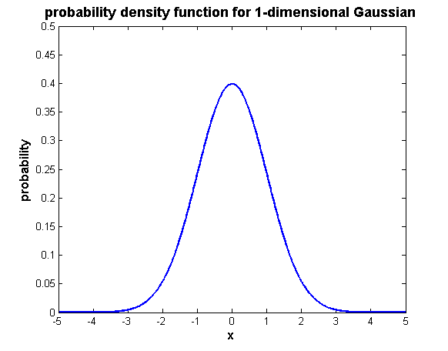
Gaussian distribution
In one dimension

Slide 4
Gaussian distribution
In one dimension
Causes pdf to decrease as distance from center increases
Controls width of curve
Normalizing constant: insures that distribution integrates to 1

Slide 5
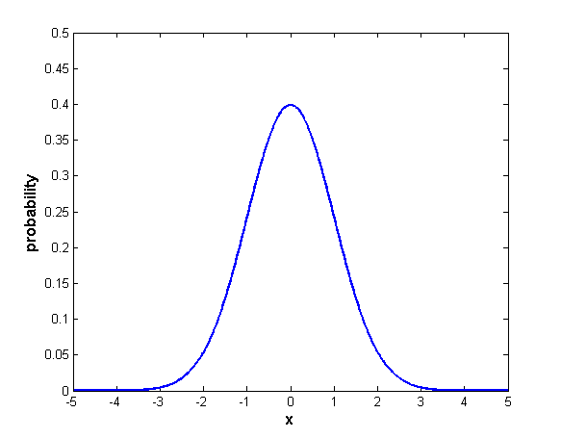
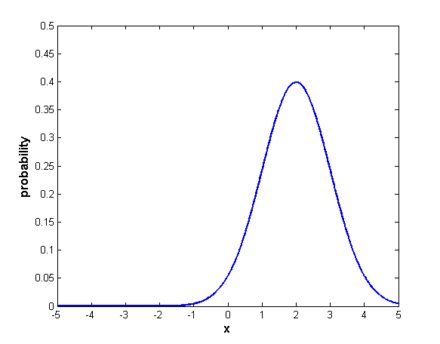
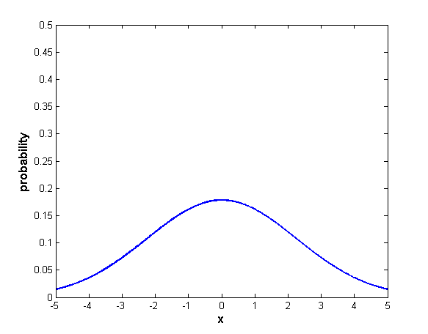
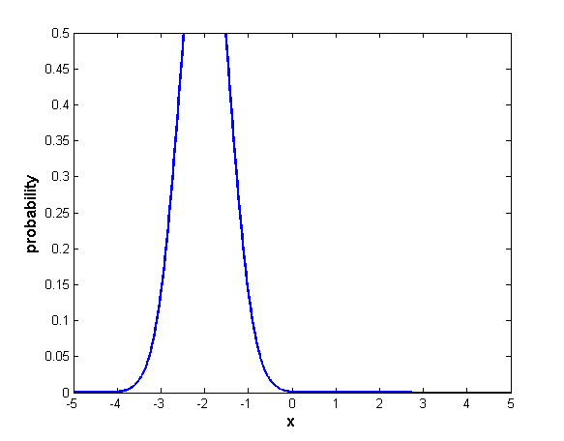
Gaussian distribution
μ = 0 σ² = 1
μ = 2 σ² = 1
μ = 0 σ² = 5
μ = -2 σ² = 0.3

Slide 6
Multivariate Gaussian distribution
In d dimensions
x and μ now d-dimensional vectors
μ gives center of distribution in d-dimensional space
σ² replaced by Σ, the d x d covariance matrix
Σ contains pairwise covariances of every pair of features
Diagonal elements of Σ are variances σ² of individual features
Σ describes distribution’s shape and spread

Slide 7
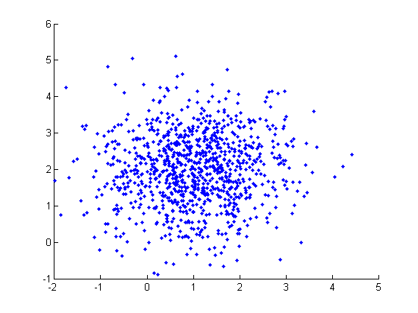
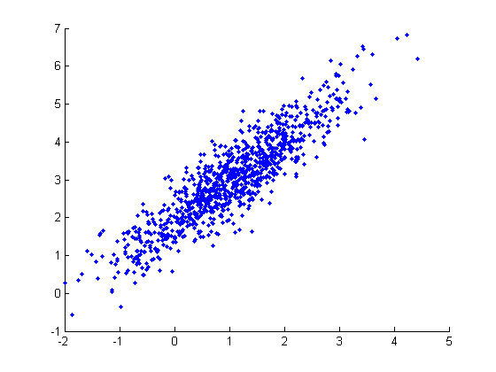
Multivariate Gaussian distribution
Covariance
Measures tendency for two variables to deviate from their means in same (or opposite) directions at same time
no covariance
high (positive)
covariance
Notes:
This is expected value of two random variables considered simultaneously.
When working in higher-dimensional spaces, can have a whole matrix of covariances (will look at later).
Formulas on this slide use summation (for discrete distributions), but could as well be integration (for continuous distributions).

Slide 8
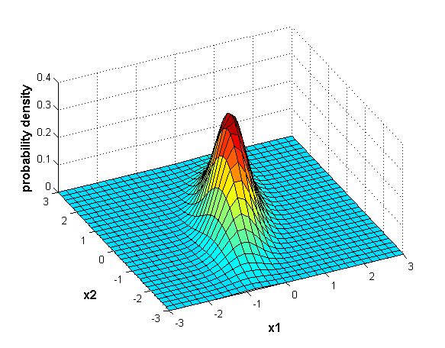
Multivariate Gaussian distribution
In two dimensions

Slide 9
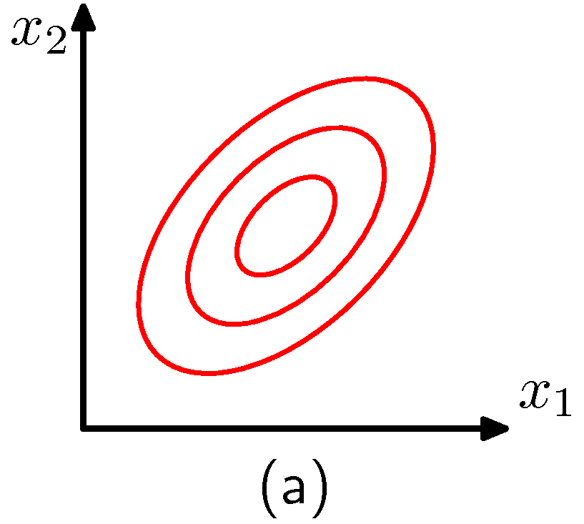
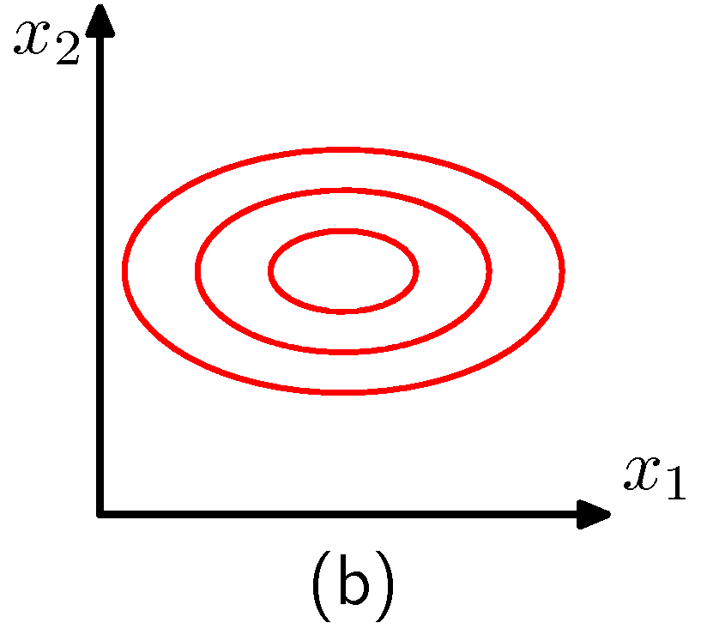
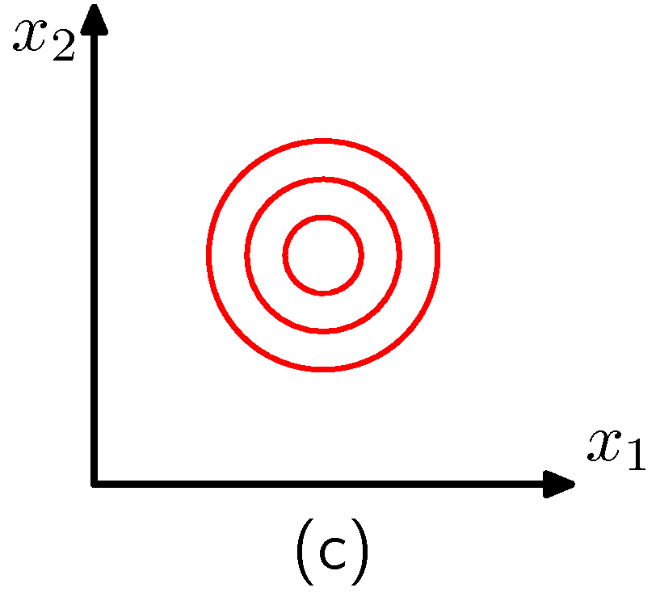
Multivariate Gaussian distribution
In two dimensions

Slide 10
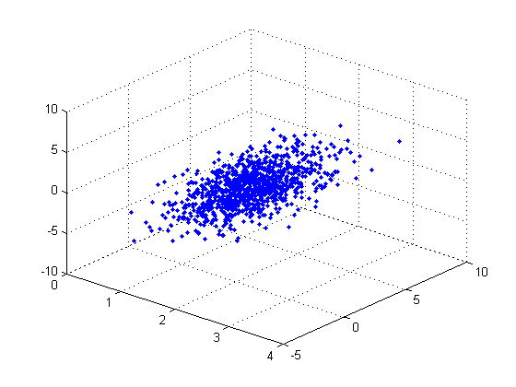
Multivariate Gaussian distribution
In three dimensions
rng( 1 );
mu = [ 2; 1; 1 ];
sigma = [ 0.25 0.30 0.10;
0.30 1.00 0.70;
0.10 0.70 2.00] ;
x = randn( 1000, 3 );
x = x * sigma;
x = x + repmat( mu', 1000, 1 );
scatter3( x( :, 1 ), x( :, 2 ), x( :, 3 ), '.' );

Slide 11
Vector projection
Orthogonal projection of y onto x
Can take place in any space of dimensionality > 2
Unit vector in direction of x is x / || x ||
Length of projection of y in direction of x is || y || ⋅ cos(θ )
Orthogonal projection of y onto x is the vector proj_{x}( y ) = x ⋅ || y || ⋅ cos(θ ) / || x || = [ ( x ⋅ y ) / || x ||² ] x (using dot product alternate form)
y
θ
x
proj_{x}( y )

Slide 12
Linear models
There are many types of linear models in machine learning.
Common in both classification and regression.
A linear model consists of a vector w in d-dimensional feature space.
The vector w attempts to capture the strongest gradient (rate of change) in the output variable, as seen across all training samples.
Different linear models optimize w in different ways.
A point x in feature space is mapped from d dimensions to a scalar (1-dimensional) output z by projection onto w:
cf. Lecture 5b
w₀ ≡ α
w ≡ β

Slide 13
Linear models
There are many types of linear models in machine learning.
The projection output z is typically transformed to a final predicted output y by some function ƒ:
example: for logistic regression, ƒ is logistic function
example: for linear regression, ƒ( z ) = z
Models are called linear because they are a linear function of the model vector components w₁, …, w_{d}.
Key feature of all linear models: no matter what ƒ is, a constant value of z is transformed to a constant value of y, so decision boundaries remain linear even after transform.

Slide 14
Geometry of projections
slide thanks to Greg Shakhnarovich (CS195-5, Brown Univ., 2006)

Slide 15
Geometry of projections
slide thanks to Greg Shakhnarovich (CS195-5, Brown Univ., 2006)

Slide 16
Geometry of projections
slide thanks to Greg Shakhnarovich (CS195-5, Brown Univ., 2006)

Slide 17
Geometry of projections
margin
slide thanks to Greg Shakhnarovich (CS195-5, Brown Univ., 2006)

Slide 18
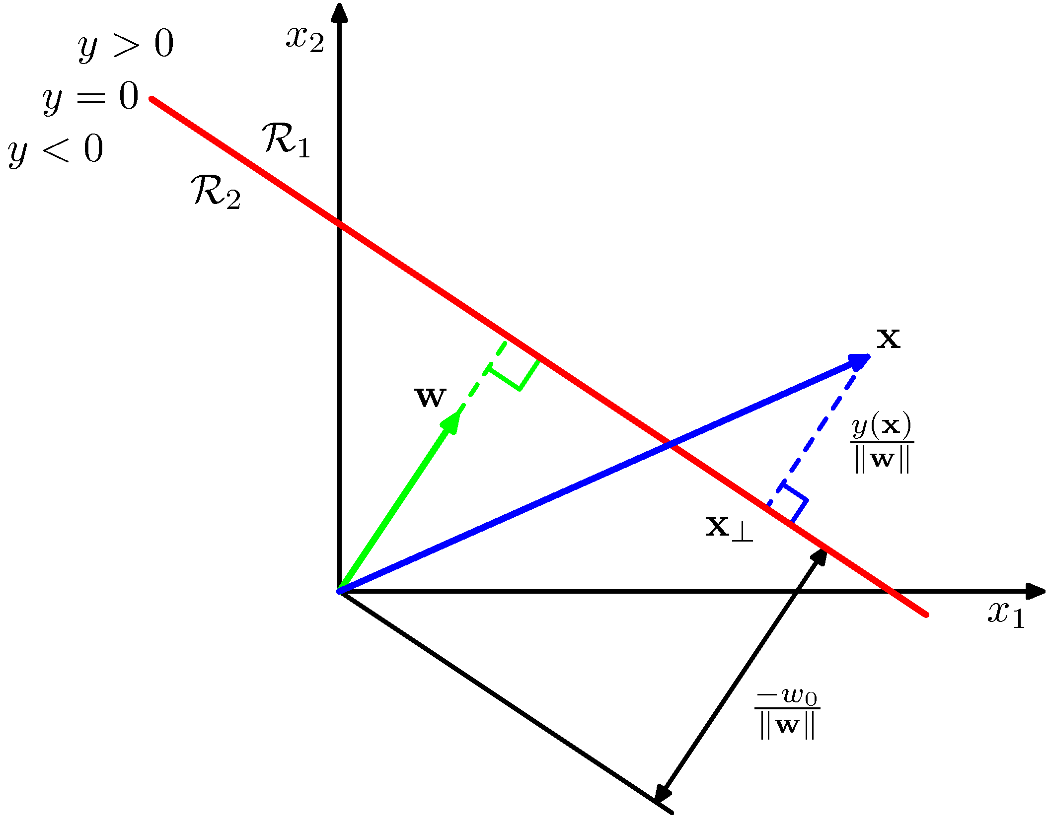
From projection to prediction
positive margin → class 1
negative margin → class 0

Slide 19
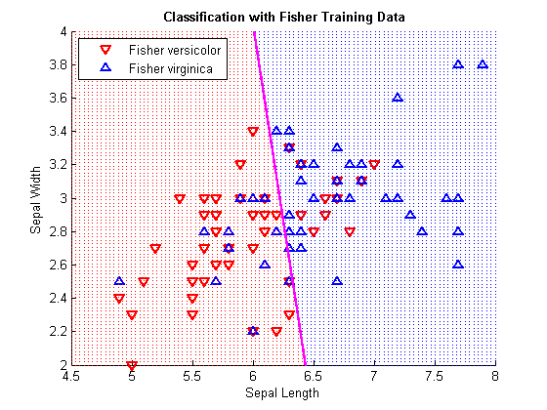
Logistic regression in two dimensions
Interpreting the model vector of coefficients
From MATLAB: B = [ 13.0460 -1.9024 -0.4047 ]
w₀ = B( 1 ), w = [ w₁ w₂ ] = B( 2 : 3 )
w₀, w define location and orientation of decision boundary
- w₀ is distance of decision boundary from origin
decision boundary is perpendicular to w
magnitude of w defines gradient of probabilities between 0 and 1
w

Slide 20
Logistic function in d dimensions
slide thanks to Greg Shakhnarovich (CS195-5, Brown Univ., 2006)

Slide 21
Decision boundary for logistic regression
slide thanks to Greg Shakhnarovich (CS195-5, Brown Univ., 2006)

