Slide 1
Regression Linear Regression Regression Trees

Slide 2
Characteristics of classification models
model | linear | parametric | global | stable
decision tree | no | no | no | no
logistic regression | yes | yes | yes | yes
discriminant analysis | yes/no | yes | yes | yes
k-nearest neighbor | no | no | no | no
naïve Bayes | no | yes/no | yes | yes

Slide 3
slide thanks to Greg Shakhnarovich (CS195-5, Brown Univ., 2006)

Slide 4
slide thanks to Greg Shakhnarovich (CS195-5, Brown Univ., 2006)

Slide 5
slide thanks to Greg Shakhnarovich (CS195-5, Brown Univ., 2006)

Slide 6
slide thanks to Greg Shakhnarovich (CS195-5, Brown Univ., 2006)

Slide 7
slide thanks to Greg Shakhnarovich (CS195-5, Brown Univ., 2006)

Slide 8
Loss function
Suppose target labels come from set Y
Binary classification: Y = { 0, 1 }
Regression: Y = ℜ (real numbers)
A loss function maps decisions to costs:
defines the penalty for predicting when the true value is .
Standard choice for classification: 0/1 loss (same as misclassification error)
Standard choice for regression: squared loss

Slide 9
Least squares linear fit to data
Most popular estimation method is least squares:
Determine linear coefficients w that minimize sum of squared loss (SSL).
Use standard (multivariate) differential calculus:
differentiate SSL with respect to w
find zeros of each partial differential equation
solve for each w_{i}
In one dimension:

Slide 10
Least squares linear fit to data
Multiple dimensions
To simplify notation and derivation, add a new feature x₀ = 1 to feature vector x:
Calculate SSL and determine w:

Slide 11
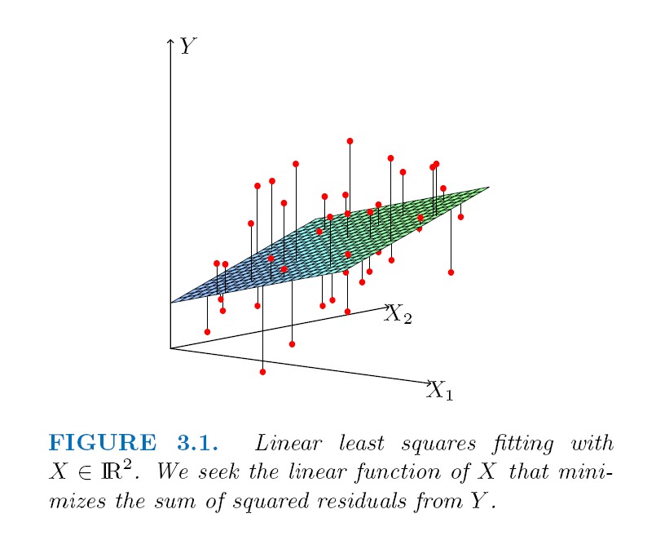
Least squares linear fit to data

Slide 12
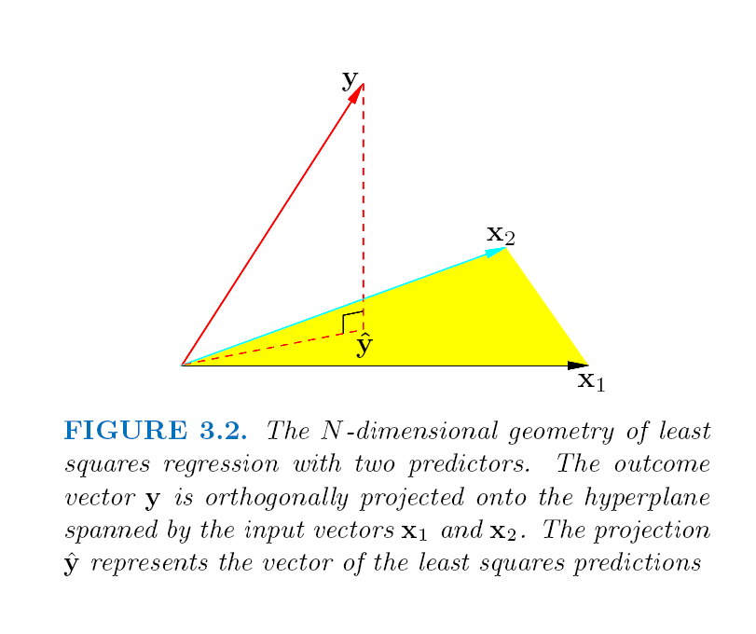
Least squares linear fit to data

Slide 13
Extending application of linear regression
The inputs X for linear regression can be:
Original quantitative inputs
Transformation of quantitative inputs, e.g. log, exp, square root, square, etc.
Polynomial transformation
example: y = w₀ + w₁⋅x + w₂⋅x² + w₃⋅x³
Basis expansions
Dummy coding of categorical inputs
Interactions between variables
example: x₃ = x₁ ⋅ x₂
This allows use of linear regression techniques to fit much more complicated non-linear datasets.

Slide 14
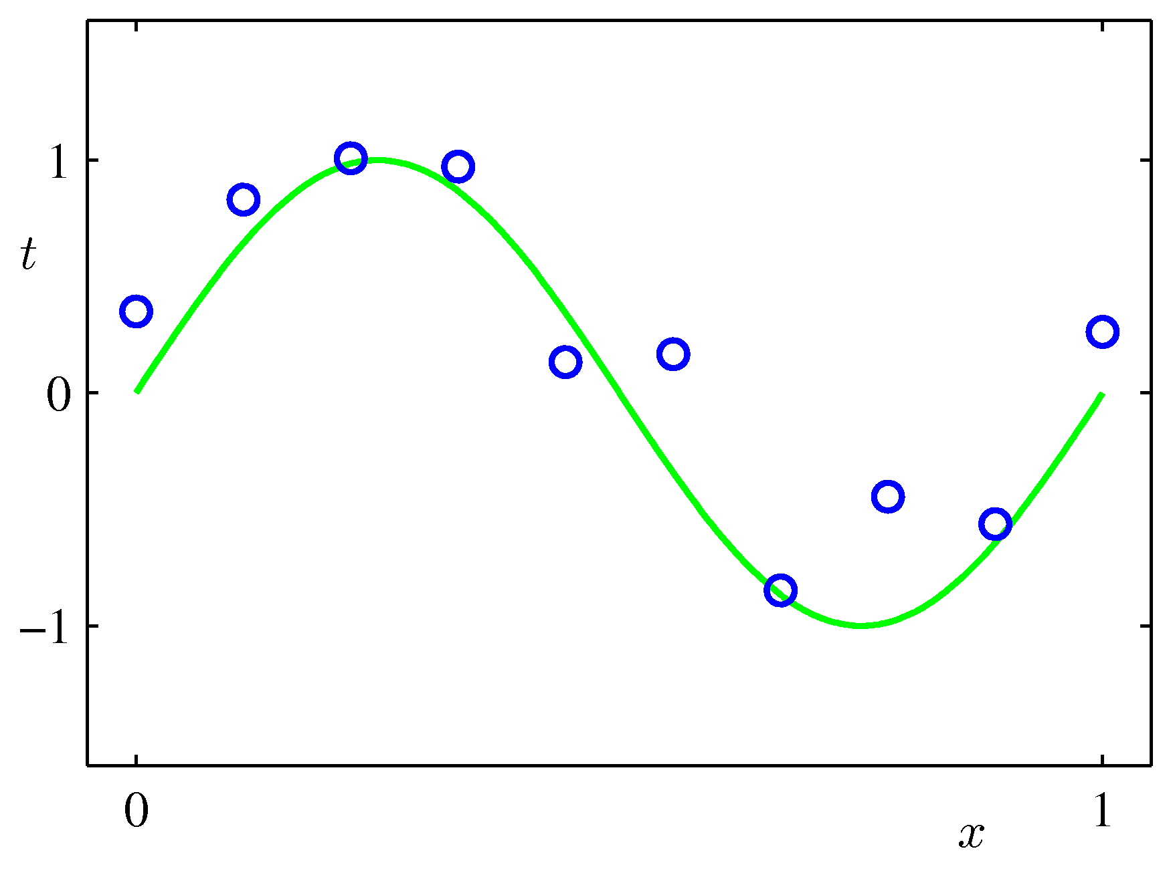
Example of fitting polynomial curve with linear model

Slide 15
Prostate cancer dataset
97 samples, partitioned into:
67 training samples
30 test samples
Eight predictors (features):
6 continuous (4 log transforms)
1 binary
1 ordinal
Continuous outcome variable:
lpsa: log( prostate specific antigen level )

Slide 16
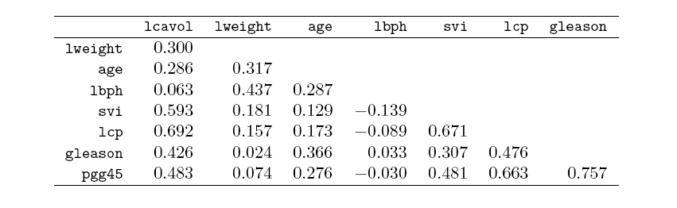
Correlations of predictors in prostate cancer dataset
lcavol log cancer volume
lweight log prostate weight
age age
lbph log amount of benign prostatic hypertrophy
svi seminal vesicle invasion
lcp log capsular penetration
gleason Gleason score
pgg45 percent of Gleason scores 4 or 5

Slide 17
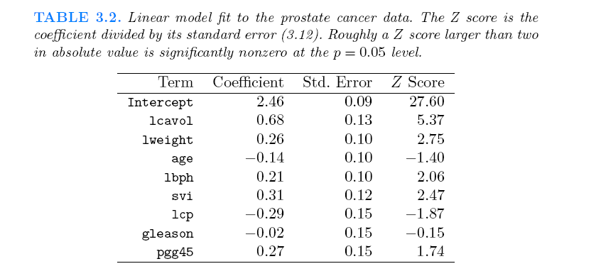
Fit of linear model to prostate cancer dataset

Slide 18
Regularization
Complex models (lots of parameters) often prone to overfitting.
Overfitting can be reduced by imposing a constraint on the overall magnitude of the parameters.
Two common types of regularization (shrinkage) in linear regression:
L₂ regularization (a.k.a. ridge regression). Find w which minimizes:
λ is the regularization parameter: bigger λ imposes more constraint
L₁ regularization (a.k.a. lasso). Find w which minimizes:

Slide 19
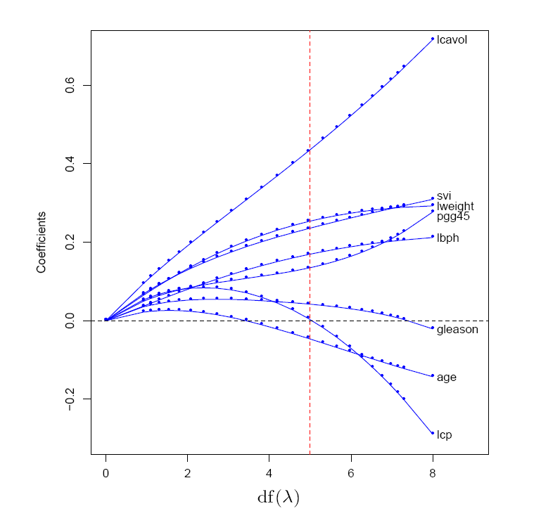
Example of L₂ regularization
L2 regularization shrinks coefficients towards (but not to) zero, and towards each other.

Slide 20
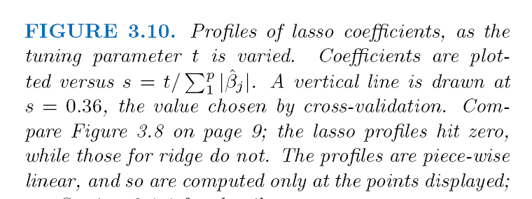
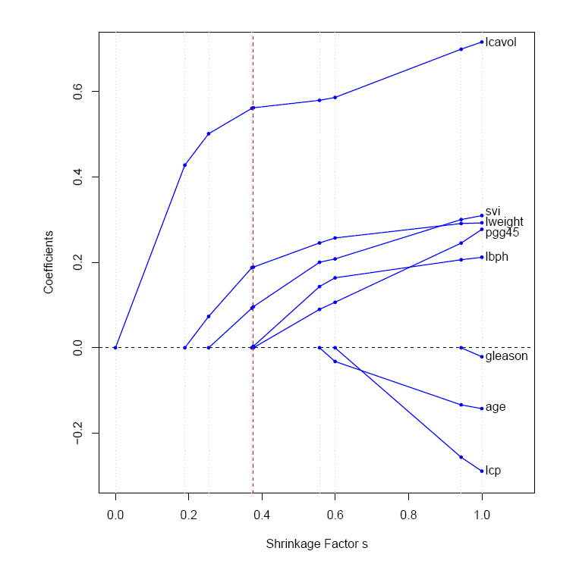
Example of L₁ regularization
L1 regularization shrinks coefficients to zero at different rates; different values of λ give models with different subsets of features.

Slide 21
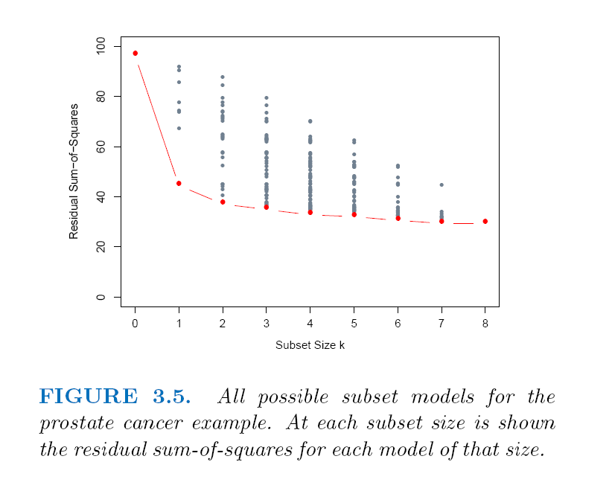
Example of subset selection

Slide 22
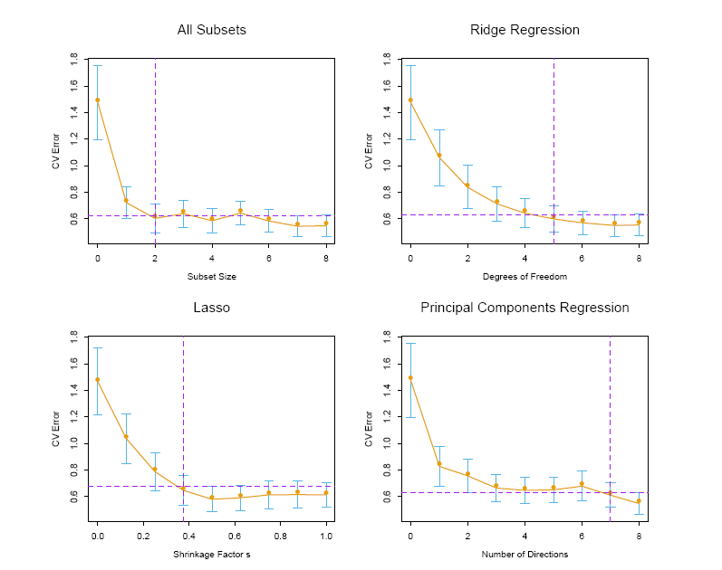
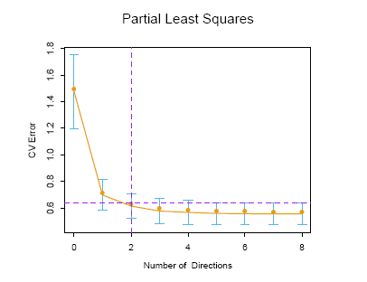
Comparison of various selection and shrinkage methods

Slide 23
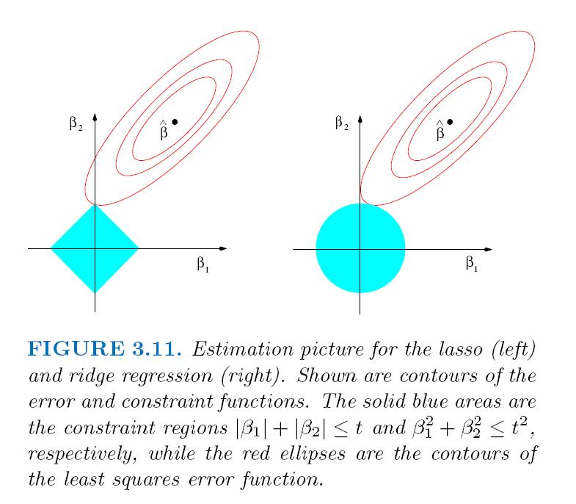
L₁ regularization gives sparse models, L₂ does not

Slide 24
Other types of regression
In addition to linear regression, there are:
many types of non-linear regression
regression trees
nearest neighbor
neural networks
support vector machines
locally linear regression
etc.

Slide 25
Regression trees
Model very similar to classification trees
Structure:
binary splits on single attributes
Prediction:
mean value of training samples in leaf
Induction:
greedy
loss function: sum of squared loss

Slide 26
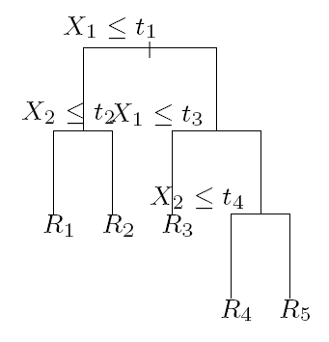
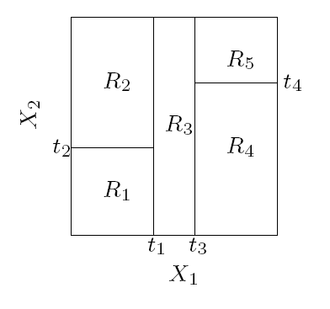
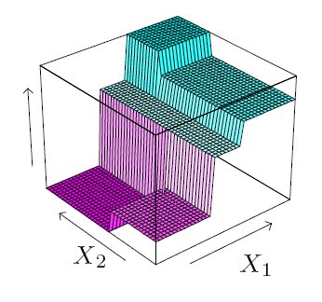
Regression trees

Slide 27
Regression tree loss function
Assume:
Attribute and split threshold for candidate split are selected
Candidate split partitions samples at parent node into child node sample sets C₁ and C₂
Loss for the candidate split is:

Slide 28
Characteristics of regression models
model | linear | parametric | global | stable | continuous
linear regression | yes | yes | yes | yes | yes
regression tree | no | no | no | no | no

Slide 29
MATLAB interlude
matlab_demo_08.m

