Slide 1
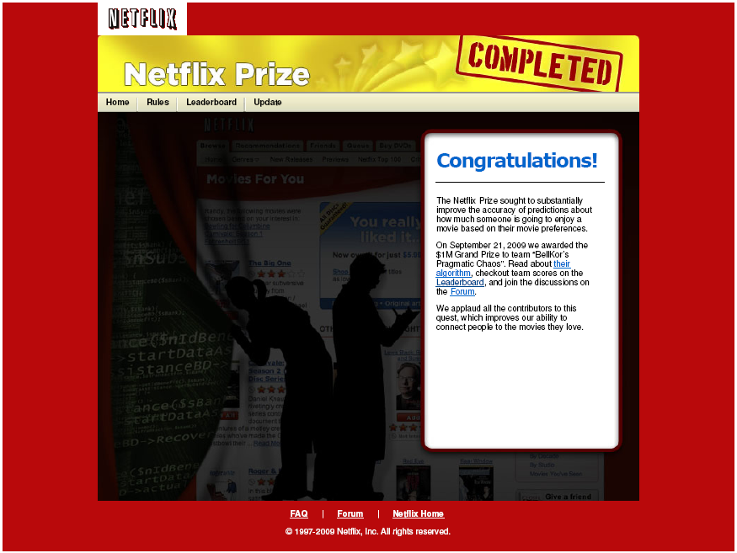

Slide 2
The Netflix Prize Contest
1) New Paths to New Machine Learning Science
2) How an Unruly Mob Almost Stole
the Grand Prize at the Last Moment
Jeff Howbert
University of Washington
February 4, 2014

Slide 3
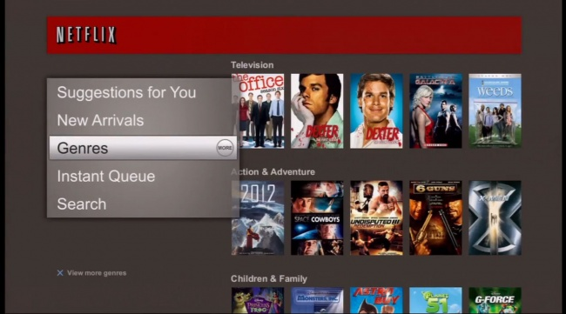
Netflix Viewing Recommendations

Slide 4
Recommender Systems
DOMAIN: some field of activity where users buy, view, consume, or otherwise experience items
PROCESS:
users provide ratings on items they have experienced
Take all < user, item, rating > data and build a predictive model
For a user who hasn’t experienced a particular item, use model to predict how well they will like it (i.e. predict rating)

Slide 5
Roles of Recommender Systems
Help users deal with paradox of choice
Allow online sites to:
Increase likelihood of sales
Retain customers by providing positive search experience
Considered essential in operation of:
Online retailing, e.g. Amazon, Netflix, etc.
Social networking sites

Slide 6
Amazon.com Product Recommendations

Slide 7
Social Network Recommendations
Recommendations on essentially every category of interest known to mankind
Friends
Groups
Activities
Media (TV shows, movies, music, books)
News stories
Ad placements
All based on connections in underlying social network graph, and the expressed ‘likes’ and ‘dislikes’ of yourself and your connections

Slide 8
Types of Recommender Systems
Base predictions on either:
content-based approach
explicit characteristics of users and items
collaborative filtering approach
implicit characteristics based on similarity of users’ preferences to those of other users

Slide 9
The Netflix Prize Contest
GOAL: use training data to build a recommender system, which, when applied to qualifying data, improves error rate by 10% relative to Netflix’s existing system
PRIZE: first team to 10% wins $1,000,000
Annual Progress Prizes of $50,000 also possible

Slide 10
The Netflix Prize Contest
CONDITIONS:
Open to public
Compete as individual or group
Submit predictions no more than once a day
Prize winners must publish results and license code to Netflix (non-exclusive)
SCHEDULE:
Started Oct. 2, 2006
To end after 5 years

Slide 11
The Netflix Prize Contest
PARTICIPATION:
51051 contestants on 41305 teams from 186 different countries
44014 valid submissions from 5169 different teams

Slide 12
The Netflix Prize Data
Netflix released three datasets
480,189 users (anonymous)
17,770 movies
ratings on integer scale 1 to 5
Training set: 99,072,112 < user, movie > pairs with ratings
Probe set: 1,408,395 < user, movie > pairs with ratings
Qualifying set of 2,817,131 < user, movie > pairs with no ratings

Slide 13
Model Building and Submission Process
training set
probe set
ratings
known
99,072,112
1,408,395
tuning
MODEL
validate
make predictions
RMSE on
public
leaderboard
RMSE kept
secret for
final scoring
1,408,342
1,408,789
quiz set
test set
qualifying set
(ratings unknown)

Slide 14
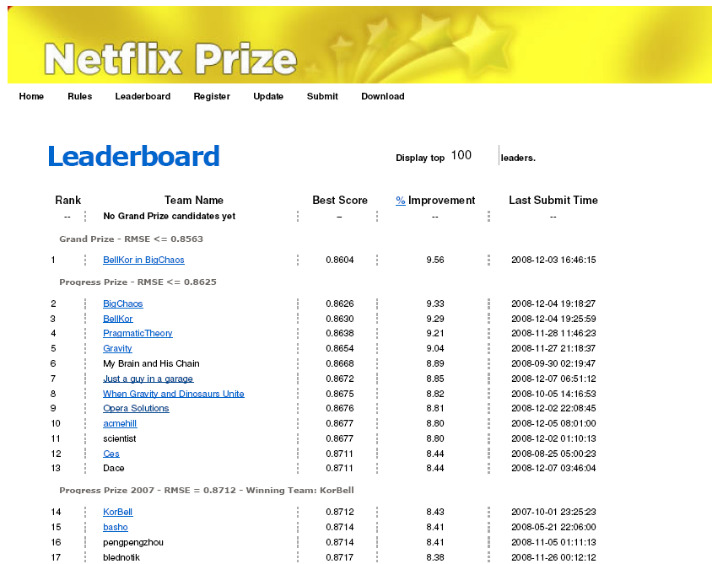

Slide 15
Why the Netflix Prize Was Hard
Massive dataset
Very sparse – matrix only 1.2% occupied
Extreme variation in number of ratings per user
Statistical properties of qualifying and probe sets different from training set

Slide 16
Dealing with Size of the Data
MEMORY:
2 GB bare minimum for common algorithms
4+ GB required for some algorithms
need 64-bit machine with 4+ GB RAM if serious
SPEED:
Program in languages that compile to fast machine code
64-bit processor
Exploit low-level parallelism in code (SIMD on Intel x86/x64)

Slide 17
Common Types of Algorithms
Global effects
Nearest neighbors
Matrix factorization
Restricted Boltzmann machine
Clustering
Etc.

Slide 18
Nearest Neighbors in Action
Identical preferences –
strong weight
Similar preferences –
moderate weight

Slide 19
Matrix Factorization in Action
< a bunch of numbers >
+
reduced-rank
singular
value
decomposition
(sort of)
< a bunch of
numbers >

Slide 20
Matrix Factorization in Action
+
multiply and add
factor vectors
(dot product)
for desired
< user, movie >
prediction

Slide 21
The Power of Blending
Error function (RMSE) is convex, so linear combinations of models should have lower error
Find blending coefficients with simple least squares fit of model predictions to true values of probe set
Example from my experience:
blended 89 diverse models
RMSE range = 0.8859 – 0.9959
blended model had RMSE = 0.8736
Improvement of 0.0123 over best single model
13% of progress needed to win

Slide 22
Algorithms: Other Things That Mattered
Overfitting
Models typically had millions or even billions of parameters
Control with aggressive regularization
Time-related effects
Netflix data included date of movie release, dates of ratings
Most of progress in final two years of contest was from incorporating temporal information

Slide 23
The Netflix Prize: Social Phenomena
Competition intense, but sharing and collaboration were equally so
Lots of publications and presentations at meetings while contest still active
Lots of sharing on contest forums of ideas and implementation details
Vast majority of teams:
Not machine learning professionals
Not competing to win (until very end)
Mostly used algorithms published by others

Slide 24
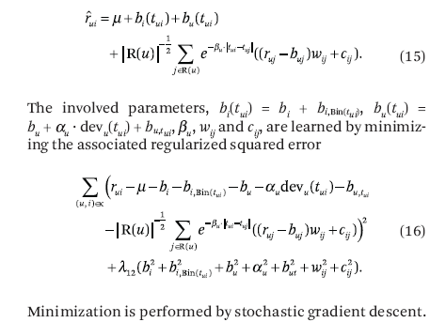
One Algorithm from Winning Team (time-dependent matrix factorization)
Yehuda Koren, Comm. ACM, 53, 89 (2010)

Slide 25
Netflix Prize Progress: Major Milestones
me, starting June, 2008
DATE: | Oct. 2007 | Oct. 2008 | July 2009
WINNER: | BellKor | BellKor in BigChaos | ???

Slide 26
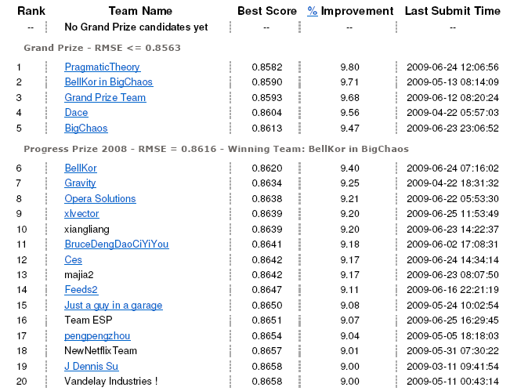
June 25, 2009 20:28 GMT

Slide 27
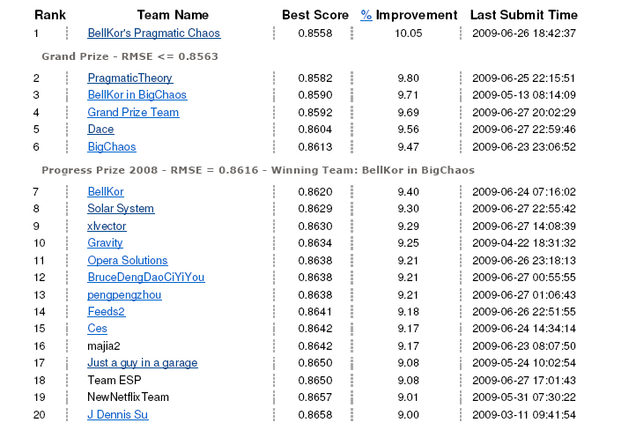
June 26, 18:42 GMT – BPC Team Breaks 10%
blending
30 day last call
period begins

Slide 28
Genesis of The Ensemble
Vandelay
Industries
5 indiv.
me
Dinosaur
Planet
3 indiv.
Opera
Solutions
5 indiv.
Gravity
4 indiv.
9 other individuals
7 other individuals
Opera and Vandelay United
19 individuals
Grand Prize Team
14 individuals
The Ensemble
33 individuals
www.the-ensemble.com

Slide 29
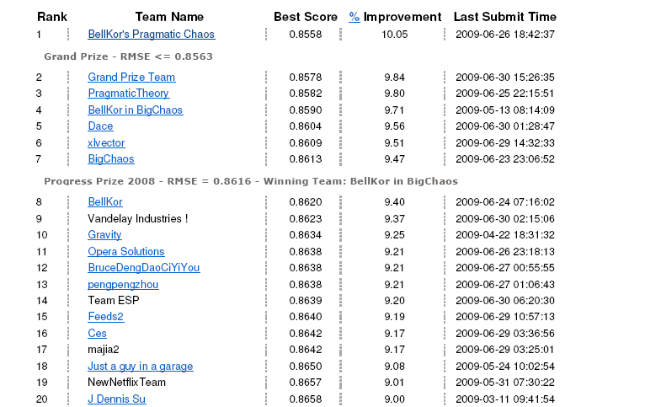
June 30, 16:44 GMT

Slide 30
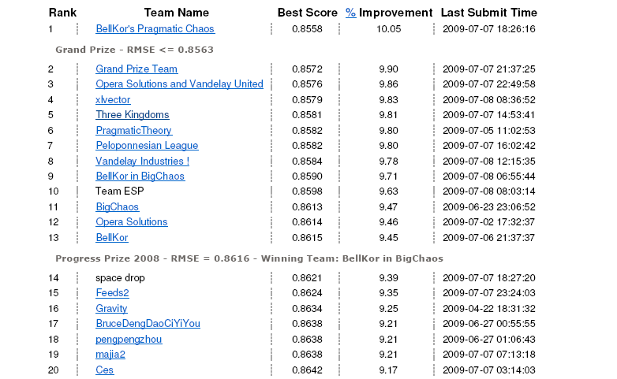
July 8, 14:22 GMT

Slide 31
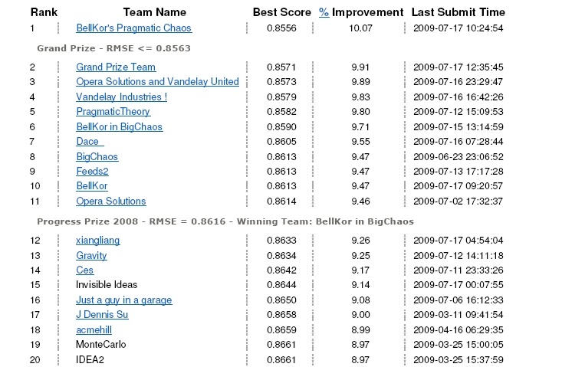
July 17, 16:01 GMT

Slide 32
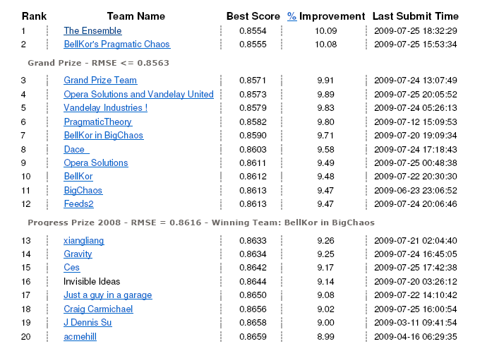
July 25, 18:32 GMT – The Ensemble First Appears!
24 hours, 10 min
before contest ends
#1 and #2 teams
each have one
more submission !

Slide 33
July 26, 18:18 GMT BPC Makes Their Final Submission
24 minutes before contest ends
The Ensemble can make one more submission – window opens 10 minutes before contest ends

Slide 34
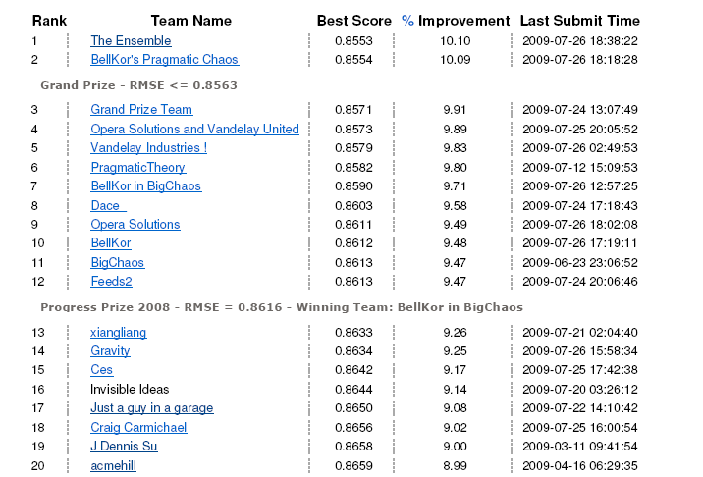
July 26, 18:43 GMT – Contest Over!

Slide 35
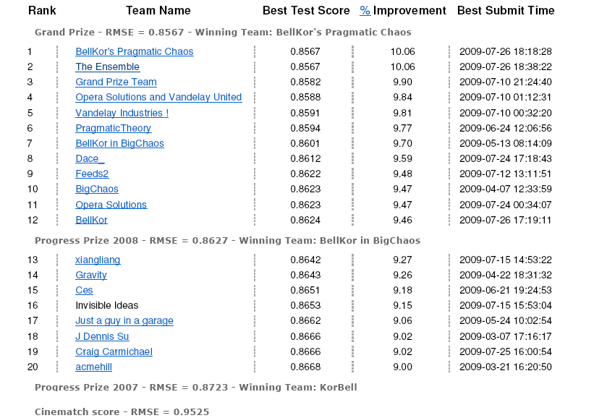
Final Test Scores

Slide 36
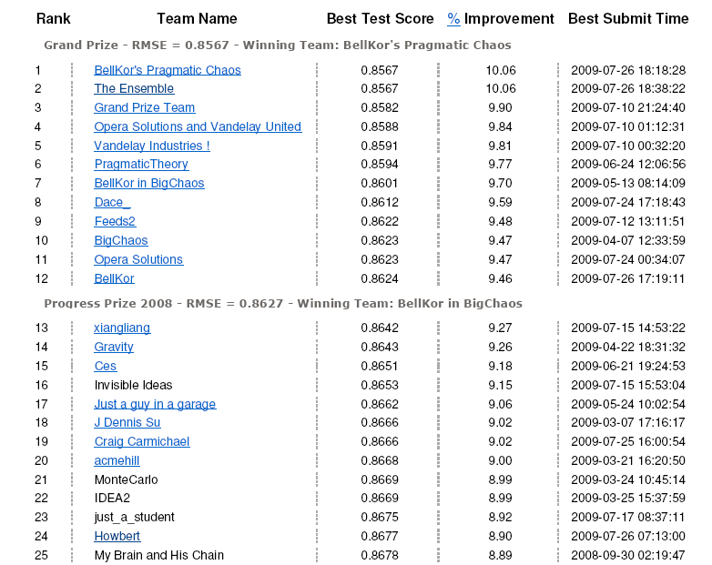
Final Test Scores

Slide 37
Netflix Prize: What Did We Learn?
Significantly advanced science of recommender systems
Properly tuned and regularized matrix factorization is a powerful approach to collaborative filtering
Ensemble methods (blending) can markedly enhance predictive power of recommender systems
Crowdsourcing via a contest can unleash amazing amounts of sustained effort and creativity
Netflix made out like a bandit
But probably would not be successful in most problems

Slide 38
Netflix Prize: What Did I Learn?
Several new machine learning algorithms
A lot about optimizing predictive models
Stochastic gradient descent
Regularization
A lot about optimizing code for speed and memory usage
Some linear algebra and a little PDQ
Enough to come up with one original approach that actually worked
Money and fame make people crazy, in both good ways and bad
COST: about 1000 hours of my free time over 13 months

