Slide 1
Collaborative Filtering Nearest Neighbor Approach

Slide 2
Bad news
Netflix Prize data no longer available to public.
Just after contest ended in July 2009:
Plans for Netflix Prize 2 contest were announced
Contest data was made available for further public research at UC Irvine repository
But a few months later:
Netflix was being sued for supposed privacy breaches connected with contest data
FTC was investigating privacy concerns
By March 2010:
Netflix had settled the lawsuit privately
Withdrawn the contest data from public use
Cancelled Netflix Prize 2

Slide 3
Good news
An older movie rating dataset from GroupLens is still available, and perfectly suitable for the CSS 581 project.
Consists of data collected through the MovieLens movie rating website.
Comes in 3 sizes:
MovieLens 100k
MovieLens 1M
MovieLens 10M
http://www.grouplens.org/node/12
http://movielens.umn.edu/login

Slide 4
MovieLens 100k dataset properties
943 users
1682 movies
100,000 ratings
1 - 5 rating scale
Rating matrix is 6.3% occupied
Ratings per user
min = 20 mean = 106 max = 737
Ratings per movie
min = 1 mean = 59 max = 583

Slide 5
Recommender system definition
DOMAIN: some field of activity where users buy, view, consume, or otherwise experience items
PROCESS:
users provide ratings on items they have experienced
Take all < user, item, rating > data and build a predictive model
For a user who hasn’t experienced a particular item, use model to predict how well they will like it (i.e. predict rating)

Slide 6
Types of recommender systems
Predictions can be based on either:
content-based approach
explicit characteristics of users and items
collaborative filtering approach
implicit characteristics based on similarity of users’ preferences to those of other users

Slide 7
Collaborative filtering algorithms
Common types:
Global effects
Nearest neighbor
Matrix factorization
Restricted Boltzmann machine
Clustering
etc.
Project 2 will explore types highlighted in red.

Slide 8
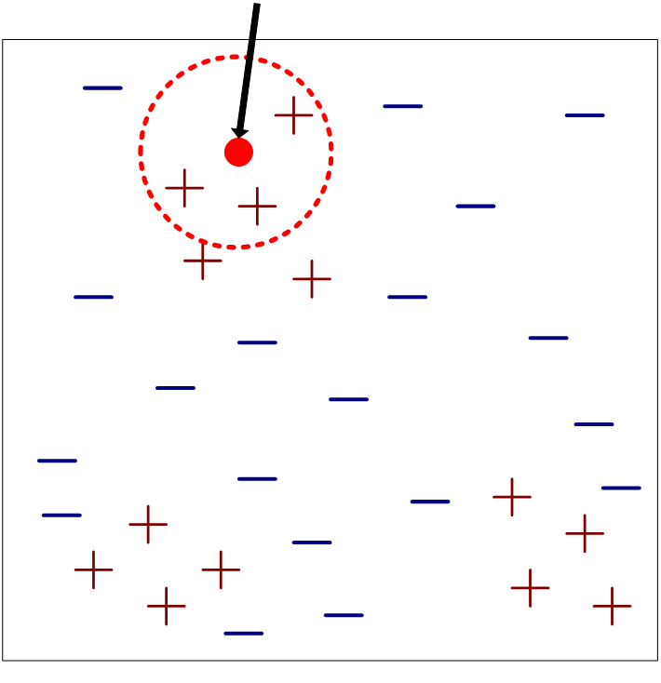
Nearest neighbor classifiers
test sample
Requires three inputs:
The set of stored samples
Distance metric to compute distance between samples
The value of k, the number of nearest neighbors to retrieve

Slide 9
Nearest neighbor classifiers
test sample
To classify test sample:
Compute distances to samples in training set
Identify k nearest neighbors
Use class labels of nearest neighbors to determine class label of test sample (e.g. by taking majority vote)

Slide 10
Nearest neighbor classification
Compute distance between two points
Example: Euclidean distance
Options for determining the class from nearest neighbor list
Take majority vote of class labels among the k-nearest neighbors
Weight the votes according to distance
example: weight factor w = 1 / d²

Slide 11
Nearest neighbor in collaborative filtering
For our implementation in Project 2:
Actually a regression, not a classification.
prediction is a weighted combination of neighbor’s ratings (real number)
We consider both all neighbors and various k-nearest subsets of neighbors.
Instead of distances, we calculate similarities that are used to:
rank neighbors to determine k nearest subset
compute weightings of each neighbor’s rating

Slide 12
Nearest neighbor in action
For this example:
Find every user that has rated movie 10
Compute similarity between user 2 and each of those users
Weight those users’ ratings according to their similarities
Predicted rating for user 2 is sum of other users’ weighted ratings on movie 10
Identical preferences –
strong weight
Similar preferences –
moderate weight

Slide 13
Measuring similarity of users
For Project 2 we will use Pearson’s correlation coefficient (PCC) as a measure of similarity between users.
Pearson’s correlation coefficient is covariance normalized by the standard deviations of the two variables:
Always lies in range -1 to 1

Slide 14
Measuring similarity of users
PCC similarity for two users a and b:
Both sums are taken over only those movies rated by both a and b (indexed by j)
r_{a,j} = rating by user a on movie j
‾r_{a} = average rating on all movies rated by user a
n = number of movies rated by both a and b

Slide 15
Measuring similarity of users
PCC similarity for two users a and b, where ratings have first been mean-centered for each user:
Both sums are taken over only those movies rated by both a and b (indexed by j)
m_{a,j} = mean-centered rating by user a on movie j
n = number of movies rated by both a and b

Slide 16
Mesauring similarity of users
Calculating PCC on sparse matrix
Calculate user mean rating using only those cells where a rating exists.
Subtract user mean rating only from those cells where rating exists.
Calculate and sum user-user cross-products and user deviations from mean only for those movies where a rating exists for both users.
Identical preferences –
strong weight
Similar preferences –
moderate weight

