Slide 1
Clustering
Basic Concepts and Algorithms 2

Slide 2
Clustering topics
Hierarchical clustering
Density-based clustering
Cluster validity

Slide 3
Proximity measures
Proximity is a generic term that refers to either similarity or dissimilarity.
Similarity
  Numerical measure of how alike two data objects are.
  Measure is higher when objects are more alike.
  Often falls in the range [ 0, 1 ].
Dissimilarity
  Numerical measure of how different two data objects are.
  Measure is lower when objects are more alike.
  Minimum dissimilarity often 0, upper limit varies.
  Distance sometimes used as a synonym, usually for specific classes of dissimilarities.

Slide 4
Approaches to clustering
A clustering is a set of clusters
Important distinction between hierarchical and partitional clustering
  Partitional: data points divided into finite number of partitions (non-overlapping subsets)
    each data point is assigned to exactly one subset
  Hierarchical: data points placed into a set of nested clusters, organized into a hierarchical tree
    tree expresses a continuum of similarities and clustering

Slide 5
Hierarchical clustering
Produces a set of nested clusters organized as a hierarchical tree
Can be visualized as a dendrogram
  A tree like diagram that records the sequence of merges or splits

Slide 6
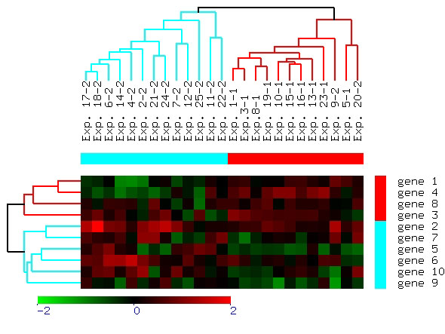
Microarray data analysis
experiment
dendrogram
gene
dendrogram
NIH Center for Information Technology

Slide 7
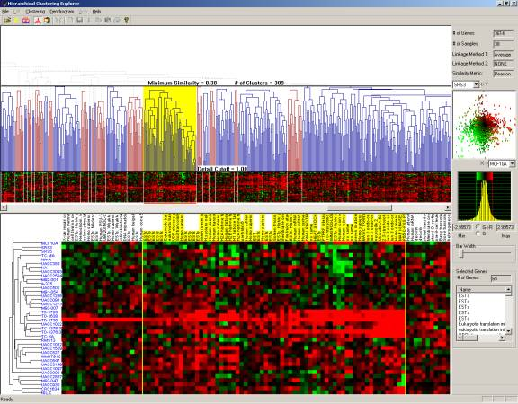
Melanoma gene expression profiles
Univ. of Maryland, Human-Computer Interaction Lab

Slide 8
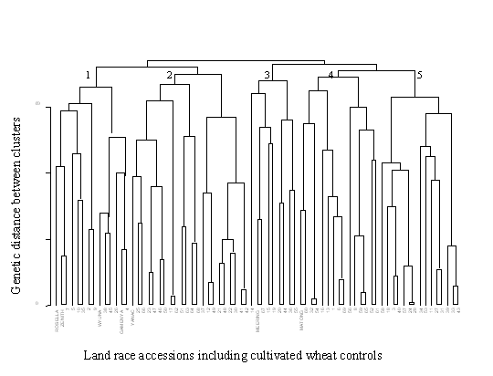
Genetic distance among wheat cultivars
Hierarchical clustering based on 13 quality traits of 75 wheat landraces including seven wheat cultivars.
Australian Society of Agronomy, The Regional Institute Ltd.

Slide 9
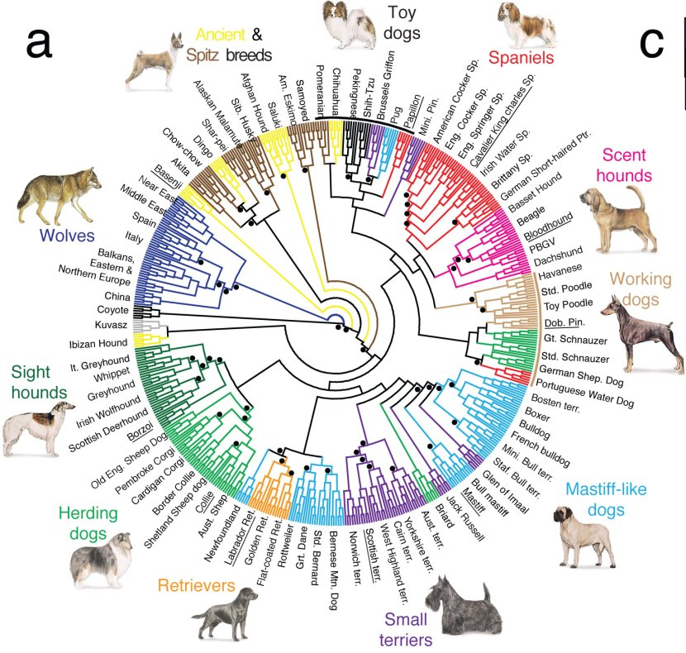
Circular cladogram

Slide 10
Strengths of hierarchical clustering
Do not have to assume any particular number of clusters
  Any desired number of clusters can be obtained by ‘cutting’ the dendogram at the proper level
They may correspond to meaningful taxonomies
  Example in biological sciences (e.g., animal kingdom, phylogeny reconstruction, …)

Slide 11
Notion of a cluster can be ambiguous
How many clusters?
Six Clusters
Two Clusters
Four Clusters

Slide 12
Hierarchical clustering
Two main types of hierarchical clustering
  Agglomerative:
    Start with the points as individual clusters
    At each step, merge the closest pair of clusters until only one cluster (or k clusters) left
  Divisive:
    Start with one, all-inclusive cluster
    At each step, split a cluster until each cluster contains a point (or there are k clusters)
Traditional hierarchical algorithms use a proximity or distance matrix
  Merge or split one cluster at a time

Slide 13
Agglomerative clustering algorithm
More popular hierarchical clustering technique
Basic algorithm is straightforward
  Compute the proximity matrix
  Let each data point be a cluster
  Repeat
  Merge the two closest clusters
  Update the proximity matrix
  Until only a single cluster remains
Key operation is the computation of proximities between cluster pairs
  Different approaches to defining the distance between clusters distinguish the different algorithms

Slide 14
Starting situation
Start with clusters of individual points and a proximity matrix
p1
p2
p3
p4
p5
. . .
p1
p2
p3
p4
p5
.
.
.
proximity matrix

Slide 15
Intermediate situation
After some merging steps, we have some clusters.
C1
C2
C3
C4
C5
C1
C2
C3
C3
C4
C4
C5
proximity matrix
C1
C2
C5

Slide 16
Intermediate situation
We decide to merge the two closest clusters (C2 and C5) and update the proximity matrix.
C1
C2
C3
C4
C5
C1
C2
C3
C3
C4
C4
C5
proximity matrix
C1
C2
C5

Slide 17
After merging
The question is “How do we update the proximity matrix?”
C2 U C5
C1
C3
C4
C1
?
C2 U C5
? ? ? ?
C3
C3
?
C4
C4
?
proximity matrix
C1
C2 U C5

Slide 18
Defining inter-cluster similarity
p1
p2
p3
p4
p5
. . .
p1
similarity?
p2
p3
p4
p5
MIN
MAX
Group average
Distance between centroids
Other methods driven by an objective function
  Ward’s method uses squared error
.
.
.
proximity matrix

Slide 19
Defining inter-cluster similarity
p1
p2
p3
p4
p5
. . .
p1
p2
p3
p4
p5
MIN
MAX
Group average
Distance between centroids
Other methods driven by an objective function
  Ward’s method uses squared error
.
.
.
proximity matrix

Slide 20
Defining inter-cluster similarity
p1
p2
p3
p4
p5
. . .
p1
p2
p3
p4
p5
MIN
MAX
Group average
Distance between centroids
Other methods driven by an objective function
  Ward’s method uses squared error
.
.
.
proximity matrix

Slide 21
Defining inter-cluster similarity
p1
p2
p3
p4
p5
. . .
p1
p2
p3
p4
p5
MIN
MAX
Group average
Distance between centroids
Other methods driven by an objective function
  Ward’s method uses squared error
.
.
.
proximity matrix

Slide 22
Defining inter-cluster similarity
p1
p2
p3
p4
p5
. . .
p1
×
×
p2
p3
p4
p5
MIN
MAX
Group average
Distance between centroids
Other methods driven by an objective function
  Ward’s method uses squared error
.
.
.
proximity matrix

Slide 23
Cluster similarity: MIN or single link
Similarity of two clusters is based on the two most similar (closest) points in the different clusters
  Determined by one pair of points, i.e., by one link in the proximity graph.
1
2
3
4
5

Slide 24
Hierarchical clustering: MIN
5
1
3
5
2
1
2
3
6
4
4
nested clusters
dendrogram

Slide 25
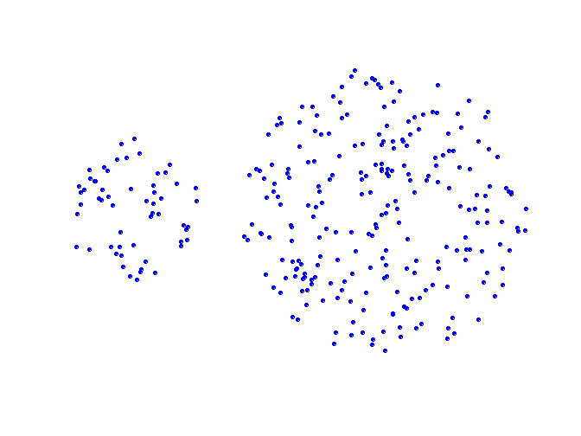
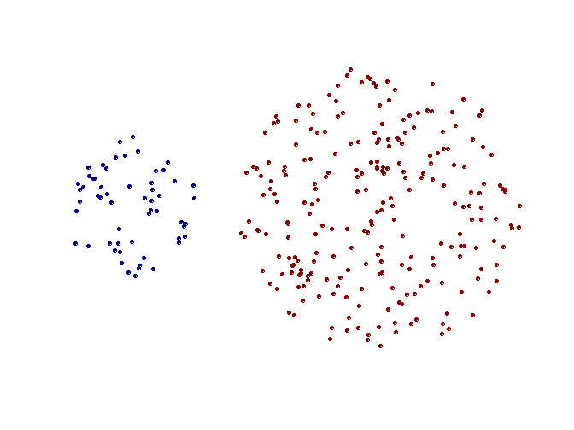
Strength of MIN
original points
two clusters
Can handle non-elliptical shapes

Slide 26
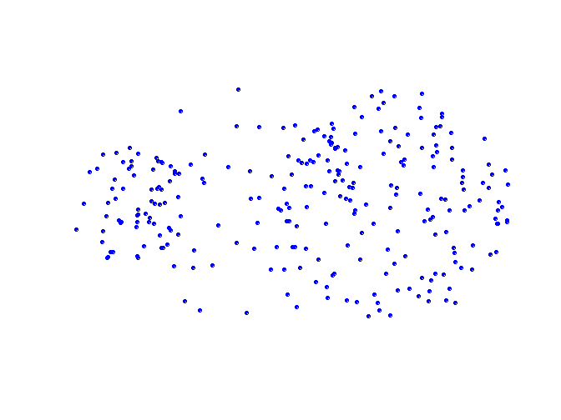
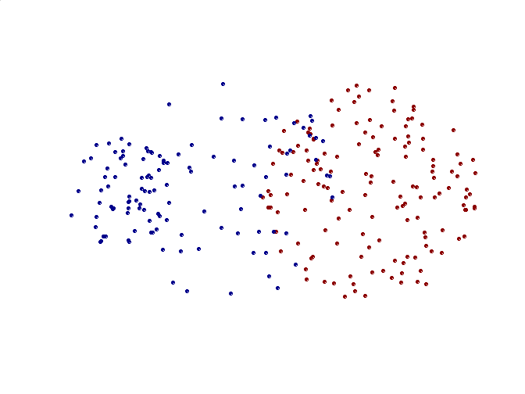
Limitations of MIN
original points
two clusters
Sensitive to noise and outliers

Slide 27
Cluster similarity: MAX or complete link
Similarity of two clusters is based on the two least similar (most distant) points in the different clusters
  Determined by one pair of points, i.e., by one link in the proximity graph.
1
2
3
4
5

Slide 28
Hierarchical clustering: MAX
4
1
2
5
5
2
3
6
3
1
4
nested clusters
dendrogram

Slide 29
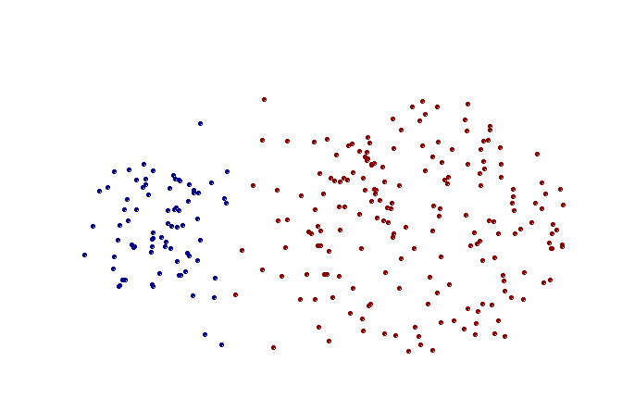
Strength of MAX
original points
two clusters
Less susceptible to noise and outliers

Slide 30
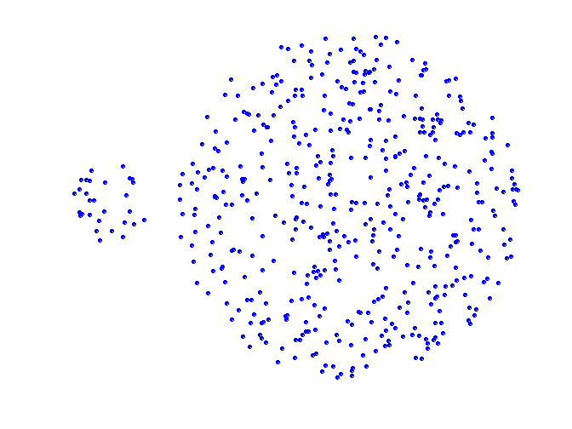
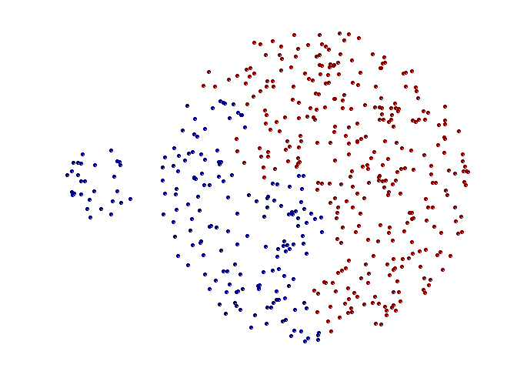
Limitations of MAX
original points
two clusters
Tends to break large clusters
Biased towards globular clusters

Slide 31
Cluster similarity: group average
Proximity of two clusters is the average of pairwise proximity between points in the two clusters.
Need to use average connectivity for scalability since total proximity favors large clusters
1
2
3
4
5

Slide 32
Hierarchical clustering: group average
5
4
1
2
5
2
3
6
1
4
3
nested clusters
dendrogram

Slide 33
Hierarchical clustering: group average
Compromise between single and complete link
Strengths:
  Less susceptible to noise and outliers
Limitations:
  Biased towards globular clusters

Slide 34
Cluster similarity: Ward’s method
Similarity of two clusters is based on the increase in squared error when two clusters are merged
  Similar to group average if distance between points is distance squared
Less susceptible to noise and outliers
Biased towards globular clusters
Hierarchical analogue of k-means
  Can be used to initialize k-means

Slide 35
Hierarchical clustering comparison
5
1
4
1
3
2
5
5
5
2
1
MIN
2
MAX
2
3
6
3
3
6
1
4
4
4
5
5
1
4
1
2
Ward’s method
2
5
2
5
2
3
6
group average
3
3
6
4
1
1
4
4
3

Slide 36
Hierarchical clustering
Time and space complexity
  n = number of datapoints or objects
  Space requirement ~ O( n² ) since it uses the proximity matrix.
  Time complexity ~ O( n³ ) many cases.
    There are n steps and at each step the proximity matrix (size n²) must be searched and updated.
    Can be reduced to O( n² log( n ) ) time for some approaches.

Slide 37
Hierarchical clustering
Problems and limitations
  Once a decision is made to combine two clusters, it cannot be undone.
  No objective function is directly minimized.
  Different schemes have problems with one or more of the following:
    Sensitivity to noise and outliers
    Difficulty handling different sized clusters and convex shapes
    Breaking large clusters
  Inherently unstable toward addition or deletion of samples.

Slide 38
From hierarchical to partitional clustering
Cut tree at some height to get desired number of partitions k
k = 2
k = 3
k = 4

Slide 39
DBSCAN
DBSCAN is a density-based algorithm.
  Density = number of points within a specified radius (Eps)
  A point is a core point if it has more than a specified number of points (MinPts) within Eps.
    These points are in the interior of a cluster.
  A border point has fewer than MinPts within Eps, but is in the neighborhood of a core point.
  A noise point is any point that is not a core point or a border point.

Slide 40
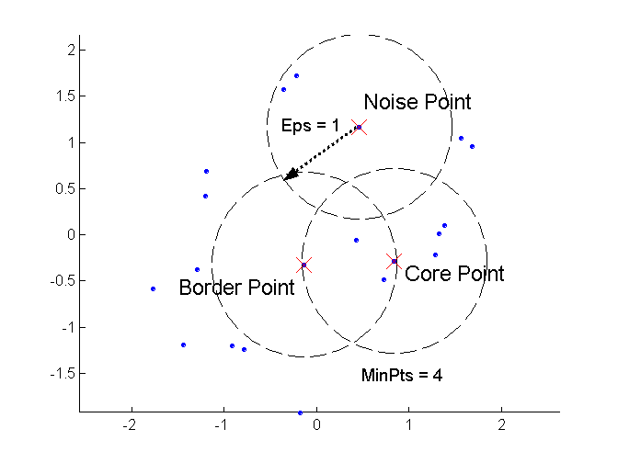
DBSCAN: core, border, and noise points

Slide 41
DBSCAN algorithm
Label all points as core, border, or noise points.
Eliminate noise points.
Put an edge between all core points that are within Eps of each other.
Make each group of connected core points into a separate cluster.
Assign each border point to one of the clusters of its associated core points.

Slide 42
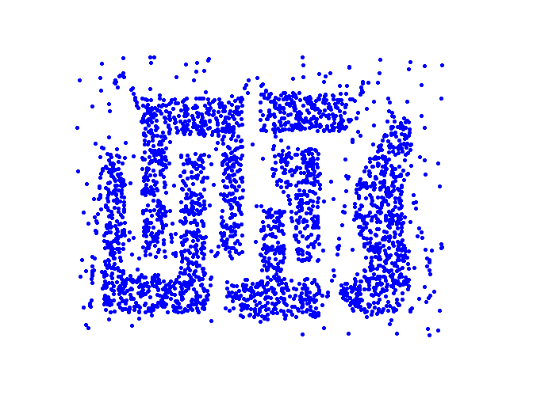
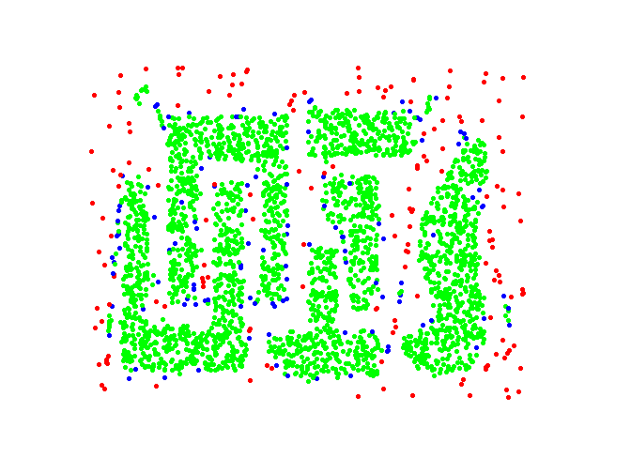
DBSCAN: core, border, and noise points
original points
point types: core, border and noise
Eps = 10, MinPts = 4

Slide 43
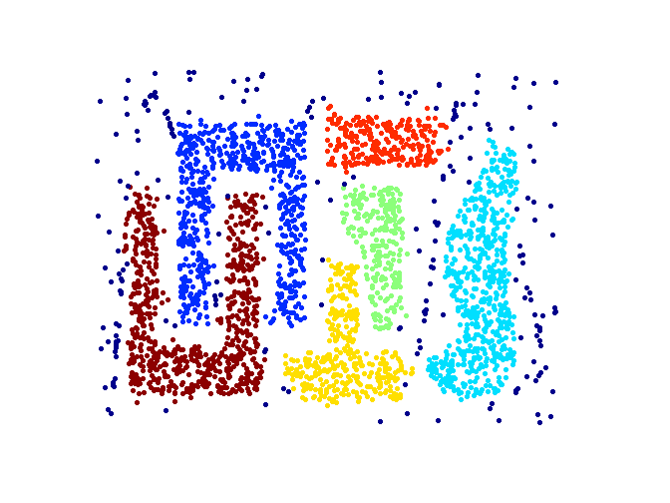
When DBSCAN works well
original points
clusters
resistant to noise
can handle clusters of different shapes and sizes

Slide 44
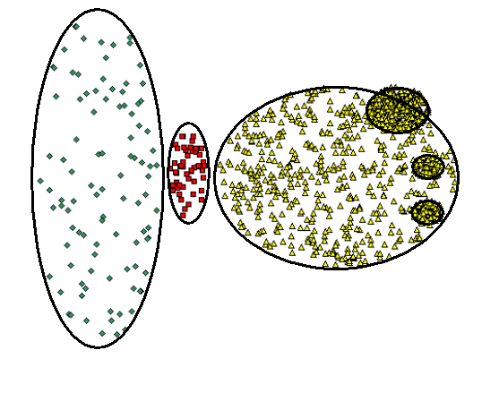
When DBSCAN does NOT work well
(MinPts=4, Eps=9.75).
original points
varying densities
high-dimensional data
(MinPts=4, Eps=9.92)

Slide 45
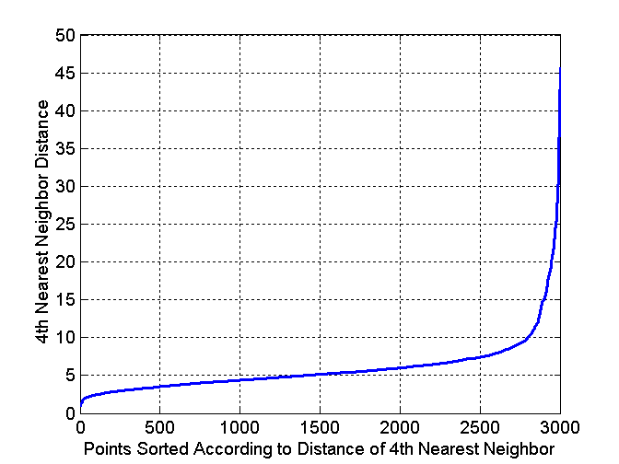
DBSCAN: determining Eps and MinPts
Idea:
  for points in a cluster, their k^{th} nearest neighbors are at roughly the same distance
  noise points have the k^{th} nearest neighbor at farther distance
  plot sorted distance of every point to its k^{th} nearest neighbor
Example:
  assume k = 4
  plot sorted distances to
  4th nearest neighbor
  select Eps as distance
  where curve has sharp
  elbow

Slide 46
Cluster validity
For supervised classification we have a variety of measures to evaluate how good our model is
  Accuracy, precision, recall, squared error
For clustering, the analogous question is how to evaluate the “goodness” of the resulting clusters?
But cluster quality is often in the eye of the beholder!
It’s still important to try and measure cluster quality
  To avoid finding patterns in noise
  To compare clustering algorithms
  To compare two sets of clusters
  To compare two clusters

Slide 47
Different types of cluster validation
Determining the clustering tendency of a set of data, i.e., distinguishing whether non-random structure actually exists in the data.
Comparing the results of a cluster analysis to externally known results, e.g., to externally given class labels.
Evaluating how well the results of a cluster analysis fit the data without reference to external information.
  - Use only the data
Comparing the results of two different sets of cluster analyses to determine which is better.
Determining the ‘correct’ number of clusters.
For 2, 3, and 4, we can further distinguish whether we want to evaluate the entire clustering or just individual clusters.

Slide 48
Measures of cluster validity
Numerical measures used to judge various aspects of cluster validity are classified into the following three types:
  External index: Measures extent to which cluster labels match externally supplied class labels.
    Entropy
  Internal index: Measures the “goodness” of a clustering structure without respect to external information.
    Correlation
    Visualize similarity matrix
    Sum of Squared Error (SSE)
  Relative index: Compares two different clusterings or clusters.
    Often an external or internal index is used for this function, e.g., SSE or entropy.

Slide 49
Measuring cluster validity via correlation
Two matrices
  Proximity matrix
  “Incidence” matrix
    One row and one column for each data point.
    An entry is 1 if the associated pair of points belong to same cluster.
    An entry is 0 if the associated pair of points belongs to different clusters.
Compute the correlation between the two matrices
  Since the matrices are symmetric, only the correlation between
  n ⋅ ( n - 1 ) / 2 entries needs to be calculated.
High correlation indicates that points that belong to the same cluster are close to each other.
Not a good measure for some density or contiguity based clusters.

Slide 50
Measuring cluster validity via correlation
Correlation of incidence and proximity matrices for k-means clusterings of the following two data sets.
corr = -0.9235
corr = -0.5810
NOTE: correlation will be positive if proximity defined as similarity, negative if proximity defined as dissimilarity or distance.

Slide 51
Visualizing similarity matrix for cluster validation
Order the similarity matrix with respect to cluster indices and inspect visually.

Slide 52
Visualizing similarity matrix for cluster validation
Clusters in random data are not so crisp
DBSCAN

Slide 53
Visualizing similarity matrix for cluster validation
Clusters in random data are not so crisp
k-means

Slide 54
Visualizing similarity matrix for cluster validation
Clusters in random data are not so crisp
complete link

Slide 55
Visualizing similarity matrix for cluster validation
Not as useful when clusters are non-globular
DBSCAN

Slide 56
Internal measures: SSE
Clusters in more complicated figures often aren’t well separated
SSE is good for comparing two clusterings or two clusters (average SSE).
Can also be used to choose the number of clusters

Slide 57
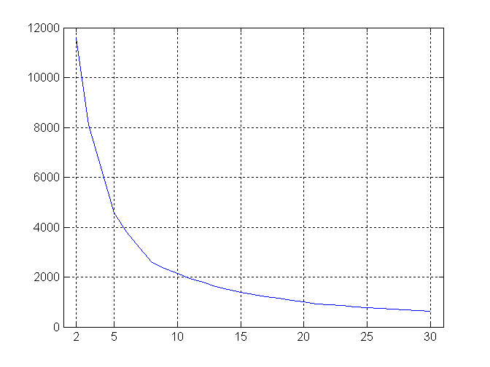
Internal measures: SSE
SSE curve for a more complicated data set
SSE of clusters found using k-means

Slide 58
Framework for cluster validity
Need a framework to interpret any measure.
  For example, if our measure of evaluation has the value 10, is that good, fair, or poor?
Statistics provide a framework for cluster validity
  The more “atypical” a clustering result is, the more likely it represents valid structure in the data
  Can compare the values of an index that result from random data or clusterings to those of a clustering result.
    If the value of the index is unlikely, then the cluster results are valid
  These approaches are more complicated and harder to understand.
For comparing the results of two different sets of cluster analyses, a framework is less necessary.
  However, there is the question of whether the difference between two index values is significant

Slide 59
Statistical framework for SSE
Example
  Compare SSE of 0.005 for three true clusters against SSEs for three clusters in random data
  Histogram shows distributions of SSEs for 500 sets of three clusters in random data points (100 data points randomly placed in range 0.2 - 0.8 for x and y)

Slide 60
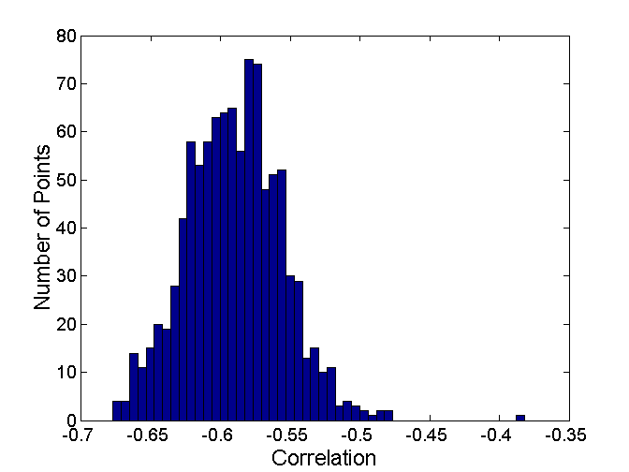
Statistical framework for correlation
Correlation of incidence and proximity matrices for the k-means clusterings of the following two data sets.
corr = -0.9235
corr = -0.5810

Slide 61
Final comment on cluster validity
“The validation of clustering structures is the most difficult and frustrating part of cluster analysis.
Without a strong effort in this direction, cluster analysis will remain a black art accessible only to those true believers who have experience and great courage.”
Algorithms for Clustering Data, Jain and Dubes, 1988

Slide 62
MATLAB interlude
matlab_demo_12.m

