Slide 1
Classification
Ensemble Methods 1

Slide 2
Ensemble methods
Basic idea of ensemble methods:
  Combining predictions from competing models often gives better predictive accuracy than individual models.
Shown to be empirically successful in wide variety of applications.
  See table on p. 294 of textbook.
Also now some theory to explain why it works.

Slide 3
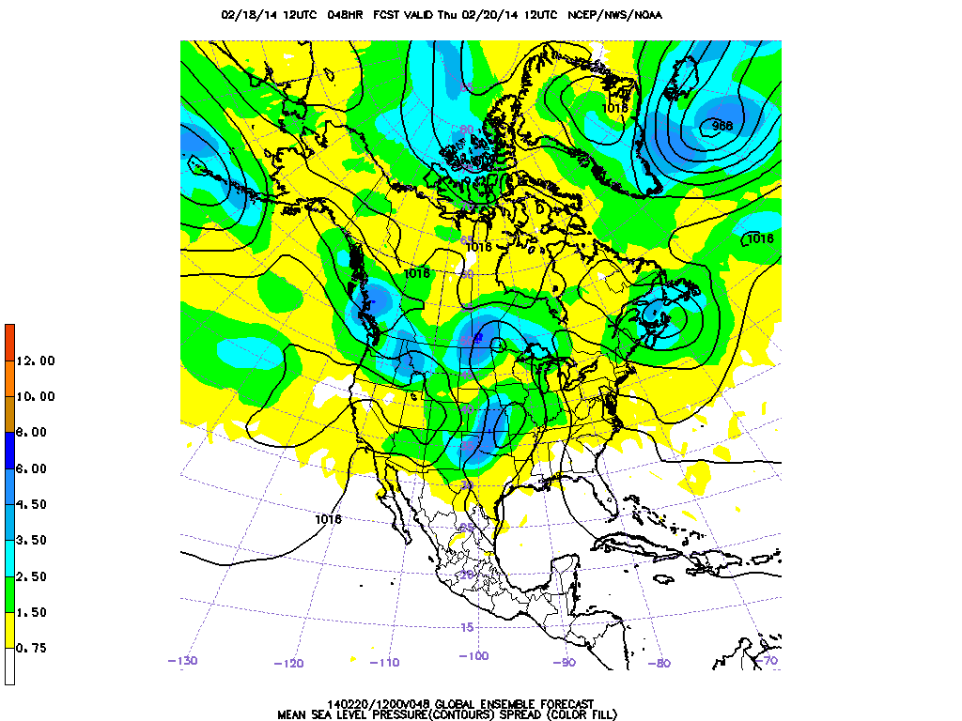
Ensemble weather forecasting

Slide 4
Build and using an ensemble
Train multiple, separate models using the training data.
Predict outcome for a previously unseen sample by aggregating predictions made by the multiple models.

Slide 5
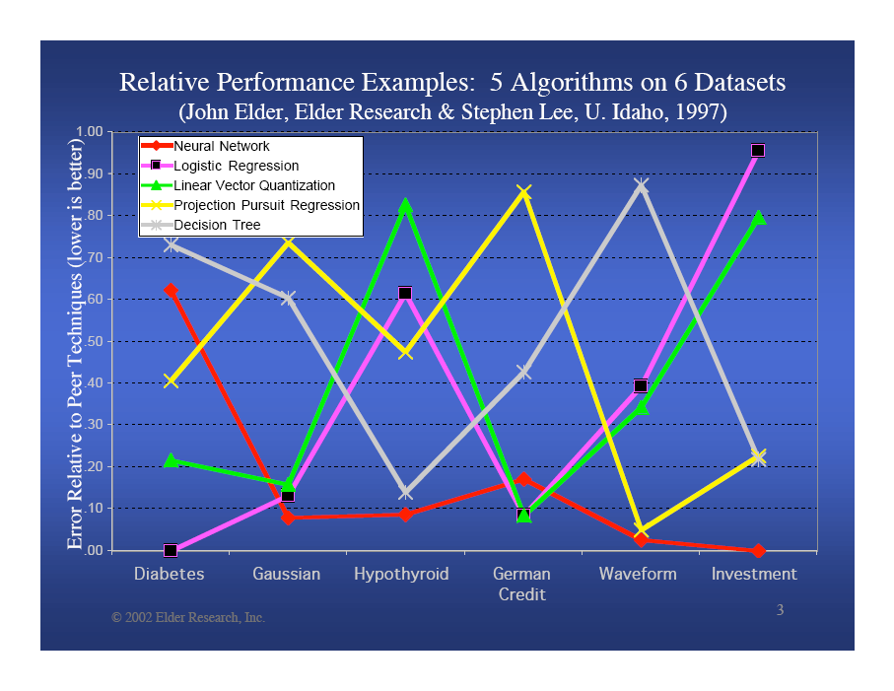

Slide 6
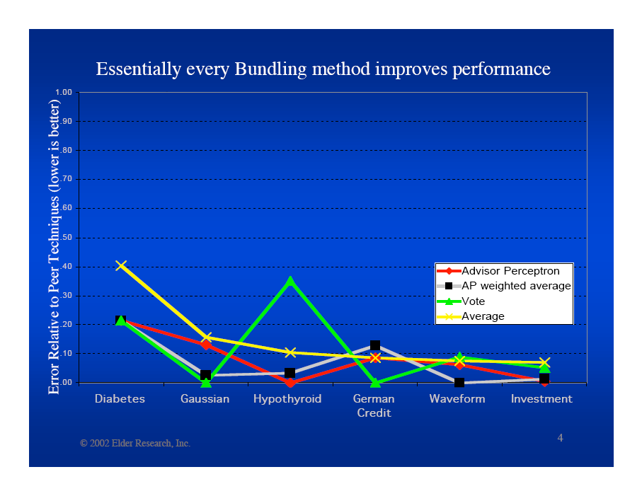

Slide 7
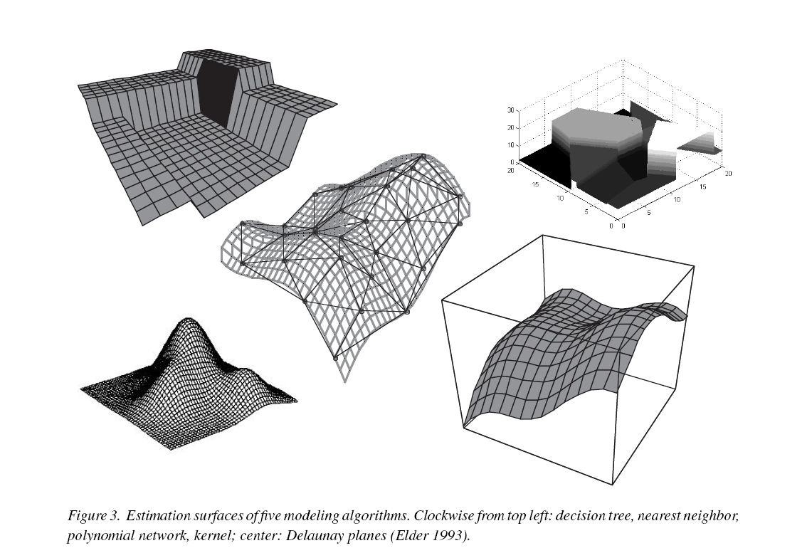
Estimation surfaces of five model types

Slide 8
Ensemble methods
Useful for classification or regression.
  For classification, aggregate predictions by voting.
  For regression, aggregate predictions by averaging.
Model types can be:
  Heterogeneous
    Example: neural net combined with SVM combined decision tree combined with …
  Homogeneous – most common in practice
    Individual models referred to as base classifiers (or regressors)
    Example: ensemble of 1000 decision trees

Slide 9
Classifier ensembles
Committee methods
  m base classifiers trained independently on different samples of training data
  Predictions combined by unweighted voting
  Performance:
  E[ error ]_{ave} / m < E[ error ]_{committee} < E[ error ]_{ave}
  Example: bagging
Adaptive methods
  m base classifiers trained sequentially, with reweighting of instances in training data
  Predictions combined by weighted voting
  Performance: E[ error ]_{train} + O( [ md / n ]^{1/2} )
  Example: boosting

Slide 10
Building and using a committee ensemble

Slide 11
Building and using a committee ensemble
TRAINING
Create samples of training data
Train one base classifier on each sample
USING
Make predictions with each base classifier separately
Combine predictions by voting
Test or new data
1 2 3 4
1 2 3 4
1 2 3 4
training
sample 1
training
sample 2
training
sample 3
A B A B
A A A B
B A A B
1 → A 2 → A 3 → A 4 → B

Slide 12
Binomial distribution (a digression)
The most commonly used discrete probability distribution.
Givens:
  a random process with two outcomes, referred to as success and failure (just a convention)
  the probability p that outcome is success
    probability of failure = 1 - p
  n trials of the process
Binomial distribution describes probabilities that m of the n trials are successes, over values of m in range 0 ≤ m ≤ n

Slide 13
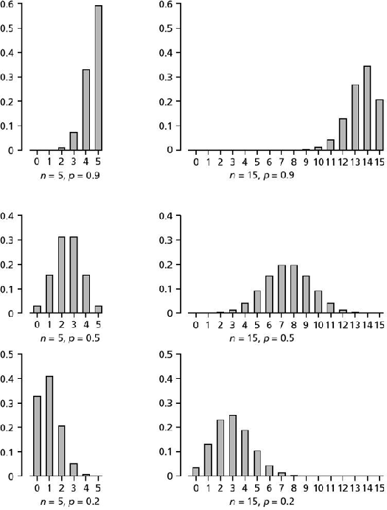
Binomial distribution
Example:
p = 0.9, n = 5, m = 4

Slide 14
Why do ensembles work?
A highly simplified example …
  Suppose there are 21 base classifiers
  Each classifier is correct with probability
  p = 0.70
  Assume classifiers are independent
  Probability that the ensemble classifier makes a correct prediction:

Slide 15
Voting by 21 independent classifiers, each correct with p = 0.7
Why do ensembles work?
0.2
0.18
0.16
0.14
0.12
0.1
0.08
ensemble vote makes wrong prediction
0.06
0.04
0.02
0
0
2
4
6
8
10
12
14
16
18
20
Probability that exactly k of 21 classifiers will make be correct, assuming each classifier is correct with p = 0.7 and makes predictions independently of other classifiers

Slide 16
Ensemble vs. base classifier error
As long as base classifier is better than random (error < 0.5),
ensemble will be superior to base classifier

Slide 17
Why do ensembles work?
In real applications …
  “Suppose there are 21 base classifiers …”
    You do have direct control over the number of base classifiers.
  “Each classifier is correct with probability
  p = 0.70 …”
    Base classifiers will have variable accuracy, but you can establish post hoc the mean and variability of the accuracy.
  “Assume classifiers are independent …”
    Base classifiers always have some significant degree of correlation in their predictions.

Slide 18
Why do ensembles work?
In real applications …
  “Assume classifiers are independent …”
    Base classifiers always have some significant degree of correlation in their predictions.
  But the expected performance of the ensemble is guaranteed to be no worse than the average of the individual classifiers:
  E[ error ]_{ave} / m < E[ error ]_{committee} < E[ error ]_{ave}
  ⇒ The more uncorrelated the individual classifiers are, the better the ensemble.

Slide 19
Base classifiers: important properties
Diversity (lack of correlation)
Accuracy
Computationally fast

Slide 20
Base classifiers: important properties
Diversity
  Predictions vary significantly between classifiers
  Usually attained by using unstable classifier
    small change in training data (or initial model weights) produces large change in model structure
  Examples of unstable classifiers:
    decision trees
    neural nets
    rule-based
  Examples of stable classifiers:
    linear models: logistic regression, linear discriminant, etc.

Slide 21
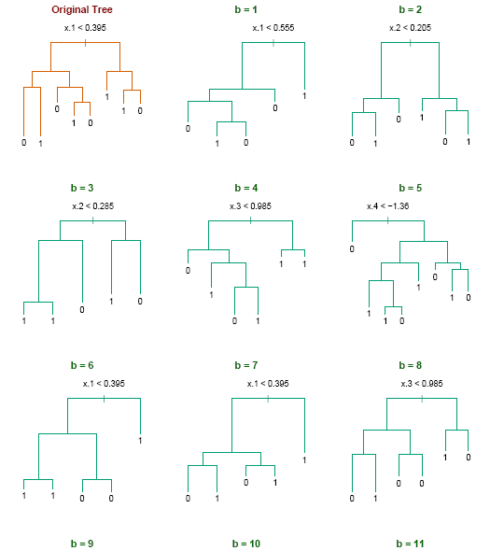
Diversity in decision trees
Bagging trees on simulated dataset.
  Top left panel shows original tree.
  Eight of trees grown on bootstrap samples are shown.

Slide 22
Base classifiers: important properties
Accurate
  Error rate of each base classifier better than random
Tension between diversity and accuracy
Computationally fast
  Usually need to compute large numbers of classifiers

Slide 23
How to create diverse base classifiers
Random initialization of model parameters
  Network weights
Resample / subsample training data
  Sample instances
    Randomly with replacement (e.g. bagging)
    Randomly without replacement
    Disjoint partitions
  Sample features (random subspace approach)
    Randomly prior to training
    Randomly during training (e.g. random forest)
  Sample both instances and features
Random projection to lower-dimensional space
Iterative reweighting of training data

Slide 24
Common ensemble methods
Bagging
Boosting

Slide 25
Bootstrap sampling
Given: a set S containing N samples
Goal: a sampled set T containing N samples
Bootstrap sampling process:
  for i = 1 to N
  randomly select from S one sample with replacement
  place sample in T
If S is large, T will contain ~ ( 1 - 1 / e ) = 63.2% unique samples.

Slide 26
Bagging
Bagging = bootstrap + aggregation
Create k bootstrap samples.
  Example:
Train a classifier on each bootstrap sample.
Vote (or average) the predictions of the k models.
original data | 1 | 2 | 3 | 4 | 5 | 6 | 7 | 8 | 9 | 10
bootstrap 1 | 7 | 8 | 10 | 8 | 2 | 5 | 10 | 10 | 5 | 9
bootstrap 2 | 1 | 4 | 9 | 1 | 2 | 3 | 2 | 7 | 3 | 2
bootstrap 3 | 1 | 8 | 5 | 10 | 5 | 5 | 9 | 6 | 3 | 7

Slide 27
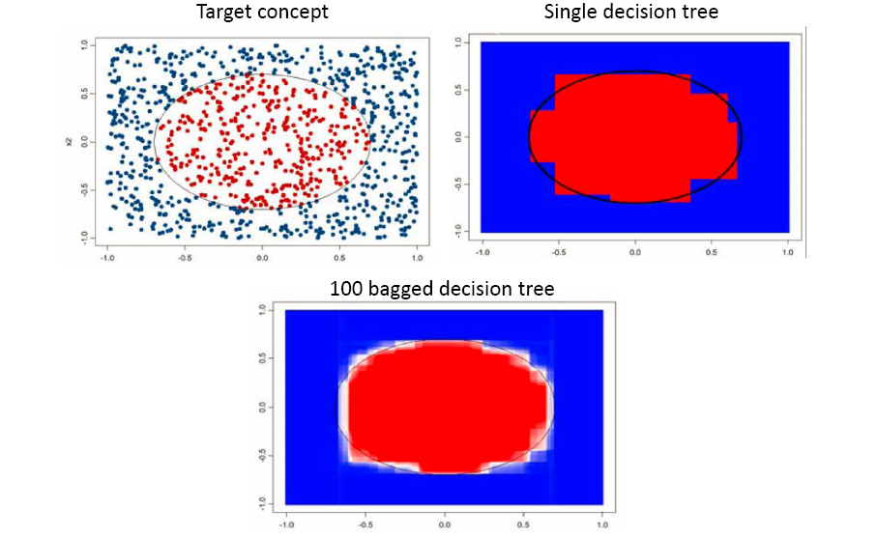
Bagging with decision trees

Slide 28
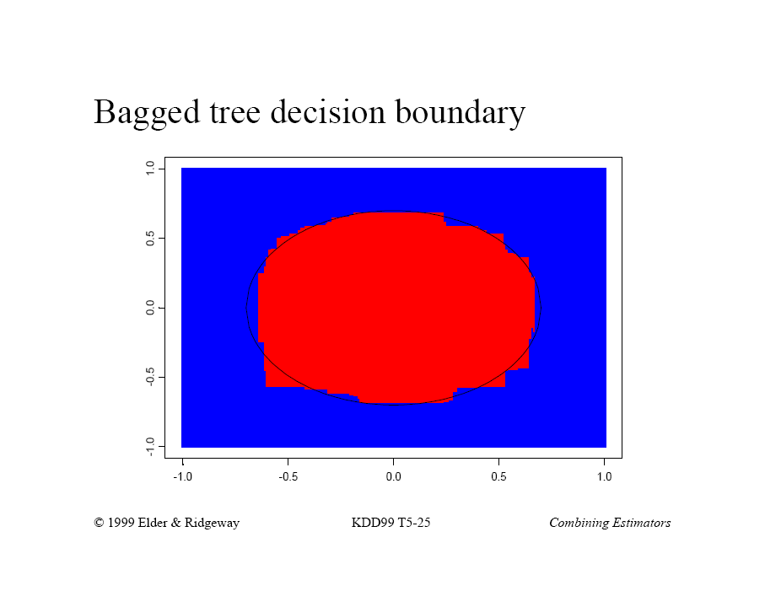

Slide 29
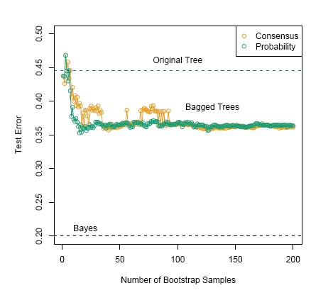
Bagging with decision trees

Slide 30
Boosting
Key difference:
  Bagging: individual classifiers trained independently.
  Boosting: training process is sequential and iterative.
Look at errors from previous classifiers to decide what to focus on in the next training iteration.
  Each new classifier depends on its predecessors.
Result: more weight on ‘hard’ samples (the ones where we committed mistakes in the previous iterations).

Slide 31
Boosting
Initially, all samples have equal weights.
Samples that are wrongly classified have their weights increased.
Samples that are classified correctly have their weights decreased.
Samples with higher weights have more influence in subsequent training iterations.
  Adaptively changes training data distribution.
sample 4 is hard to classify → its weight is increased

Slide 32
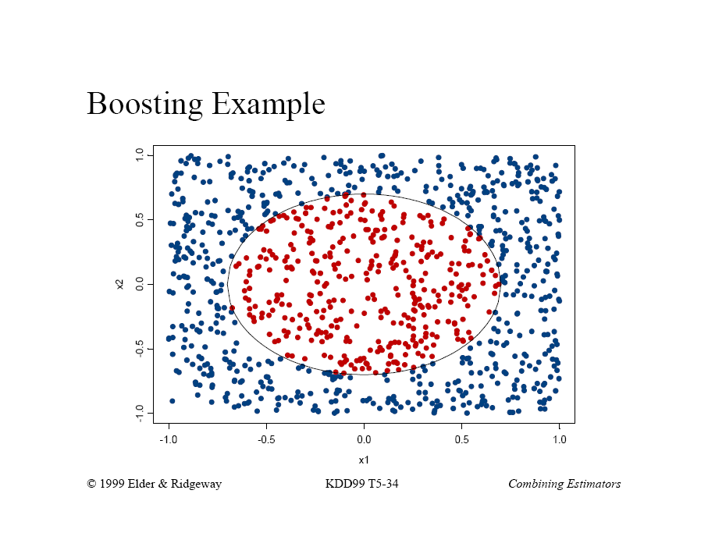
Boosting example

Slide 33
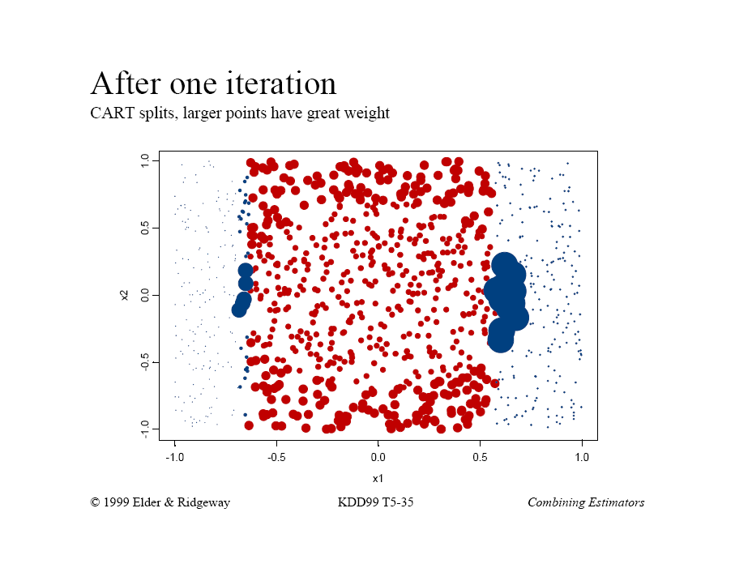

Slide 34
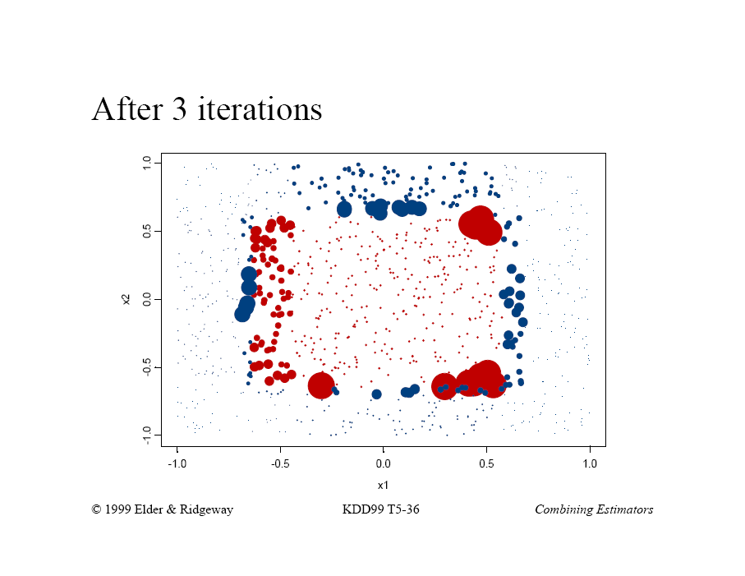

Slide 35
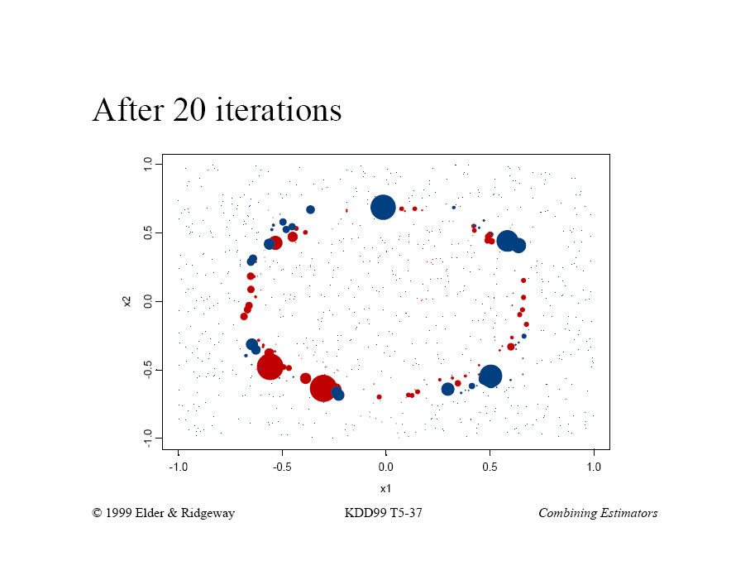

Slide 36
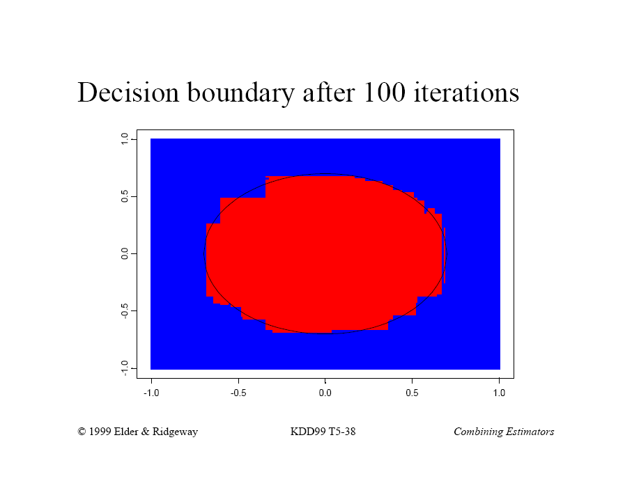

Slide 37
AdaBoost
Training data has N samples
K base classifiers: C₁, C₂, …, C_{K}
Error rate ε_{i} on i ^{th} classifier:
  where
  w_{j} is the weight on the j ^{th} sample
  δ is the indicator function for the j ^{th} sample
    δ ( C_{i}( x_{j} ) = y_{j} ) = 0 (no error for correct prediction)
    δ ( C_{i}( x_{j} ) ≠ y_{j} ) = 1 (error = 1 for incorrect prediction)

Slide 38
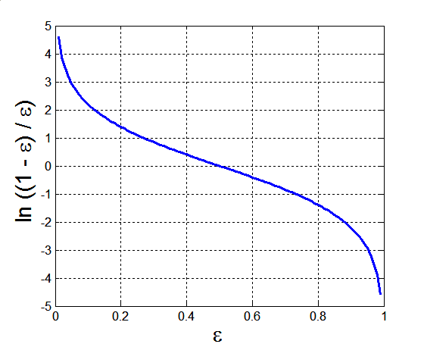
AdaBoost
Importance of classifier i is:
α_{i} is used in:
  formula for updating sample weights
  final weighting of classifiers in voting of ensemble
Relationship of classifier importance α
to training error ε

Slide 39
AdaBoost
Weight updates:
If any intermediate iteration produces error rate greater than 50%, the weights are reverted back to 1 / n and the reweighting procedure is restarted.

Slide 40
AdaBoost
Final classification model:
  i.e. for test sample x, choose the class label y which maximizes the importance-weighted vote across all classifiers.

Slide 41
Illustrating AdaBoost
Initial weights for each data point
Data points for training

Slide 42
Illustrating AdaBoost

Slide 43
Summary: bagging and boosting
Bagging
  Resample data points
  Weight of each classifier is same
  Only reduces variance
  Robust to noise and outliers
  Easily parallelized
Boosting
  Reweight data points (modify data distribution)
  Weight of a classifier depends on its accuracy
  Reduces both bias and variance
  Noise and outliers can hurt performance

Slide 44
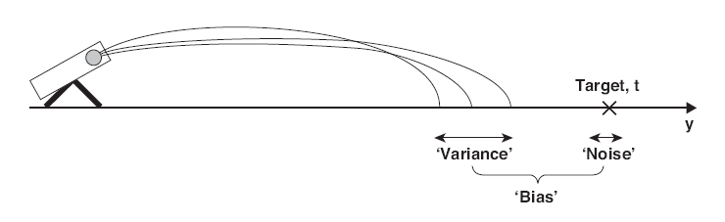
Bias-variance decomposition
An analogy from the Society for Creative Anachronism …
Ideally, want to have low bias and low variance.

Slide 45
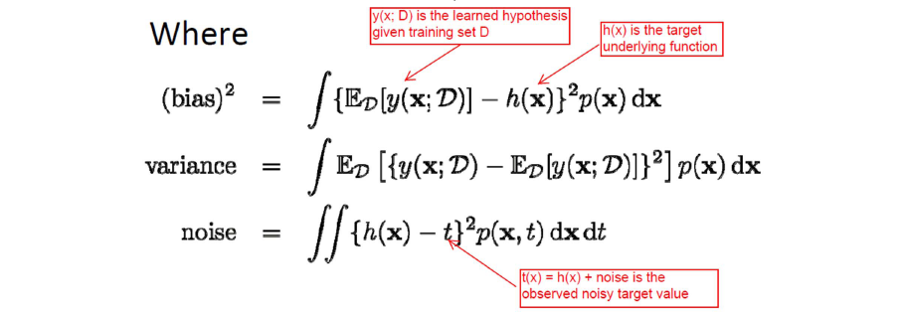
Bias-variance decomposition
expected error = bias² + variance + noise
where “expected” means the average behavior of
the models trained on all possible samples of
underlying distribution of data

Slide 46
Bias-variance decomposition
Examples of utility for understanding classifiers
  Decision trees generally have low bias but high variance.
  Bagging reduces the variance but not the bias of a classifier.
  ⇒ Therefore expect decision trees to perform well in bagging ensembles.

Slide 47
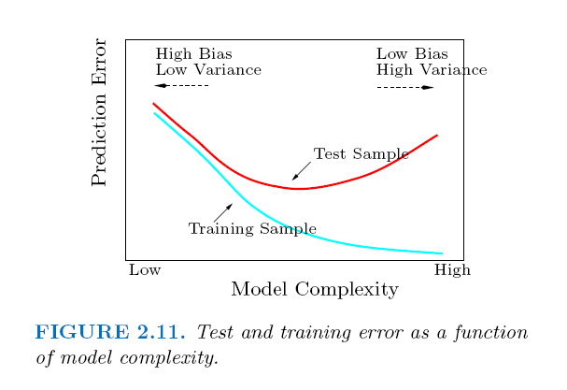
Bias-variance decomposition
General relationship to model complexity

